Slide 1

Suicide Prevention
Kyla Montes
Atrium Health Employer Solutions

Slide 2
Objectives
1
4
Learn how to help someone who is considering suicide
Demystify the topic of suicide
2
Notice if someone you know is displaying signs of suicide
5
Understand available resources
3
Learn what the signs of suicide are

Slide 3
Training Format
1
4
Effective ways to talk with someone about suicide
General information about suicide
2
Common misconceptions about suicide
5
Resources
3
Suicide signs and symptoms: verbal, behavioral, situational

Slide 4
Language Matters
Topic | Instead of | Try | Why?
First person language | "addict" "schizophrenic" "alcoholic" | "someone who experiences," "someone with a diagnosis of" | We are much more than a diagnosis.
Suicide | "Commit" | "Died by suicide," "Ended their life" | The word "commit" is associated with crime and sin.
Suicide | "Successful suicide," "Failed attempt" | "Died by suicide," "Attempted suicide" | There is nothing successful about suicide.

Slide 5




Some Facts About Suicide
2018
  48,344 deaths by suicide
    Compared to 40,000 traffic deaths
  Second leading cause of death in adolescents
  Highest rate of suicide is in middle-aged white males
Notes:
Compare traffic deaths to deaths by suicide. It’s a public health crisis we need to talk about

Slide 6

Some Facts About the Impact of Suicide
2019
  For each death by suicide, up to 135 people are exposed (affected).
  Of those 135 people, approximately 1/3 will seek therapeutic treatment or other support.
  40-50% of US population will be exposed to a suicide in their lifetime.
  The impact is felt throughout the community. When there’s another suicide, the trauma reappears.
Notes:
Julie cerel, University of Kentucky

Slide 7
CDC’s Suicide United States Youth
Youth Risk Behavior Surveillance Study, 2019
Adolescents ages 15-19 years old
Males - United States | %
Seriously considered suicide | 13.3%
Planned | 11.3%
Attempted to take their own life | 6.6%
Females - United States | %
Seriously considered suicide | 24.1%
Planned | 19.9%
Attempted to take their own life | 11%
*North Carolina Males – 14.6
*North Carolina Females – 3.6
*Deaths per 100,000 adolescents ages 15-19
Notes:
There’s a ton of info here---https://www.cdc.gov/healthyyouth/data/yrbs/index.htm
Bi-annual survey by Centers for Disease Control
Consider using it if participants work with youth; “hide” it otherwise (right click on slide in panel; select “hide slide.” Click again to “unhide”.)

Slide 8
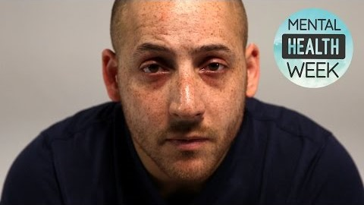
The Story of Kevin Hines
Notes:
Kevin Hines – mental health advocate. At 17, diagnosed with bipolar disorder; at 19, jumped off Golden Gate Bridge in an attempt to take his own life. He now travels the world talking about mental illness, suicide prevention, hope and recovery.
This video provides some insight into his story and the important work he does.

Slide 9
This is not intended to be a form of counseling or treatment.
This is intended to offer hope through positive action.
Notes:
QPR is not treatment.
Intro Slide #12
You could say something here like, “We know there’s a lot of misunderstanding when it comes to suicide. Let’s walk through a few…”

Slide 10
Suicide Myths and Facts
Myth or Fact?
No one can stop a suicide, it is inevitable.
Myth
If people in a crisis get the help they need, they will probably never be suicidal again.
Myth or Fact?
Confronting a person about suicide will only make them angry and increase the risk of suicide.
Myth
Asking someone directly about suicidal intent lowers anxiety, opens up communication and lowers the risk of an impulsive act.
Myth or Fact?
Only experts can prevent suicide.
Myth
Suicide prevention is everybody’s business, and anyone can help prevent the tragedy of suicide.
Notes:
Regarding Fact: If people in a crisis get the help they need, they will probably never be suicidal again. The belief that something is inevitable discourages taking any action, and only positive action can prevent suicide.

Slide 11
Suicide Myths and Facts
Myth or Fact?
A person who is suicidal keeps their plans to themselves.
Myth
Most suicidal people communicate their intent sometime during the week of preceding their attempt.
Myth or Fact?
Those who talk about suicide don’t do it.
Myth
People who talk about suicide may attempt an act of self-destruction.
Myth or Fact?
Once a person decides to attempt suicide, there is nothing anyone can do to stop them.
Myth
Suicide is the most preventable kind of death, and almost any positive action may save a life.
Notes:
.
Consider unsharing the screen and asking if anyone has questions at this point.
Intro slide #14
Consider saying something like, “We just learned that someone who is considering suicide typically shows some signs and symptoms. What are those signs and symptoms?—what we might SEE (signs) and what someone might tell us they FEEL (symptoms).
When might you be concerned about someone you care for?” Participants can write in chat box, unmute if desired. Validate and cultivate. Once the discussion comes to a natural close, move to slide #14

Slide 12






Risk Factors
Stressful Situations or Major Changes E.g., COVID (doing virtual learning or activities changing / being cancelled
Exposure to Another’s Suicide
Rejection
Bullying

Slide 13

Suicide Clues and Warning Signs
The more clues and signs observed, the greater the risk.
Take all signs seriously.

Slide 14

Direct
Verbal Clues
“I’ve decided to kill myself.”
“I wish I were dead.”
“I’m going to end it all.”
“If (such and such) doesn’t happen, I’ll kill myself.”
Notes:
Sometimes an individual will be very direct in their intention

Slide 15

Indirect Verbal Clues
“I’m tired of life, I just can’t
go on.”
“My family would be better off without me.”
“Who cares if I’m dead anyway.”
“I just want out.”
“I won’t be around much longer.”
“Pretty soon you won’t have to worry about me.”
Notes:
Sometimes an individual will be very direct in their intention

Slide 16

Any previous suicide attempt.
Acquiring a gun/weapon or stockpiling pills.
Co-occurring depression, moodiness, hopelessness.
Putting personal affairs in order.
Giving away prized possessions.
Sudden religion interest/disinterest.
Drug or alcohol abuse, or relapse after a period of recovery.
Unexplained anger, aggression
and irritability.
Behavioral Clues
Notes:
These are just a few of the behavior clues you might encounter.

Slide 17
Changes in Sleep
Changes in Appetite
Withdrawing from Activities or isolating from family or friends
Neglecting Appearance
Risk taking behaviors – sexual promiscuity, sneaking out, running away
Preoccupation with death – writing, drawing, art work, music
Anxiety or acting out
Behavioral Clues Continued
Notes:
These are just a few of the behavior clues you might encounter.

Slide 18

Situational Clues
Being fired or being expelled from school.
A recent unwanted move.
Loss of any major relationship.
Death of a spouse, child, or best friend, especially if by suicide.
Notes:
Again, many more situations that we can list could set in motion thinking about suicide. These are some of the more obvious.

Slide 19

Situational Clues, Cont.
Diagnosis of a serious or terminal illness.
Sudden unexpected loss of freedom/fear of punishment.
Anticipated loss of financial security.
Loss of a cherished therapist, counselor or teacher.
Fear of becoming a burden to others.
Notes:
Consider taking a pause and unsharing screed to check in.
It’s really important to acknowledge that sometimes, despite having resources, despite doing everything right, we still may lose someone to suicide. It’s also important to know that sometimes an individual considering suicide may hide signs and symptoms to those they love most. Last, know that sometimes suicide is an impulsive act which means signs and symptoms may not have been apparent.
Intro to Slide #21
If you’re in a situation where you think someone is considering suicide, here are some things to think about.

Slide 20
Tips for Asking the Suicide Question
1
If in doubt, don’t wait, ask the question.
4
Allow the person to talk freely.
2
If the person is reluctant, be persistent.
5
Give yourself plenty of time.
3
Talk to the person alone in a private setting.
6
Have your resource handy; QPR Card, phone numbers, counselor’s name
and any other info that might help.
Remember: How you ask the question is less important than that you ask it.
Notes:
If you notice some of these signs and symptoms it’s important to ask an individual about their suicidal intent, questions like, “are you thinking about suicide?” “are you thinking about killing yourself”. Consider saying something like, “let’s walk through what that might sound like”

Slide 21
How to Ask the Question
Less Direct Approach
1
4
“Do you ever wish you could go to sleep and never wake up?”
“Have you been unhappy lately?”
2
“Have you been very unhappy lately?”
3
“Have you been so very unhappy lately that you’ve been thinking about ending your life?”
Notes:
When you’re talking to someone you think is in crisis and thinking about suicide, you might ask these questions first but it’s critical to be direct.
Often people ask if they can ask questions like, “are you thinking about hurting yourself?” We know that someone who’s considering suicide may not consider suicide hurting themselves. Critical to be crystal clear
So these words may precede direct approach but not replace

Slide 22
How to Ask the Question
Direct Approach
1
“You know, when people are as upset as you seem to be, they sometimes wish they were dead. I’m wondering if you’re feeling that way, too?”
3
“Are you thinking about killing yourself?”
2
“You look pretty miserable; I wonder if you’re thinking about suicide?”
Note: If you cannot ask the question, find someone who can.
Notes:
Focus on the first and third dot points. Participants might read it, but consider not highlighting it
It’s really, really hard to ask someone you love or work with whether they’re considering taking their life. It’s alright to be afraid; it’s important to communicate verbally and non-verbally that you can handle whatever comes up

Slide 23

How NOT to Ask the Question
1
“You’re not thinking of killing yourself, are you?”
2
“You wouldn’t do anything stupid would you?”
3
“Suicide is a dumb idea. Surely you’re not thinking about suicide?”
Notes:
Judgment, closed
Intro to slide #25
We’ve covered “Q”, “Question.” Let’s go on to Persuade

Slide 24
How to Talk to Someone Who is Suicidal
How to Persuade Someone to Stay Alive
1
Listen to the problem and give them your full attention.
3
Do NOT rush to judgment.
2
Remember, suicide is not the problem, only the solution to a perceived insoluble problem.
4
Offer hope in any form.
Notes:
Listening is critical in this step. Active listening is a defined skill set. It can be very difficult to listen intently. Think about your facial gestures, your body language, your voice inflections

Slide 25

How to Talk to Someone Who is Suicidal
Then Ask:
1
“Will you go with me to get help?”
2
“Will you let me help you get help?”
Your willingness to listen and to help can rekindle hope and make all the difference.
3
“Will you promise me not to kill yourself until we’ve found some help?”
Notes:
3rd dot point:
This may sound like a safety contract but that’s not the intent.
One strategy that may work is to encourage the individual to create a safety plan.
What are my warning signs
What are some ways I can cope in this moment
Who can I call for help? What is their contact info?
What is the contact info for the professionals I can call
Safety plan sample: https://www.google.com/search?q=safety+plan+template&sxsrf=ALeKk02sq6XcwzYtBQZjJ1EuOeowRGkyJA:1588337220463&tbm=isch&source=iu&ictx=1&fir=eqmhgI5hSRYdXM%253A%252CawS69sa58eLnqM%252C_&vet=1&usg=AI4_-kR_p-l9Mz4JLkMM2OJ54rcmOgZNyg&sa=X&ved=2ahUKEwjnmLye2ZLpAhUFZKwKHWrvDpYQ9QEwAnoECAoQNA#imgrc=A6hew5TqjexFbM
Intro to Slide #27
We’ve talked about “Question” and we’ve talked about “Persuade.” Let’s now look at the “R. Refer”

Slide 26

How to
Get Help
Suicidal people often believe they cannot be helped, so you may have to do more.
The best referral involves taking the person directly to someone who can help.
The next best referral is getting a commitment from them to accept help, then making the arrangements to get that help.
The third best referral is to give referral information and try to get a good faith commitment not to attempt suicide. Any willingness to accept help at some time, even if in the future, is a good outcome.
Notes:
Consider asking about Employee Assistance Programs, insurance policies (look at policy together even), call National Suicide Prevention Lifeline together (1-800-273-8255).
This is a space for local information
CIT
Mobile Crisis
Resources for uninsured/underinsured (Cardinal)

Slide 27

Since almost all efforts to persuade someone to live instead of attempt suicide will be met with agreement and relief, don’t hesitate to get involved or take the lead.
Remember
Notes:
Encourage gatekeepers to step up and take charge if need be. They need to be encouraged to be bold.

Slide 28
To Be Effective
1
Say: “I want you to live,” or “I’m on your side...we’ll get through this.”
4
Follow up with a visit, a phone call or a card, and in whatever way feels comfortable to you, let the person know you care about what happens to them. Caring may save a life.
2
Get Others Involved. Ask the person who else might help. Family? Friends? Brothers? Sisters? Pastors? Priest? Imam? Rabbi? Bishop? Physician?
3
Join a Team. Offer to work with clergy, therapists, psychiatrists or whomever is going to provide the counseling or treatment.

Slide 29
Remember
When you talk about suicide, you can plant the seeds of hope.
Hope helps prevent suicide.
If you need help right now, please call 1-800-273-8255 or text “connect” to 741741.

Slide 30
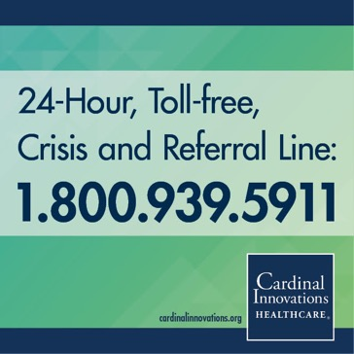
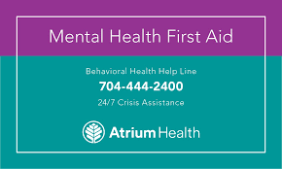
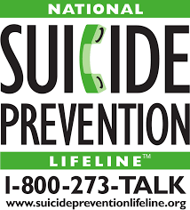
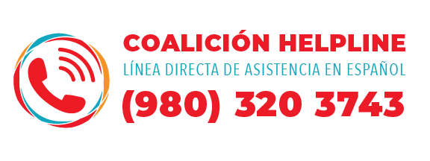

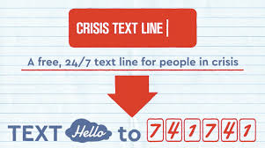
Resources
Mecklenburg County Crisis (CriSyS)
Hotline: 704-566-3410 (Select option 1)

Slide 31
Thank you.

