Slide 1
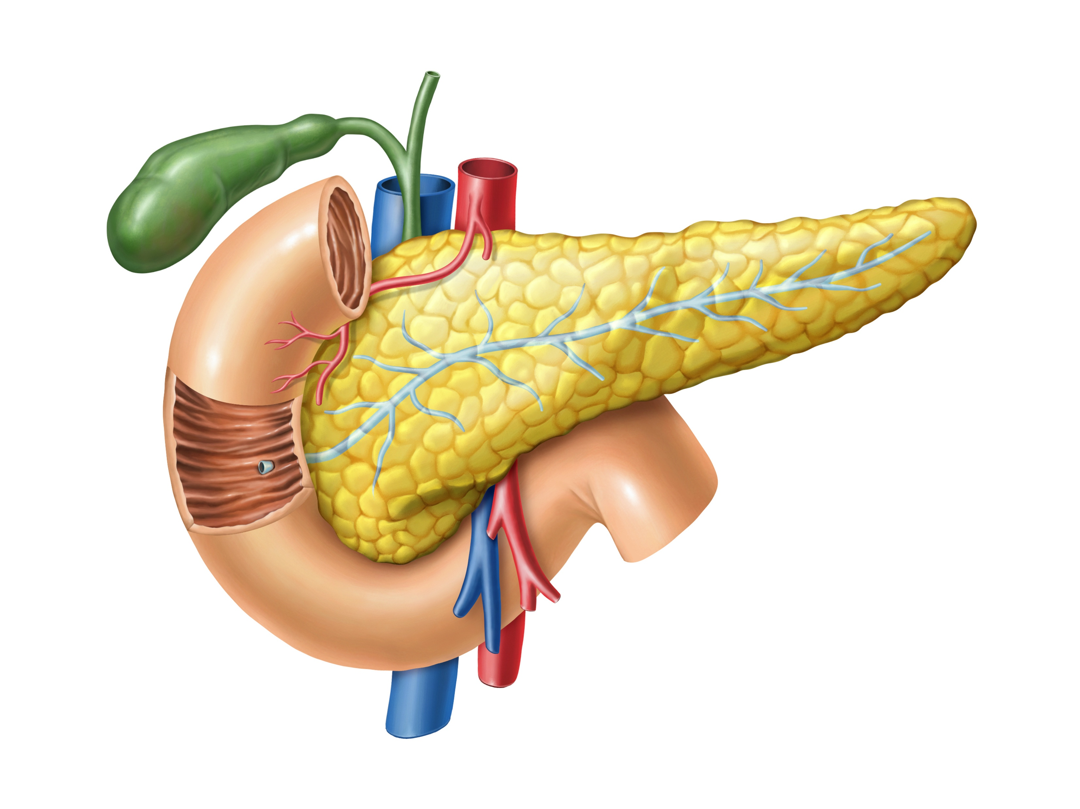
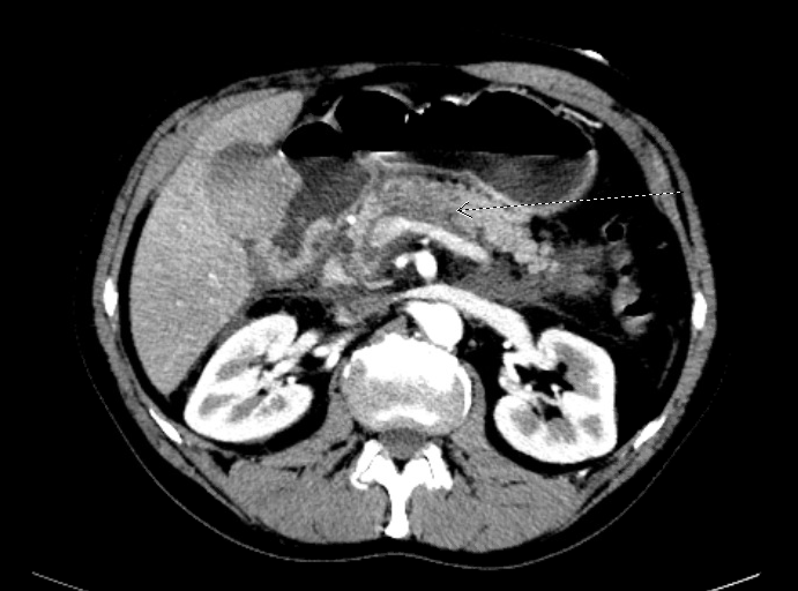
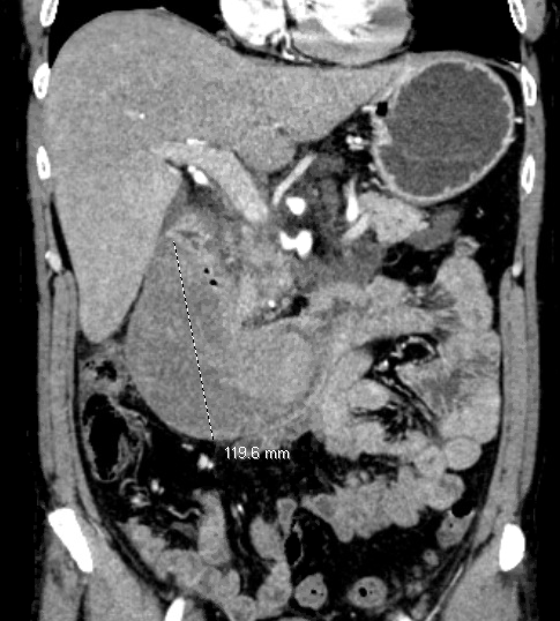
A Case of Duodenal Obstruction from Pancreatitis-Induced Duodenal Wall Hematoma
Chaudry Nasir Majeed MBBS¹;Ahmad Bilal²; Christopher Ma,BS³;Richard Bloomfeld,MD¹.
Section on Gastroenterology, Department of Internal Medicine, Wake Forest School of Medicine 2. M. Islam Medical & Dental College 3. Wake Forest School of Medicine, Winston Salem, NC
INTRODUCTION
Spontaneous duodenal wall hematomas can be a complication of pancreatitis²⁻⁶.
Patients can present with symptoms of small bowel obstruction. They should initially be managed conservatively but worsening hematoma may require invasive management.
Management
Symptoms worsened and CT angiography showed enlarging hematoma, so evacuation was planned.
Outcome
Post-procedure, the patient’s obstructive symptoms resolved with improved oral intake, and he was discharged on regular diet.
Pre-evacuation, the gastroduodenal and inferior pancreaticoduodenal artery were embolized to prevent further expansion of the hematoma followed by a laparoscopic drainage.
FIGURE 2: Pathogenesis of Duodenal Wall Hematoma
HPI
Examination
The patient denied recent trauma or anticoagulant use.
Temperature 99.5, heart rate 112 and moderate diffuse abdominal tenderness was noted, greatest in the epigastric area.
Work up
Lipase: 185.
CT abdomen: Large descending duodenal wall hematoma with partial proximal obstruction and pancreatitis in the pancreatic head.
EGD: Collapsed 2nd portion of duodenum, without any mucosal lesion.
48-year male with history of alcohol dependence and excessive non-steroidal anti-inflammatory drugs (NSAIDs) use presented with abdominal pain, nausea, vomiting.
The symptoms have been going on for a month. Two weeks prior to current presentation, a computed tomography (CT) scan showed pancreatic head stranding and serum lipase was 172.
Outpatient conservative management was planned but patient presented with worsening obstructive gastroenterology (GI) symptoms requiring a nasogastric tube.
Release of proteolytic enzymes from an inflamed pancreas causing vascular erosions in the small bowel²
Blunt trauma, bleeding disorders, anticoagulant therapy, and iatrogenic factors¹
FIGURE 1:Duodenal hematoma with peripancreatic stranding consistent with acute pancreatitis
DISCUSSION
Spontaneous duodenal hematomas may be a rare complication of pancreatitis²⁻⁶.
Management includes supportive care, but drainage of the hematoma may be required if hematoma is expanding with worsening obstructive symptoms.
A prophylactic arterial embolization may help drainage by stabilizing the bleeding and enable a minimally invasive drainage.
REFERENCES
1. Ha TS, Chung JC. Delayed manifestation of Isolated Intramural Hematoma of the duodenum resulting from Blunt abdominal Trauma. J Trauma Inj. 2020;33(1):53-58.
2. Kumar R, Athwal PSS, Kumar M, Devi K, Kahlon S. Spontaneous Intramural Duodenal Hematoma: A Rare Complication of Pancreatitis. Cureus. 2020;12(6):e8491-e8491.
3. Ma JK, Ng KK, Poon RT, Fan ST. Pancreatic-induced Intramural Duodenal Haematoma. Asian Journal of Surgery. 2008;31(2):83-86.
4. Eurboonyanun C, Somsap K, Ruangwannasak S, Sripanaskul A. Spontaneous Intramural Duodenal Hematoma: Pancreatitis, Obstructive Jaundice, and Upper Intestinal Obstruction. Case Rep Surg. 2016;2016:5321081-5321081.
5. Haque Z, Khan N, Udechukwu V. S2834 Spontaneous Intramural Duodenal Hematoma: A Rare Complication of Acute Pancreatitis. Official journal of the American College of Gastroenterology | ACG. 2020;115.
6. Khurana T, Shah A, Ali I, Islam R, Siddiqui AA. Intramural Duodenal Hematoma with Acute Pancreatitis in a Patient With an Overt Pancreatic Malignancy. ACG Case Reports Journal. 2014;1(4).

