Slide 1
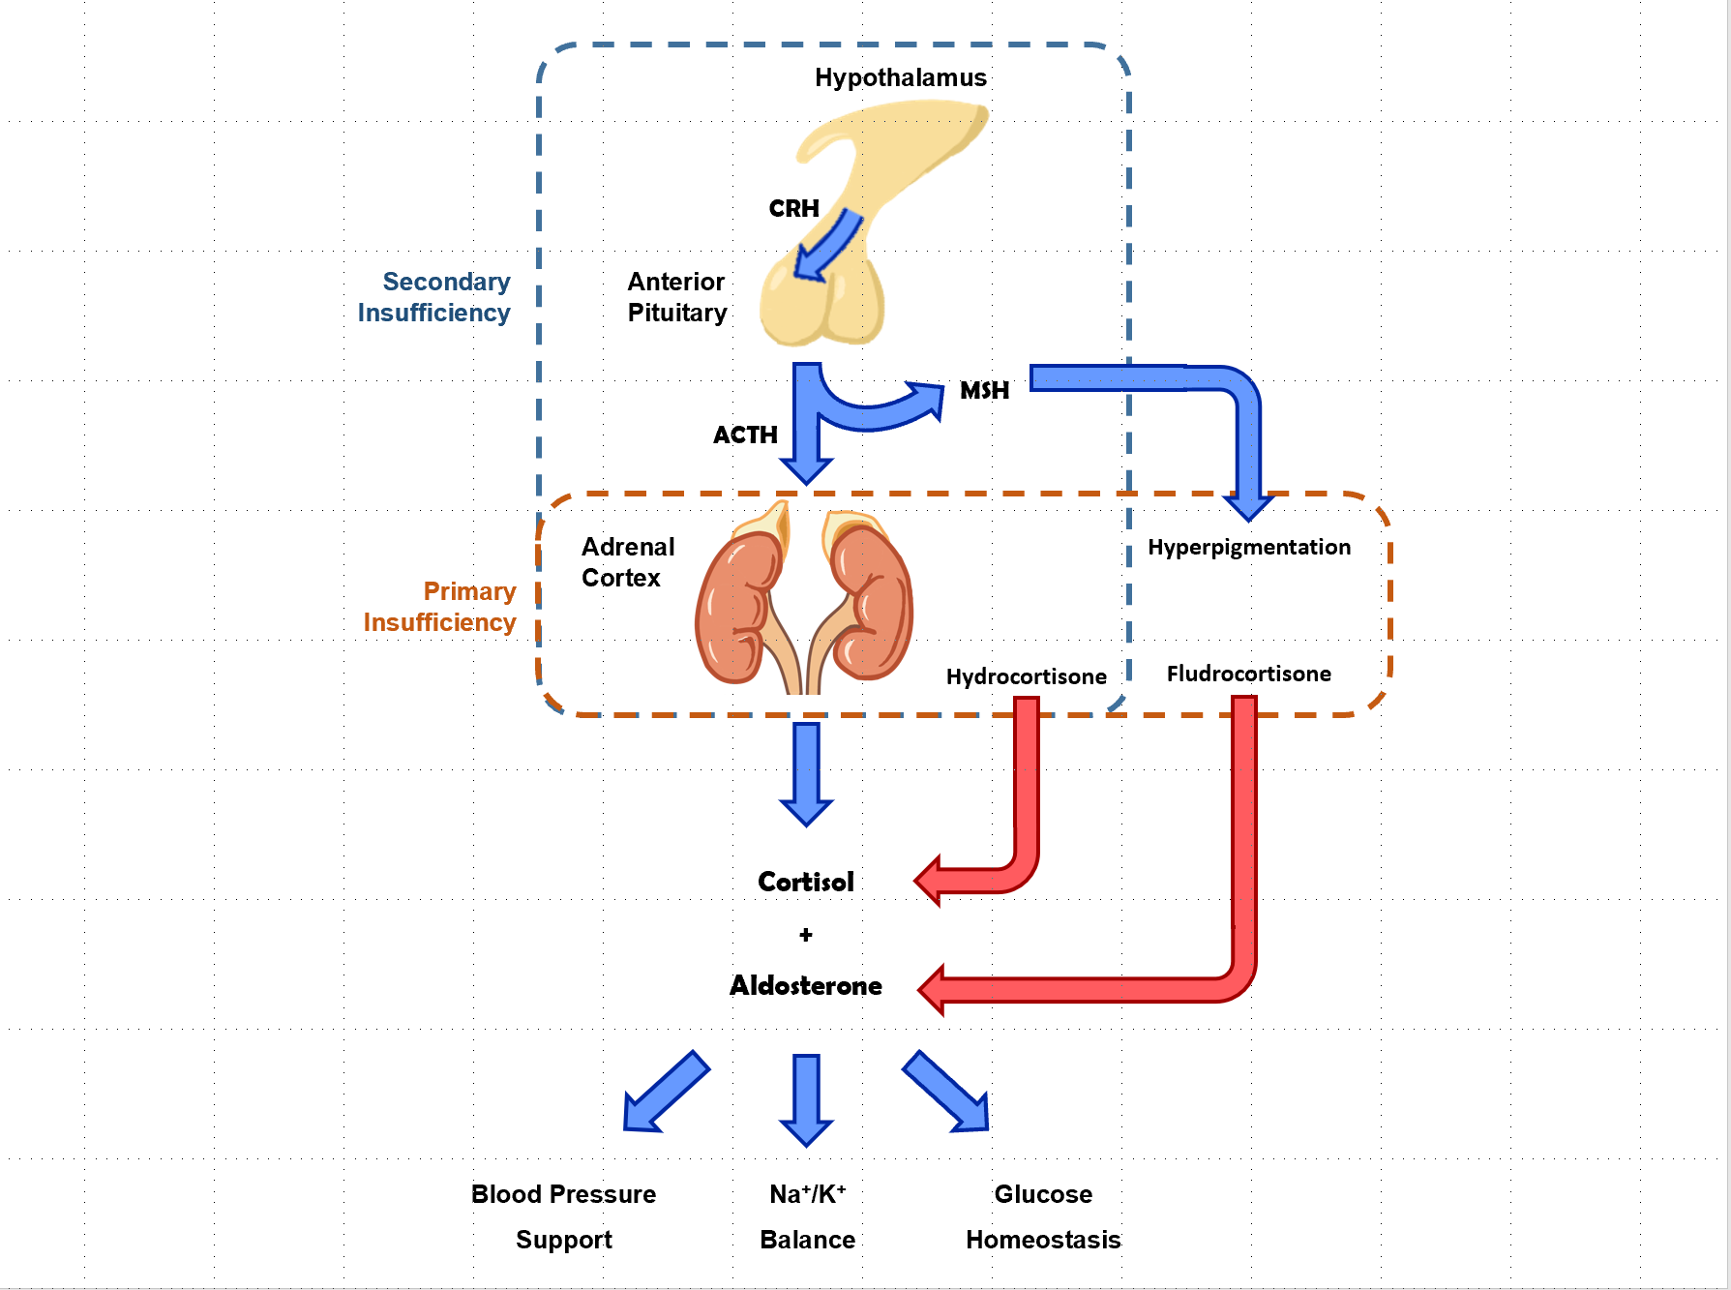
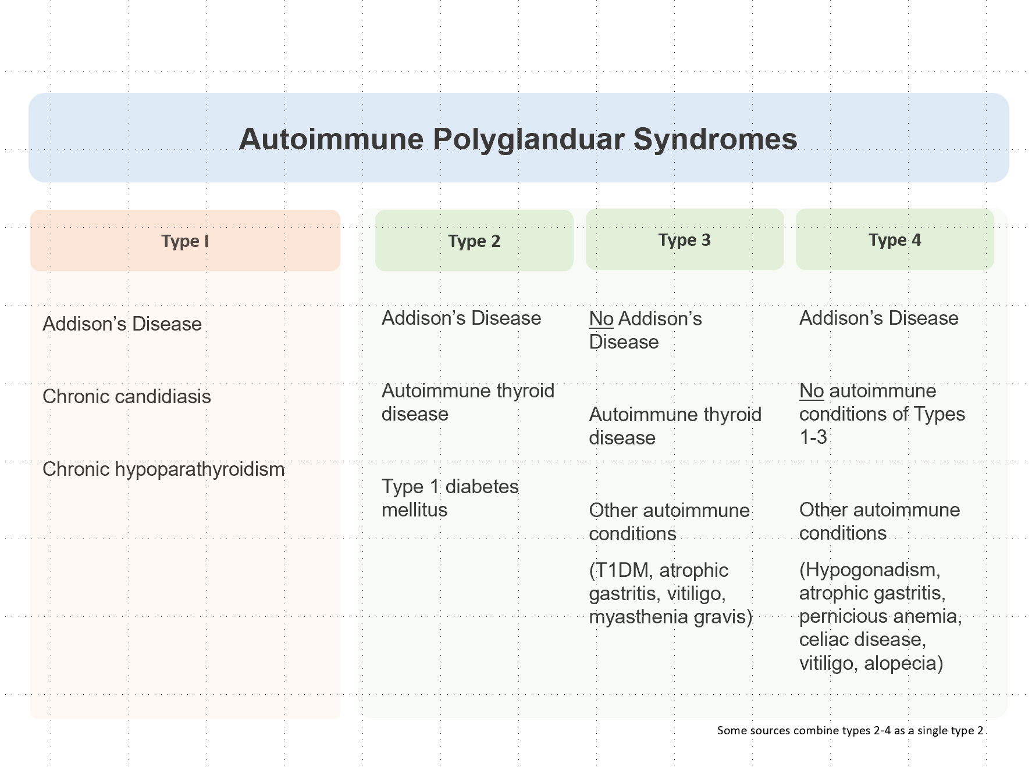
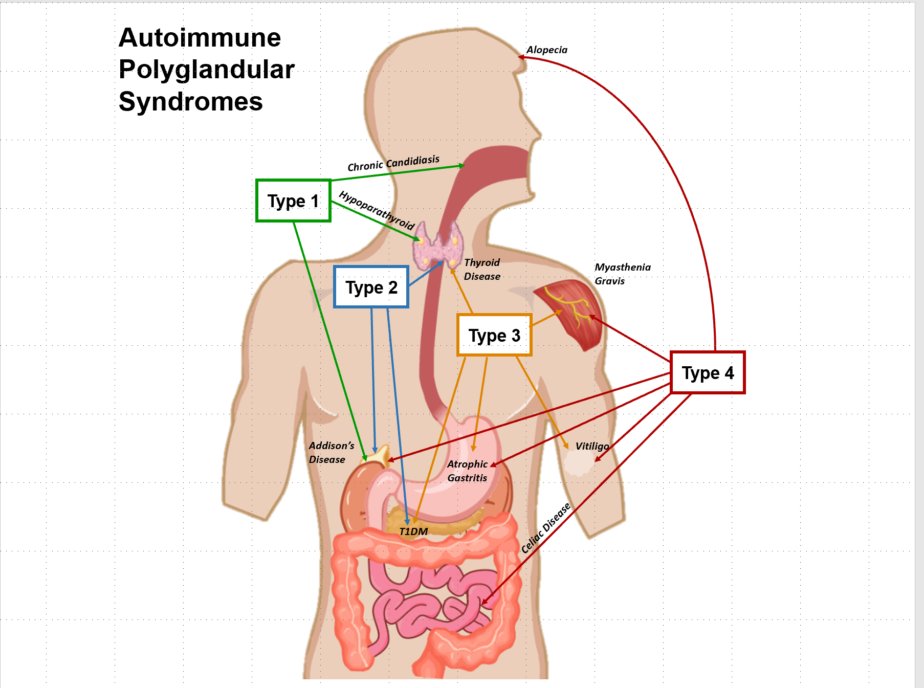
Kathleen Herring MD¹, Sangho Jee¹, Izzah Vasim MD¹ Chaudry Nasir Majeed MBBS² 1. Department of Internal Medicine, Wake Forest Baptist Medical Center 2. Department of Gastroenterology, Wake Forest Baptist Medical Center
Celiac Disease and Adrenal Insufficiency:
A Case of Autoimmune Polyglandular Disease
Introduction
Celiac disease is an important clue to diagnose adrenal insufficiency due to its association with Addison's disease.
We present a man with celiac disease and Grave's disease who presented with 6 days of vomiting and loose stools with severe hyponatremia found to have adrenal insufficiency.
He received a diagnosis of autoimmune polyglandular disease type 4, a rare disease characterized by multiple autoimmune disorders affecting both endocrine and non-endocrine organs.
Case
A 39-year-old man with Graves status post iodine ablation on levothyroxine and celiac disease presented with 6 days of vomiting, loose stools, and poor oral intake. Labs revealed hyponatremia with sodium of 110 mmol/L. In the ED he was hypotensive with physical exam revealing a non-focal neurological exam, non-tender abdomen, and bronze skin according to his wife.
He received aggressive hydration with normal saline for the initial diagnosis of hypovolemic hyponatremia in the setting of a positive Norovirus test and history of severe diarrhea.
His sodium level did not improve so a cortisol level was ordered which came back low at 2.4 mcg/dL. An ACTH stimulation test demonstrated inadequate stimulation from the adrenal glands which prompted the administration of hydrocortisone.
His sodium began to improve with the addition of fludrocortisone and hydrocortisone to 127 mmol/L. His 21 hydroxylase antibodies came back positive confirming primary adrenal insufficiency.
Discussion
Adrenal insufficiency should be considered as the cause of hyponatremia in patients with celiac disease.
A positive norovirus became a distractor from his pertinent medical history of celiac disease.
Autoimmune polyglandular disease can have an insidious onset as circulating autoantibodies and lymphocytic infiltration may not cause acute symptoms until an inciting event triggers a potentially fatal adrenal crisis.
Furthermore, these symptoms have been reported in all ages ranging from infants to older adults. Therefore, a cortisol level can be obtained to avoid precipitation of an adrenal crisis in patients with celiac disease and hyponatremia.
Figure 2. Illustration of the difference between primary and secondary adrenal insufficiency.
Figure 1. Autoimmune Polyglandular Syndromes
Figure 3. Illustration of organs affected in autoimmune polyglandular syndromes

