Slide 1
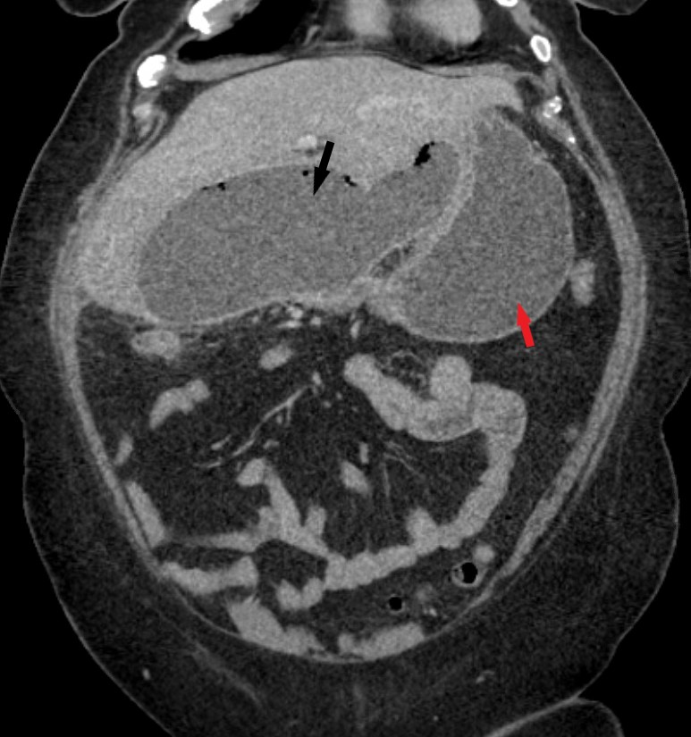
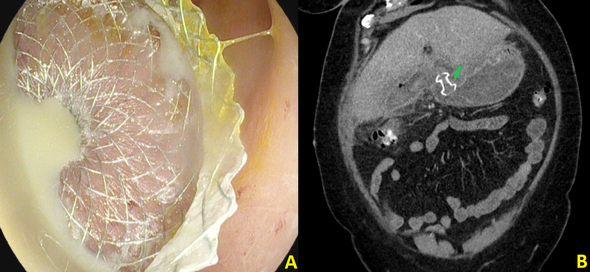
Ted Xiao MD¹, Nicholas Koutlas MD², Rishi Pawa MBBS² ¹Department of Internal Medicine, Wake Forest University School of Medicine, Winston-Salem, NC ²Department of Internal Medicine, Section of Gastroenterology, Wake Forest University School of Medicine, Winston-Salem, NC,
Endoscopic Ultrasound-Guided Transgastric Drainage of an Infected Biloma After Cholecystectomy: A Case Report
INTRODUCTION
A biloma is a known but uncommon complication of cholecystectomy
Treatment involves percutaneous drainage; surgery for refractory cases
More recently, endoscopic ultrasound (EUS)-guided transenteric drainage has emerged as a viable alternative
This is a case of an infected biloma treated using a EUS-guided drainage with a transgastric lumen-apposing metal stent (LAMS)
CASE DESCRIPTION
A 57-year-old female presented with fever, abdominal pain, nausea, and vomiting after a laparoscopic cholecystectomy 12 days prior. Labs noted a leukocytosis with normal liver chemistries. CT abdomen showed a large peripherally enhancing collection in the subhepatic space with gastric outlet obstruction (Fig 1).
Gastroenterology was consulted for management. Endoscopic retrograde cholangiography (ERC) revealed a bile leak from the cystic duct stump. This was treated with biliary sphincterotomy and placement of a 10 Fr x 7 cm plastic biliary stent.
Figure 1. CT scan illustrates a large subhepatic fluid and gas containing collection with a well-defined wall (black arrow). It measures 14.5 x 7 x 8 cm, resulting in mass effect on the antrum and proximal duodenum (red arrow).
Figure 2. A) Successful placement of a transgastric lumen apposing metal stent (LAMS) into the biloma cavity with immediate drainage of purulent fluid. B) Post-drainage CT scan demonstrating biloma cavity decompression and appropriate positioning of the LAMS (green arrow).
DISCUSSION
EUS-guided transenteric biloma drainage is a safe and effective alternative to percutaneous drainage
Initial cases used plastic stents but more recently, LAMS have been used via a transduodenal approach
Endoscopic drainage also enables same session diagnosis and treatment of the culprit bile leak
Our case is the first reported EUS-guided transgastric drainage of an infected biloma using a LAMS
REFERENCES
1. Copelan A, Bahoura L, Tardy F, Kirsch M, Sokhandon F, Kapoor B. Etiology, Diagnosis, and Management of Bilomas: A Current Update. Tech Vasc Interv Radiol. Dec 2015;18(4):236-43. doi:10.1053/j.tvir.2015.07.007
2. Shami VM, Talreja JP, Mahajan A, Phillips MS, Yeaton P, Kahaleh M. EUS-guided drainage of bilomas: a new alternative? Gastrointest Endosc. Jan 2008;67(1):136-40. doi:10.1016/j.gie.2007.07.040
3. Tonozuka R, Itoi T, Tsuchiya T, et al. EUS-guided drainage of hepatic abscess and infected biloma using short and long metal stents (with videos). Gastrointest Endosc. 2015;81(6):1463-9. doi:10.1016/j.gie.2015.01.023
4. Cassis P, Shah-Khan SM, Nasr J. EUS-guided drainage of a 20-cm biloma by use of a lumen-apposing metal stent. VideoGIE. Jan 2020;5(1):20-21. doi:10.1016/j.vgie.2019.09.009
EUS-guided drainage of the infected biloma was performed using a 15 x 10 mm electrocautery enhanced LAMS via a transgastric approach. Approximately 1L of purulent fluid was evacuated from the cavity (Fig 2A). Subsequent CT scan confirmed correct positioning of the LAMS with marked cavity decompression (Fig 2B).
Imaging one week later noted near complete resolution of the fluid collection. The LAMS was removed and two 10 Fr x 4 cm double pigtail (DPT) stents were placed. Six weeks after the index procedure, ERC showed resolution of the cystic duct leak and both DPT stents were removed. The patient has remained well clinically at follow up visit.

