Slide 1
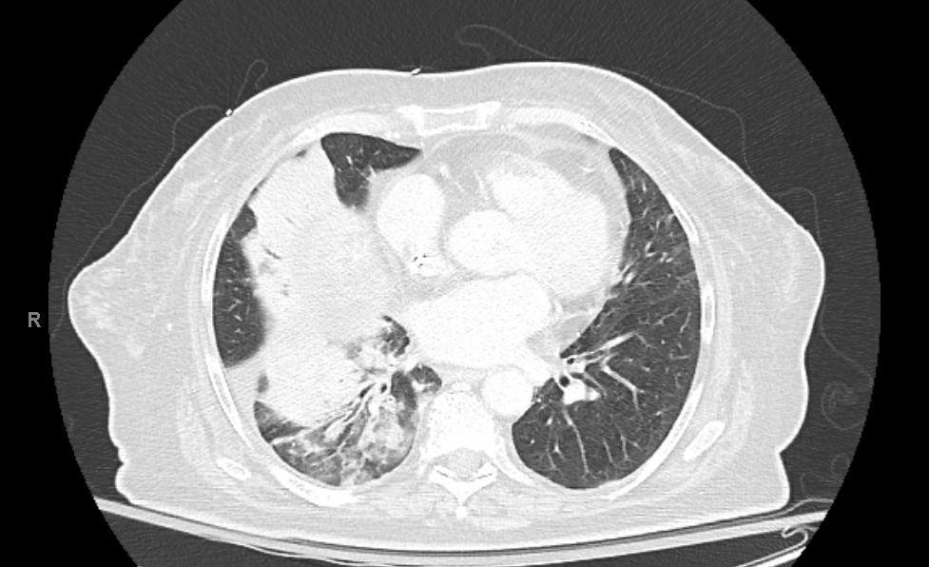
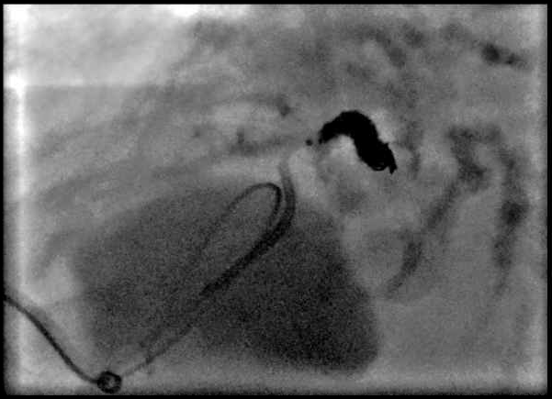
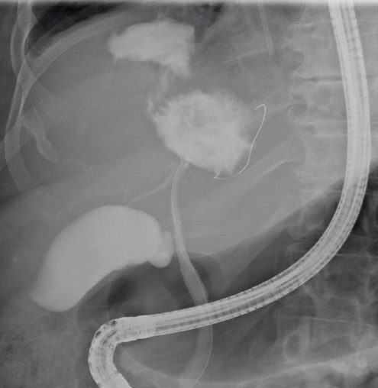
Jessica Hollingsworth, MD¹; Brian Kouri, MD²; Swati Pawa, MD¹
1. Department of Internal Medicine, Section on Gastroenterology, Atrium Health Wake Forest Baptist Medical Center
2. Department of Radiology, Atrium Health Wake Forest Baptist Medical Center
A Rare Case of Delayed Bilioptysis Due to Radioembolization of Intrahepatic Cholangiocarcinoma: Case Report and Review of Literature
INTRODUCTION
Bronchobiliary fistula (BBF) is a rare pathologic communication between the biliary tree and bronchial airway and presents as bile in the sputum (bilioptysis).
BBF can occur in the setting of trauma, infection, malignancy, or iatrogenesis.
We present a rare case of BBF managed with both ERCP and IR embolization.
CASE DESCRIPTION
A 73-year-old female with large intrahepatic cholangiocarcinoma was treated with systemic chemotherapy and radioembolization.
Ten months later, residual viable disease in the right lobe of the liver was treated with repeat radioembolization and microwave ablation.
Eighteen months after the initial radioembolization, she presented with productive cough unresponsive to antibiotics and steroids which progressed to bilioptysis.
CT thorax showed right lower lobe pneumonia, enlarging pulmonary nodules, and multiple peripherally enhancing liver lesions (Fig. 1).
ERCP confirmed BBF via cholangiography (Fig. 2). This was treated with biliary sphincterotomy and placement of a 10 Fr x 12 cm double pigtail stent into the biloma.
HIDA scan showed a large biloma overlying the right hepatic dome and persistent BBF.
IR embolization of BBF and placement of percutaneous drain into the biloma was performed (Fig. 3).
Although the bilioptysis resolved, repeat ERCP demonstrated persistent BBF which was treated with stent exchange.
Figure 1: CT Thorax with RLL opacities
Figure 2: Cholangiography demonstrating BBF
Figure 3: IR embolization of BBF
DISCUSSION
Intrahepatic cholangiocarcinoma treated with radioembolization is a rare cause of BBF. The pathophysiology includes chronic subdiaphragmatic inflammation with breakdown of the local diaphragm and lung tissue or frank invasion of the diaphragm and lung by an active liver process. Due to the infrequent presentation of this entity, there is no treatment protocol established for management of BBF. ERCP is a minimally invasive option that can be considered for both diagnosis and treatment of BBF, either alone or in conjunction with IR embolization.
REFERENCES
Marcos-Ramirez E, Tellez-Aguilera A, Ramirez-Morin M, et al. Endoscopic retrograde cholangiopancreatography for treatment of biliopleural fistulas. Cirugia Y Cirujanos. 2021;89(1)89-96.
Tassi V, Mosillo C, Mutignani M, et al. Biliothoracic fistula after microwave ablation of liver metastasis: literature review. Emergency Medicine International. vol. 2021, Article ID 9913076, 5 pages, 2021

