Slide 1
Diabetes
Creating Awareness
Ashley Harris, BSN, RN, CHWC
Atrium Health Employer Solutions 4/30/2020

Slide 2
Objectives
What is Diabetes?
Myths vs. Facts
What are the signs and symptoms of diabetes?
Type 1 and Type 2 Diabetes
Preventing Diabetes
What is my risk? – Know your numbers: HbA1c
Touch on Weight Management/Weight Loss Tips
Creating Awareness

Slide 3
1
What is Diabetes?

Slide 4
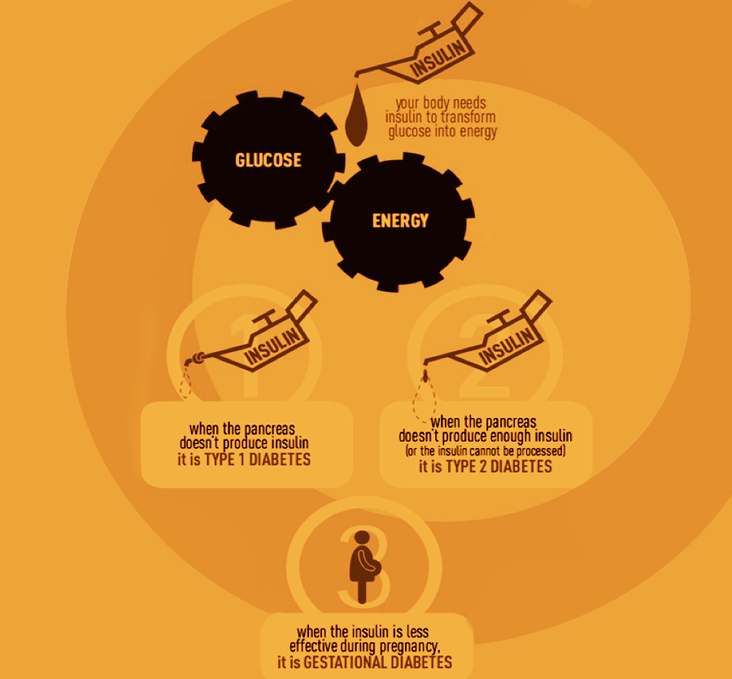
Diabetes
Diabetes is a disease that affects the amount of insulin and sugar in your body
Your body needs insulin to turn sugar (glucose) into energy
With diabetes, your body may not make enough insulin
If you don’t make enough insulin, you need to take insulin
Taking insulin will help to keep you from having too much sugar in your blood.

Slide 5
2
Myth vs. Fact

Slide 6
Myth vs. Fact
Myth: Diabetes is not a serious disease
Fact: Diabetes is a growing epidemic with a devastating physical, emotional and financial toll our country.
Diabetes kills more Americans each year than AIDS and breast cancer COMBINED.
<
AIDS
BREAST CANCER
CURE DIABETES

Slide 7
Myth vs. Fact
Myth: People with diabetes need to follow a special diet.
Fact: People with diabetes benefit from the same healthy diet that is good for everyone else.

Slide 8
Fruit & Grain Train
Myth: Healthy foods won’t raise your blood glucose
Fact: Eating too much of even healthful foods, such as fruit and whole grains, can lead to high blood glucose

Slide 9
3
Signs & Symptoms

Slide 10
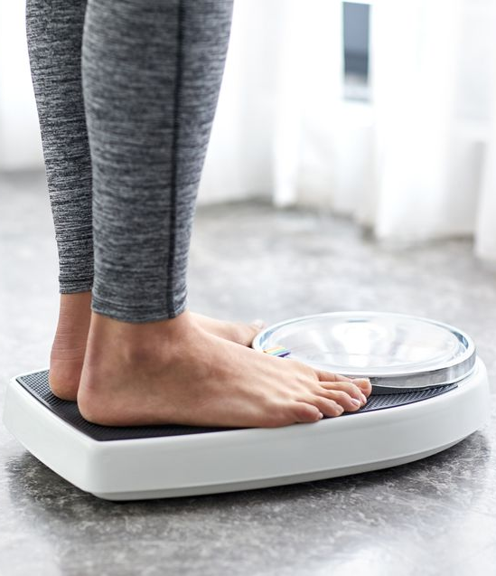
Signs & Symptoms
Frequent urination
Excessive thirst
Weight loss
Hunger
Skin problems

Slide 11
Signs & Symptoms
Fatigue & irritability
Numbness & tingling
Blurry vision
Slow healing
Yeast infections

Slide 12
Would I notice the signs?
Even before you notice symptoms, such as high blood and sugar issues (hypoglycemia or hyperglycemia), it can damage parts of your body.
That’s why certain diabetes tests to check blood sugar control and catch problems early are needed.

Slide 13
The Right Tests!
Hemoglobin A1C
Eye Exam
Foot Exam
Cholesterol

Slide 14
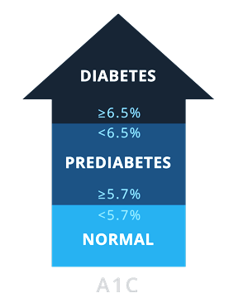
Plasma “Glucose” or Glycated Hemoglobin?
Fasting Plasma Glucose
HA1C
<5.7 % =Optimal
5.7-6.4% = Pre-Diabetes
*for a non-diagnosed diabetic
6.5% and ↑= Diabetes
> 126 mg/dl
< 126 mg/dl
> 100 mg/dl
< 100 mg/dl

Slide 15
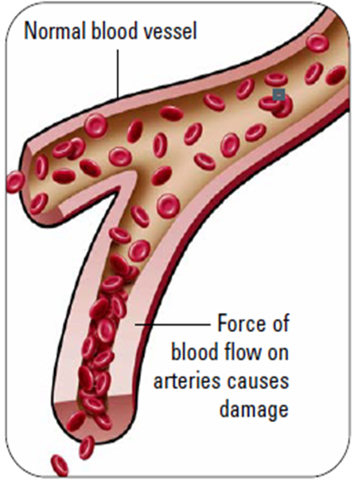
Normal Blood Pressure vs. High Blood Pressure
Normal Blood Pressure
<120/ <80
Elevated Blood Pressure
Systolic between 120-129/ < 80
Normal blood vessel
Stage 1 Hypertension
Systolic between 130-139 or diastolic between 80-89
Stage 2 Hypertension
Systolic at least 140 or diastolic at least 90 mm Hg
Hypertensive crisis
Systolic over 180 and/or diastolic over 120
Force of blood flow on arteries cause damage

Slide 16
What’s Triglycerides got to do with Diabetes?
A common cause of high triglycerides in your blood is Insulin Resistance
Your cells won’t let insulin or its companion glucose, inside your cells
Insulin also allows your body to use triglycerides for energy
The Result: High triglycerides AND high blood sugar
Triglycerides
greater than 150 mg/dl
Glucose
Less than 100mg/dl
This is one puzzle you want to dismantle! They go hand in hand!
http://www.webmd.com/cholesterol-management/diabetes

Slide 17
4
Prevention

Slide 18
Can Diabetes be Prevented?
58% of all cases of diabetes can be prevented.
Early detection ( A1c below 6.4)
150 minutes of physical activity per week
7% weight loss
Very Important:
Always know your numbers
Know your family history
Note: Diabetes is very strongly related to family history

Slide 19
Are you at Risk?
Age
Gender
Family history
Gestational diabetes?
Physically active?
High blood pressure?
Healthy weight?

Slide 20
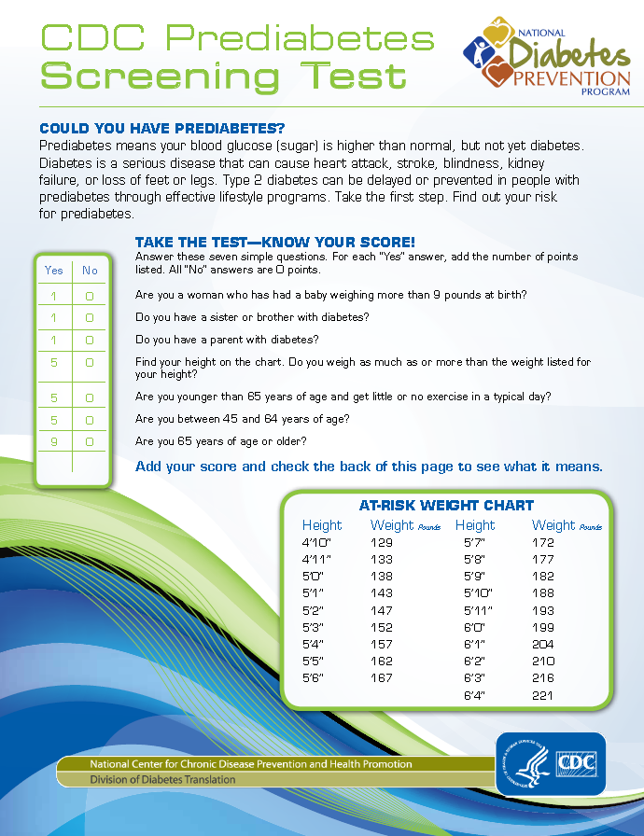
Are You at Risk?

Slide 21
Facts from American Diabetes Association?
Nearly 30 million people in the United States live with diabetes
86 million more have prediabetes
Diabetes and prediabetes costs our country $322 billion dollars each year!
Recent estimates project that as many as 1 in 3 American adults will have diabetes by 2050 unless we take steps to Stop Diabetes®.

Slide 22
So How is America Doing?
Nearly 30 million people in the United States live with diabetes (Population of Michigan and Florida combined!)
1 in 11 Americans has it.
1 in 4 adults who has it does not know it.
1 in 3 adults is at risk of developing it.

Slide 23
Recapping
Type 1
Body does not make enough insulin
Can develop at any age
No known way to prevent it
Type 2
Body cannot use insulin properly
Can develop at any age
Most cases can be prevented
Currently, at least 1 out of 3 people will develop the disease in their lifetime.

Slide 24
5
Know Your Risks

Slide 25
How Do We Avoid Diabetes?
You can prevent or delay type 2 diabetes
Lose weight
Eat healthy
Be more active
Learn more at: www.cdc.gov/diabetes/prevention

Slide 26
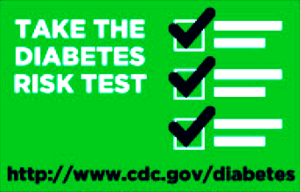
Know Your Risk
Risk Factors for Type 2 Diabetes
Being overweight
Having a family history
Having diabetes while pregnant (gestational)
Without weight loss and moderate physical activity
15-30% of people with prediabetes will develop type 2 diabetes within 5 years.
http://www.diabetes.org/diabetes-basics/statistics/cdc-infographic.html

Slide 27
What are the Risks?
People who have diabetes are at higher risk of serious health complications
Blindness
Kidney Failure
Heart Disease
Stroke
Loss of toes, feet or legs

Slide 28
6
How to Tackle Diabetes

Slide 29
How Do We Tackle Diabetes?
Manage it!
Work with a health professional
Eat healthy
Be more active
Learn more at: www.cdc.gov/diabetes/prevention

Slide 30
Managing High Blood Pressure
Make positive lifestyle changes
Exercise
Reduce alcohol intake
Quit smoking
Alter your diet – low sodium, DASH diet
Explore relaxation techniques
Maintain a balanced lifestyle – take time out for enjoyment!

Slide 31
Helping with Weight Loss
Limit simple sugars and processed carbohydrates:
Leading source of excess calories
Pushes up triglycerides, reduces HDL
Learn portion control
Limit restaurant eating
Re-balance plate with fruit & veggies to get full!

Slide 32
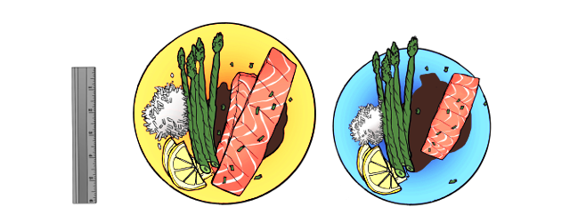
Switch to a Smaller Plate Size
By switching from a 12” plate to a 9” plate, you can easily cut 500 calories per day and still feel satisfied, this is portion control!

Slide 33
Have Your Dressing on the Side
Avoid pouring your dressing on your salad
With your fork, dip your salad into the dressing- you can cut calories and fat this way!

Slide 34
Watch Your Alcohol intake
Just two drinks can equal
500 calories

Slide 35
Eight Ways Water Promotes Weight Loss
Fullness and appetite control
Can minimize cravings for snacks
More energy, more activity, faster weight loss
Zero calories!
It’s a source of motivation!
Detoxing
Reduces water weight (water retention)
↑ muscle tone and healthy skin

Slide 36
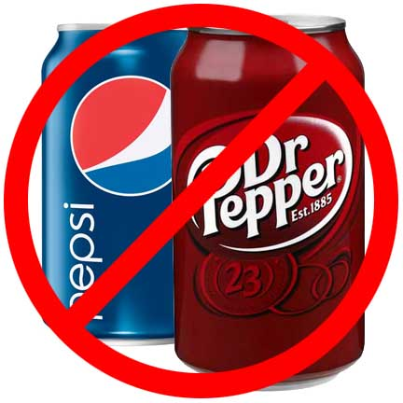
Maybe Now Isn’t the Time to Start…
Change Gain to Maintain! It would only require a100 calorie change per day!
&
2,000 steps more activity daily
100 calories less food daily

Slide 37
Snack Healthy
Balance your snack choices with some lower fat options such as:
10 Healthy Snack Ideas
Vegetables and fruit
Low fat milk products
Baked chips
Plain popcorn
Sliced veggies
A handful of trail mix
A cereal bar

Slide 38
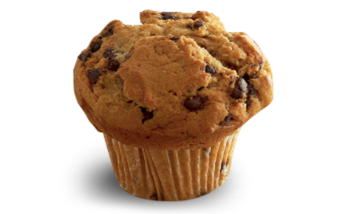
Portion Distortion
20 Years Ago
Today
VS
Calorie difference:
290 calories
210 calories
1.5 ounces
500 calories
4 ounces

Slide 39
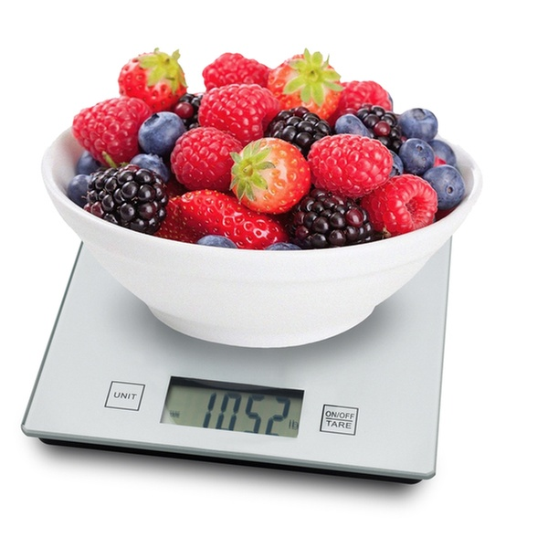
500 Calories a Day
By cutting just 500 calories a day, you could lose up to 1 pound per week!

Slide 40
What Exercise?
I am soooooooooo tired and I work all the time!!!
How in the world do I find time to exercise???

Slide 41
Exercise is Mind Over Matter
Change your perspective
Don’t see it as a chore, but as a privilege
Choose activities you enjoy

Slide 42
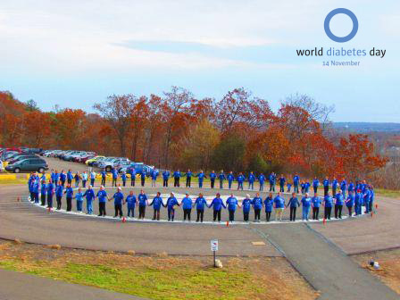
Becoming Aware – World Diabetes Day (WDD)
Celebrated every year on November 14
Increase recognition of the blue circle
Blue circle as the symbol of diabetes awareness

Slide 43
Becoming Aware
Helpful Websites
http://www.carolinashealthcare.org/diabetes?
http://www.cdc.gov
http://www.idf.org/about-diabetes
http://www.diabetes.org

Slide 44
Becoming Aware
Resources
Health Sciences Institute, 5th Edition Chronic Care Professional, 2013
Source: http://www.idf.org/worlddiabetesday/toolkit/gp/raising-awareness
www.cdc.gov/diabetes/ndep
http://www.diabetes.org/diabetes-basics/statistics/cdc-infographic.html
American Diabetes Association official website
http://www.webmd.com/cholesterol-management/diabetes
http://www.cdc.gov/diabetes/prevention/pdf/prediabetestest.pdf

Slide 45
Thank you.
AtriumHealth.org/EmployerSolutions

