Slide 1
How to Have a Healthy Heart
Atrium Health Employer Solutions

Slide 2
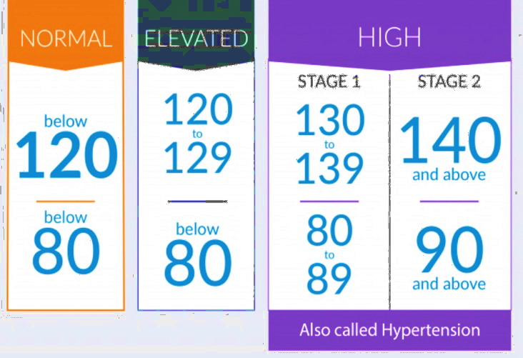
What Are Your Numbers?
Blood Pressure
Cholesterol
Blood Sugar
Weight
BMI

Slide 3
What is Blood Pressure?
What is Blood Pressure?

Slide 4
What is Blood Pressure?
Blood pressure is the force of blood against the walls of your blood vessels.
Normal blood vessels are wide open and the blood moves freely, which results in a ‘normal blood pressure’.
Abnormal or clogged blood vessels have narrowing that causes the blood to move slower and be “under pressure” therefore result in “high blood pressure”.

Slide 5
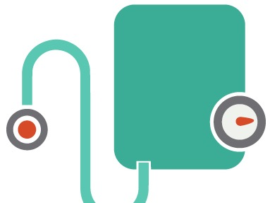
What is High Blood Pressure?
High blood pressure also known as ‘hypertension’ occurs when the heart has to work harder to pump blood through your blood vessels to all parts of your body at a greater force.
2 Parts to Blood Pressure:
Systolic
The top number in the blood pressure when your heart is ‘pumping’.
Diastolic
The bottom number and is the pressure when your heart is ‘resting’ or ‘refilling’.

Slide 6
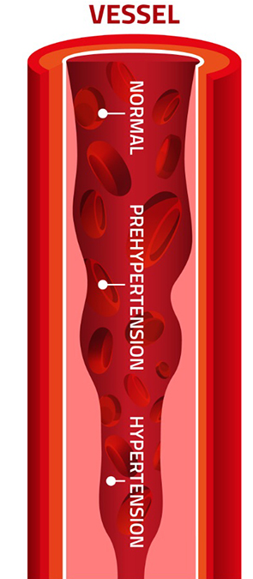
Normal Blood Presser vs. High Blood Pressure
NORMAL BLOOD PRESSURE
STAGE 1 HYPERTENSION
< 120 mmHG systolic
< 80 mmHG diastolic
140-159 mmHG systolic OR
90-99 mmHG diastolic
PRE-HYPERTENSION
STAGE 2 HYPERTENSION
120-139 mmHG systolic OR
80-89 mmHG diastolic
>140 mmHG systolic or higher
>100 mmHG or higher diastolic

Slide 7
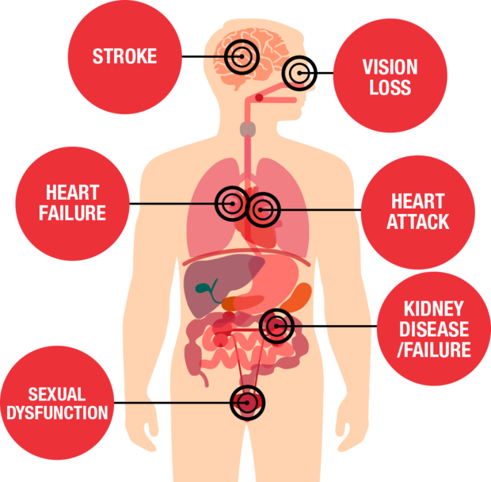
The Risks of High Blood Pressure
The Dangers
Symptoms can be different
You may not know you have it
Many other health problems can develop when high blood pressure is not treated

Slide 8
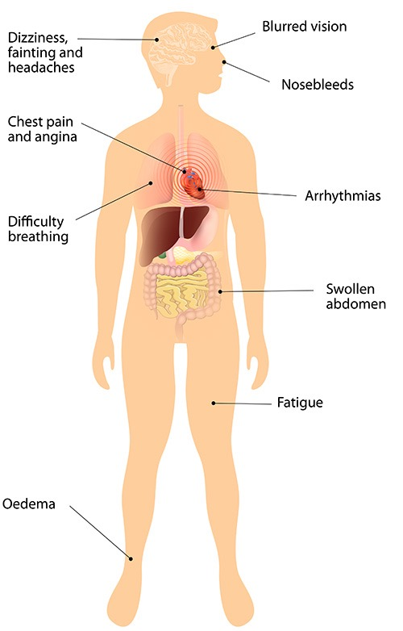
Signs and Symptoms
Regular headaches
Feeling lightheaded
Dizziness
Fatigue
1 in 4 people do not exhibit symptoms

Slide 9
Risk Factors
Controllable
Being overweight or obese
Tobacco use
Eating too much salt
Drinking too much alcohol
No exercise / living a sedentary lifestyle
Having high levels of Stress
Uncontrollable
Family History – High blood pressure tends to run in families
Race (African Americans – higher probability)
Age – Men over the age of 55 and women over the age of 65

Slide 10
Managing High Blood Pressure
Make Positive Lifestyle Changes
Exercise
Reduce alcohol intake
Quit smoking
After your diet – Low sodium, DASH diet
Relaxation techniques like yoga
Balanced lifestyle/take time out for fun

Slide 11
What is Blood Pressure?
What is Cholesterol?

Slide 12
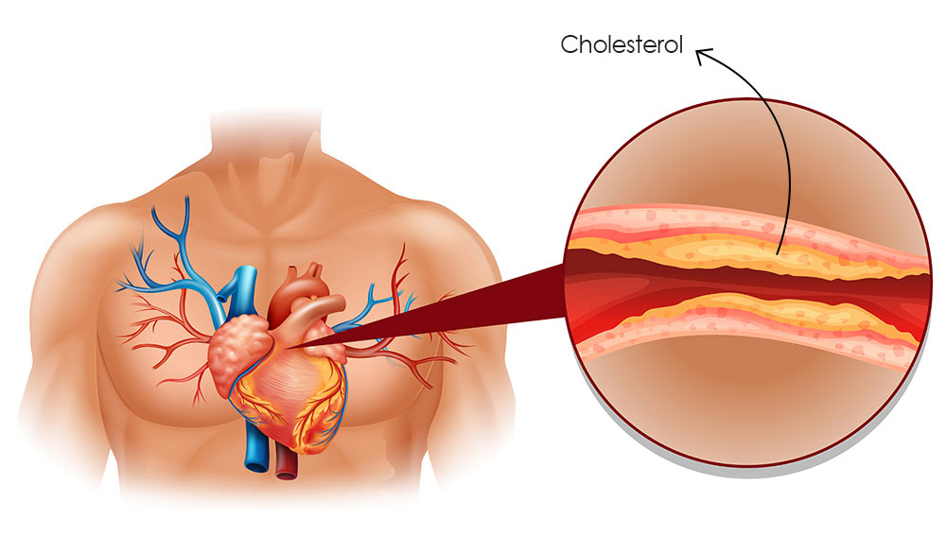
Defining Cholesterol
A waxy fatlike substance produced in the liver
Travels in the blood via lipoproteins
2 main kinds of lipoproteins that carry cholesterol
Cholesterol helps to make hormones, bile acids, and vitamin D

Slide 13
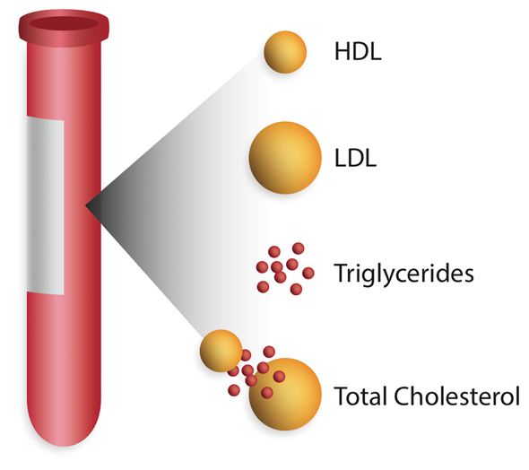
Cholesterol Screening
The American Heart Association/ National Cholesterol Education Program guidelines for detection of cholesterol
All adults age 20 or older should have a fasting lipoprotein profile. It measures:
LDL cholesterol
HDL cholesterol
Triglycerides
This test is done after a 9 to 12 hour fast without food, liquids, or pills.
Age, gender, family health history, and diet effect cholesterol levels.

Slide 14
Knowing my Cholesterol Numbers
Total Cholesterol |  | LDL (Bad) Cholesterol
< 200 mg/dL | Desirable | < 100 mg/dL | Optimal
200-239 mg/dL | Borderline high | 100-129 mg/dL | Near Optimal
240 mg/dL and > | High | 130-159 mg/dL | Borderline High
 |  | 160-189 mg/dL | High
 |  | 190 mg/dL and > | Very High
Triglycerides (another form of fat)
< 150 mg/dL | Desirable
150-199 mg/dL | Desirable
>200 mg/dL | High

Slide 15
Cholesterol Numbers Continued
HDL (Good) Cholesterol – Higher Numbers are Better!
< 40 mg/dL | Low – Major risk for heart disease
> 60 mg/dL | Desirable – May provide some benefit of lowering your risk for heart disease
Total Cholesterol/HDL Ratio > 5.5 mg/dL | Desirable

Slide 16
How to Manage Your Cholesterol
Reducing weight
Cardio exercise – at least 30 mins/ day most days of the week
Reduce saturated fat and cholesterol in your diet
Stop smoking
Reduce your blood pressure
Increase your fiber

Slide 17
HDL: The “Good” Cholesterol
High Density Lipoprotein
A low HDL-cholesterol level is strongly associated with risk for CHD.
HDL Cholesterol Level | HDL Cholesterol Category
Less than 40 mg/dL | A major risk factor for heart disease
40-59 mg/dL | The higher, the better
60 mg/dL and above | Protects against heart disease

Slide 18
LDL: The “Bad” Cholesterol
Low Density Lipoprotein
Studies show a strong causal relationship between elevated LDL cholesterol and heart disease.
LDL Cholesterol Level | LDL Cholesterol Category
Less than 100 mg/dL | Optimal
100-129 mg/dL | Near Optimal/Above Optimal
130-159 mg/dL | Borderline High
160-189 mg/dL | High
190 mg/dL and above | Very High

Slide 19
Triglycerides
Elevated serum triglycerides are associated with increased risk for heart disease.
A form of fat found in both the body and in foods
Act like saturated fat
Triggers the liver to make more cholesterol
Triglyceride Classifications | Triglyceride Levels (mg/dL)
Normal | Less than 150
Borderline High | 150 to 199
High | 200 to 499
Very High | 500 and up

Slide 20
In the United States:
Every 39 seconds an adult dies of a heart attack, stroke or other cardiovascular disease
Nearly 68 million adults have high blood pressure and 1 in 2 are uncontrolled
71 million US adults have high cholesterol and 2 in 3 are uncontrolled
Source: www.cdc.gov/vitalsigns

Slide 21
By the Numbers
High Blood Pressure
High Cholesterol
1 in 3
Adults have high blood pressure.
1 in 3
Adults have high cholesterol.
1 in 2
Adults with high blood pressure do not get treatment.
1 in 2
Adults with high cholesterol do not get treatment.
1 in 2
Adults with high blood pressure do not have it under control.
1 in 2
Adults who have high cholesterol do not have it under control.
Source: www.cdc.gov/vitalsigns

Slide 22
Prevention and Treatment
Understand Your Number
HDL
LDL
Triglycerides
Lifestyle Changes
Enjoy a heart healthy diet
Enjoy regular physical activity
Avoid tobacco smoke
Know Your Fats
Know which fats raise LDL and which ones don’t
Cooking for Lower Cholesterol
Come up with recipes that fit the low saturated fat, low cholesterol eating plan
Cooking for Lower Cholesterol
For some, lifestyle changes are not enough to reach healthy levels. Your doctor may prescribe medication

Slide 23
Increasing HDL Cholesterol
Stay physically active
Trim any extra pounds of body fat if you are not at your healthy weight
Reduce fat intake to no more than 30% of total Calories
Replace saturated fats with monounsaturated fats
If you smoke, quit
HDL

Slide 24
Decreasing LDL Cholesterol
Substitute unsaturated fats for saturated fats
Keep total fat and dietary cholesterol low
Cut back on trans fatty acids (found in partially hydrogenated vegetable oils)
Increase soluble fiber and consider using 25 gm soy protein/day
LDL

Slide 25
What Increases Triglycerides?
Causes of high triglycerides in the general population
Overweight and obesity
Physical inactivity
Cigarette smoking
Excess alcohol intake
Very high-carbohydrate diets (>60% of total energy)
Other diseases (type 2 diabetes, chronic renal failure)
Certain drugs (corticosteroids, protease inhibitors for HIV, beta-blockers, estrogens)
Genetic factors

Slide 26
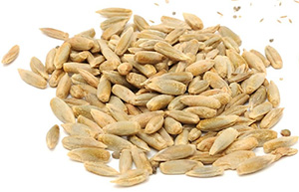
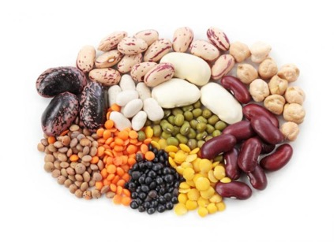
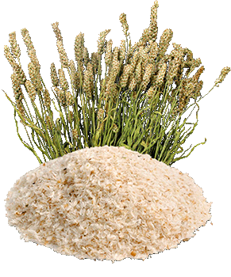
Soluble Fiber
Legumes
Oats, rye, barley
Apples, bananas, berries, citrus
Fruits, plums, prunes
Broccoli, brussels sprouts, carrots
Psyllium

Slide 27
Lifestyle Changes
Cigarettes
Smoking aggravates and speeds up growth of atherosclerosis
Over time fats, cholesterol, platelets, cellular debris, and calcium are deposited in artery wall
Nicotine in Smoke
Decreases oxygen to the heart
Increases blood pressure and heart rate
Increases blood clotting
Damages cells that line arteries

Slide 28
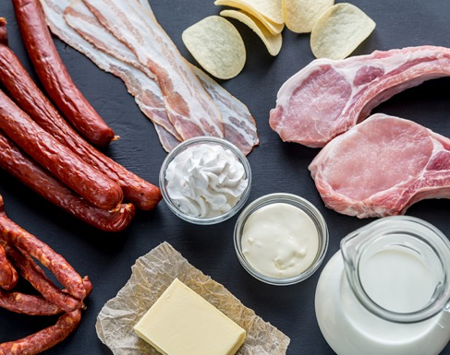
Know Your Fats
GOOD FATS
NOT AS GOOD FATS
REALLY BAD FATS
Monounsaturated and Polyunsaturated Fats
Avocados, olives, soybean oil, corn oil, safflower oil, canola oil, olive oil, sunflower oil, salmon, trout, herring, and walnuts.
Saturated Fats
Beef, pork, lard, poultry fat, butter, cheese, cream, milk (whole and 2%), coconut oil, palm oil, palm kernel oil, and cocoa butter
Trans Fats
Margarine, cooking oils, shortening, and partially hydrogenated oils

Slide 29
What is Blood Pressure?
Weight Management

Slide 30
Waist Circumference
What is it anyway?
Waist circumference (WC) is a measure of the distance around the abdomen.
WC measures:
abdominal fat for chronic disease risk
weight loss during a weight loss treatment program.

Slide 31
Normal Waist Circumference
According to the United States Department of Health and Human Services the following individuals are at increased risk for developing chronic diseases:
GENDER
NORMAL
≤ 35
A high WC or a greater level of abdominal fat is associated with an increased risk for type 2 diabetes, high cholesterol, high blood pressure and heart disease.
≤ 40

Slide 32
Cooking
Limit processed meats
Cook a day ahead of time
Broil rather than pan fry
Buy “choice” or “select”
Trim all visible fat
Select lean cuts
Prepare fish baked/grilled/broiled
Try meatless options
Use liquid vegetable oils in place of butter, lard, or shortening
Choose low fat dairy

Slide 33
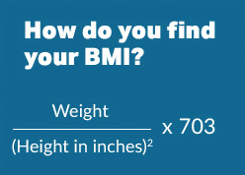
Body Mass Index (BMI)
What is BMI?
A number calculated from a person's weight and height. A fairly reliable indicator of body fatness for most people. BMI does not measure body fat directly, but research has shown that BMI correlates to direct measures of body fat, such as underwater weighing and dual energy x-ray absorptiometry (DXA).
BMI | Weight Status
Below 18.5 | Underweight
18.5 – 24.9 | Normal
25.0 – 29.9 | Overweight
30.0 and Above | Obese

Slide 34
What is Blood Pressure?
Blood Sugar (Glucose)

Slide 35
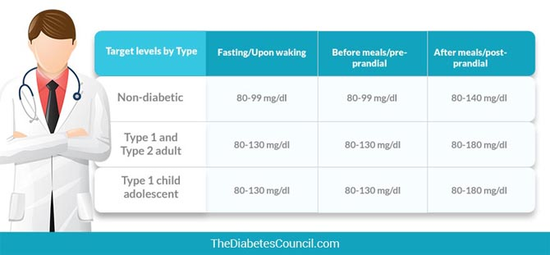
Glucose
Blood Glucose is an essential measure of your health
Many foods break down into blood glucose is used for energy to fuel our brain, heart and muscles. Blood glucose usually comes from the food we eat or is made by the liver
It is found in blood stream and inside the cell where it is changed into energy

Slide 36
Diabetes
Diabetes is diagnosed by any one of the following:
Two consecutive fasting blood glucose tests that are equal to or greater than 126 mg/dl
Any random blood glucose that is greater than 200 mg/dl
An A1c that is equal to or greater than 6.5 percent. An A1c is an easy blood test that gives a three-month average of blood sugars
A two-hour oral glucose tolerance test with any value over 200 mg/dl
Symptoms
Fatigue
Excessive urination
Excessive thirst
Unplanned weight loss

Slide 37
Are you at Risk for Diabetes?
https://www.bing.com/videos/search?q=prediabetes&&view=detail&mid=D4B747E2FFFB1995621CD4B747E2FFFB1995621C&&FORM=VRDGAR

Slide 38
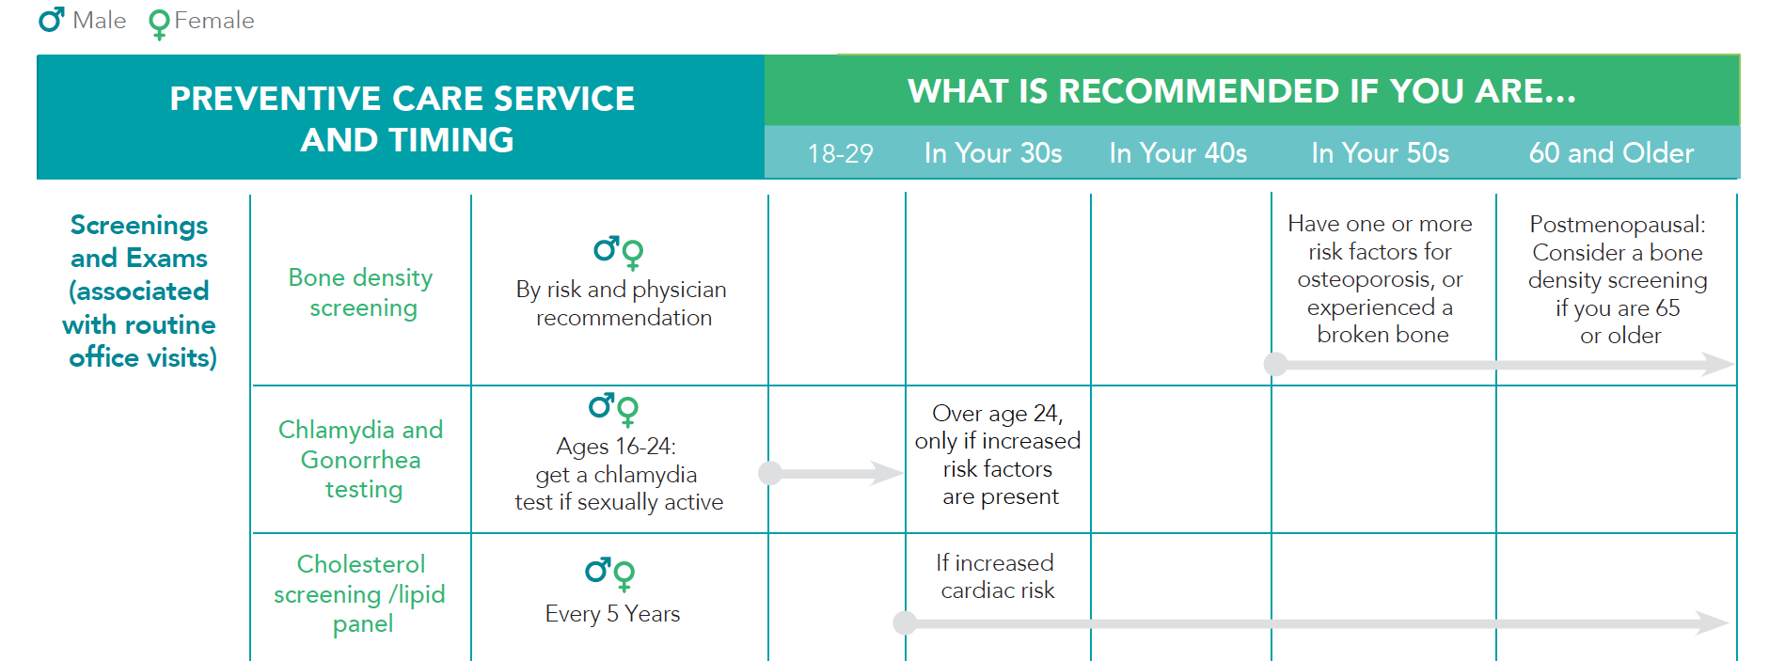
2019 Preventive Health Guide

Slide 39
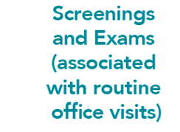
2019 Preventive Health Guide

Slide 40
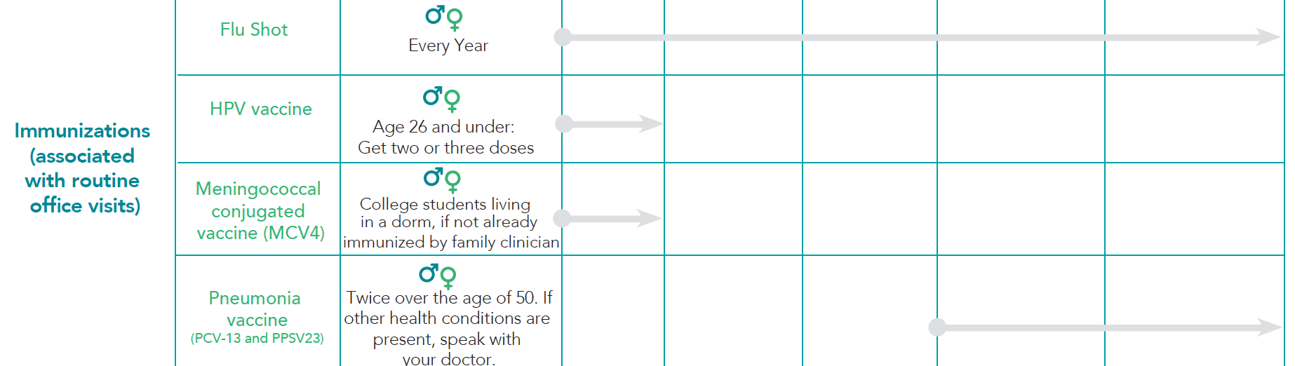
2019 Preventive Health Guide

Slide 41
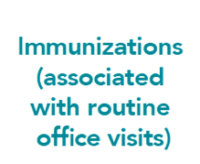
2019 Preventive Health Guide

Slide 42
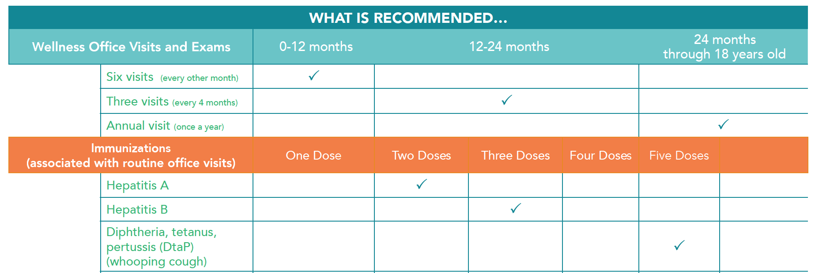
2019 Preventive Health Guide

Slide 43
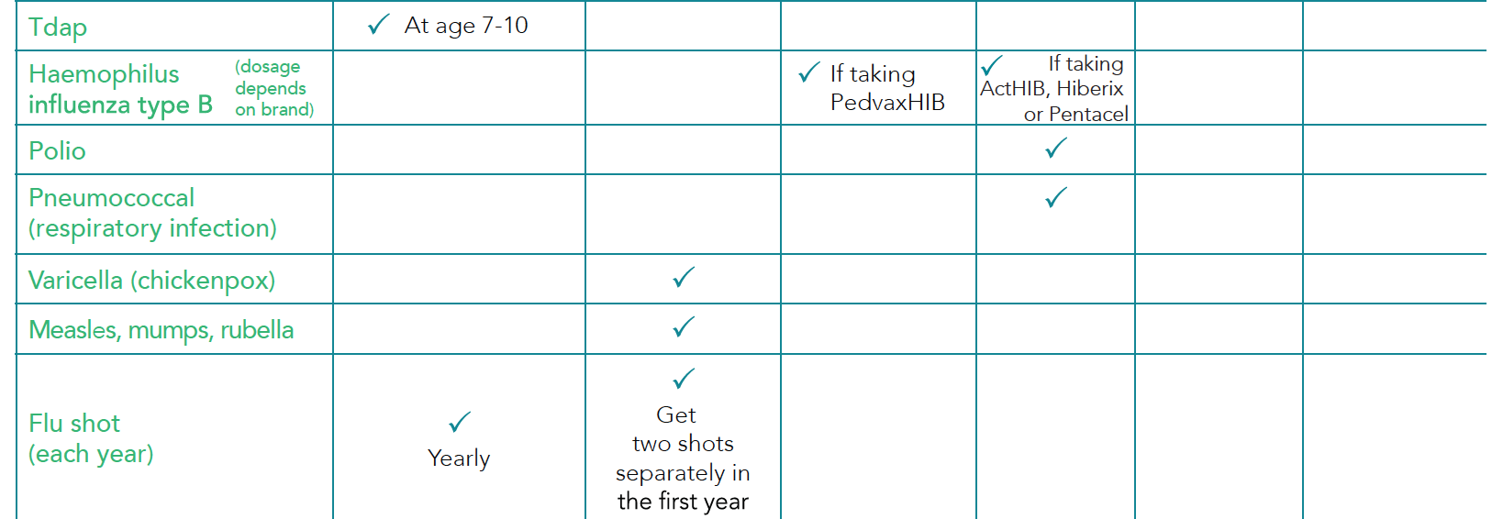
2019 Preventive Health Guide

Slide 44
2019 Preventive Health Guide

Slide 45
2019 Preventive Health Guide

Slide 46
Questions?

Slide 47
Thank you.

Slide 48
References
Ask ABOUT HIGH BLOOD PRESSURE. Your Treatment & You: Working Together for Better Health (2009). Retrieved November 15, 2012 from http://www.mipcc.org/sites/mipcc.org/files/u4/Ask%20about%20High%20Blood%20Pressure.pdf
Centers for Disease Control and Prevention (2012). Healthy weight, it’s not a diet, it’s a lifestyle. Retrieved November 15, 2012 from http://www.cdc.gov/healthyweight/assessing/bmi/adult_bmi/index.html
McKinley Health Center (2012). Waist Circumference. Retrieved November 20, 2012 from http://www.mckinley.illinois.edu/handouts/waist_circumference/waist_circumference.htm
National Heart Lung and Blood Institute (2012). People Science Health. Retrieved November 26, 2012 from http://www.nhlbi.nih.gov/health/health-topics/topics/obe/

Slide 49
References, Continued
Sanger Heart & Vascular Institute (2012). Healthy Living Blood Pressure. Retrieved November 16, 2012 from www.sangerheart.org
U.S. Department of Health and Human Services National Institutes of Health (2007). High Blood Cholesterol; What you need to know. National Cholesterol Education Program. Information on cholesterol lowering (www.nhlbi.hih.gov/chd).
https://www.virginiamason.org/whatarenormalbloodglucoselevels
** For help with weight management: View this HBO movie- The Weight Of The Nation @ hbo.com/theweightofthenation.

