Slide 1
What About Nutrition?
Presenter Name
Ashley Harris, BSN, RN, CHWC
Atrium Health Employer Solutions

Slide 2
Objectives
Why does nutrition matter?
Food groups: protein, carbs, and fats (portions)
Macro-micronutrients and hydration
Healthy food choices
Exercise can’t conquer all
Healthy culture means healthy people

Slide 3
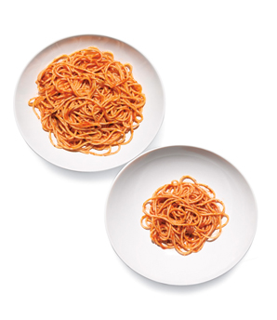
Understanding Portion Sizes
A serving is different than what we normally put on our plates. For example, a serving of spaghetti is ½ cup – not a full plate!
Monitoring portion sizes is key in acquiring proper nutrients for our body and managing weight.

Slide 4
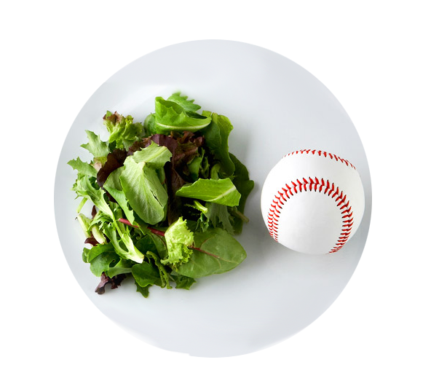
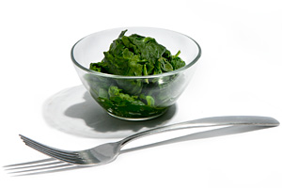
Portions: Vegetables
1 cup raw leafy vegetables – size of a baseball
½ cup chopped raw or cooked vegetables
¾ cup (6 oz) juice

Slide 5
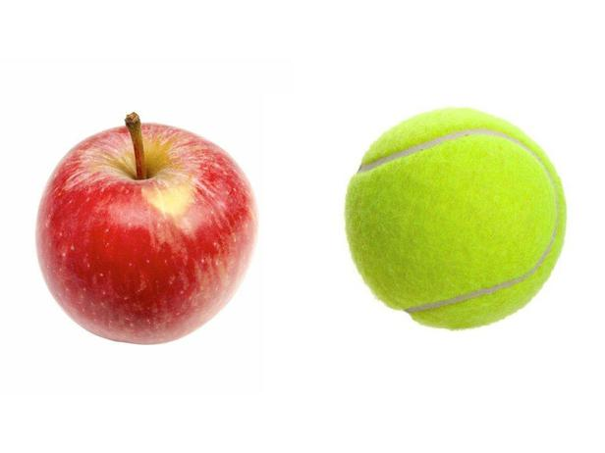
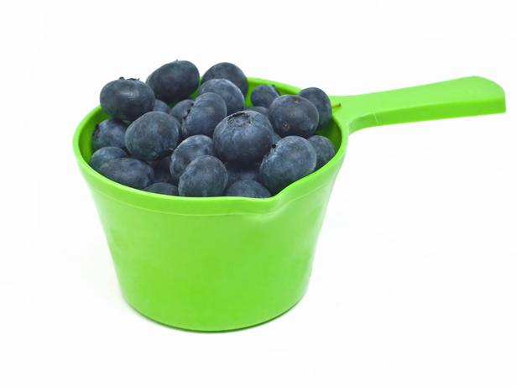
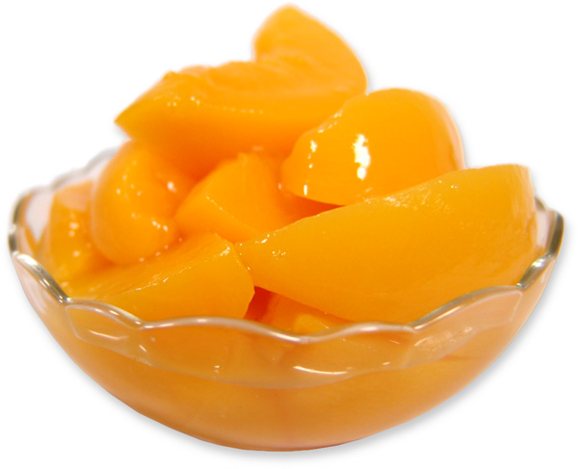
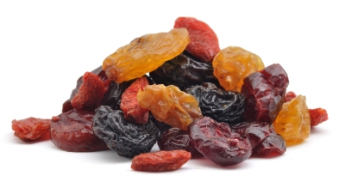
Portions: Fruits
1 medium piece fresh fruit = size of a tennis ball
1 cup berries or melon
¾ cup (6 oz) juice
¼ cup dried fruit
½ cup canned fruit

Slide 6
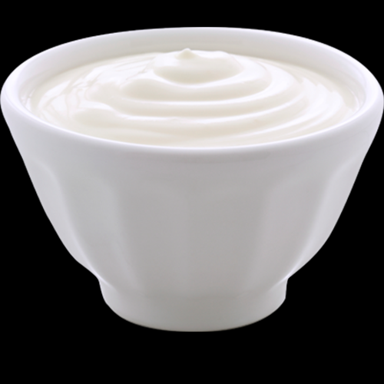
Portions: Dairy
1 cup milk or yogurt
1 oz. cheese = size of a 9 volt battery or 2 dice
*Be careful having cheese sticks as a snack!

Slide 7
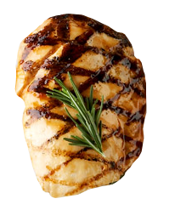
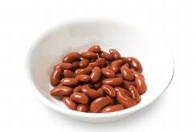
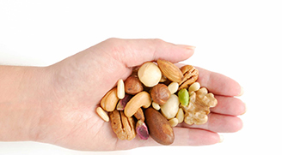
Portions: Meat and Beans
3 ounces of fish, poultry, meat = size of a deck of cards or palm of woman’s hand
2 tablespoons of Peanut Butter = size of standard ice cube
¼ cup nuts or seeds = cupped hand
½ cup beans or peas
1 egg = 1 ounce

Slide 8
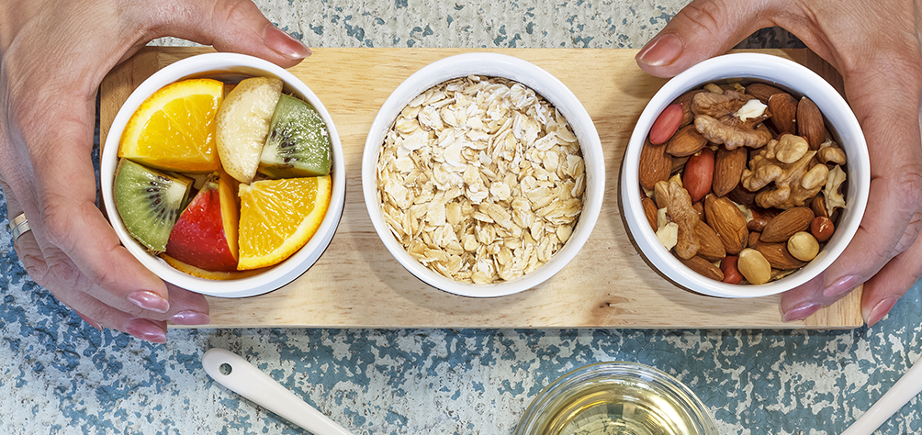
Portions are the Key

Slide 9
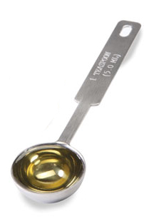
Portions: Oils
1 teaspoon butter, oil = size of a stamp

Slide 10
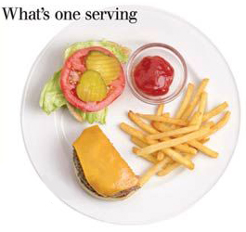
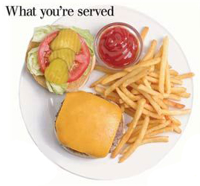
Portion Sizes in Restaurants
Serve 2-3 times the recommended serving sizes
Share larger portions
Consider buying a half-sandwich
Order from the child’s menu
Avoid “supersizing” meals

Slide 11
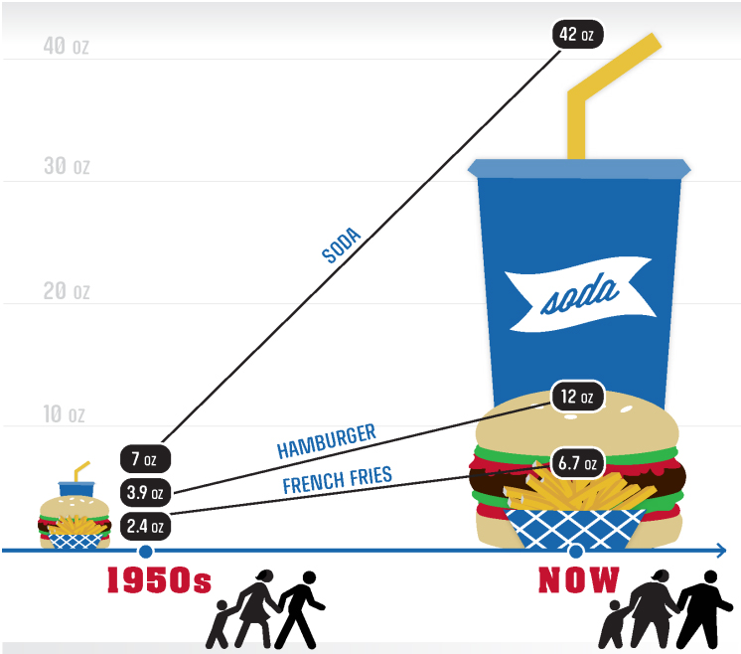
The New ‘Scary’ Normal

Slide 12
Exercise and Nutrition
The Truth!
Exercise can help you lose weight and keep it off
To lose a pound of fat, you have to burn approximately 3500 calories more than you consume
Proper nutrition and exercise = optimal function of all body systems

Slide 13
Building Muscle
Muscle burns more than fat at rest
Increased muscle mass is the key to a ‘revved metabolism’
Strength training can help maintain a proper weight and support your skeletal integrity
Notes:
Strength training important component to weight management 2-3 times/wk. at least 30 minute sessions alternate with cardio three times per week at least 30 minutes

Slide 14
What Does Nutrition Deliver?
Constant supply of nutrients for normal structure and function
Adequate fluid – proper hydration of tissues
Fiber – proper bowel function
Vitamins and minerals – proper enzymatic processes

Slide 15
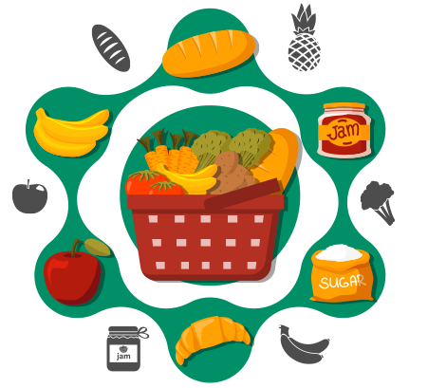
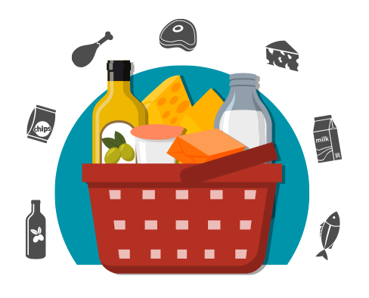
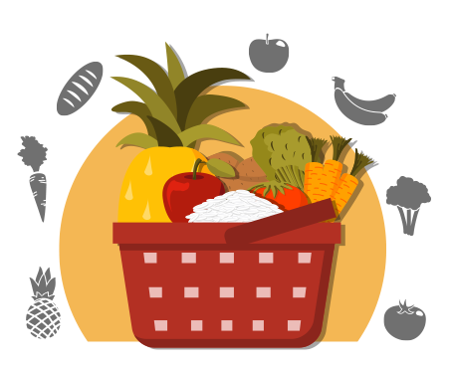
Macronutrients
FATS
CARBOHYDRATES
PROTEIN
FIBER
FLUID

Slide 16
Micronutrients
Skull
Calcium
Magnesium
Manganese
Potassium
Phosphorus
Vitamins A, C, D, E and B-complex
Scapula
Humerus
Rib
Ulna
Radius
Femur
Pelvis
Tibia
Fibula

Slide 17
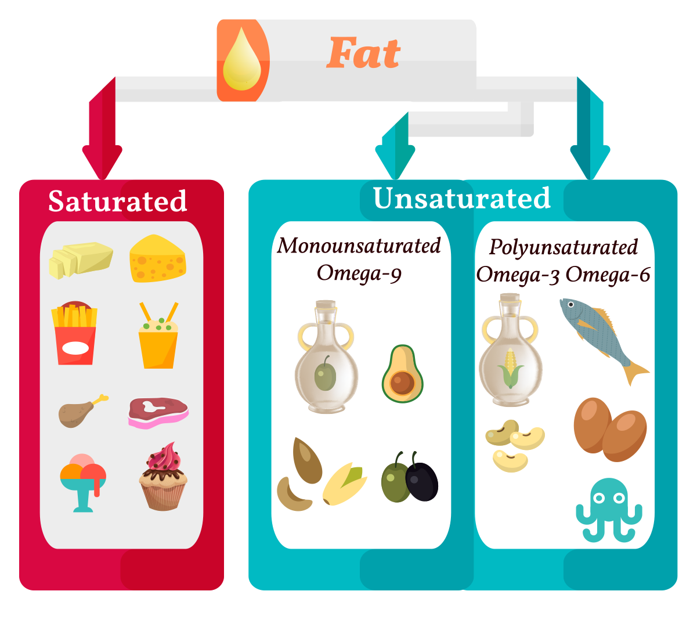
A Word on Fats
Saturated (butter; solid at room temperature
Polyunsaturated (corn oil; liquid at room temperature or refrigerated)
Monounsaturated (olive oil; liquid when at room temperature, but often solid when refrigerated).

Slide 18
Carbohydrates
Simple
Complex
Typically sugars and are sweet to the taste
Easily absorbed with minimal digestion
Increase blood sugar rapidly
Typically starches like bread, pasta or potatoes
Take longer to digest
Tend to satisfy hunger longer

Slide 19
Proteins
Complete
Incomplete
Animal protein
Meat, fish, eggs or milk products
Plant sources and comprise 3 primary groups
Nuts (usually encased in a hard shell)
Seeds (generally found in clusters)
Legumes (generally encased in a pod like peas, beans and peanuts)

Slide 20
Does Culture Perpetuate Unhealthy Eating?
Food everywhere…
At meetings
Celebrations
Workplace Rewards
Do Break Rooms become a dumping ground for food?

Slide 21
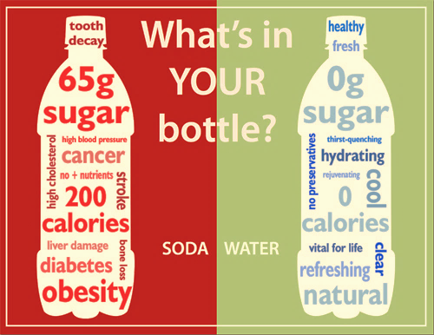
Don’t Drink Your Calories
Calories in liquid form do not keep us as full as calories in the solid form. Liquid leaves our stomach more rapidly than solid foods.
The best way to stay hydrated is through water.

Slide 22
And the drink of choice is…
WATER

Slide 23
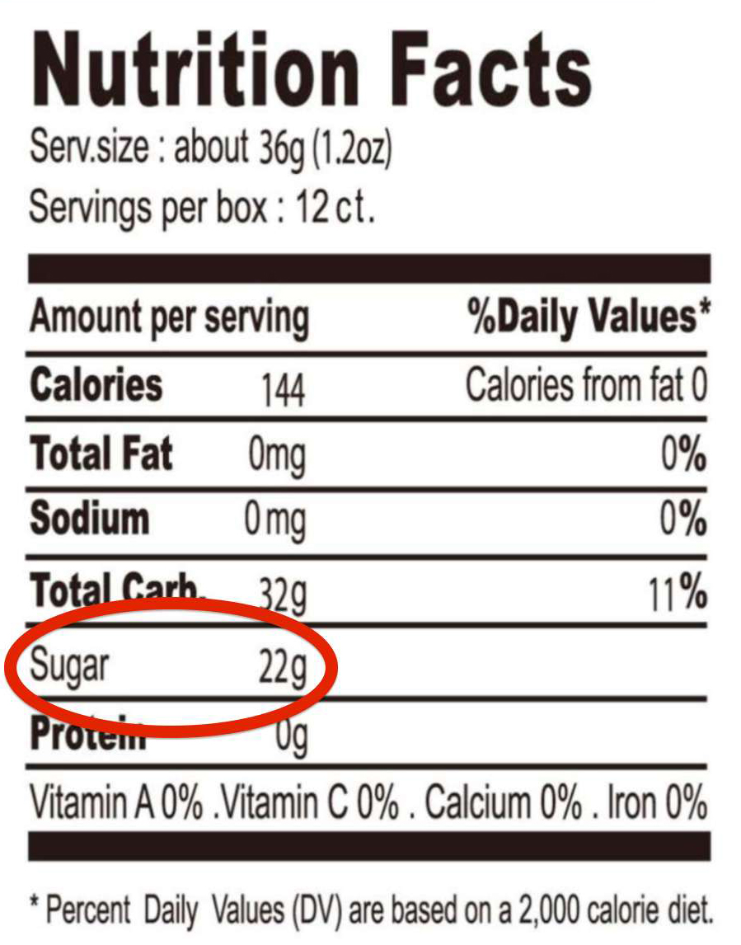
Maintain Reduced Sugar Intake
The sugar content of a product (listed directly below carbohydrates on a nutrition label) should not be over half of the total carbs in that product.
For weight management, consume only 40-60 grams of sugar per day.
Select products that do not have the sugar forms mentioned previously as the first three ingredients.

Slide 24
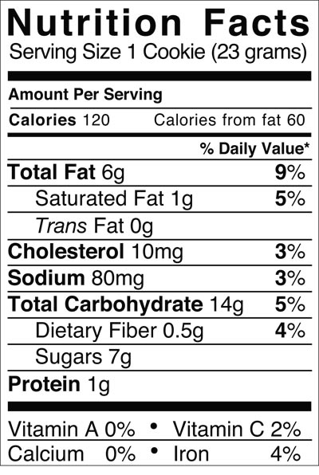
How Much Sugar is in 1 Cookie?

Slide 25
How They Hide Sugar
Here are a few of the names for added sugar that show up on food labels
(List adapted from the Dietary Guidelines for Americans (1).)
Agave nectar
Glucose
Honey
Lactose
Malt syrup
Raw sugar
Brown sugar
High-fructose corn syrup
Invert sugar
Maltose
Molasses
Sucrose
Syrup
Cane crystals
Corn syrup
Dextrose
Fructose
Fruit juice concentrate
Corn sweetener
Crystalline fructose
Evaporated cane juice

Slide 26
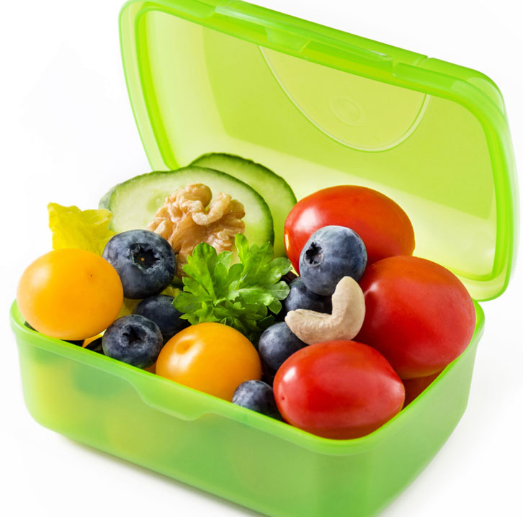
Snack Healthy
Balance your snack choices with some lower fat options such as:
Vegetables and fruit
Low fat milk products
Baked chips
Plain popcorn
A handful of trail mix
Fig bars
A cereal bar

Slide 27
Dining Out: Making Better Choices
Instead of: | Try: | Kcals saved:
20oz regular cola (250 kcals) | 20oz diet cola (0 kcals) | 250
Large French fry (540 kcals) | Small French fry (210 kcals) | 330
Chick-fil-a chicken sandwich (410 kcals) | Chick-fil-a chargrilled chicken sandwich (270 kcal) | 250
BK Big Fish sandwich (720 kcals) | Plain Burger King hamburger (330 kcals) | 390
Original Crust, meat supreme, Papa John’s Pizza (1 slice) | Thin crust, garden special, Papa John’s Pizza (1 slice) | 164

Slide 28
Dining Out: Watch out for fat!
Look for these lower-fat menu terms when eating out
Baked
Broiled
BBQ
Charbroiled
Poached
Roasted
Steamed
Stir-fried

Slide 29
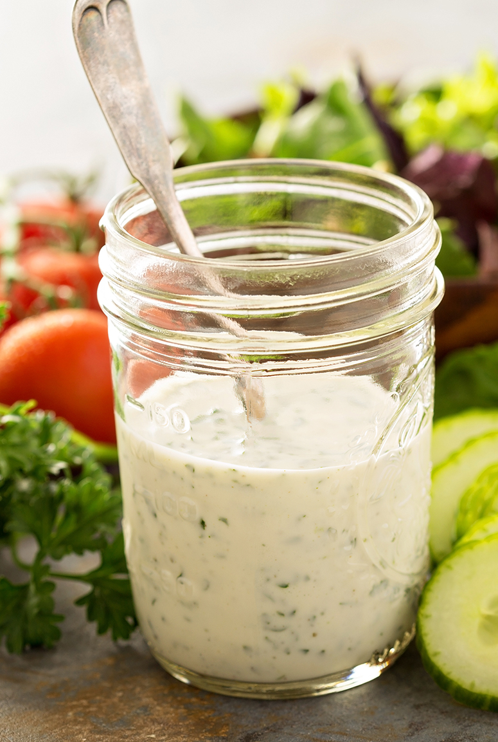
Dining Out: Leave it off!
To cut the calories without cutting the portion, try ordering items without cheese and mayonnaise.
Ask for salad dressing on the side.
1 oz of cheese contains nearly 10g of fat and 100 calories.
1 tbsp of regular mayonnaise contains 100 calories and 11g of fat.
2 tbsp of Ranch or creamy Caesar salad dressing contains 14-18 g of fat/ 140-170 calories!

Slide 30
Don’t Wait ‘til it’s Too Late!
When you are overly hungry you may be more likely to grab a candy bar or a bag of chips. PLAN AHEAD!
Stock your desk, lunch bag or knapsack with some healthy snacks from home.
A piece of fruit, cereal bars and trail mixes are all great portable choices.

Slide 31
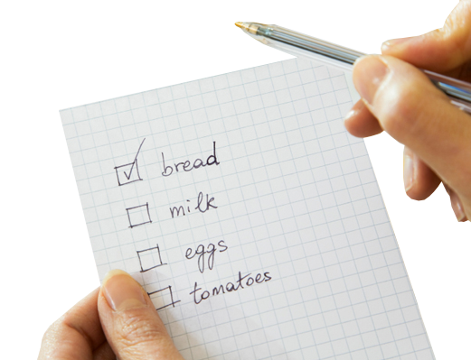
At Home: Make a Shopping List
Make a shopping list and stick to it
Never shop when hungry
Shop with a calculator and coupons to get the best price
Shop the perimeter of the store first
Buy foods that require preparation

Slide 32
At Home: Healthy Cooking
INSTEAD OF: | TRY:
½ cup of oil | ½ cup unsweetened applesauce
1 cup heavy cream | 1 cup evaporated fat free milk
1 cup all-purpose flour | ½ cup all-purpose flour & ½ cup whole wheat flour

Slide 33
At Home: Healthy Cooking
INSTEAD OF: | TRY:
Salt | Garlic, onions, herbs, spices, Mrs. Dash, lemon pepper
Sugar | Splenda
Canned vegetables and beans | Look for “no added salt” on label. Fresh/frozen are best.

Slide 34
At Home: Healthy Cooking
INSTEAD OF: | TRY:
American processed cheese | Part-skim mozzarella, provolone, swiss, soy cheese
Meat, poultry | Look for “loin” or “round” cuts when selecting beef or pork. They have less fat.
Ground beef | Extra-lean beef, ground turkey, or chicken breast
Dairy products | Reduced-fat, low-fat, or fat-free

Slide 35
Get Untraditional
INSTEAD OF: | TRY:
Chicken sandwich with lettuce, tomato, mayo, chips/fries soda | ½ avocado, 1 tomato, sliced cucumber, sprinkle of dressing, crackers and hummus, fruit, water
Burger with fries/onion rings, brownie or cookie, and sweet tea | Canned tuna on a bed of lettuce w/tomato, peppers, cucumbers, stone wheat crackers and bean dip, pear (or fruit of choice), water
Grilled mexi-chicken burrito with tortilla chips and queso/bean dip, side of rice, soda/sweet tea | Chicken taco salad, minus the queso and rice; enjoy the tortilla chips (1 serving, beans (1 serving) + serving of fruit, water
Chicken artichoke panini, chips soup, bread, soda or sweet tea | Mixed greens & spinach salad w/grilled chicken or salmon, butternut squash soup, grapes and apple medley, water

Slide 36
Preparing & Goals
Think about what you/your family like to eat- make a plan
Pre-prepare a few meals on the weekend
Get creative
Shop an isle you haven’t shopped
Make small goals for healthy eating

Slide 37
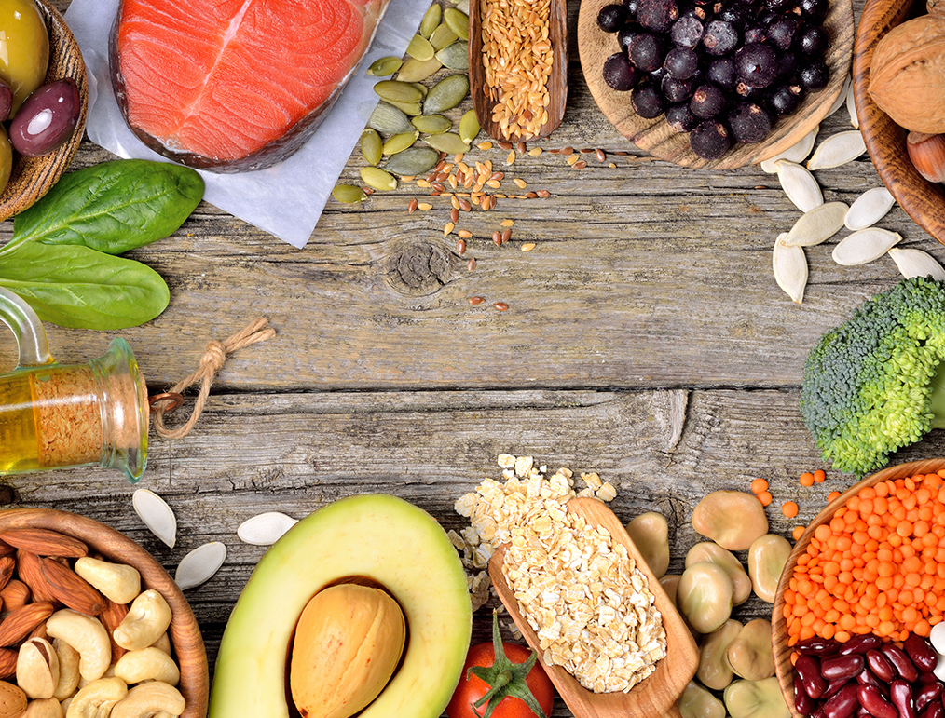
Nutrition Matters

Slide 38
Questions? Ashley.Harris1@atriumhealth.org

Slide 39
Thank you.

