Slide 1
Stress & Health
Kyla Creel Barnes | Coordinator, Health Promotions
Atrium Health Employer Solutions

Slide 2
What Is Stress?
Stress:
A feeling of tension or pressure experienced when an individual feels that the demands placed on them exceed the resources the individual has personally to meet them.
Feeling Fear and Anxiety during COVID-19 is a normal reaction.

Slide 3
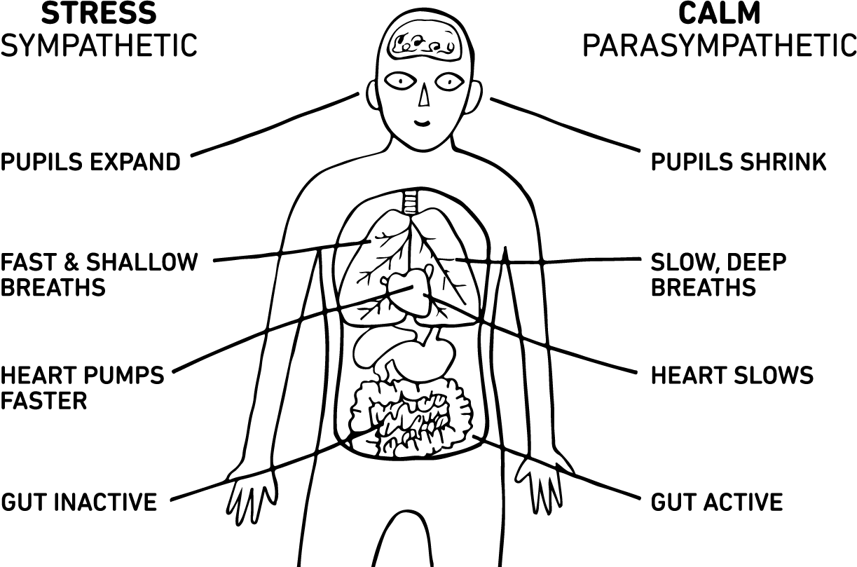
Stress Sympathetic Versus Calm Parasympathetic

Slide 4
Modern Stressors
Money / Bills
Household Chores
Traffic
Work

Slide 5
Added Stressors with COVID-19
Increase in alcohol and other substances
Fear of the unknown
Home schooling children
Feeling trapped
Overworking

Slide 6
What are Common Psychological Symptoms of Stress?
Emotional
Mental
Everyone reacts differently!
Behavioral

Slide 7
Changes you may see during this time
Sleeping Difficulty
Weight Gain
Children reverting
to old behaviors

Slide 8
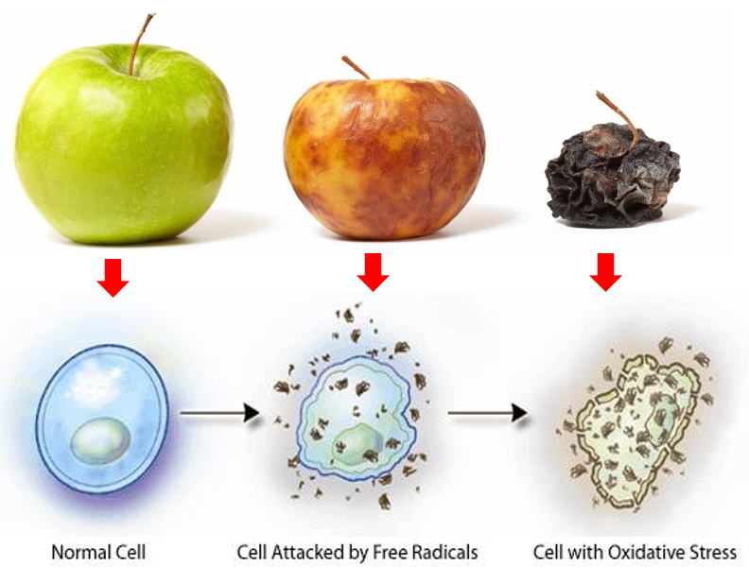
Effects of Oxidative Stress
These apples demonstrate how oxidative stress breaks down your cells, causing premature aging and disease.

Slide 9
Working From Home Tips
Keep a Routine
Set Regular Hours
Create a Workspace

Slide 10
Creating Conscious Relief
Mindfulness
Practice
Focus
Accept
Mindfulness
The practice of training the mind to focus its attention on the present moment in a systematic way, while accepting whatever arises.

Slide 11
Mindful Exercises
Calming the Mind
Approximately 12 million adult coloring books sold in the US in 2015
Boosting the sale of adult nonfiction by 6.6 percent
Faber Castell-Global pencil shortage for the largest pencil producing company in the world!

Slide 12
“Nature’s medicine is anti-oxidants!”
These can help with your stress levels

Slide 13
Lifestyle
Meeting our basic needs
Get 7-8 hours sleep
Daily exercise – walk, bowling, swim, dance
Choose healthy energizing foods
Stretching and strengthening activities, deep breathing
Relax by actively enjoying an activity or a hobby

Slide 14
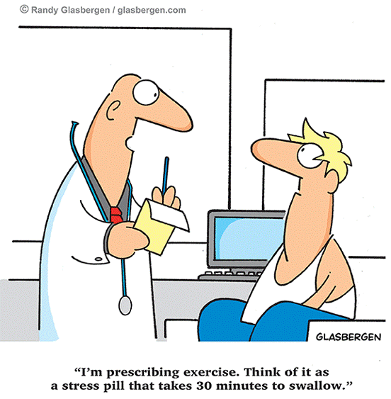

Slide 15
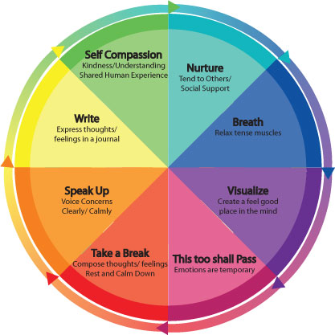
Ways to Elicit the Relaxation Response

Slide 16
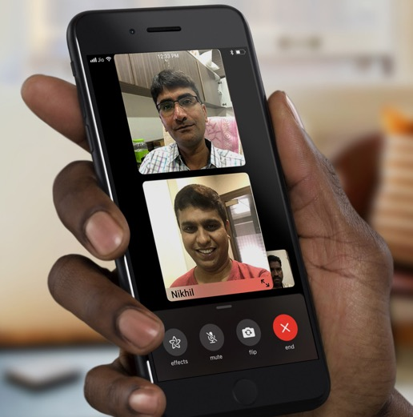
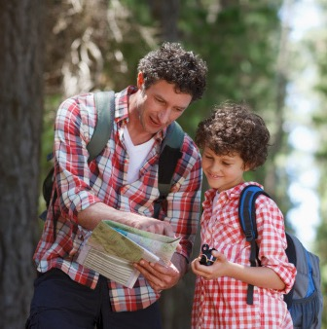
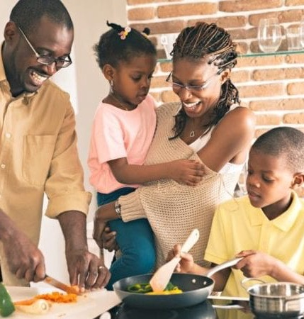
Get Creative at Home
Group Facetime
Get outside – go on a bear hunt!
Cook – and get the kids involved

Slide 17
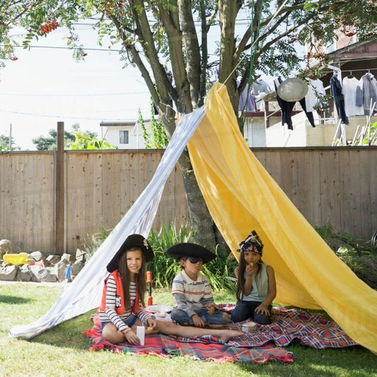
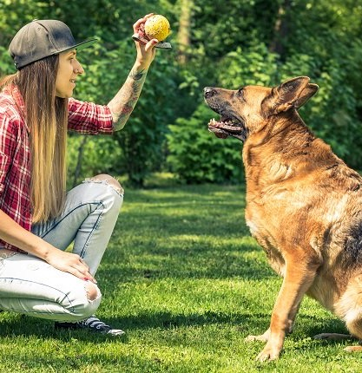
Get Creative at Home
Learn a new craft or hobby
Build a fort or camp in the backyard
Teach your pet new tricks

Slide 18
Take a Break from Social Media

Slide 19
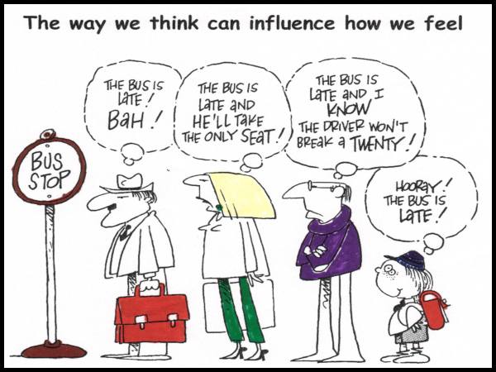

Slide 20
Questions?

Slide 21
Thank you.

