Slide 1
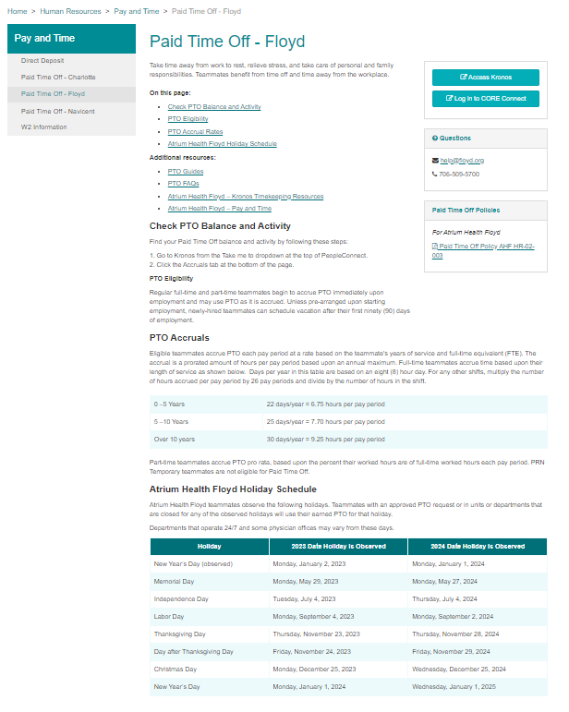
https://teammates.atriumhealth.org/human-resources/pay-and-time/paid-time-off-floyd#checkpto
INSERT:
PTO Cash Out Update
Atrium Health Floyd teammates can elect PTO Cash Out twice a year. During each cash out, you can sell a minimum of 10 hours and a maximum of 80 hours of PTO. A minimum of 80 hours must be in your PTO bank to receive a payout.
Update: Effective March 24, payout of PTO will be at 90% of its value in accordance with IRS guidelines. Teammates must elect cash out by March 11 to receive payout at 100%.
To check your PTO balance or elect PTO Cash Out:
Go to Kronos from the Take me to dropdown at the top of PeopleConnect.
Click the Accruals tab at the bottom of the page.
Learn more:
Review FAQ – link to FAQ
Managing Time Away Guide – link to guide with update

