Slide 1
Research Town Hall: April 27, 2023
Kristie Foley, PhD MS
Vice Dean for Research Strategy & Integration
Sara Stanley, MS, CRA
AVP & Assistant Dean, Sponsored Programs
Selvin Ohene, MS
AVP & Assistant Dean, Research Operations

Slide 2
Agenda Topics
Extramural Funding Updates
Research Plan for Excellence (RPE) Updates
Progress on Concerns Discussed at Last Town Hall (Dec/Jan)
New Initiatives Since Last Town Hall
Group Discussion

Slide 3
Extramural Portfolio Growth
 | Jan 2023 | Feb 2023 | Mar 2023
Industry | $3M | $7M | $16M
Federal | $14M (NIH: $11M) | $29M (NIH: $23M) | $48M (NIH: $36M)
State/ Non- Profit | $26M | $29M | $38M
Total | $43M | $64M | $103M
In Millions

Slide 4

Academic Enrichment Funds: $70M
Focused Recruitment Investments
  Health Equity
  Aging & Mobility
  Cardiovascular & Diabetes
  Implementation/Health Services
  Alzheimer’s Disease
  Neurosciences
Opportunity Fund Investments
  Microbial Ecology & Emerging Diseases
  Pediatric Research
  Remote Patient & Participant Monitoring
  Sleep & Circadian Rhythms
  Transformative Stroke Care
  Translational Radiation & Cancer Care

Slide 5
Overarching Goals
Focus on investigators conducting research that supports our Academic Learning Health System, positively impacting the health of our patients and the communities we serve, with a focus on health equity and our “for all” mission.
Commit to a “cells to communities” approach to science.
Increase the number of research-intensive faculty at Wake Forest University School of Medicine
Significantly increase extramural funding, with a goal of 25% over the next couple of years.
Increase national reputation, mostly through rankings—heavier focus on Blue Ridge given recent movement with US News & World Report.
Increase the diversity among our faculty
It will always depend on availability within the market, but as a guiding principle, focus recruitments on mid-career faculty ready to take off in their career. While not a strict rule, think about a distribution of 20% early-career, 60% mid-career, and 20% senior.

Slide 6
Operating Principles
Collaboration: We seek to increase the number of collaborative recruitments. We want to position our recruiting leaders (Chairs, Center Directors, RPE Conveners) to identify candidates and work with colleagues to build packages. This increases commitment and collaboration long-term, better positioning recruits for success.
Efficiency: This will take some more time, but we are in the process of revamping our administrative processes to support recruitments and improve the flow from position request to offer and onboarding.
Transparency: We are developing a dashboard that will track recruitments, allow collaborators to understand activities, and to understand where things are in process.
Coordination: In the coming years, we will better position ourselves to understand the # of recruitments available within each year, make these discussions part of annual reviews, etc. so everyone is clear on path and approach.

Slide 7
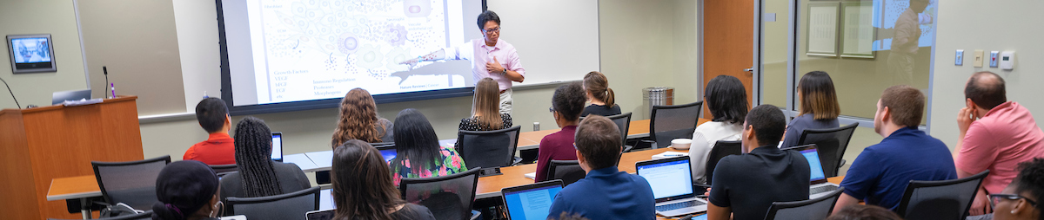
Supporting Faculty with Resources & Services
INTEGRATED
Animal Resources Program
Office of Clinical Research
Office of Sponsored Programs
Regulatory Affairs & Research Integrity
  IRB
  IACUC
  Monitoring & Oversight
  Research Integrity Office
Research Data
  Patient demographics
  Visit metadata
  Diagnoses
  Parent Location Distinction
EXPANDED
All CTSA Resources & Services
All CTSA Education Opportunities
Access to all Research Shared Services & Cores
Grant Development & Medical Editing Support

Slide 8
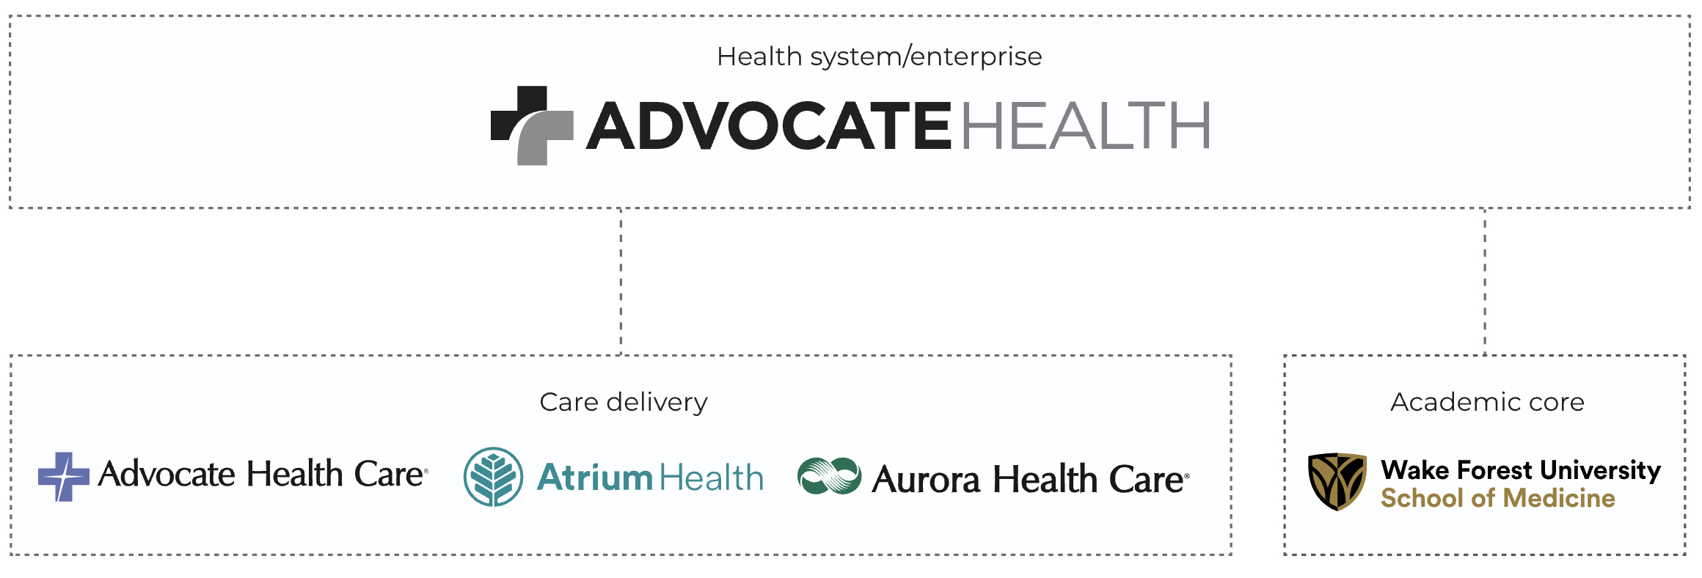
As the Academic Core, Wake Forest is responsible for the integration, organization, and direction of the Enterprise’s academic (education & research) activities and programs.

Slide 9

OUR GOALS
Today, the Wake Forest University School of Medicine (WFUSM) IRB serves as the Single IRB for the Southeast Region. By the conclusion of 2023:
The WFUSM IRB will expand operations to serve as the Single IRB for the full Advocate Health Enterprise.
All new studies submitted for approval from across the Enterprise will use this Single IRB.
All historically approved studies will be under the regulatory purview of this Single IRB.

Slide 10

Single IRB
Our Pathway
  April/May 2023
    Begin cross-regional discussions
    Review policies & procedures
    Discuss IT needs
  June/July 2023
    Align policies & procedures
    Plan Single IRB board-assignments
  August/September 2023
    Train staff and board members
    Provide researcher resources
    Develop research team training
  November/December 2023
    Test Software
    Combine FWA #’s
    Go Live
Notes:
‘

Slide 11
Progress on Concerns Discussed at Last Town Hall (Dec/Jan)

Slide 12
CORE Connect: Previous Challenges
Cross-Business Unit Functions
Inconsistent configuration across business units
Inability to efficiently exchange funds across business units
Lack of department- or mission-based security permissions
Reporting
Significant gap in reporting (both global SOM & grants-based)
Difficulty getting revenue to post accurately/timely
No validation for chart of accounts/combo edits
Labor Distribution
No effort distribution/workflow capability
Flawed costing of positions to PPM labor distribution design
System stability, specifically in the PPM labor areas (labor schedules, labor costs)

Slide 13
CORE Connect Updates
Weekly Academic-focused meetings with Research, IAS and CORE Connect leadership are in place to work through system challenges.
Cross-Business Unit Functionality Complete (new!)
  All Atrium Faculty & Staff have now been given access to WFUHS Business Unit (Wake BU)
  Allows team to perform transactions on research projects in the Wake BU
Labor Distribution has fully transitioned to the LD team under Nate Wagner, Director, Academic Accounting
  Communication venues for Labor Distribution updates:
  Academic Business Administrator (BA) Meetings
  Research Administrator (RA) Meetings
  BA and RA email listservs
  Department Research Admin Group Meetings
Effort Certification Pre-Review Cycles begin between the 17th & 22nd of January & July. Please note increase in requests for August & December & February

Slide 14
CORE Connect: AXIOM Reporting
New AXIOM Reporting Tools – 6 New Reports
Budget Income Detail_Trend_Academics_CYB
Comp_Ops & Budget Trend_Research_Multi Pass_Final_Wake
Income Statement Horizontal_PPM Projects_Fund100_CurrentBudget
Income Statement Horizontal_PPM Projects_Fund100_LastYear
Income Statement Horizontal_PPM Projects_Fund200_CurrentBudget
Income Statement Horizontal_PPM Projects_Fund200_LastYear
Details of the reports have been provided in April Research Rundowns. Link here: https://ctsi.wakehealth.edu/-/media/wakeforest/ctsi/files/announcement-files/2023/axiom-reporting-guide.pdf

Slide 15
CORE Connect and AXIOM Reporting
New Axiom Reports targeted to coincide with our April Month End Close
Fund Balance Report (PPM Actual Data) - Will be limited to one cost center at a time; team has also created a separate report with the same data that includes all projects at once. This can be filtered by PI, status, start date, end data, balances, etc – it will roll up any parameter within the report itself.
Payroll GL Distribution Report – essentially shows (by teammate and pay type) the payroll dollar details including the payroll accrual from the HCM module and where they are posted in the general ledger.
VALUE: The inclusion of the accrual from HCM allows for a clean reconciliation between the HCM payroll module and the general ledger.
PPM Labor Cost Distribution Report – essentially shows (by teammate and pay type) the payroll dollar details by project and the subsequent allocation to the general ledger account
VALUE: This calculation shows the allocation of the payroll dollars that are posted to the labor cost distribution department in the general ledger from HCM to the correct general ledger department that should be charged (the PPM module creates this distribution).
Reporting Solutions for Legacy PeopleSoft Reports (Open Tickets)
  Extramural Variance Report
  Extramural Award Summary by Department
  Teammate Distribution Summary for a Defined Period
  Job Code Summary (Grade, Mid, Min, Max)
  Faculty Compensation Reporting – REAs, Central Reporting

Slide 16
Key Performance Reporting Optimizations
Before – December 2022 Close
After – January 2023 Close
Data Extracts | CMHA | Wake | Navicent | Floyd
Income Statements Actuals to Budget by Department (GL Account -Detail) | ü | ü | ü | ü
Volumes & Statistics | ü | ü | ü | ü
Labor $s - Job Code/Name Detail by Department (Payroll Database) | ü | x | ü | x
GL Transaction Detail | x | x | x | x
AP Detail | x | x | x | x
Materials Management Detail | x | x | x | x
Data Extracts | CMHA | Wake | Navicent | Floyd
Income Statements Actuals to Budget by Department (GL Account -Detail) | ü | ü | ü | ü
Volumes & Statistics | ü | ü | ü | ü
Labor $s - Job Code/Name Detail by Department (Payroll Database) | ü | ü | ü | ü
GL Transaction Detail | ü | ü | ü | ü
AP Detail | ü | ü | ü | ü
Materials Management Detail | ü | ü | ü | ü
Axiom Win Phase 1
Jan close
Payroll Detail by Jobcode by Employee
Account balance support through the General Ledger Detail / Accounts Payable Detail / Materials Management Detail
Payroll and Account details in one report
Infrastructure built for Phase 2 initiatives and enhancements (System and Resources)
Axiom Win Phase 2
Targeted for April close
Payroll Hours to GL (Wake) – this isn’t a report, but the integration behind the scenes
PPM Labor Distribution (Academic Split for Dollars; Hours pending) – team is getting close on this, Chris confirming with FIN team whether this will be available with March close
Payroll GL Dist Report
PPM Actual Data (Fund Balance Report) - Report is written with all data elements in place. Marsha and Jeremy Smith are validating it now; if approved, this will be deployed with the reports for March close. Note that the report will be limited to one cost center at a time; we’ve also created a separate report with the same data that includes all projects at once. This can be filtered by PI, status, start date, end data, balances, etc – it will roll up any parameter within the report itself.

Slide 17
Research Administration Support Updates
Investigators are now able to fully execute clinical trial agreements ready for signature even if IRB-approval is pending.
OCR Customer service surveys implemented to obtain real-time performance feedback from Investigators at activation and termination of awards.
OCR Contract negotiation and execution timelines have improved since last Town Hall.
Parallel submission process to eIRB, Huron and OnCore vs sequential submission process would further streamline efficiency.
Leadership Contacts
Debbie Sanabria (Director of Pre-Award, Office of Sponsored Programs): dsanabri@wakehealth.edu
Sharon Brooks (Director of Post-Award, Office of Sponsored Programs): sgbrooks@wakehealth.edu
Michele Gordon (Director of Contracts, Office of Sponsored Programs): mgordon@wakehealth.edu
Ryan Favreau (Director of Systems & Reporting, Office of Sponsored Programs): rfavreau@wakehealth.edu
Kara King (Director of Research Admin. Business Partners, Office of Sponsored Programs): Kara.King@atriumhealth.org
Christina Rivera (Director of Pre & Post-Award, Office of Clinical Research): Christina.Rivera@atriumhealth.org

Slide 18
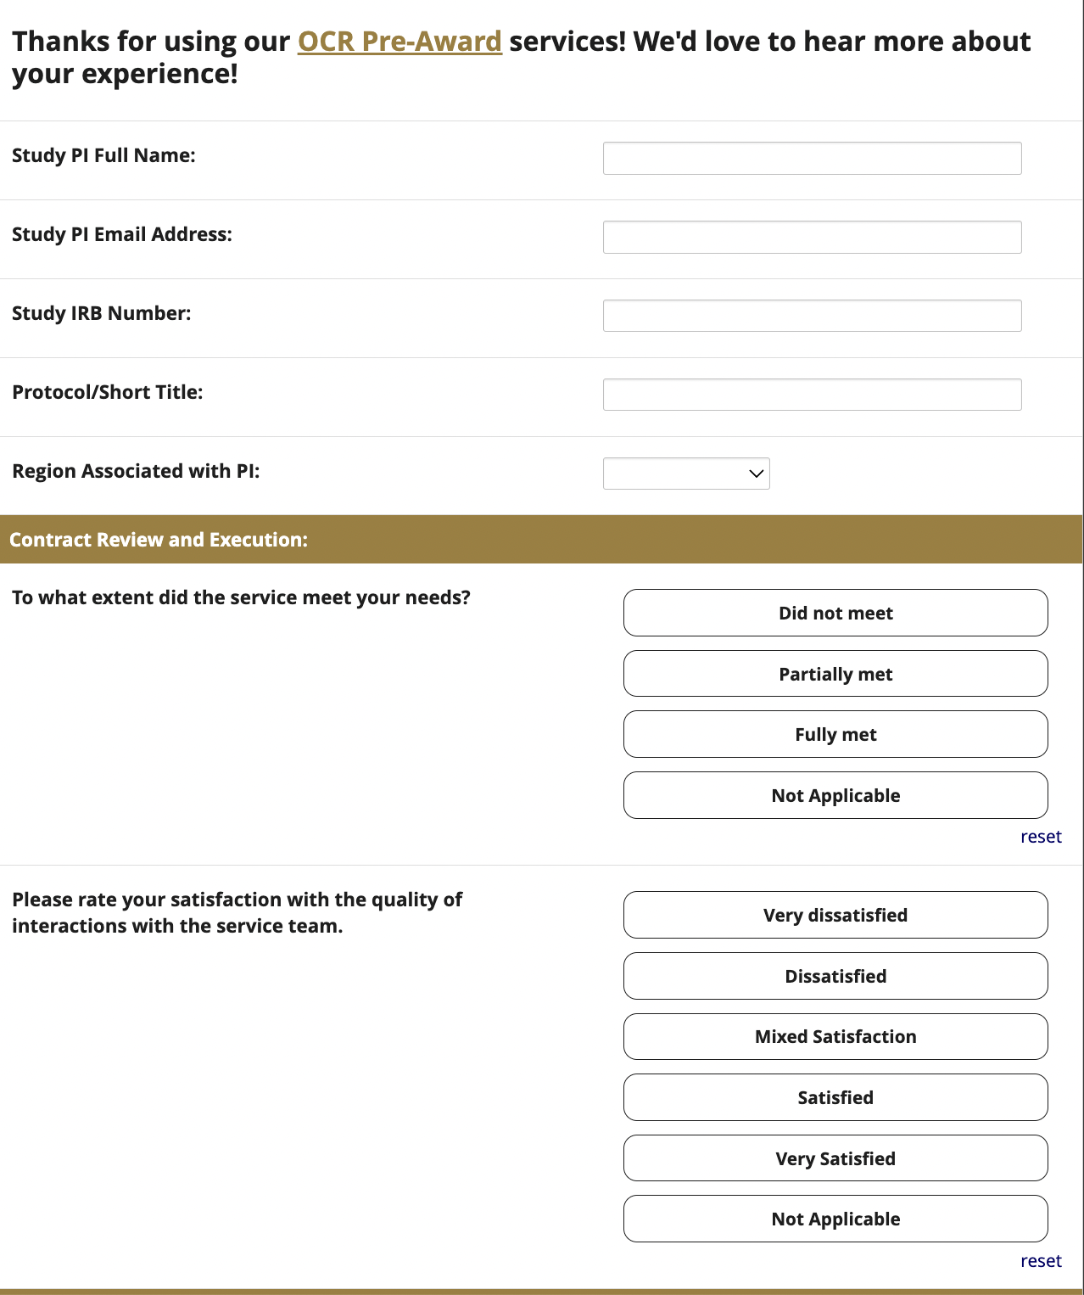
Research Infrastructure: OCR Pre-Award Survey
Sent out 46 Surveys after study activation.
Only 10 sent back completed.

Slide 19
Research Infrastructure: OCR Pre-Award Survey Results

Slide 20
Research Infrastructure: OCR Pre-Award Survey Results

Slide 21
Research Infrastructure: OCR Pre-Award Survey Results

Slide 22
Research Infrastructure: OCR Pre-Award Survey Results

Slide 23
Research Infrastructure: OCR Contract Timelines
Target

Slide 24
Research Infrastructure: OCR Contract Timelines

Slide 25
New Initiatives Since Last Town Hall

Slide 26
Clinical Trials Executive Committee
Name | Title
Jamy Ard (co-Chair) | Vice Dean, Clinical Research
Ebony Boulware (co-Chair) | Dean and Chief Science Officer
Anthony Asher | President & Enterprise Service Line Leader, Atrium Health Neurosciences Institute
Ralph D’Agostino Jr. | Director, Biostatistics Shared Resource, Comprehensive Cancer Center
Kristie Foley | Vice Dean for Research Integration & Strategy
Nina Garlie | VP Clinical Trials Research, Advocate Aurora Research Institute
David Herrington | Prof of Cardiology, Co-Director Cardiovascular Science Center
Kevin High | EVP, Health System Affairs
Marc Kowalkowski | Clinically Integrated Research, Associate Professor, Atrium Health
Andy McWilliams | Medical Director, Data and Analytics
Ruben Mesa | Director, WFBCCC & Vice Dean, Cancer Programs
Sandra Moore | DIO, GME, Associate Professor of Pediatrics, Atrium Health Navicent
Chris O’Byrne | VP, WFUSM Administration & Operations
Selvin Ohene | AVP, Assistant Dean, Research Operations
Geoffrey Rose | President of Sanger Heart & Vascular Institute
Membership: Multi-Disciplinary; representatives from all Regions.
Purpose:
Articulate the Future Vision of Clinical Trials for the Enterprise
Develop and finalize an RFP to initiate a consulting relationship that assists in the design of a best-in-class clinical trials infrastructure.

Slide 27
Clinical Trials Executive Committee
[Working] Vision Statement:
“By 2030, Advocate Health will be the nation’s premier health system for high impact clinical research that advances health, hope, and healing, for all.”
Our intent is to become the go-to destination for traditional clinical trials – which would include the ability to conduct trials entirely within the health system.
RFP development in final stages. Preparing for release in May.
We aim to engage a consulting partner to help us develop a strategy to integrate and streamline our clinical research enterprise to fully harness Advocate Health’s capabilities and scale and to maximize the impact of our research on the health of the communities we serve.

Slide 28
Other Research Activities
Evaluating Approach to Institutionally-Sponsored Research Centers
  Release Plans: Summer, 2023
Creating a Strategy for Central versus Local Research Infrastructure
  Release Plans: TBD

Slide 29
Research Admin Virtual Office Hours
Office | Team | Subject Area | Web Link | Day of the Week | Time Available
Regulatory & Research Integrity (RARI) | IRB | eIRB submissions & facilitated reviews | IRB - eIRB Submissions and Facilitated Reviews [wakehealth.webex.com] | Tuesday | 11:00am – 12:00pm
Interdisciplinary Research | IRT | How to use iLab | IRT ILAB | Wednesday | 9:00am – 10:00am
Office of Clinical Research (OCR) | Pre-Award | Creating New Studies in OnCore | OCR Pre Award - Creating New Study in OnCore [teams.microsoft.com] | Wednesday | 2:00pm – 3:00pm
Office of Clinical Research (OCR) | Pre-Award | Non-Federal Clinical Contract Submissions in Huron (CDA/CTA) | OCR Contracts - Non-Government Agreements (CDA/CTA) [teams.microsoft.com] | Monday | 10:00am – 11:00am
Office of Clinical Research (OCR) | Pre-Award | Industry Clinical Funding Proposal submissions in Huron | OCR Contracts - Huron Funding Proposal Submissions [teams.microsoft.com] | Tuesday | 10:00am – 11:00am
Office of Clinical Research (OCR) | Post-Award | Logging Visits & Milestones in OnCore | OCR Post Award Finance - Logging Visits and Milestones in OnCore[teams.microsoft.com] | Tuesday | 3:00pm – 4:00pm
Office of Clinical Research (OCR) | Post-Award | Viewing OnCore & CORE Connect Financials | OCR Post Award Finance - Viewing OnCore and CORE Connect Financials | Wednesday | 3:00pm – 4:00pm
Office of Clinical Research (OCR) | Post-Award | Managing Research Participants in EPIC | OCR Post Award - Research Participants in Epic [teams.microsoft.com] | Tuesday | 3:00pm – 4:00pm
Office Hours begin Monday, May 1st!

Slide 30
Research Admin Virtual Office Hours
Office | Team | Subject Area | Web Link | Day of the Week | Time Available
Office of Sponsored Programs (OSP) | Pre-Award | Huron Proposal Submissions (Federal, State, Foundation) | OSP Pre-Award Open House | Wednesday | 11:00am – 12:00pm
Office of Sponsored Programs (OSP) | Contracts | Huron Agreements & Subcontracts | OSP-Contracts | Wednesday | 10:00am – 11:00am
Office of Sponsored Programs (OSP) | Post-Award | Working with Project Financial Information (CORE Connect) Post Award Management Topics (Set-Up to Closeout) Compliance Questions | OSP Post-Award | Thursday | 1:00pm – 2:00pm
Office of Sponsored Programs (OSP) | Research Administration Business Partners (RABP) | Proposal Development Budget to Actuals Reporting (CORE Connect) Cayuse Proposals through Atrium (as required by Sponsor) | RABP Office Hours [teams.microsoft.com] | Wednesday | 2:00pm – 3:00pm
Office of Sponsored Programs (OSP) | Systems & Reporting | Huron Grants & Agreements Grants Financial Dashboard | OSP Systems & Reporting | Tuesday | 9:00am – 10:00am *3rd Tuesday of the month in person at BPP
Office Hours begin Monday, May 1st!

Slide 31
Questions & Discussion
Next Town Hall: August 8th
(W-S: Biotech Place)
Fall Research Symposium: September 26th (W-S)
Kfoley@wakehealth.edu
Sara.Stanley@wakehealth.edu
sohene@wakehealth.edu

