Slide 1
Research Town Hall: August 08, 2023
Jamy Ard, MD
Vice Dean for Clinical Research
Kristie Foley, PhD MS
Vice Dean for Research Strategy & Integration
Selvin Ohene, MS
AVP & Assistant Dean, Research Operations
Rachel Woodside, MS
Director of Administration, Office of the Dean
Tara Aguilar
AVP, Information Systems

Slide 2
Agenda Topics
Research Plan for Excellence (RPE) Updates
Charlotte Research Hub
Clinical Trials Request for Proposals (RFP)
Extramural Funding Update
Information Systems (IS) Updates

Slide 3
Research Plan for Excellence (RPE) Updates
Faculty recruitment

Slide 4
Recruitment Summary – Q1/Q2
28 signed offers
18 Research Plan for Excellence
10 Dept. based
12 pending/in negotiation
4 scheduled onsite visits

Slide 5
Status Dashboard

Slide 6
Cross-Department/Center Collaboration

Slide 7
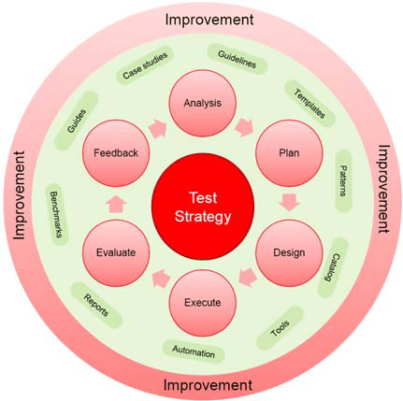
RPE is doing what it was intended to do….
It has also tested our recruitment and onboarding process for faculty in unprecedented ways

Slide 8
Recruitment Navigation + Training
Weekly virtual office hours with the Dean’s Office team
12-1pm Wednesdays OR can be scheduled at an alternative time with the team
Link: WFUSM Faculty Recruitment Navigation

Slide 9
Faculty Recruitment Standard Operating Procedure

Slide 10
Stakeholder Feedback
Department Chairs Ruth Benca (Clinical) Lindsay Thompson (Clinical) Kristie Foley Sara Jones Michelle Mielke Joel Stitzel Business Administrators Lynn Myers Deanna Sizemore Dawn Smith Heather Hooks Talent Acquisition Team Lindsay Teague | Faculty Affair Team Nick Smith-Stanley Finance David Weaver Mike Kennedy University Group Practice Mary Rice

Slide 11
The new process will:
Creating a ‘single point of entry’ for recruitment of research intensive faculty
Create parallel processes for recruitment to create more rapid timing
Replace a “paper-based” system with an electronic system
Evaluate our recruitments according to RPE expectations
E.g., #, rank distribution, cross-funding
Evaluate our process whereby increasing efficiency
E.g., identify “bottlenecks” and optimize experience

Slide 12
Dissemination Plan + Next Steps
Launch:
Current - Pilot testing with two departments
September - goal is to fully launch SOP to all RPE teams and Winston region departments/release status dashboard
November – expand to incorporate Charlotte department workflow
October – expand to incorporate clinical workflow
Communication + SOP (includes links to electronic REDCap forms)
Dept. Chairs
Center/Institute leaders
Business Administrators
Create access + share status dashboard link
Continue to hold weekly navigation + offer training to BA’s and other stakeholders
Finalize Open Recruitment dashboard and legacy funding sources
Target Date: September, 2023

Slide 13
Charlotte Research Hub
Location proposal

Slide 14
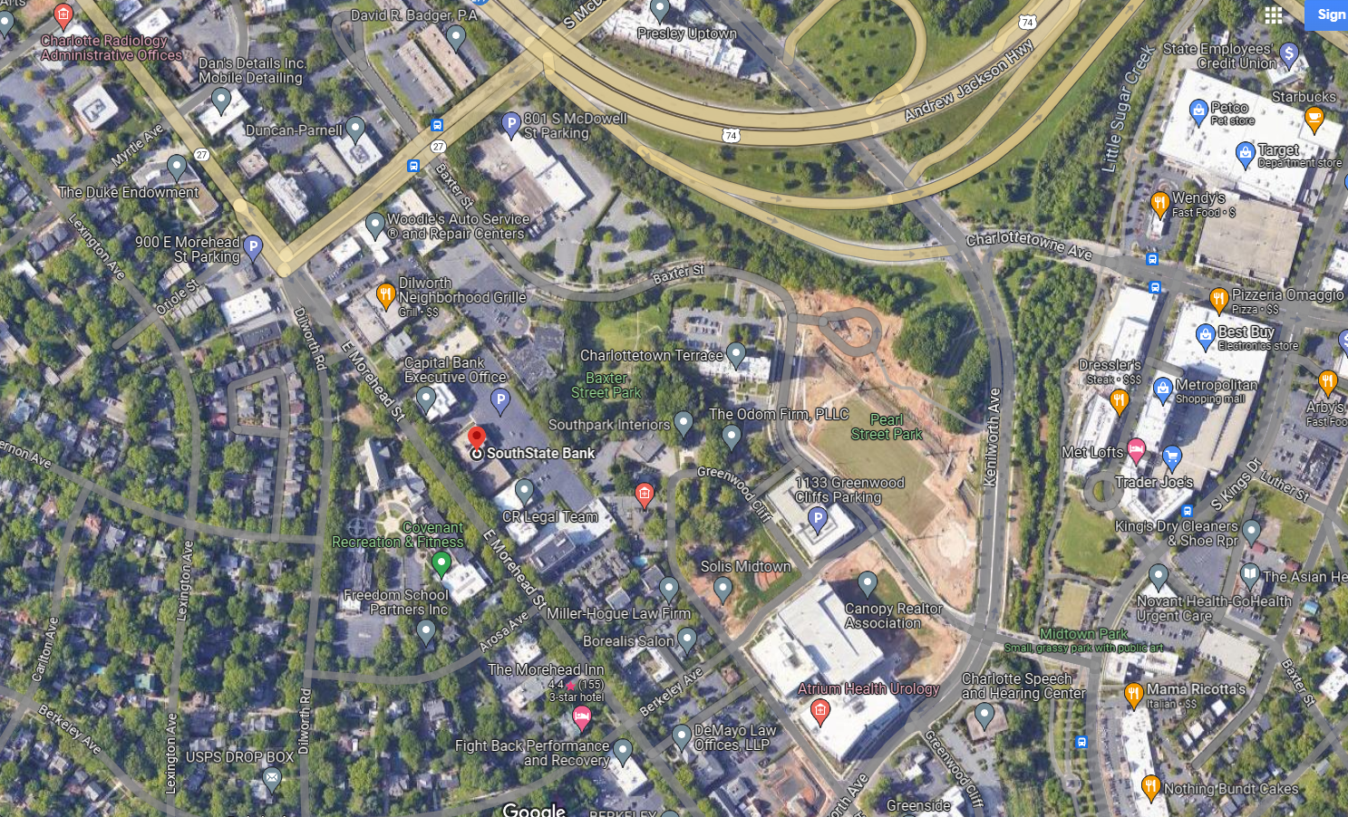
Proposed Location
1043 E. Morehead Street, Charlotte, NC 28204

Slide 15
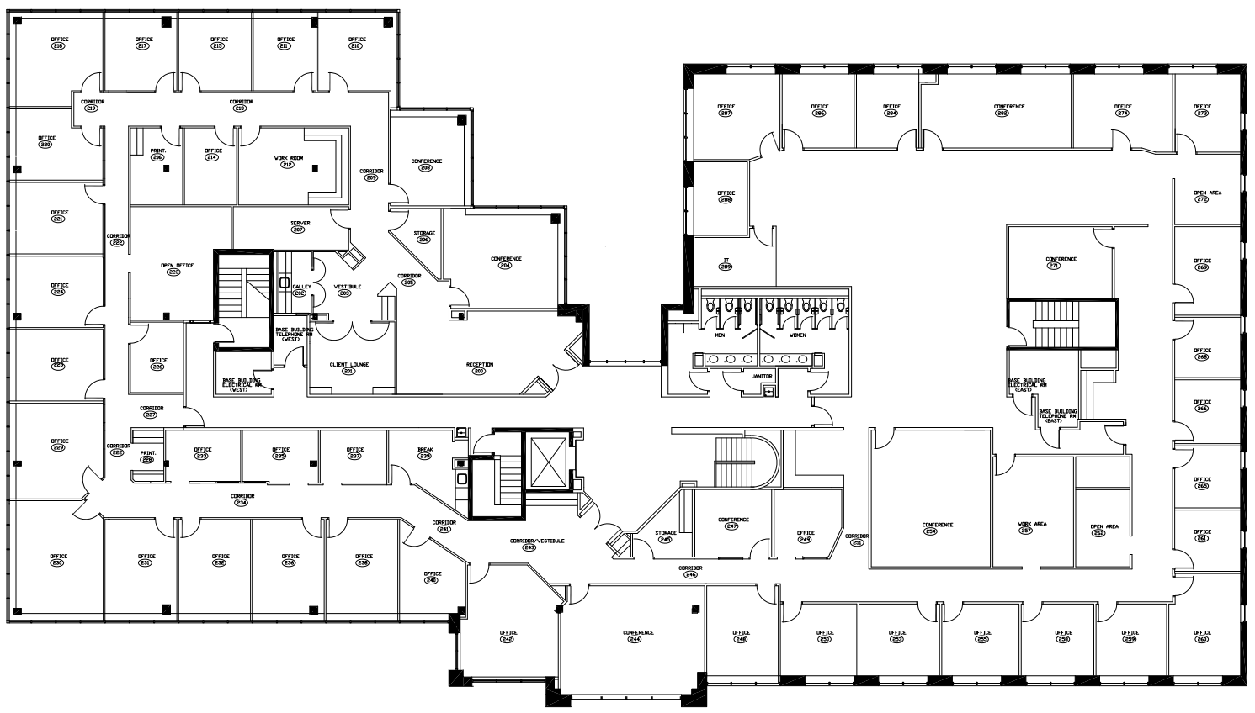
2nd Floor | South State Bank Building
21 Enclosed Spaces
12 Open Workstations
1 Large Conference Room
2 Medium Shared Conference Rooms
Multiple Office Support Spaces
1 Large Breakroom
Shared
Dedicated

Slide 16
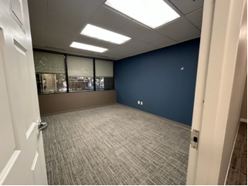
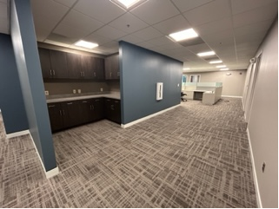
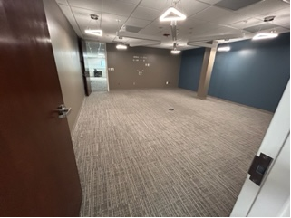
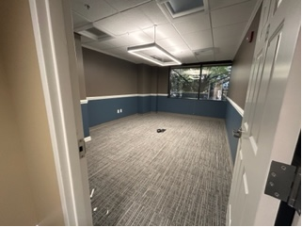
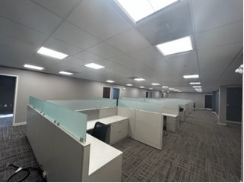
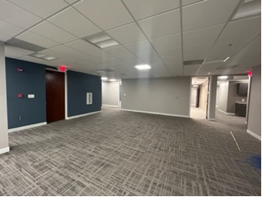
2nd Floor Images
OFFICE
OFFICE SUPPORT
LARGE CONF. ROOM
SHARED MEDIUM CONF. ROOM
OPEN WORKSTATIONS
OPEN AREA
(ADJACENT TO WORKSTATIONS)

Slide 17
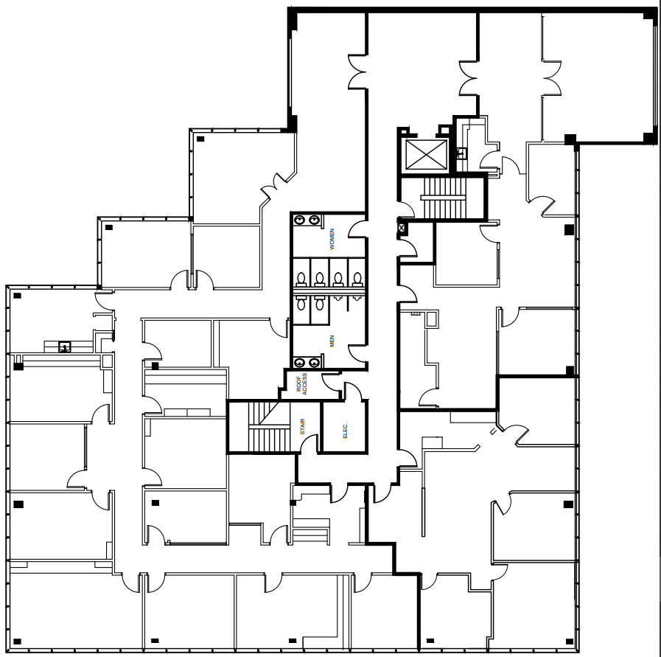
3rd Floor | South State Bank Building
Reception and Waiting Area
15 Enclosed Spaces
1 Breakroom
2 Office Support Spaces
Dedicated

Slide 18
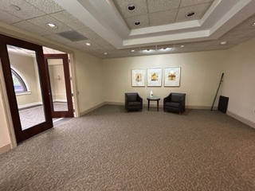
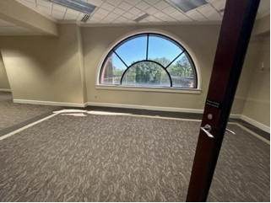
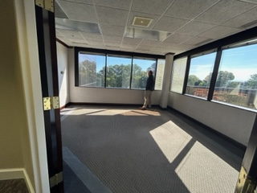
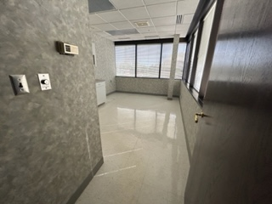
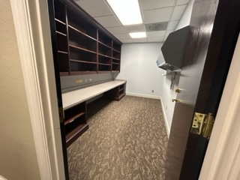
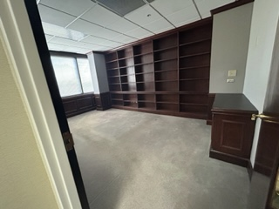
3RD Floor Images
ELEVATOR LOBBY
RECEPTION/ENTRANCE
ENCLOSED ROOM
BREAKROOM
OFFICE SUPPORT
ENCLOSED ROOM

Slide 19
Clinical Trials Executive Committee
Clinical Trials Request For Proposal (RFP)

Slide 20
Membership
David Herrington
Christopher O’Byrne
Sandra Moore
Tony Asher
Nina Garlie
Selvin Ohene
Kristie Foley
Ruben Mesa
Ralph D’Agostino
Kevin High
Geoffrey Rose
Andrew McWilliams
Marc Kowalkowski
Ebony Boulware

Slide 21
Project
Strategic planning
integrate and streamline our clinical research enterprise to fully harness Advocate Health’s capabilities and scale
maximize the impact of our research on the health of the communities we serve

Slide 22
Working Vision Statement
“By 2030, Advocate Health will be the nation's premier academic learning health system for high impact clinical research that advances health, hope, and healing, for all.”

Slide 23
Update
Distribute Request for Proposal (RFP)
Initial review of proposals
Finalist interviews (end of July)
Recommendation to Dean (mid August)
Implementation of planning process (Fall 2023)

Slide 24
Research Admin Updates
Extramural funding

Slide 25
Extramural Funding Portfolio
In Millions

Slide 26
Extramural Funding Portfolio
 | Jan 2023 | Feb 2023 | Mar 2023 | Apr 2023 | May 2023 | June 2023
Industry | $3M | $7M | $16M | $19M | $23M | $27M
Federal | $14M (NIH: $11M) | $29M (NIH: $23M) | $48M (NIH: $36M) | $61M (NIH: $47M) | $76M (NIH: $60M) | $102M (NIH: $77M)
State/ Non- Profit | $26M | $29M | $38M | $43M | $45M | $52M
Total | $43M | $64M | $103M | $123M | $143M | $181M
In Millions

Slide 27
Information Systems (IS) Updates
Microsoft Office
Email retention

Slide 28
IT Updates
August 1: Outlook Personal Folders (PST files):
The use of an Outlook Personal Folder (PST) will be limited to read-only. This will reduce our cybersecurity risk as PST files aggregate large amounts of emails and data in one location. You will still be able to access emails already in these folders, including forwarding them & opening any attachments they have. You will need to restart your computer any time after 8 pm Tuesday, or it will automatically be restarted Friday, August 4 at 10 pm.
August 14 through September: Microsoft Office 365:
Teammates who do not need the full capabilities of the desktop version of Microsoft Office will transition to Microsoft Office on the web. For those teammates, the desktop versions will remain installed but will be limited to viewing and printing. Microsoft Office on the web will be required to create or edit. Teammates will be notified via email in advance of the change. The following teammates will automatically retain the desktop applications:
Supervisors and above
Corporate operations teammates
Teammates with an academic designation**
Administrative staff assistants
October 2: Upgrade from Skype to Teams:
We will upgrade from Skype for Business to Microsoft Teams as the communication tool for chat, peer-to-peer audio/video calls, and meetings (including phone dial-in). Teammates may use all versions of Teams, including desktop, mobile, and web. Access to WebEx will not be impacted at this time.
October 10: Email Retention
The organization is moving to a 2 year retention policy for emails. This aligns with the enterprise standard. Academic teammates** are not included in this and will have a separate exception policy currently being defined.
**Information Technology has worked with Wake Forest University School of Medicine leadership to identify those teammates who are granted an academic designation.
** An exemption request form will be available for users in servicenow
https://carolinashealthcare.sharepoint.com/sites/learning/SitePages/Quick-Start-for-Office-on-the-web.aspx [carolinashealthcare.sharepoint.com]

Slide 29
Questions & Discussion
Fall Research Symposium: September 26th (W-S: Biotech Place)
Next Town Hall: December 14th
jard@wakehealth.edu
Kfoley@wakehealth.edu
sohene@wakehealth.edu

