Slide 1


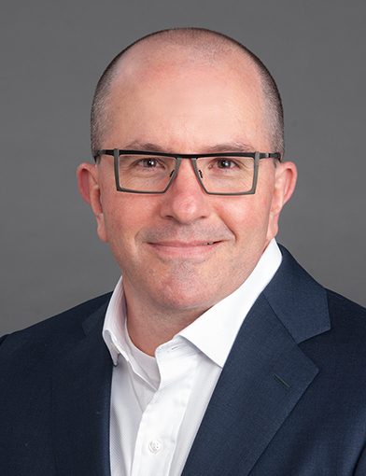
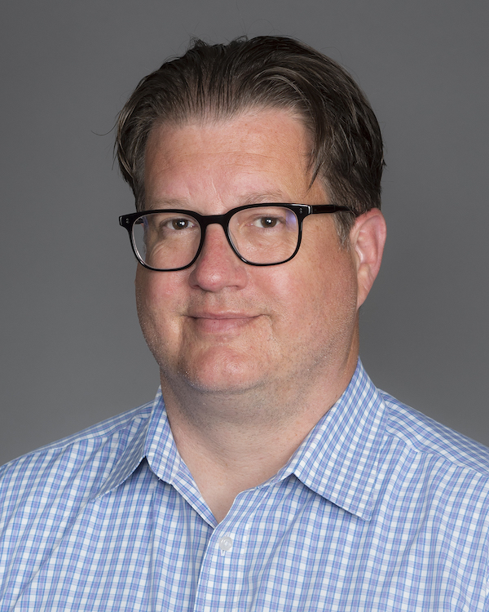
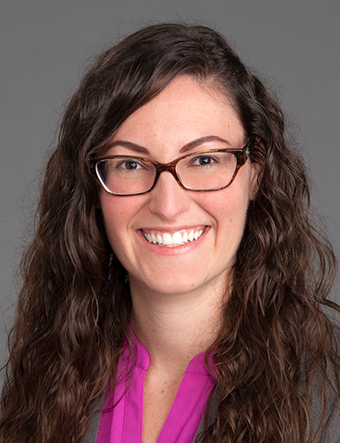
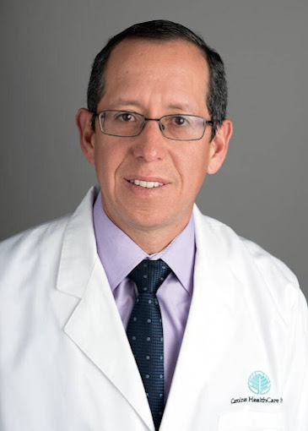

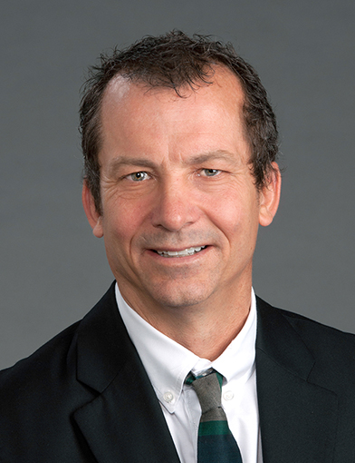
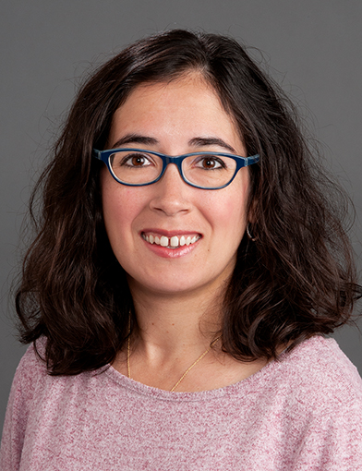
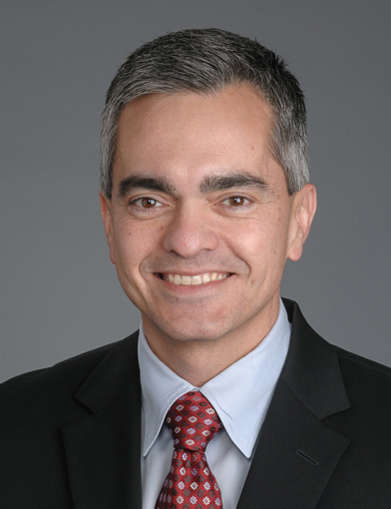

CTSI 2023 CLINICAL/POPULATION HEALTH
PILOT RECIPIENTS
Paul Laurienti, MD, PhD
Radiology
“Multi-omics Analysis of Brain-Body Interactions Identifying Signatures of Hazardous Alcohol Use and Craving”
*co-funded by Center for Addiction Research
Justin Moore, PhD Implementation Science
“Dissemination and Implementation of Brenner FIT in the Atrium Health Enterprise“
*co-funded by Center for Prevention Science in Child and Family Health
Jaime Speiser, PhD, MSc
Biostatistics and Data Science
“Standardized, Harmonized Repository of Longitudinal Aging Data (SHARE Data)”
*Awarded a $10,000 supplement from the Wake Forest Center for Biomedical Informatics
Julio Mateus Nino, MD
Obstetrics & Gynecology
“Implementation of a Mediterranean Diet Program for Overweight and Class 1 Obese Pregnant Women in a Low-Resource Clinical Setting”
*co-funded by the Center on Diabetes, Obesity, and Metabolism
Carl Westcott, MD
Renal Transplant, General Surgery
“Image Based Intra-Operative Real-Time Quality Assurance (IBIO-RT QA)”
Atalie Thompson, MD, MPH
Ophthalmology
“A Feasibility Study of Screening for Visual Impairment in Older Adults”
Michael Jones, DPM
Orthopaedic Surgery
“Infracalcaneal Peppering Injection Technique for Chronic Plantar Fasciitis: Protocol for a Parallel Randomized Clinical Non-Inferiority Trial”

Slide 2
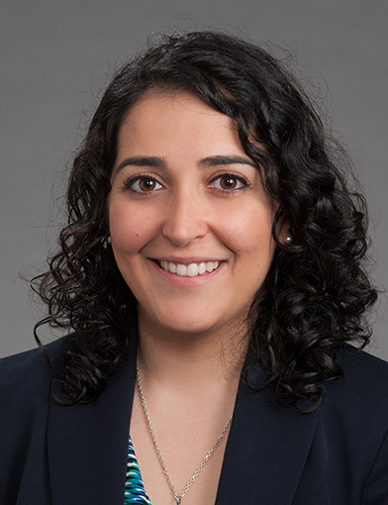
CTSI 2023 BASIC/TRANSLATIONAL
PILOT RECIPIENT
Elaheh Rahbar, PhD
Biomedical Engineering
“Development of a Three-Dimensional Human Hepatic Cell Culture Model for the Study of Allele-Driven Variations in PUFA and Lipid Metabolism”
CTSI 2023 TRANSLATIONAL SCIENCE
PILOT RECIPIENT
Michael Supples, MD
Emergency Medicine
“Overcoming Barriers to Physical Activity Behavior Change Among Emergency Medical Services Professionals”
The Intramural Research Support Committee (IRSC) reviewed 34 letters of intent and 22 full grant applications. There were 14 applications submitted to the Clinical/Population Health RFA, 6 applications to the Basic/Translational RFA and 2 applications to the Translational Science RFA.

