Slide 1
IACUC Personnel Training Records
What you need to know to be compliant

Slide 2
Why?
We need to comply with federal regulations
We need to maintain continued accreditation with AAALAC International
USDA
AWA
OLAW
The Guide for the Care and Use of Laboratory Animals

Slide 3
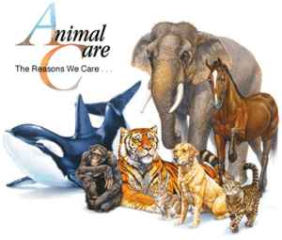
Animal Welfare Act
Federal
Regulations
“It shall be the responsibility of the research facility to ensure that all scientists, research technicians, animal technicians, and other personnel involved in animal care, treatment, and use are qualified to perform their duties.”

Slide 4
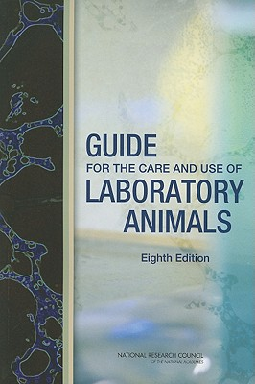
The Guide – Chapter 2 Training and Education
AAALAC International Accreditation
“All personnel involved with the care and use of animals must be adequately educated, trained, and/or qualified in basic principles of laboratory animal science to help ensure high-quality science and animal well-being.”
“All Program personnel training should be documented.”

Slide 5
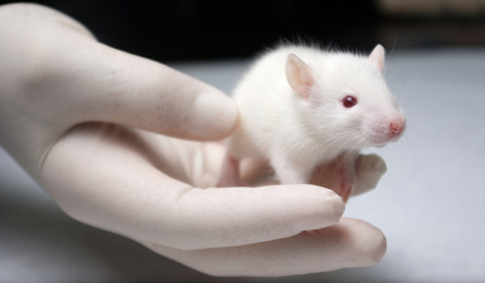
Steps to maintain compliance
Complete required online AALAS Learning Library courses
Complete handling class for the species you will be working with
Maintain a personal training log

Slide 6
Step one: Required Online Training: AALAS Learning Library
Wake Forest IACUC will determine required courses
Course requirements are based on the type of research and the species used
Required classes will be prompted automatically in eIACUC by personnel amendments or new protocols.

Slide 7
Requirements from the AALAS Learning Library
3 base courses for all new personnel
Species specific courses for each species used
Anesthesia courses for personnel utilizing anesthesia or performing surgery
Rodent breeding courses for personnel responsible for rodent breeding colonies
Bio-safety course for personnel working in BSL-2 laboratories
“Refresher” course for established personnel every 3 years

Slide 8
Other Benefits of AALAS Learning Library
Lots of other courses available (at no charge) to personnel at any time:
AALAS certification prep, conversions/calculations, management, other biomethodologies, etc
Use as reference library, tests are not required unless credit is needed
Transfer credits from other institutions for incoming personnel
Online & printable transcripts are available through AALAS Learning Library at anytime

Slide 9
Step Two
All laboratory personnel must keep a personal training log
Can be:
folder, three-ring binder, etc
Shall contain:
any documentation or certificates
From:
in-house training, training obtained from off site, and training received prior to employment at Wake Forest

Slide 10
Why do I need Personnel Training Log?
Trainings records will need to be made available during semi-annual inspections by the IACUC.
Could be requested during a site visit by AAALAC or an inspection by USDA.

Slide 11
Organizing your Personnel Training Log
Log can be divided into categories if desired
For example:
Laboratory Specific Training Log (provided by IACUC)
In house training certificates & individual procedure training records
Off Site Continuing Education certificates/documents
Relevant professional accolades
MD, DVM, pHD, BS, RVT, AALAS certifications, Academy of Surgical Research certifications, etc.

Slide 12
Laboratory Specific Procedure Training Log
Where:
Copies available from IACUC (make it your first page)
Why:
Provides a quick glance “overview” of individual’s training history
Highlights:
Training goals for laboratory specific procedures
Measures of proficiency
Training plan
Recertification dates
Personnel Attestation
Notes section
Offsite and additional training

Slide 13
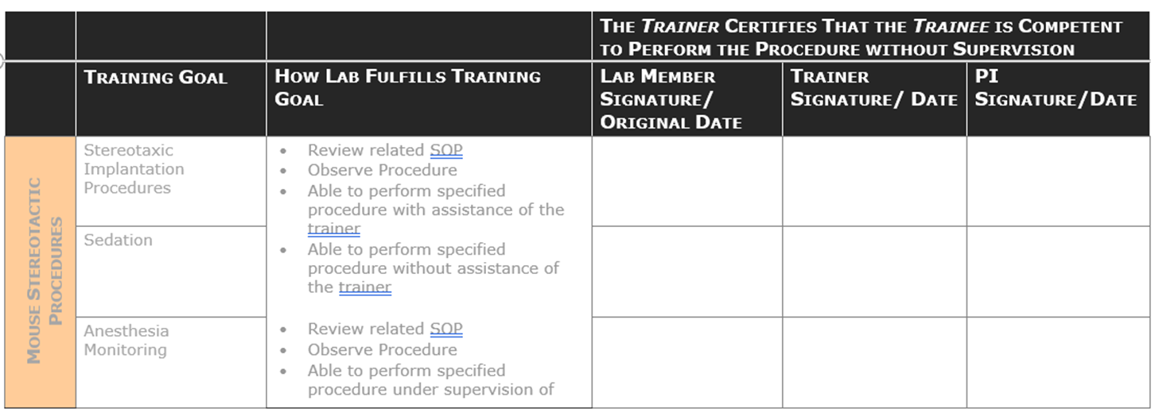

Slide 14
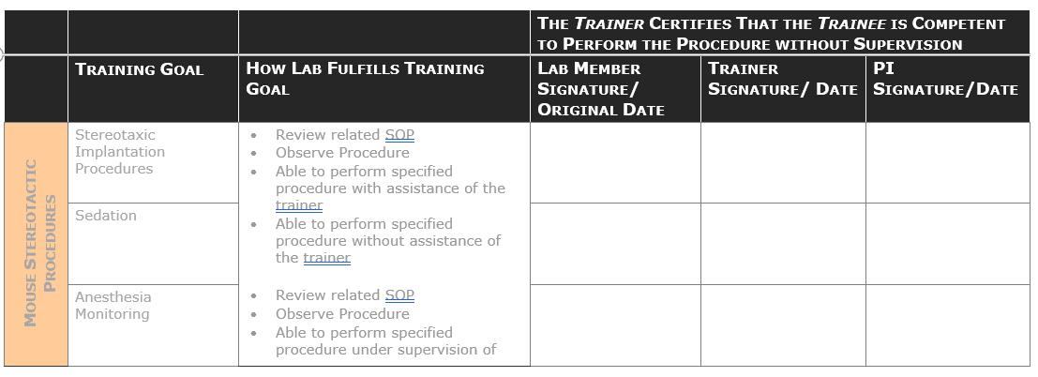
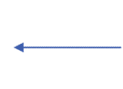
Attestation: | I have read and understand the following Animal Care and Use Protocols and have received training for the specific tasks I will be performing under these protocols/amendments:
Protocol(s):
Lab Member Name: | Lisa Colvin
Principal Investigator(s) Name: | David Lyons
A24-346
Every protocol the training will apply to.
New protocols may be added in the future.
Training category, i.e., stereotactic surgery
Includes the training plan for the related procedure, i.e. how lab member will become proficient in performing the procedure.
Examples: Observation of the procedure, supervised performance of procedure, able to perform without assistance, etc.
Three signatures (lab member, trainer & PI) signify that the person is fully trained and can no perform the procedure without supervision
The specific procedure per category, i.e., sedation, implantation, intubation, etc.

Slide 15
Questions???
Contact:
Amanda Dillard
Laboratory Animal Training Coordinator
716-6738
or
Wake Forest IACUC
administrative staff
716-3540

