Slide 1
Laboratory Animal Orientation
Amanda Dillard, Animal Training Coordinator
Lisa Colvin, IACUC Coordinator
Miranda Moore, Protocol Analyst II, IACUC

Slide 3
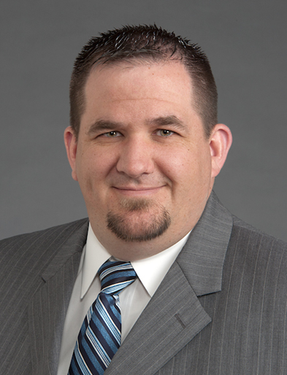
Institutional Official (IO)
Chris O’Byrne
Vice President and Associate Dean
Research Administration and Operations

Slide 4
Groups To Know
ARP – Animal Resources Program
Procurement
Husbandry
Veterinary Care/Support
Pathology Services
Enrichment
Wake Forest IACUC (Institutional Animal Care and Use Committee)
Protocol Submission & Review
Protocol Amendments
Training
Animal Research Oversight & Outreach
PAMs (Post Approval Monitoring)
Adverse Events
Non-Compliance

Slide 5
ARP – Animal Resources Program
3 Campuses:
Winston Salem
Bowman Gray, Downtown and Reynolda
Clarkson
Charlotte
All Have:
Veterinary Staff
Operations Staff
Access to Pathology Staff
Access to Behavioral Management and Animal Welfare Staff

Slide 6
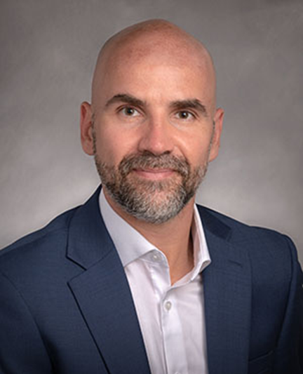
Attending Veterinarian (AV)
Dr. Mathias Leblanc, PhD, DVM, DACLAM
Associate Professor Pathology and Comparative Medicine
Director Animal Resources Program

Slide 7
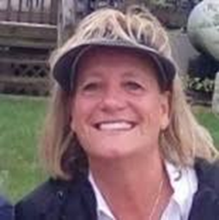
ARP Associate Director of Operations
Vickie Hardy, BS, LATG, CMAR

Slide 8
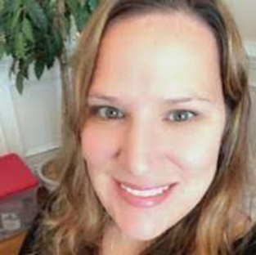
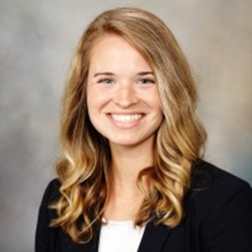
Winston-Salem Campus
ARP Assistant Director : Erin Mitchell, DVM, DACLAM
ARP Staff Veterinarian: Katie LaVallee, DVM, DACLAM
ARP Operations Manager: Gaye Hodges, BS, LATG, CMAR
Dr. Erin Mitchell
Dr. Katie LaVallee

Slide 9
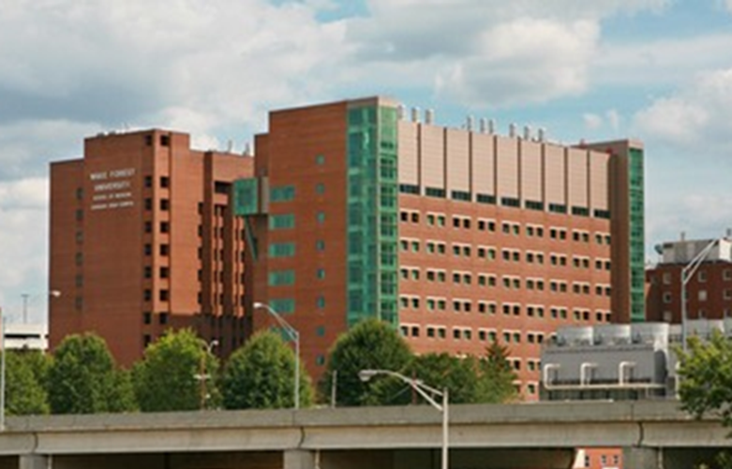
Winston-Salem Campus (Medical Center and Undergraduate Campus)
Bowman Gray: NRC, Hanes and Gray
Downtown: Dean, PTCRC and BTP
Reynolda: Reynolds Building and Wake Downtown

Slide 10
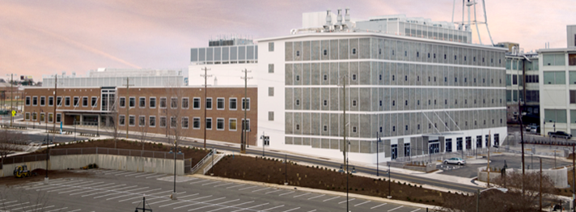
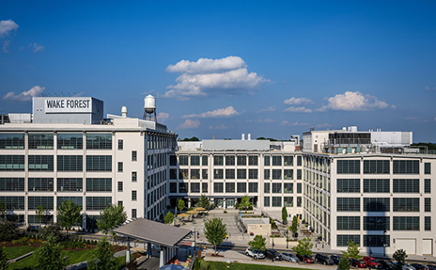
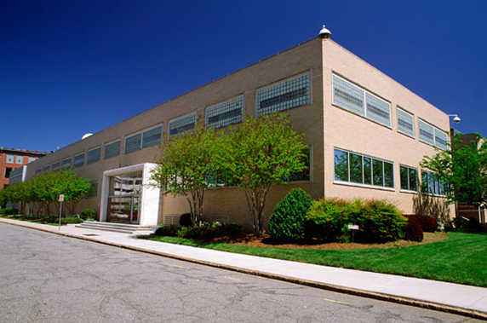
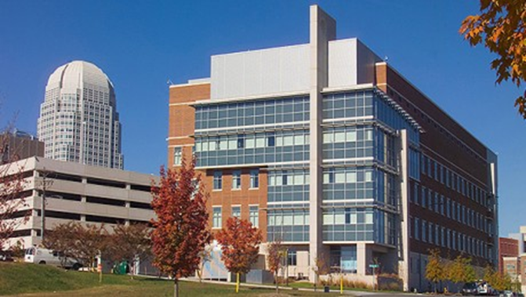
Winston-Salem Campus (Downtown)
BioTech Place
Wake Downtown
PTCRC
Richard Dean Biomedical Research Bldg.

Slide 11
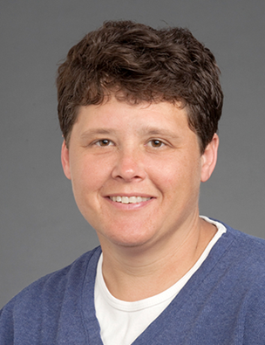
Clarkson Campus
ARP Associate Director: Mel Gee, DVM, DACLAM
ARP Staff Veterinarian: Andre LeGrande, DVM
Operations Manager: Suzy Mounsey, BS, LATG, CMAR
Dr. Mel Gee

Slide 12
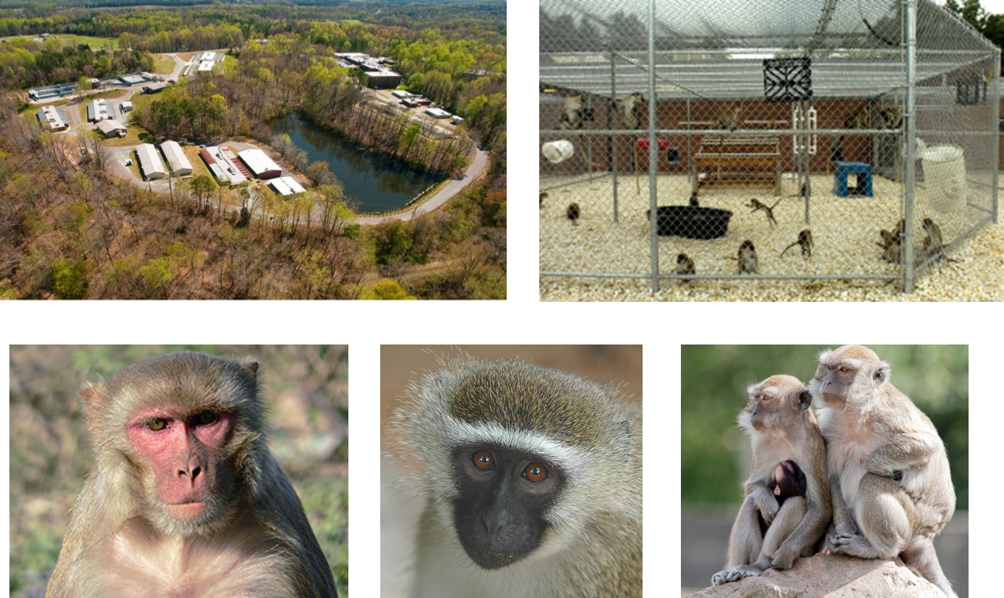
Clarkson Campus Wake Forest University Primate Center

Slide 13
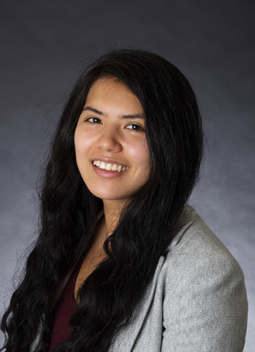
Charlotte Campus
ARP Staff Veterinarian: Melissa Stair, DVM, DACLAM
ARP Operations Manager: Vickie Hardy, BS, LATG, CMAR
Dr. Melissa Stair

Slide 14
Charlotte Campus (Cannon Research Center)

Slide 15
ARP Office
Badge Access Forms
Animal Procurement
Due by Monday 5pm
Animal Transfer Requests
Diagnostic Necropsy Requests
General email: arpoffice@wakehealth.edu
Pager website:
http://spokwebxchg.wakehealth.edu/webxchange/Default.aspx?rd=y

Slide 16
Diagnostic Pathology Services
Nancy Kock, DVM, PhD, DACVP
Anatomic Veterinary Pathology Training Director
Dr. Nancy Kock
Faculty veterinary pathologists & on-site residency training program provide services for all species housed at Wake Forest
Complete necropsy report & biopsy services available
Submit death report to the ARP Office
Necropsy Suites are available on all campuses at no charge
Sign up for use
Clean up after yourself

Slide 17
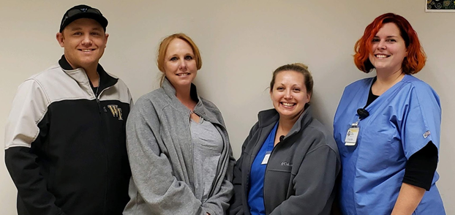
Behavioral Management and Animal Welfare Program Staff
Manager: Kelsey Lambert, BS, LATG
Behavior Technicians:
Michael Kimmer, LATG
Terry Taylor, ALAT
Becky Collins, MSc

Slide 18
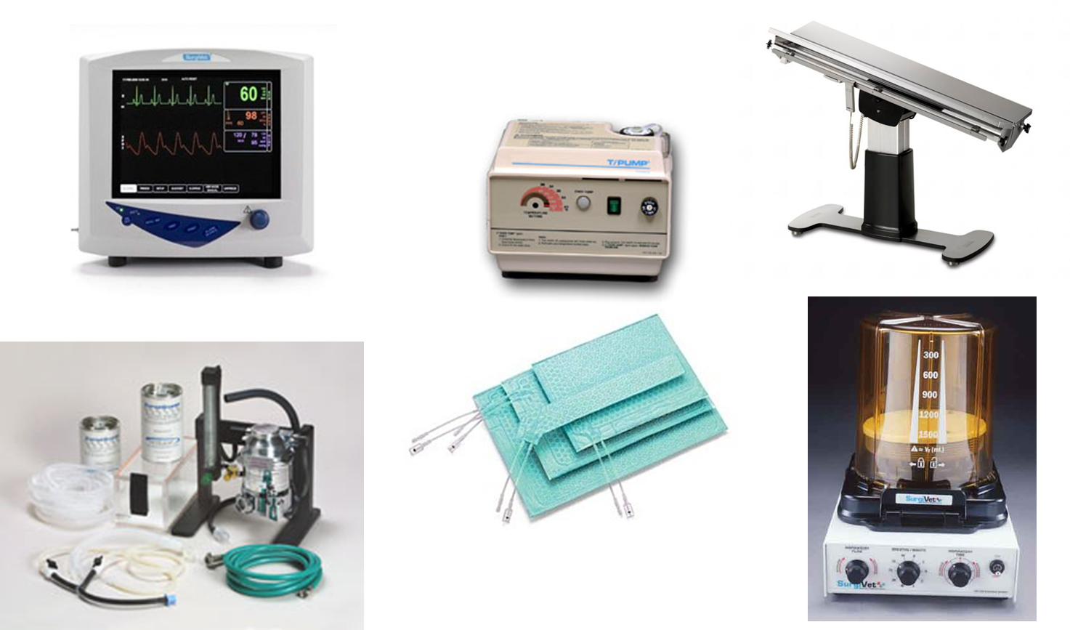
ARP Surgical Suites & Rodent Procedure Rooms

Slide 19
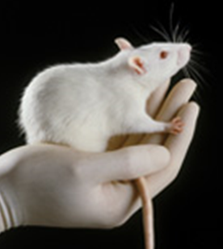
Laboratory Animal Training
Required online AALAS Learning Library Training Courses
Campus specific for badge access
Operating room, vivarium, barrier, BSL-2, etc.
Required hands-on class animal handling
Project Specific
Handling, blood collection, gavage, injections, aseptic technique, anesthesia, euthanasia, etc.
Other training by request as needed
Ventilators/ advanced anesthesia
New techniques/new species
Crash Box Set-up/Surgery Prep

Slide 20
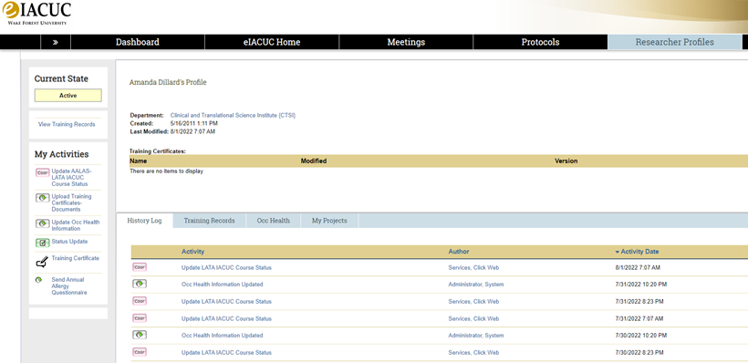
Personal Training Logs
All employees required to have one
3 ring binder or folder -or-
Digital upload available in eIACUC
In-House Certificates
Procedure Specific Record
Any outside training received

Slide 21
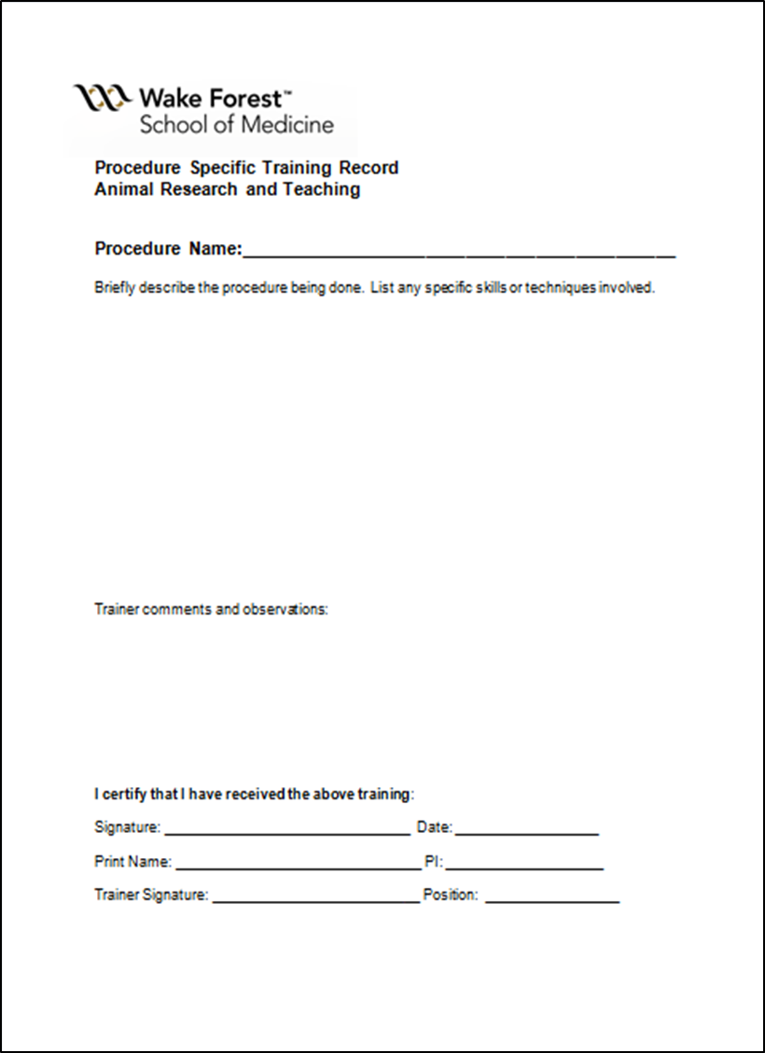
Procedure Specific Training Documentation

Slide 22
Laboratory Manager Training
Inspection Preparation
Training Log Management
Recordkeeping (ARP, DEA, Experimental, Surgical, etc.)

Slide 23
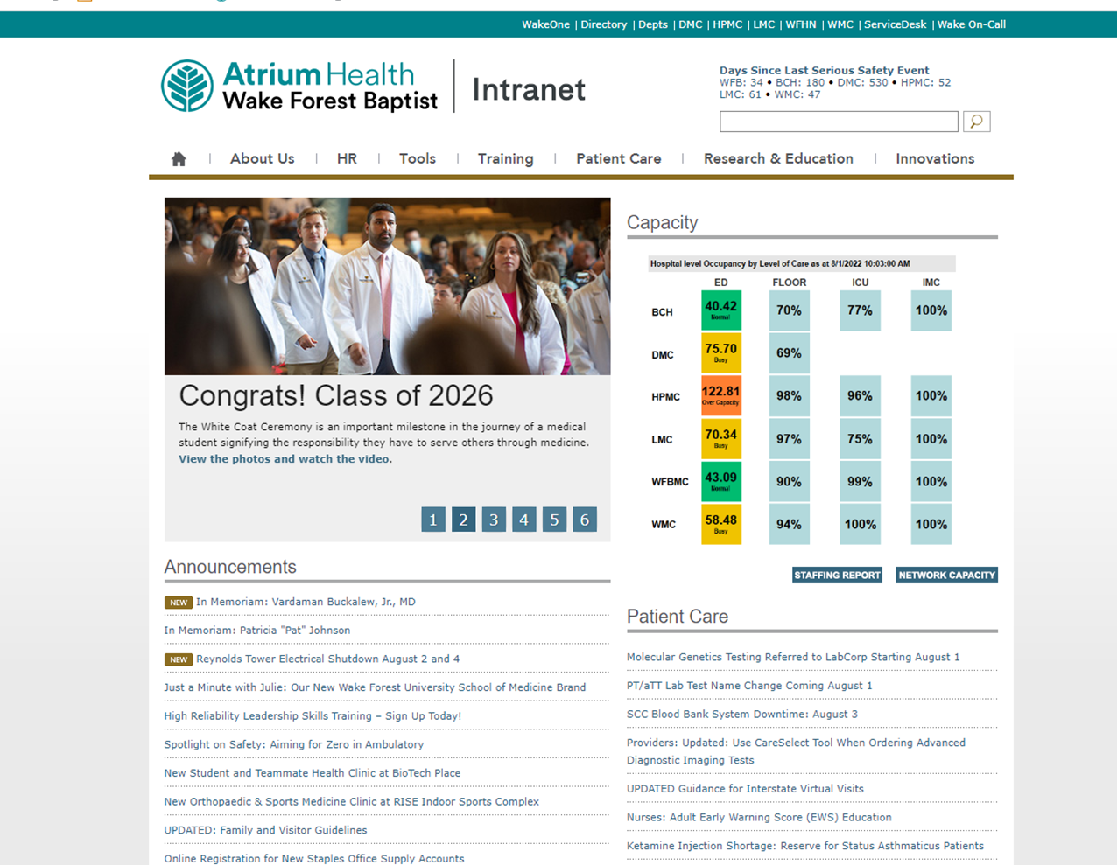
How To Access CTSI Website from Intranet

Slide 24
How To Access CTSI Website from Intranet
Click CTSI

Slide 25
Clinical and Translational Science Institute

Slide 26
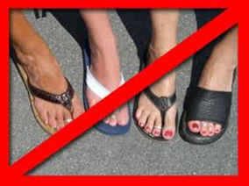
Institutional Policies
No one under 18 allowed in animal vivariums
Tours of facility must be pre-approved
Closed toe shoes and long pants (or equivalent)
Eating, drinking, applying contacts, applying make-up, talking on cell phones or smoking (including e-cigs) should not be done in areas where there are animals or their products, including the laboratories.

Slide 27
Occupational Health Requirements
All employees working with animals must be enrolled in the Wake Forest Occupational Health Program to participate in research.
Tetanus vaccine required for entry into animal housing areas
Annual Allergy Screening Questionnaire
Bi-Annual TB Blood test required if working with Nonhuman Primates

Slide 28
Occupational Health Locations
Charlotte:
Teammate Health, CMC Main Annex Bldg.
Winston Salem and Clarkson:
Employee Health, Meads Hall (Spine)
Student & Teammate Health, BioTech Place

Slide 29
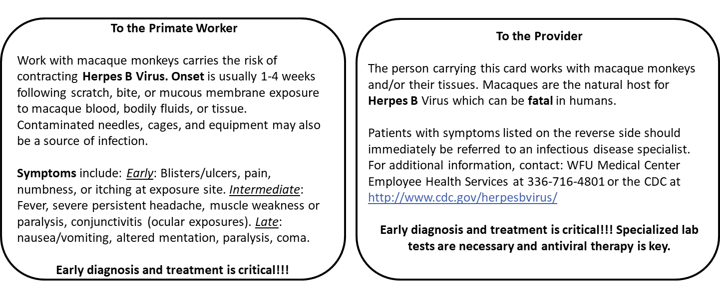
Researchers Working with Nonhuman Primates Require a Herpes B Card

Slide 30
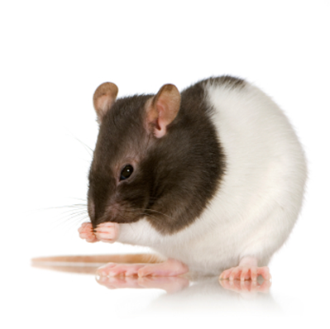
Occupational Health Concerns
Allergen Sources
Urine
Feces
Dander
Hair
Fur
Scales
Saliva
Latex

Slide 31
Occupational Health Concerns Allergens
The estimated prevalence of allergic symptoms in the general population of regularly exposed animal-care workers is 10-44%.
10%of eventually develop occupation related asthma
Reactions can occur immediately after exposure or up to 8 hours later. Sometimes symptoms can progress to asthma and rarely, anaphylaxis (shock) reactions.

Slide 32
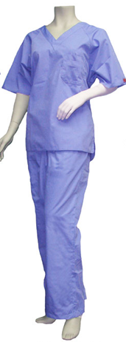
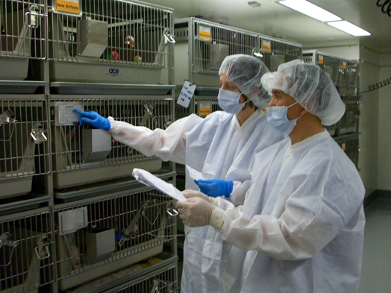
Occupational Health Concerns Zoonosis
Must wear proper PPE
Dedicated scrubs for large animals
Close toed shoes
Wash hands after working with animals

Slide 33
Remember: No Pants, No Shoes, No Science!

Slide 34
PPE Signage for Vivarium Spaces

Slide 35
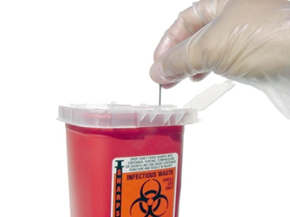
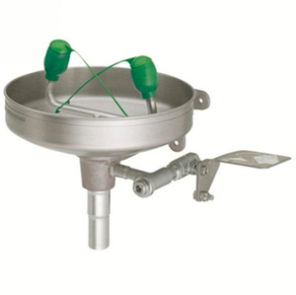
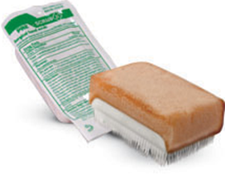
Additional Occupational Health Concerns
Chemicals
Sharps
Bites & Scratches – Monkey Exposure Kits
Biohazards
Radiation Hazards
Burns
Cage Wash
Autoclaves
Chemicals

Slide 36
Post Incident Management Winston-Salem and Clarkson Campuses
Following any incident (bite, scratch, splash of body fluids, fall, injury to self):
Wash exposed area
For all animal exposures, other than monkey, wash exposed area using available hand-washing sink and anti-bacterial soap.
For monkey exposure, use a monkey exposure kit and follow instructions provided in the kit. Contact ARP to report the exposure immediately.
Contact Employee Health 336-716-4801
Hours: Monday- Friday 7:00am – 5:00pm
After hours: Report to Winston Salem Emergency Room

Slide 37
Post Incident Management Charlotte Campus
Following any incident (bite, scratch, splash of body fluids, fall, injury to self):
Wash exposed area
For all animal exposures, other than monkey, wash exposed area using available hand-washing sink and anti-bacterial soap.
Contact TeammateHealth 704-631-0200
Hours: Monday- Friday 7:00am – 4:00pm
After hours: Report to Atrium Health Emergency Room
Complete (or have supervisor complete if incapable)
ROII (Report of Occupational Injury or Illness)
https://chriskmanagement.secure.force.com/IntakePortal/

Slide 38
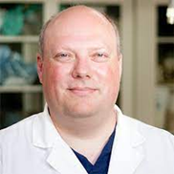
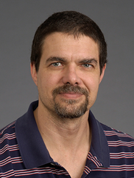
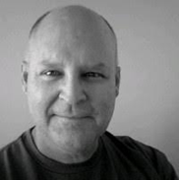
IACUC Committee
Chair: Jim Jordan, Ph.D. Associate Professor Surgical Sciences Cardiothoracic Surgery and Associate Professor Physiology/Pharmacology
Vice Chair: Jeff Martin, Ph.D. Professor Anesthesiology and Professor Physiology/Pharmacology
Vice Chair: Scott Gamble, DVM, Assistant Professor Infectious Diseases and Assistant Professor Pathology in Comparative Medicine
Committee Members include: veterinarians, scientists, non-scientists, and community members
Dr. Jim Jordan
Dr. Jeff Martin
Dr. Scott Gamble

Slide 39
IACUC Staff
Dave Lyons, PhD - Director
Jessica Baker - Assistant Director
MJ Fitzgerald - Protocol Analyst II
Miranda Moore - Protocol Analyst II
Lisa Colvin - IACUC Coordinator
Amanda Dillard - IACUC Training Coordinator

Slide 40
eIACUC
Electronic System which houses protocols, amendments, and training.
Can be accessed using your Wakehealth credentials

Slide 41
Pre Animal Use Checklist
Before you can being any animal work, you must first complete ALL of the below listed requirements:
Complete all required AALAS Training Courses
Complete all Occupational Health requirements
Complete the “Agree to Participate” activity for the protocol
Receive approval on an IACUC protocol
Have scheduled any required Hands-On Animal Handling classes

Slide 42
Animal Research Oversight & Outreach
The Animal Research Oversight program is independent of the Wake Forest Institutional Animal Care and Use Committee (IACUC).
The goal of the program is to help fulfill the institution's responsibility for ensuring compliance with federal regulations governing animal research and to promote an environment in which animal research will be conducted according to the highest standards.

Slide 43
Animal Research Oversight & Outreach
Colleen Bennett, MS – Assistant Director
PAM reviews, compliance issues, adverse event reports, best practices, inspections
Vicky Cook - Animal Monitoring and Oversight Specialist
PAM reviews, inspections

Slide 44
Regulatory Groups
WFU IACUC
Semi-annual inspections – must be every 6 months
AAALAC International (all species)
Site visit every 3 years
Voluntary
WFU accredited since 1966 – we are #8
Uses The Guide
OLAW (all vertebrate species)
Submit annual report annually
Required for all NIH grants
Uses The Guide and PHS Policy on Humane Care and Use of Laboratory Animals
USDA (warm blooded animals except birds, Mice of genus Mus, & Rats of genus Rattus)
Veterinary Medical Officer (VMO) inspection annually
Enforces Animal Welfare Act and Animal Welfare Regulations

Slide 45
Other Regulatory Groups
DOD
FDA
VA

Slide 46
Animal Research Security Committee
Monitors animal rights organizations/extremists
Alert staff of upcoming events/protests/liberation weeks
Provide support to researchers/staff that may be targeted by groups

Slide 47
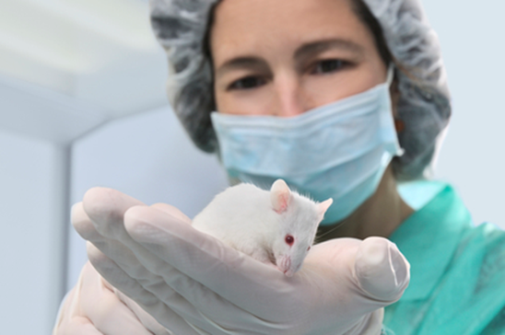
Animal Welfare Concerns
Go to your immediate supervisor
Contact ARP veterinary staff
Contact IACUC staff
Hotline - Confidential and Anonymous Reporting
Phone: 1-877-880-7888
http://www.tnwinc.com/reportline/international/
Internal Compliance Office
Phone: 704-512-5900
Email: Compliance@AtriumHealth.org
Anonymous Hotline: 844-587-0825
Online Ethics Reporting: AtriumHealth.EthicsPoint.com

Slide 48
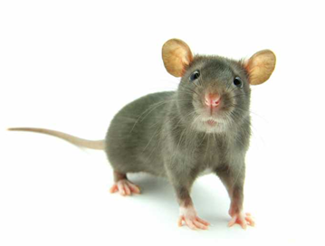
Questions?
If you have any questions, feel free to reach out to any of us at any time!
Amanda Dillard, Animal Training Coordinator adillard@Wakehealth.edu
Lisa Colvin, IACUC Coordinator lcolvin@Wakehealth.edu
Miranda Moore, Protocol Analyst II, IACUC mlmoore@Wakehealth.edu

