Slide 1
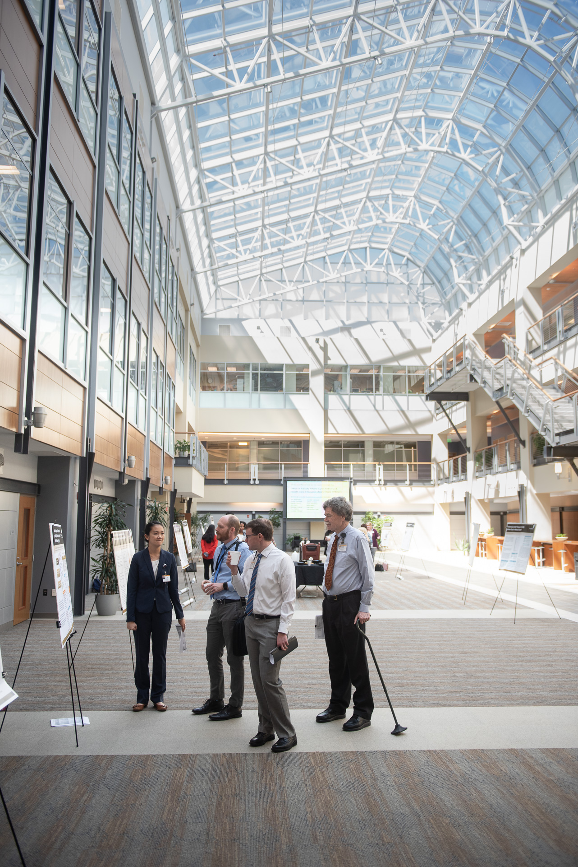
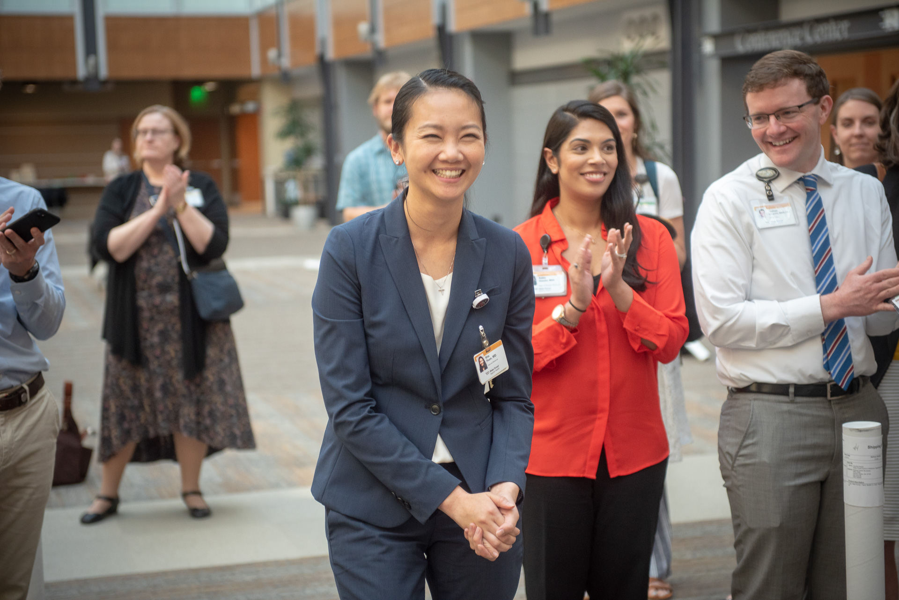
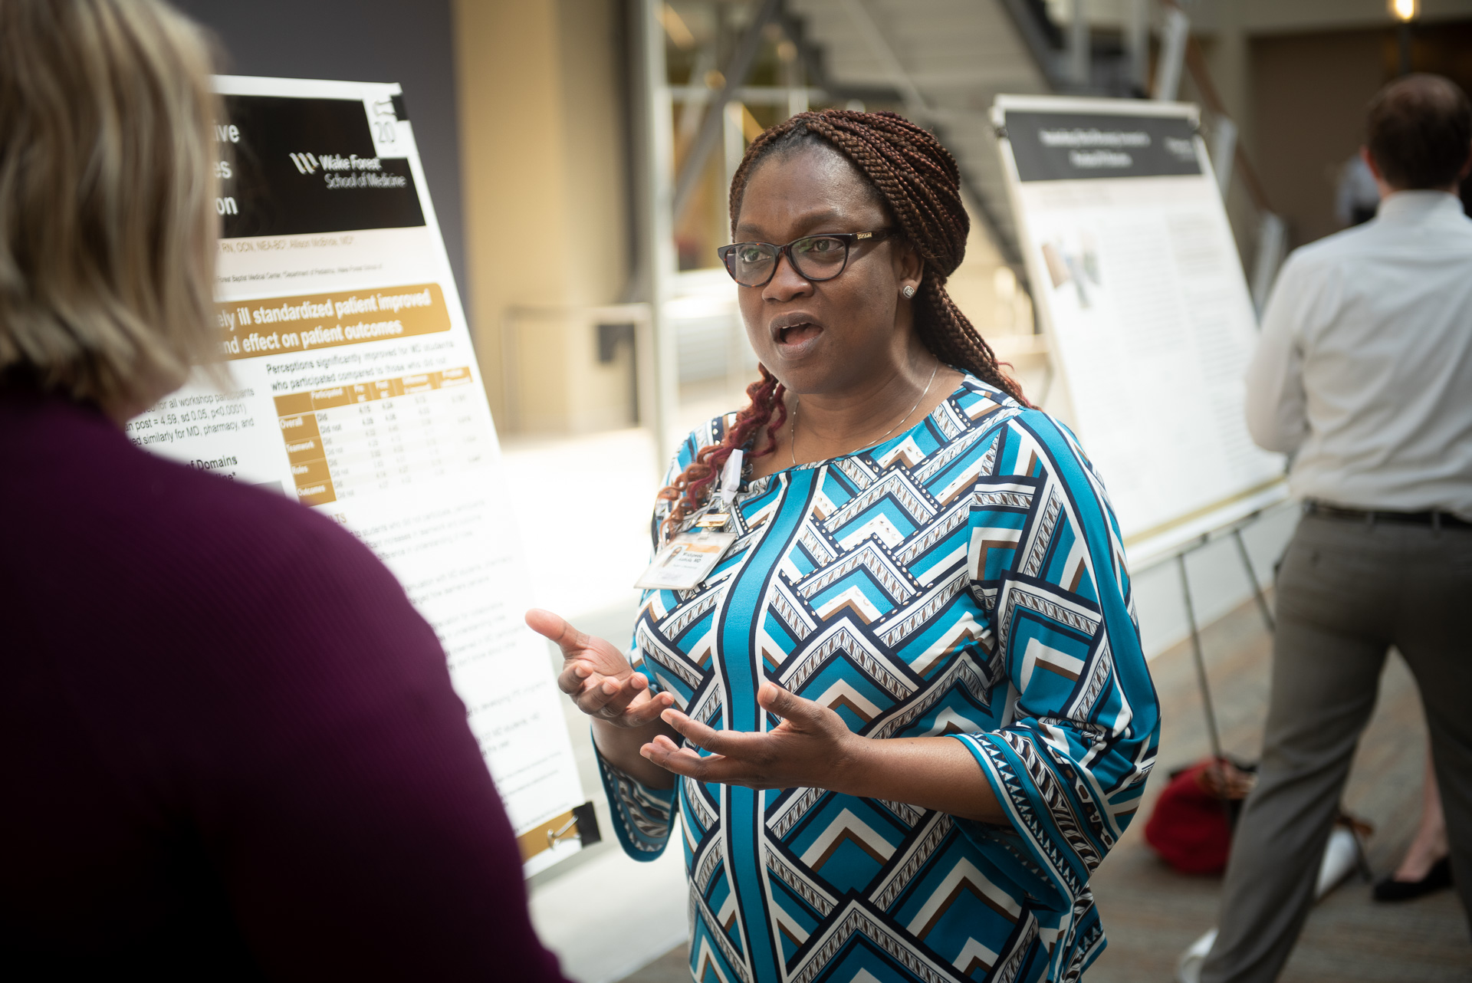
Health Professions Education Institute May 14, 2020
HPEI Educator Conference 2020
The Wake Forest School of Medicine is accredited by the Accreditation Council for Continuing Medical Education to provide continuing medical education for physicians.
The Wake Forest School of Medicine designates this live activity for a maximum of 2.0 AMA PRA Category 1 CreditsTM. Physicians should claim only the credit commensurate with the extent of their participation in the activity.

Slide 2
This conference is Co-Sponsored by:
Faculty Affairs & Medical Education
And made possible by the following planning committee members:
Roy Strowd
Jim Beardsley
Sonia Crandall
Randy Clinch
Jill Grant
Matt Miles
Tim Peters
Lindsay Strowd
Grace Buffone
Julie Freischlag
Jennifer Jackson
JaNae Joyner
Dave Manthey
Pat Ober
Sobia Hussaini
Cynthia Burns
Heather Whitley

Slide 3
CME Code: 508B8 Text to 336-793-9317
Attendance confirmation will be closed 5 minutes after the session ends
Participants who neglect to TEXT IN will not receive credit
If you do not have a MyAHEC account, you will have 30 days to create one and receive credit from today’s session
To create/update a profile or recover your existing username or password, visit http://my.ncahec.net/
The Wake Forest School of Medicine is accredited by the Accreditation Council for Continuing Medical Education to provide continuing medical education for physicians.
The Wake Forest School of Medicine designates this live activity for a maximum of 2.0 AMA PRA Category 1 CreditsTM. Physicians should claim only the credit commensurate with
the extent of their participation in the activity.

Slide 4
Agenda
12pm – 12:05pm Welcome
12:05 – 12:45pm Oral Presentations – Top Scoring Abstracts
Submissions in the following categories:
Medical Education Research, Curricular Innovation and Works in Progress
12:45 – 1:15pm Keynote: ‘Education in the Era of COVID-19’
Trainee Reflections and Q&A from former WF Students practicing at the center of
outbreak in New York City.
1:15 – 1:35pm Wake Forest SGEA Oral Presentations
1:35 – 1:50pm Virtual Poster Tour (1-Minute Poster Blitz)
Poster presenters will provide a 1-minute highlight of their poster to entice
conference attendees to check out more details in a virtual poster hall that will be
available during and after the conference.
1:50 – 2:00pm Awards and Conclusion

Slide 5
Top Scoring Abstracts Medical Education Research & Curricular Innovation
Capri Foy, PhD
Nicholas Hartman, MD
Kristin Henderson, DNAP, CRNA, CHSE
Ian Smith, MMS, PA-C
Jasmine Kim, Medical Student, Class of 2021
C. Nasir Majeed, MBBS
Sarah White, MD

Slide 6
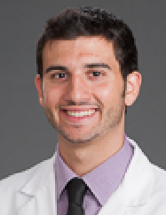
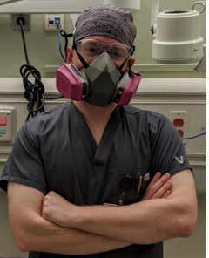
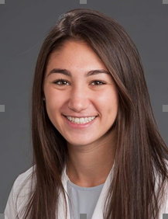
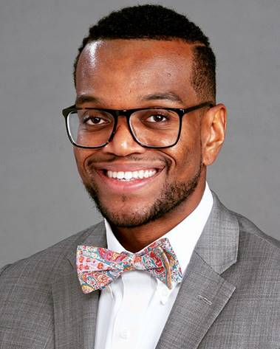
‘Education in the Era of COVID: Trainee Reflections’
Shane Stone, MD, Resident
Internal Medicine, Lenox Hill Hospital
Sanford Williams, MD, Resident
Pediatrics, Columbia University
Rachel Shenker, MD, Resident
Internal Medicine, Winthrop University Hospital
Matt Russell, PA
Emergency Medicine, Mount Sinai

Slide 7
SGEA Presenters
Jon Goforth, MBA
Alexandria Marshall, Medical Student Class of 2023
Modupeola Akinola, MD

Slide 8
1-Minute Poster Blitz
Virtual Poster Tour

