Slide 1
Common Respiratory Tract Infections: Evaluation and Therapy
Antibiotic Stewardship Curriculum
Developed by:
Vera P. Luther, M.D.
Christopher A. Ohl, M.D.
Wake Forest School of Medicine
With Support from the Centers for Disease Control and Prevention
Notes:
Designed for 1st year or 2nd year medical students for use during: Respiratory systems, fundamental infectious diseases, microbiology or pharmacology (antibiotic) blocks.

Slide 2
Objectives
Review the etiology, diagnosis and therapy of 5 common respiratory tract infections: community-acquired pneumonia, acute bronchitis, rhinosinusitis, pharyngitis, and acute otitis media (AOM)
List criteria for symptomatic therapy
List criteria for each of the 5 conditions that indicate antibiotic therapy is the most appropriate treatment
List the first line antibiotic therapy for each of the 5 conditions when indicated

Slide 3
Outline
Introduction
Evaluation and therapy
Community-acquired pneumonia
Acute bronchitis
Rhinosinusitis
Acute pharyngitis
AOM
Conclusion

Slide 4
Common Respiratory Tract Infections
Community-acquired pneumonia
Acute bronchitis
Pharyngitis
Rhinosinusitis
AOM
Notes:
Defined anatomically
Acute Otitis Media: Due to its extension from the nasopharynx by the eustachian tube and lining by typical respiratory epithelium these infections behave pathophysiologically as a respiratory tract infection

Slide 5
Respiratory Infections are the Most Common Reason for Office Visits
180
100
80
60
40
20
0
161
73
Number of Office Visits (millions)
55
35
26
Respiratory Hypertension Gastrointestinal Diabetes Depression
Infections Disorders
IMS America NDTI (National Disease Therapeutics Index) 2001.
Mehrotra A. Health Affairs 2008 Sep-Oct;27(5):1272-82.
Notes:
Prevalence of Respiratory Infections
Respiratory tract infections make up more than twice the number of office visits made for hypertension, gastrointestinal disorders, diabetes, and depression combined.

Slide 6
Over half of Antibiotic Use in Adults is for Respiratory Tract Infections
2004-2005 Physician Drug & Diagnosis Audit (PDDA)
Notes:
The Physician Drug and Diagnosis Audit (PDDA) is a proprietary monthly survey that monitors disease states and the physician-intended associated drug and nondrug therapy. Approximately 3,400 office-based physicians representing 29 different specialties across the United States report all patient activity during 1 typical workday per month.

Slide 8
Burden of Acute Respiratory Tract Infections
Significant time away from school and work
Significant healthcare expenditures for clinic visits, hospitalization and medications
Mortality rare except for community-acquired pneumonia in persons with comorbidities

Slide 9
Pathogens
Respiratory viruses account for the majority of infections
Bacterial infections are more prominent in acute otitis media and pneumonia
Antibiotic resistance is common among S. pneumoniae, H. influenzae, and M. catarrhalis isolates
Streptococcus pneumoniae | Haemophilus influenzae
Moraxella catarrhalis | Streptococcus pyogenes
Mycoplasma sp. | Chlamydiophila sp.

Slide 10
Proportion of Resistant Invasive Streptococcus pneumoniae spp., 1992-2008
Percent Fully Resistant
Source: CDC Active Bacterial Core Surveillance and Sentinel Surveillance Network.
Erythromycin resistance data not available

Slide 11
Outline
Introduction
Evaluation and therapy
Community-acquired pneumonia
Acute bronchitis
Rhinosinusitis
Acute pharyngitis
Acute otitis media
Conclusion

Slide 12
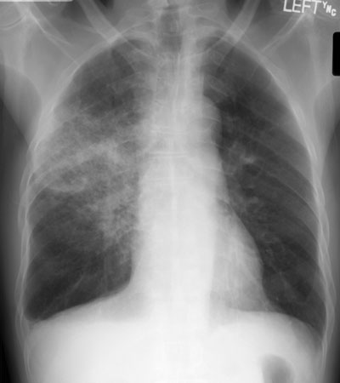
Community- Acquired
Pneumonia
Notes:
The diagnosis of pneumonia can often be difficult.
This CXR demonstrates a lobar pneumonia: How often do our pneumonia patients have this type of classic infiltrate?

Slide 13
Community-Acquired Pneumonia Overview
3-4 million cases/year
10 million patient visits/year
Approximately 80% are mild to moderate in severity and treated as outpatients
500,000 hospitalizations and 45,000 deaths/year
(8th leading cause of death)
Mortality
1% in outpatients
5% in inpatients
25-50% in patients admitted to ICU
File TM, Marrie TJ Postgrad Med 2010;122(2):130.

Slide 14
Community-Acquired Pneumonia Symptoms
Cough
Fever
Pleuritic chest pain
Dyspnea
Sputum production

Slide 15
Community-Acquired Pneumonia Diagnosis
Common physical examination findings
Fever
Respiratory rate > 24 breaths/minute
Heart rate > 100 beats/minute
Crackles/râles usually present on auscultation
Evidence of consolidation on exam
Peripheral white blood cell count (WBC) usually elevated
Chest x-ray (CXR) should be used to confirm diagnosis

Slide 16
Community-Acquired Pneumonia Microbiology and Proportion of Deaths in Adults
Microbial Agent
S. pneumoniae
H. influenzae
S. aureus
Gram Negative Rods
Miscellaneous Bacteria
“Atypical” Bacteria
Legionella spp.
Mycoplasma spp.
C. pneumoniae
Viral (including influenza)
Aspiration
Proportion of Hospital Admissions
20-60%
3-10%
3-5%
3-10%
3-5%
10-20%
2-8%
1-6%
4-6%
2-15%
6-10%
Deaths
66%
7%
6%
3%
9%
6%
5%
1%
<1%
<1%
ND
Notes:
Data from multiple sources including File TM Lancet 2003;362:1991-2001

Slide 17
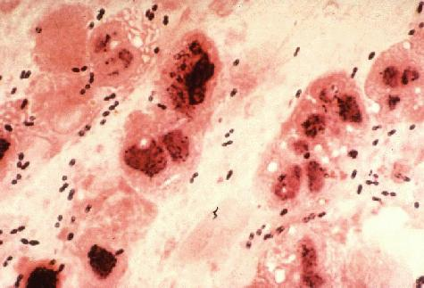
Antibiotic Considerations
Therapy is almost always empiric initially
Most important pathogen to target is S. pneumoniae based on its frequency and associated morbidity and mortality
Local prevalence of macrolide- resistant S. pneumoniae influences antibiotic choice
“Atypical pathogens” more common among older children and adults
Sputum gram-stain showing the typical lancet-shaped gram positive diplococci of S. pneumoniae
If an etiology is identified, therapy should be de-escalated and directed at that pathogen

Slide 18
Community-Acquired Pneumonia Treatment Recommendations for Outpatients
Clinical Characteristic | Treatment Regimen
Previously healthy and no risk factors for drug-resistant S. pneumoniae | Macrolide* Doxycycline
Risk factors for drug resistant S. pneumoniae Presence of comorbidities or immunocompromised Use of antimicrobials within the previous 3 months Regions with a high rate (>25%) of macrolide-resistant S. pneumoniae | Respiratory fluoroquinolone** High dose amoxicillin plus macrolide* Amoxicillin/clavulanate plus macrolide* Alternative: Ceftriaxone, cefpodoxime or cefuroxime plus macrolide*
* Azithromycin, Clarithromycin or Erythromycin
** Gemifloxacin, Levofloxacin or Moxifloxacin
Mandell et al. Clin Infect Dis 2007. 44: S27-S72

Slide 19
Community-Acquired Pneumonia Treatment Recommendations for Inpatients
Clinical Characteristic | Treatment Regimen
Non-ICU Admission | Respiratory fluoroquinolone** Cefotaxime or ceftriaxone plus macrolide* Ampicillin plus macrolide* Ertapenem plus macrolide*
ICU Admission | Cefotaxime or ceftriaxone or ampicillin-sulbactam PLUS Azithromycin or fluoroquinolone
* Azithromycin, Clarithromycin or Erythromycin
** Gemifloxacin, Levofloxacin or Moxifloxacin
Mandell et al. Clin Infect Dis 2007. 44: S27-S72

Slide 20
Community-Acquired Pneumonia: Reasons for Overtreatment
Community-acquired pneumonia is commonly misdiagnosed
Abnormal findings on chest radiographs often lead to “cannot rule out pneumonia”
e.g. atelectasis, malignancy, hemorrhage, pulmonary edema, heart failure, pulmonary embolism, effusions, fibrosis
Emergency department protocols are designed to expedite therapy
Pines, et. al. J Emerg Med. 2009 Oct;37(3):335-40.

Slide 21
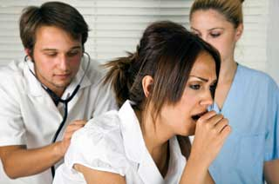
Acute
Bronchitis

Slide 22
Acute Bronchitis
Definition: An acute respiratory tract infection that may last up to 3 weeks in which cough, with or without phlegm, is a predominant feature and alveolar inflammation is not present (normal chest radiograph)
Occurs predominately in the late fall, winter and early spring
Common: Up to 5% of adults self report an episode each year
Gonzales et al. Annals of Int Med. 2001;134(6):521
Brahman. Chest 2006;129:95S-103S

Slide 23
Acute Bronchitis Almost Always a Viral Etiology
Less than 10% due to bacterial causes
Etiologic diagnosis not usually attempted unless influenza suspected
Antibiotic therapy not indicated and should not be offered
Exception: some episodes of prolonged paroxysmal cough are due to Bordetella pertussis
Viral Causes of Bronchitis
Respiratory Syncytial Virus
Adenovirus
Parainfluenza virus
Rhinovirus
Influenza virus
Gonzales et al. Annals of Int Med. 2001;134(6):521
Brahman. Chest 2006;129:95S-103S

Slide 24
Patient Management
Some patients may expect an antibiotic based on past experience or expectations
Explain to the patient why an antibiotic is not necessary and that these drugs may have unwanted side-effects
Use terms like “chest cold” rather than bronchitis or infection
Suggestions for symptom relief
Humidified air
Over-the-counter pain relievers
Some recommend cough suppressants
No role for bronchodilators in absence of asthma or chronic obstructive pulmonary disease (COPD)

Slide 25
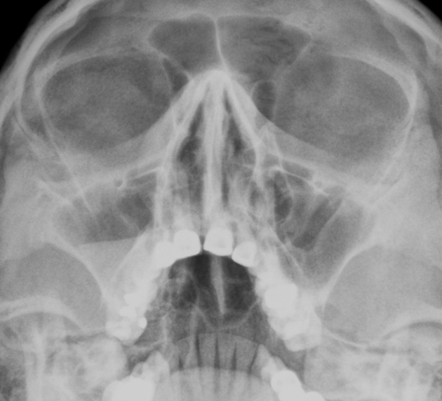
Acute Rhinosinusitis (ARS)

Slide 26
Acute Rhinosinusitis
Broad term describing multiple disease processes affecting the nasal cavity and sinuses with a duration of <4 weeks
Allergy
Infection (viral, bacterial, fungal)
Polyps
Frequent: 1 of 7 adults per year seeks medical attention for acute rhinosinusitis (ARS)
Chow et al. Clin Infect Dis. 2012; 54(8):e72-112

Slide 27
Acute Viral Rhinosinusitis (Common Cold)
Pathogens: Viruses similar to acute bronchitis
Common symptoms: Nasal congestion and mucous discharge, facial pressure, post-nasal discharge
Usually symptoms peak at 2-3 days and resolve by day 7-10
Diagnosis relies on exam: radiographs not sensitive or specific
Treat with topical and oral decongestants, nasal irrigation, +/- topical corticosteroids
No indication for antibiotics
Meltzer et. al. Mayo Clin Proc. 2011 86: 427
Chow et al. Clin Infect Dis. 2012; 54(8):e72-112

Slide 28
Acute Bacterial Rhinosinusitis (ABRS)
Pathogens: S. pneumoniae, H. influenzae, M. catarrhalis, Streptococcus sp, S. aureus, anaerobes
Much less frequent than viral ARS
Follows <2.0% of viral ARS cases
Important to attempt to differentiate from viral ARS
CT imaging indicated for severe infection with suspected orbital or intracranial extension
Symptoms Suggesting Bacterial Infection
Symptoms > 10 days
Unilateral maxillary face pain
Maxillary tooth ache
Unilateral maxillary sinus tenderness
Unilateral purulent nasal discharge
Double sickening (symptoms improve then worsen)
Green or colored nasal discharge and cough do not predict ABRS.
Meltzer et. al. Mayo Clin Proc. 2011 86: 427
Chow et al. Clin Infect Dis. 2012; 54(8):e72-112

Slide 29
ABRS treatment
First-line antibiotic therapy:
Amoxicillin-clavulanate
Penicillin allergy: doxycycline, levofloxacin or moxifloxacin
Adjunctive treatment
Hydration, analgesics, antipyretics
Irrigation with physiologic or hypertonic saline
Intranasal corticosteroids for those with concurrent allergic rhinitis
Topical or oral decongestants or antihistamines not indicated due to lack of effect
Meltzer et. al. Mayo Clin Proc. 2011; 86: 427, Young J et al. Lancet. 2008; 371:908,
Chow et al. Clin Infect Dis. 2012; 54(8):e72-112

Slide 30
Acute Pharyngitis

Slide 31
Acute Pharyngitis
Classically the triad of fever, sore throat and pharyngeal inflammation
Pathogens:
Viruses: Epstein-Barr, Cytomegalovirus, respiratory viruses, enteroviruses, Herpes simplex type I
Bacteria: Group A Streptococcus (GAS), Non-group A Streptococcus, Arcanobacterium hemolyticum, and Fusobacterium spp.
Pharyngitis in 85-95% of adults and 80-85% of children is due to viruses
For uncomplicated pharyngitis, antibacterial therapy is reserved for GAS infection

Slide 32
Clinical Features of Pharyngitis
Features suggestive of GAS etiology
Sudden onset sore throat
Fever
Headache
Tonsillopharyngeal inflammation
Tonsillopharyngeal exudate
Palatal petechiae
Tender anterior cervical adenopathy
Winter-early spring presentation
Age 5-15 years
History of exposure to GAS pharyngitis
Features suggestive of viral etiology
Absence of fever
Conjunctivitis
Coryza
Cough
Hoarseness
Ulcerative mouth lesions
Viral type rash
Overlap between GAS and viral pharyngitis may be considerable
McIsaac et al. JAMA. 2004; 291:1587, Bisno et al. Clin Infect Dis. 2002; 35:113

Slide 33
Acute Pharyngitis Diagnosis
For adults and children with features that strongly suggest a viral etiology, testing is not indicated
In persons with findings suggestive of GAS infection, confirmation with a rapid antigen detection test (RADT) or culture is needed
In children and adolescents a negative RADT has a low negative predictive value and should be backed up with a throat culture for GAS
McIsaac et al. JAMA. 2004; 291:1587, Bisno et al. Clin Infect Dis. 2002; 35:113

Slide 34
Acute Pharyngitis Treatment
Antibiotics for those with confirmed GAS
Penicillin or amoxicillin
Penicillin allergic: first generation cephalosporin for minor allergy and clindamycin or macrolide if anaphylaxis
No GAS resistance to penicillin has been reported
Symptomatic treatment:
Over-the-counter pain relievers/antipyretic
Throat lozenges or sprays
Adequate oral hydration
Corticosteroids not recommended

Slide 35
Acute Otitis Media

Slide 36
Acute Otitis Media (AOM)
Acute illness with fluid and mucosal inflammation of the middle ear space
Extremely common in young children: By age 3, two-thirds have had at least one episode
Much less common in adults
Increased risk with some ethnic groups, exposure to polluted air (including tobacco smoke), and with children who attend daycare

Slide 37
Acute Otitis Media
Pathogenesis: Anatomic and physiologic disruption of eustachian tube drainage of the middle ear with subsequent fluid accumulation and bacterial infection
Often follows viral respiratory infection
Incidence due to S. pneumoniae decreasing due to vaccination of children starting in 2000
Pathogen | Proportion of cultures (2001-2003) (%)
S. pneumoniae | 23
H. influenzae | 36
M. catarrhalis | 3
Group A Streptococcus | 1.3
None | 41
Adapted from Casey et. al. Pediatr Infect Dis J. 2004; 23:824

Slide 38
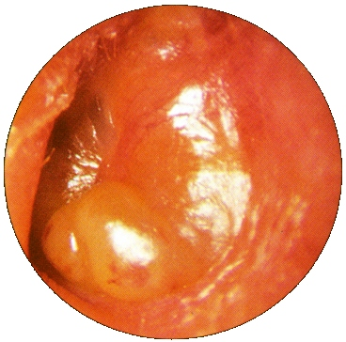
Acute Otitis Media
Symptoms/signs
Fever, chills, ear pain, ear drainage, hearing loss, lethargy, irritability, pulling on ear
Exam
Tympanic membrane erythema, loss of landmarks and bulge
Presence of middle ear fluid on pneumatic otoscopy or tympanometry, or otorrhea

Slide 39
Acute Otitis Media: Treatment
Many cases of AOM (~25%) are due to viruses and will not respond to antibiotics
A significant number of cases due to bacteria will spontaneously resolve without antibiotics
If antibiotics are indicated, use high dose amoxicillin
Severe illness: Amoxicillin-clavulanate
Penicillin allergy: 2nd or 3rd generation cephalosporin, azithromycin or clarithromycin
AAP. Pediatrics. 2004; 113:1451

Slide 40
Acute Otitis Media Treatment
Age | Certain Diagnosis | Uncertain Diagnosis
<6 mo | Antibacterial therapy | Antibacterial therapy
6 mo -2 yr | Antibacterial therapy | Antibacterial therapy if severe illness; observation option if non-severe illness
≥ 2 yr | Antibacterial therapy if severe illness; observation option if non-severe illness | Observation option
AAP. Pediatrics. 2004; 113:1451

Slide 41
Acute Otitis Media
Symptom relief
Oral analgesics
Topical analgesic spray/drops
Warm, moist cloths over ear
Avoid narcotics
Prevention
Conjugate pneumococcal and Haemophilus vaccination
Influenza vaccination
Rarely antibiotic prophylaxis for frequent recurrences

Slide 42
Outline
Introduction
Evaluation and therapy
CAP
Acute bronchitis
Rhinosinusitis
Acute pharyngitis
Acute otitis media
Conclusion

Slide 43
Conclusion
Antibiotics are frequently given for respiratory tract infections in outpatient and inpatient settings
Inappropriate antibiotic use is common for these diagnoses
Misdiagnosis of pneumonia is common
Most upper respiratory infections are viral and do not need antibiotic treatment
Observation without antibiotics is an option for children with acute otitis media
Guidelines exist for the appropriate treatment of respiratory tract infections

Slide 44
Treatment Guidelines and Resources
Centers for Disease Control and Prevention (CDC)
http://www.cdc.gov/getsmart/
Get Smart: Know When Antibiotics Work
Adult Guideline Summaries
Pediatric Guideline Summaries
Infectious Diseases Society of America (IDSA) http://www.idsociety.org/IDSA_Practice_Guidelines/
American Academy of Pediatrics (AAP)
American Academy of Family Physicians(AAFP)

