Slide 1








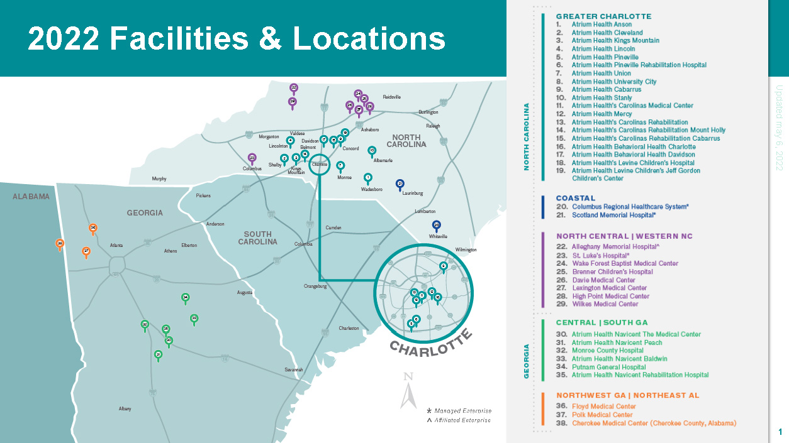

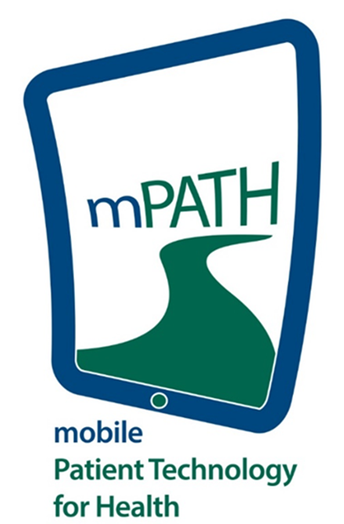





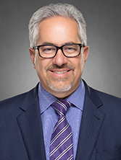

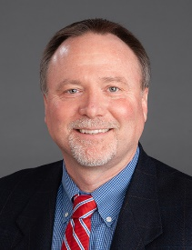
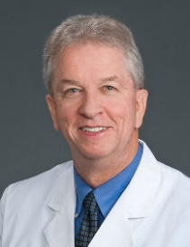
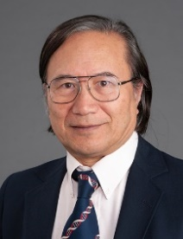
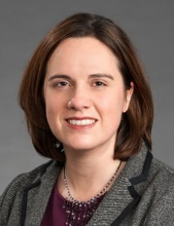
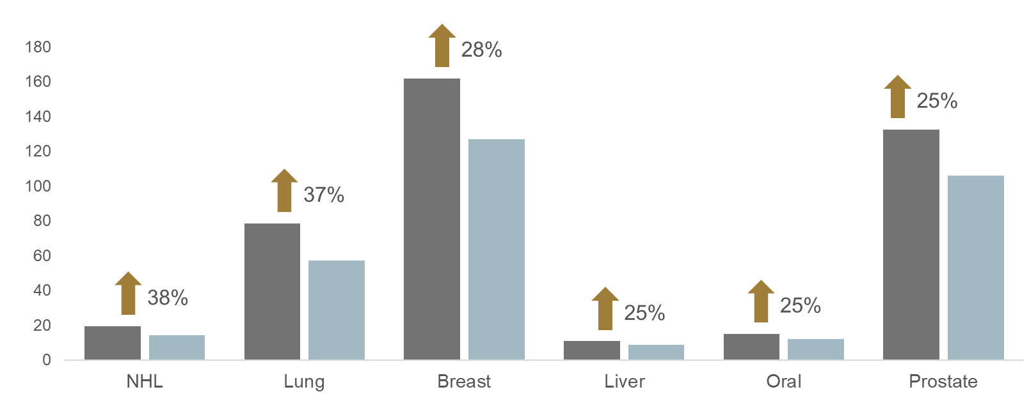
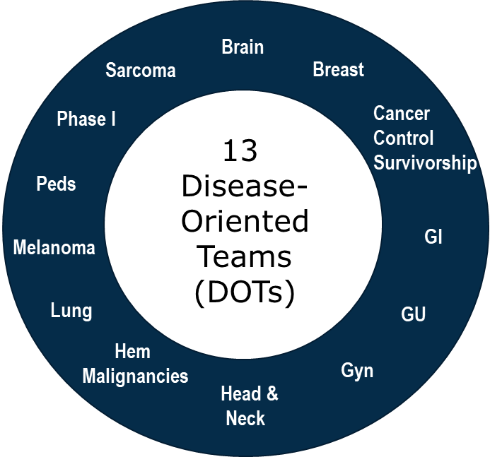



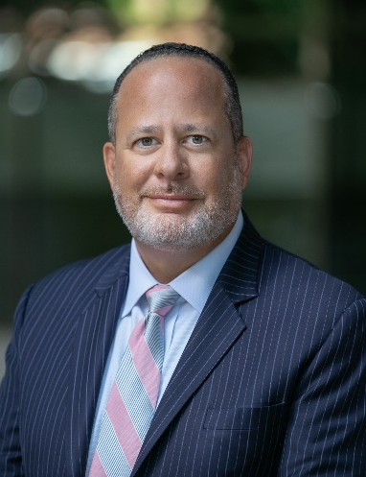
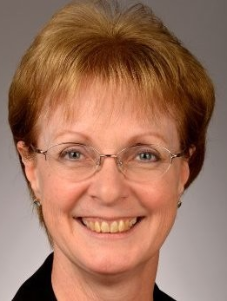
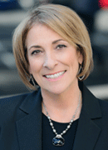
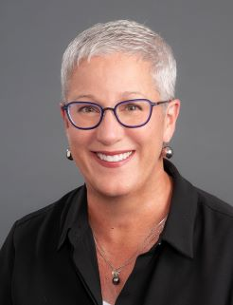
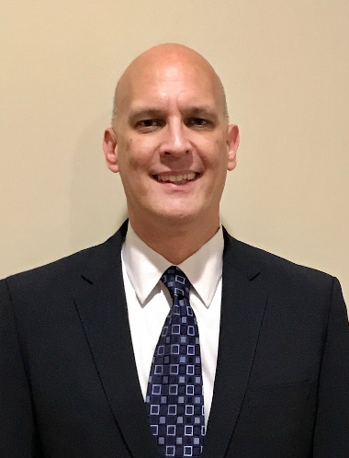

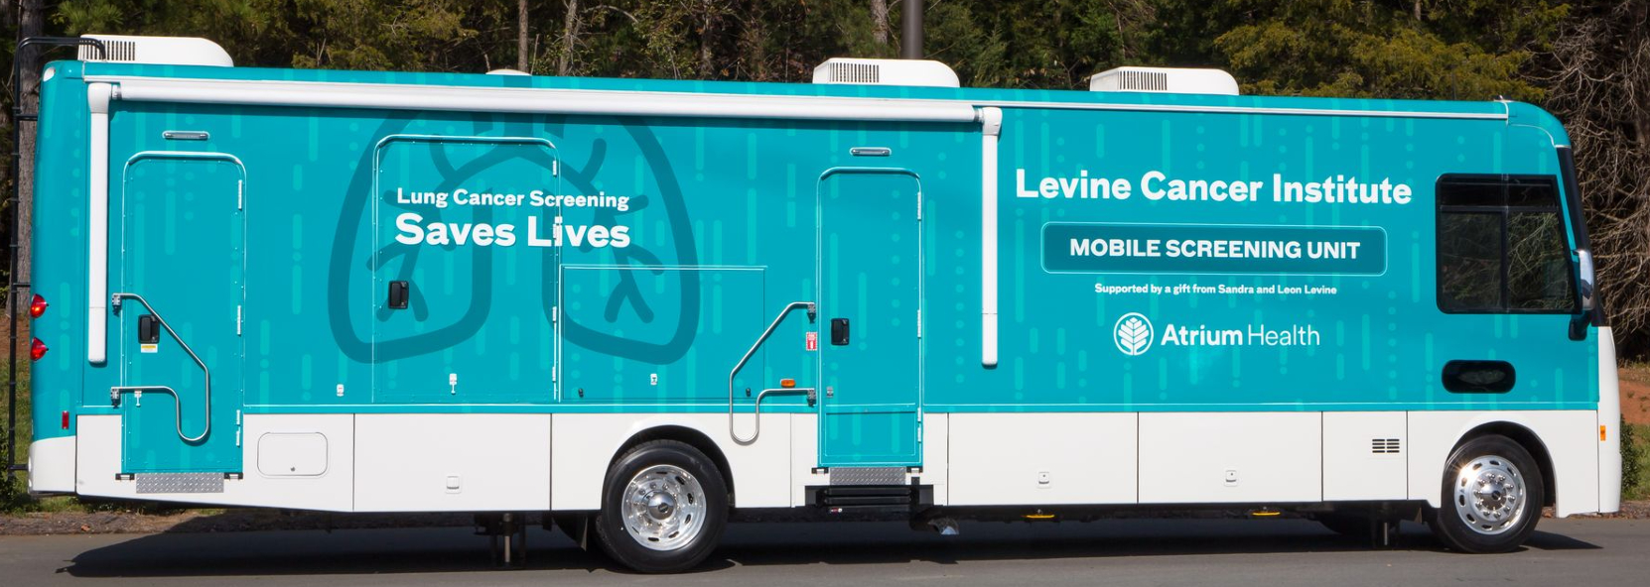

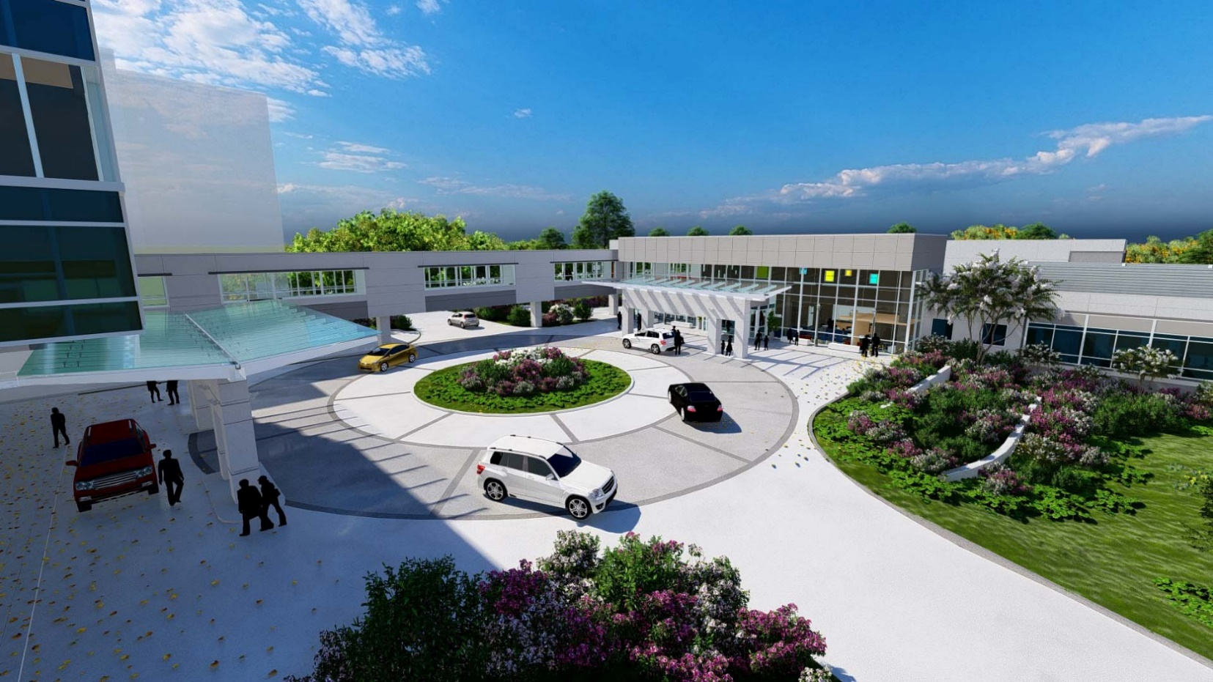
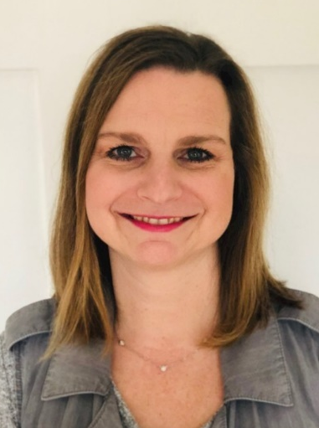
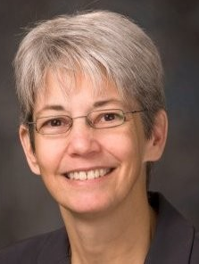
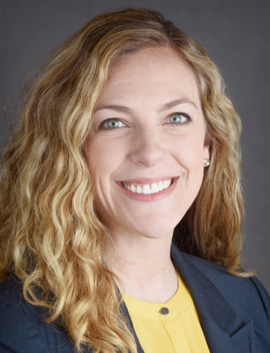
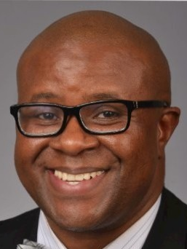
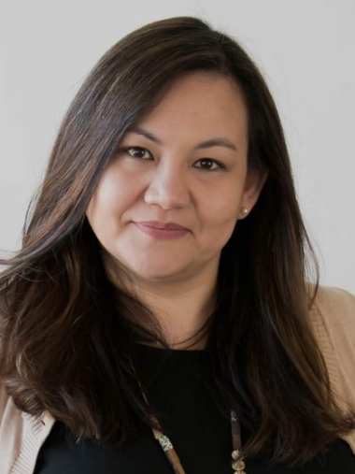
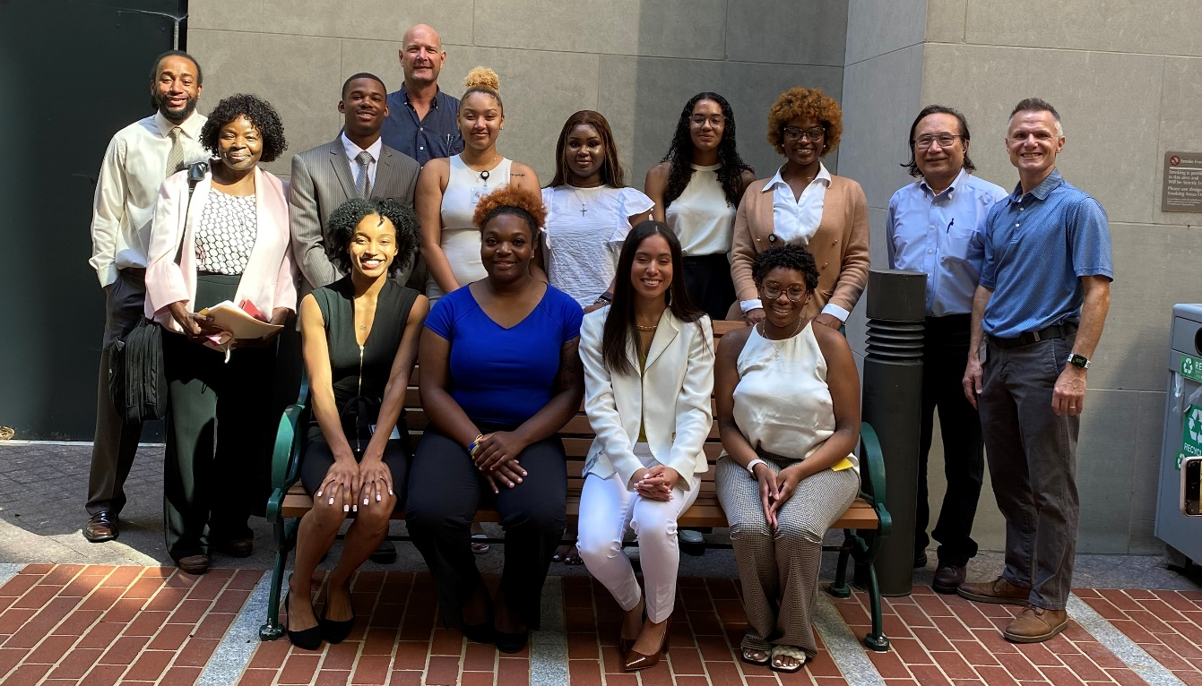
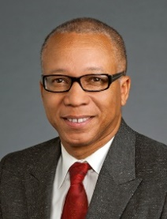
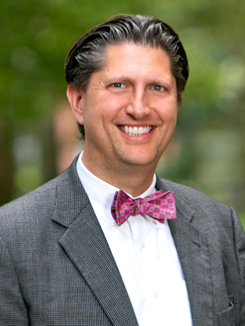
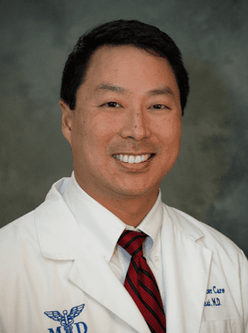
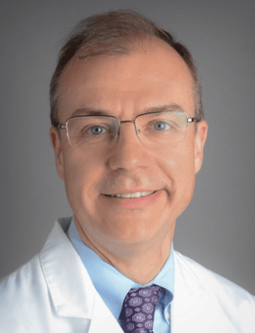
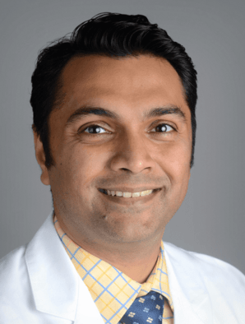
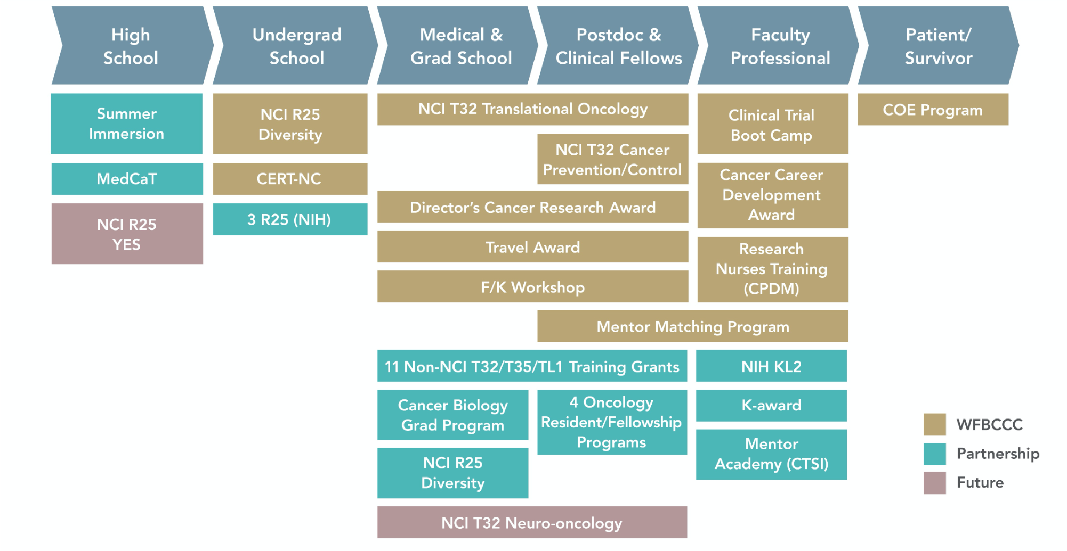
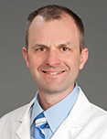
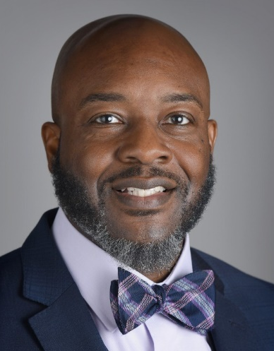
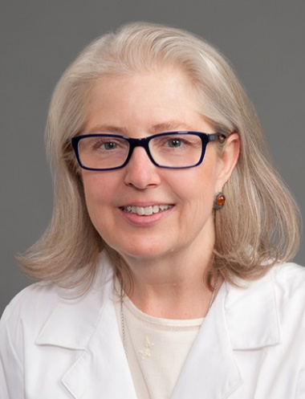
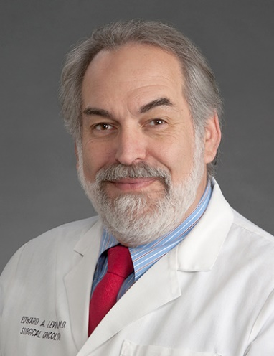
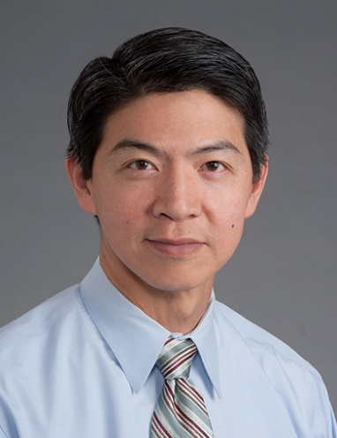
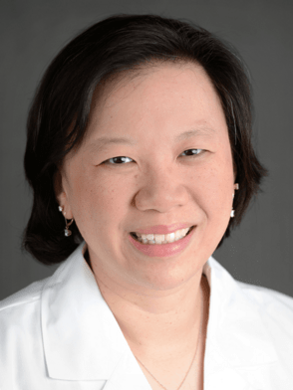
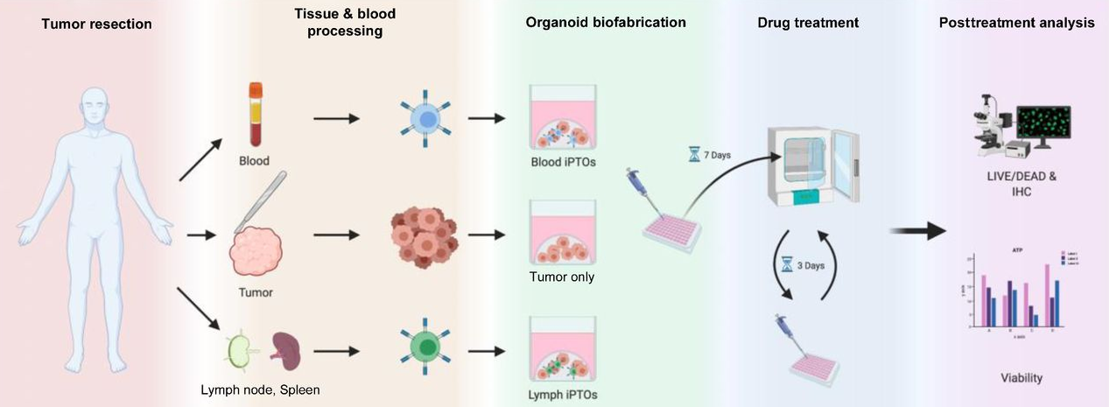
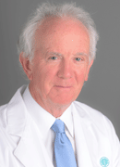
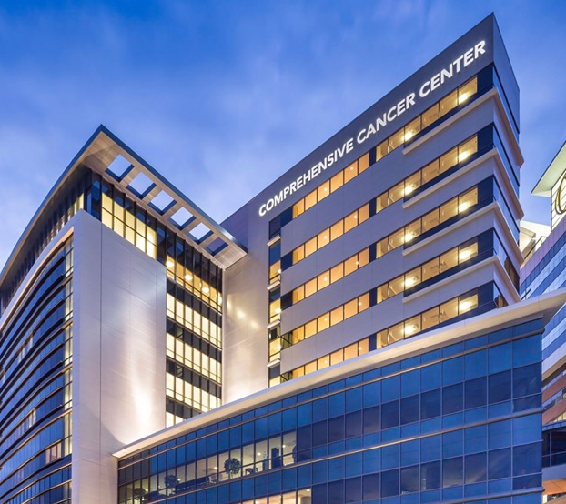
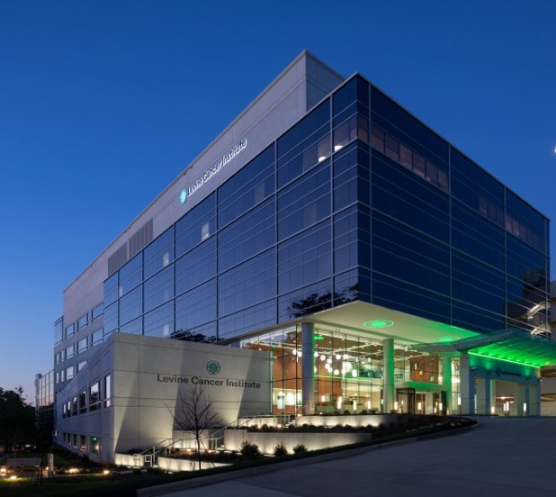

Comprehensive Cancer Center
Mission
A fully integrated cancer center that tackles the cancer burden of a diverse and expanded catchment area through innovative, relevant cancer research; increasing access to high-quality cancer care and clinical trials; trustworthy engagement and outreach; and meaningful pipeline programs that foster workforce diversity, equity, and inclusion.
Leadership
Cancer Care Impact
Research Project Spotlight
1 NCI-Designated
Comprehensive Cancer Center
(1 of 53 nationally)
39 Academic Departments
of Wake Forest University represented
Using Embedded Pragmatic Clinical Trials to Evaluate
Digital Health Interventions
for Cancer Screening
160
scientific
members
1 NCORP Research Base
(1 of 2 NCI-designated cancer centers with NCORP-RB)
9
Shared Resources
Campus Location
4
1.5M ft² +
$32M +
Catchment Area
Peer
Reviewed Research
Funding
Colorectal cancer screening program used in over 60,000 patient encounters, doubles screening rates
Clinical Trial Site
Scientific
Research
Programs
Physical
Research
Space
Ruben A. Mesa, MD, FACP
President, Enterprise Cancer Service Line
Executive Director, Atrium Health Wake Forest Baptist Comprehensive Cancer Center
Enterprise Senior Vice President, Atrium Health
Vice Dean for Cancer Programs, Wake Forest University School of Medicine
Professor of Medicine, Wake Forest University School of Medicine
530
clinical trials accruing patients
1,000+
patients in interventional trials
600+
clinicians and researchers
20,000+
new cancer cases annually
Our Cancer Burden
Catchment
Area
US
Research Priorities
Precision Medicine
Tobacco
Health Disparities
Treatment Resistance & Recurrence
Survivorship
M. Jennifer Kim, MBA
Associate Director, Administration
Lance D. Miller, PhD
Associate Director, Basic Sciences
Bayard Powell, MD
Associate Director, Clinical Research
Kounosuke Watabe, PhD
Associate Director, Shared Resource Management
Kate Weaver, PhD
Associate Director, Population Sciences
Average Age 60.2 yrs
Under 55 Lung Bus Study
Expanded to Lung Cancer Screening in 2022
Todd M. Bankhead, MBA, MPA
Senior Vice President, Clinical Operations
Donna Feild, RPh, MBA
Interim Senior Vice President, Levine Cancer Institute
Maureen Swick, PhD, MSN, RN
Enterprise Senior Vice President, Nursing and Pharmacy
Deb Harding, DNP, RN, NEA-BC
Vice President and Regional Chief Nursing Executive
Philip J. Butera, MBA
Assistant Vice President, Clinical Trials
Opening 2023
New Radiation Therapy Facility in Charlotte
Featuring proton beam therapy and gamma knife radiosurgery for children and adult patients with complex tumors
EHR Query to Identify Potential Screening Candidates
Invitation sent to Patients via MyChart or Text Message
Study Website Determines Patient Eligibility
mPATH-Lung
(n=660)
Potential Screening Event
Training the Next Generation
of Cancer Researchers
Eligible
Randomized
Primary Outcome
Brenda Crump, MBA, MSN, RN, NE-BC Assistant Vice President, Nursing, Central & Western Region Operations
Carol Farhangfar, PhD, MBA
Assistant Vice President, Tissue Procurement & Translational Research
Laura Kelsey, MHA, FACHE
Assistant Vice President, Operations
Tomain Murphy
Assistant Vice President, Radiation Oncology
Carla Sims, MBA
Associate Vice President, Clinical Operations, Oncology
Control Program
(n=660)
Potential Screening Event
K-12
Primary Outcome
863
total trainees in 2022
Organoid Research
Leveraging tumor organoid technology for the transformation of
cancer care, at the level of the individual patient.
A. William Blackstock Jr., MD
Chair, Radiation Oncology
Stuart H. Burri, MD
Chair, Radiation Oncology, Levine Cancer Institute
Jean Chai, MD
Administrative Physician-in-Chief, Levine Cancer Institute
Peter Clark, MD
Chair, Urologic Oncology, Levine Cancer Institute
Nilanjan Ghosh, MD
Chair, Hematologic Oncology & Blood Disorders, Levine Cancer Institute
43
residents and fellows across 14 programs
Over 3,000 visitors of mPATHTM – Lung
71% competed eligibility criteria
42% randomized
Adolescents and Young Adults (AYA) Oncology Program
Bridging the gap between pediatric
and adult cancer care
Dave Miller, MD, MS
Principal Investigator
R01CA218416
R01CA237240
Carnell Hampton, PhD
Chair, Physics, Levine Cancer Institute
Dianna Howard, MD
Co-Executive Director, Oncology Service Line
Edward A. Levine, MD
Section Head, Surgical Sciences, Oncology
Perry Shen, MD
Co-Executive Director, Oncology Service Line
Antoinette Tan, MD
Chair, Solid Tumor Oncology & Investigational Therapeutics, Levine Cancer Institute
1 of 43
hospital partners
Organoid workflow diagram. Incorporating patient-matched immune system into tumor organoids, followed by immunotherapy testing and analysis.
Forsythe S, Erali RA, Sasikumar S, Laney P, Shelkey E, D'Agostino R Jr (NRO), Miller LD (CGM), Shen P (SBT), Levine EA (CGM), Soker S (SBT), Votanopoulos KI (SBT). Organoid Platform in Preclinical Investigation of Personalized Immunotherapy Efficacy in Appendiceal Cancer: Feasibility Study. Clinical cancer research : an official journal of the American Association for Cancer Research. 2021 Sep; 27(18): 5141-5150. doi: 10.1158/1078-0432.CCR-21-0982. PMID: 34210684.
Declan Walsh, MD
Chair, Oncology Support Services, Levine Cancer Institute
Recently licensed to Digital Health Navigation Solutions, Inc., DHN Solutions will be developing additional mPATH™ modules for other preventive and chronic care needs.
Notes:
Multidisciplinary and translational research allowing researcher collaboration to take the most promising discoveries from the laboratory into the clinic.

