Slide 1
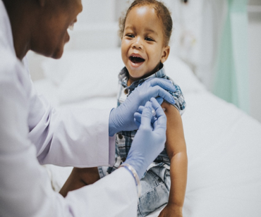
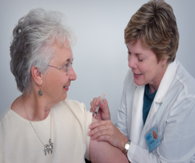
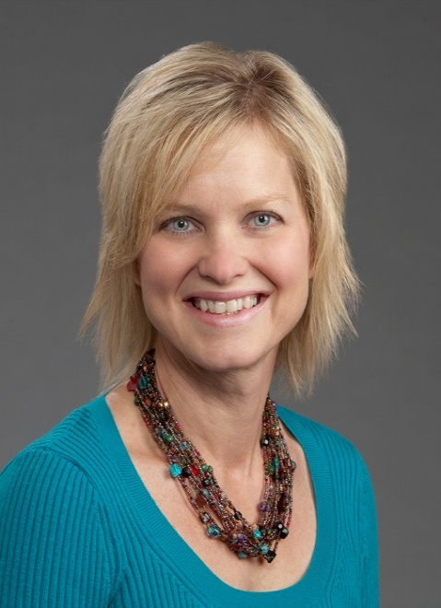
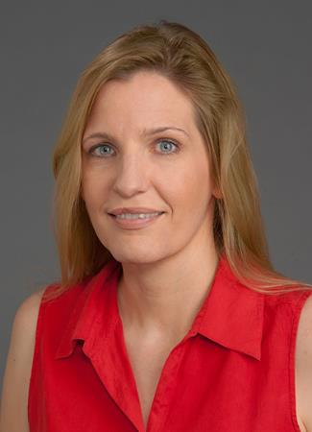
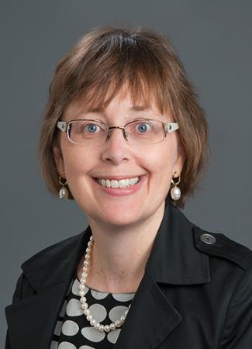
Directors: Martha A. Alexander-Miller PhD, Karen M. Haas PhD, Katherine A. Poehling MD, MPH Because You Matter: Allison Chandler, Cheryl Courtlandt, Stephanie Daniel, Capri Foy, Cara Janusz, Sarah Mabus, Laura Noonan, Katherine Poehling, Beverly Snively, Lauren Vannoy
Center for Vaccines at the Extremes of Aging
Purpose/Mission
To improve health and save lives in our most vulnerable populations through developing more effective vaccines and promoting their uptake through educational activities.
To improve the effectiveness, safety, and uptake of vaccines in the very young and very old using basic, translational, public health, and clinical research as well as community education.
To leverage diverse perspectives and generate innovative approaches to overcome the limitations of vaccination in the very young and the very old.
To increase vaccine confidence.
Leadership
Membership
43 members across Winston-Salem and Charlotte campuses
Members from 13 departments--3 Basic Science and 10 Clinical
Types of Science
Vaccine development for
newborns (influenza)
infants (E. coli)
elderly (S. pneumoniae)
COVID-19
Innate immune regulation in elderly
Vaccination and immunity in pregnant women and their infants
Immune regulation & Alzheimer’s Disease
Vaccine hesitancy/confidence
Improving implementation and equity as a part of the Academic Learning Health System
Foci of Interest from Strategic Planning Retreat
Vaccine hesitancy/confidence
Mucosal immunity
Leveraged Resources
Brenner Children's Hospital
Center for Advancing Pediatric Excellence
Levine Children’s Hospital
Maya Angelou Center for Health Equity
Nonhuman Primate Colony
Qualitative and Patient-Reported Outcomes Shared Resource (Q-PRO)
Sticht Center for Healthy Aging and Alzheimer's Prevention
STRIVE for Healthier Futures
Community Outreach
Rx for Science Literacy- Vaccines
Host annual Rx for Science Literacy workshop on vaccines for middle and high school teachers across the state, including rural NC. Center members present information for teachers to use in their classrooms and share cutting-edge research. Presenters include students who share their work and hone skills in communicating research to non-scientists.
Mentoring and Training
Junior faculty (MD, PhD, DVM)
Mentored research with publications
Elizabeth Halvorson, MD, MS (Pediatrics)
Matthew Zuber, MD (ObGyn)
Charles Semelka, MD (IM/Geriatrics)
Mentored to K grant submission
Shane Sills, DVM, current PhD student supported with pilot funding
Pilot funding to support independent research program development
Matthew Zuber, MD (ObGyn): Association between maternal smoking exposure during pregnancy and vaccine response/transplacental antibody transfer
David Kram, MD (Pediatrics):
Addressing vaccine-hesitant individuals using an altruism-focused educational intervention
Graduate and medical students
Center members train students pursuing PhD, MD, DVM, and MS degrees and host short research experiences for students interested in research.
Because You Matter: Conversations You Want about COVID-19 Vaccine
Objective:
Focus group informed development of a tailored and EHR-linked toolkit to address COVID-19 vaccine concerns and increase vaccine acceptance in adults.
Study Population: 22 individuals across both regions
20 to 77 years of age
82% female, 50% Hispanic, 32% Spanish-speaking
Results:
Preliminary Themes
Influence of myths (e.g., altering DNA, trackers)
Cultural considerations & community beliefs (e.g., translations need to use everyday language and interactions need to value family connections)
Information specific to me (e.g., COVID + diabetes)
Include community in message development
Empower trusted influencers familiar with local preferences to disseminate information
Need fresh approach to counter information fatigue (e.g., brief videos, cartoons)
Make information understandable and relatable
Next Steps:
Finalize qualitative analysis
Utilize member checking by inviting focus group members to confirm findings and co-create toolkit
Create questionnaire to identify questions/concerns and inclusive videos to address each concern
Pilot link in MyChart to evaluate use and acceptability of tool, and impact on COVID vaccine acceptance in EHR
Funded by WFSM CTSI (IRB #75790)
https://www.freepik.com
https://www.unsplash.com
Martha Alexander-Miller, PhD Dolores G. Evans, PhD Chair & Professor, Microbiology & Immunology
Karen Haas, PhD Associate Professor, Microbiology & Immunology
Katherine Poehling, MD, MPH Professor, Pediatrics & Epidemiology
Notes:
Working to improve the efficacy and safety of vaccines aimed at preventing and treating disease in the very young and very old through innovative research.

