Slide 1

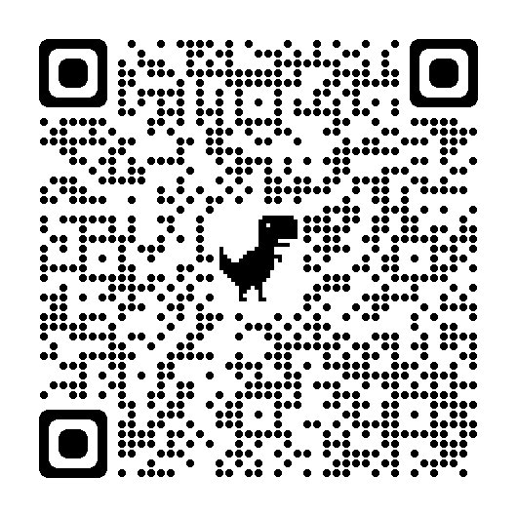
Our Members Have a Vision for Prevention, Research and Evidence-Based Treatment for Individuals with Substance Use Disorders
Center for Addiction Research (CFAR)
Purpose/Mission
To promote state-of-the-art research, education and disseminate effective strategies focusing on:
Advanced preclinical models that lead the U.S. in the development of personalized treatments for substance-related disorders;
Dynamic population research involving epidemiology, community, and policy interventions to promote population health; and
Timely clinical-translational research that will generate new care approaches and contribute new knowledge to our learning healthcare system.
Leadership
The Executive Committee represents the three focus areas of research.
Types of Research
Basic Science
  Human and Animal Subjects
  Imaging: MRI, PET, TMS
  Behavioral Pharmacology
Clinical
  SBIRT
  Telemedicine
Population
  Epidemiology
  Prevention
  Representation
  22 Departments at WFUSM and Atrium Health
  Wake Forest University
  Winston-Salem State Univ
  NC A&T
  University of South Carolina
Membership
Members receive e-mail updates
regarding new science, funding opportunities, and upcoming events.
Training Components
Building an Education & Training Core
Medical Student Addiction Medicine Interest Group
Addiction Medicine Fellowship Program
Master’s Degree in Addiction Research & Clinical Health
Region IV Prevention Technology Transfer Center
NC Governor’s Institute Providers Clinical Support System
Students for Sensible Drug Policies
Intellectual Home for Scientific Discovery
Invited Speakers
Including Dr. Nora Volkow,
Director of the
National Institute on
Drug Abuse
Annual Retreat
Movie Night
Ignite Sessions
World Café
Research Symposia
Recent 5-part Symposium in Collaboration with WFUSM Tobacco Control Center of Excellence
Research Project Spotlight
2022 Funding by CFAR Members = $155,799,100
2023 Pending Grants (to date) = $60,918,416
Creating opportunities for new partnerships. In 2023, CFAR was the catalyst in establishing a Research Agreement with NC A&T, a local Historically Black College and University (HBCU), to promote and encourage multidisciplinary research across the campuses. We are working to extend the agreement to other HBCUs in our region.
Notes:
The Center for Addiction Research offers translational research pilot awards for competitive studies in the area of substance use and addiction.

