Slide 1
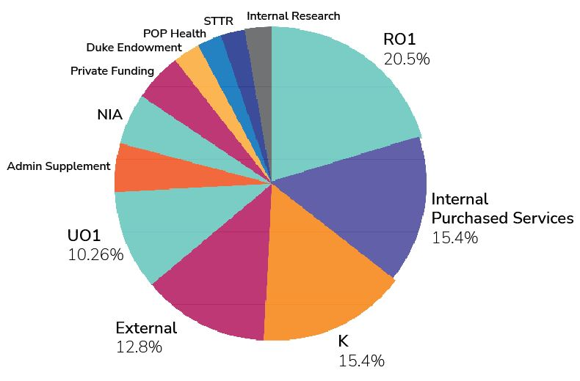
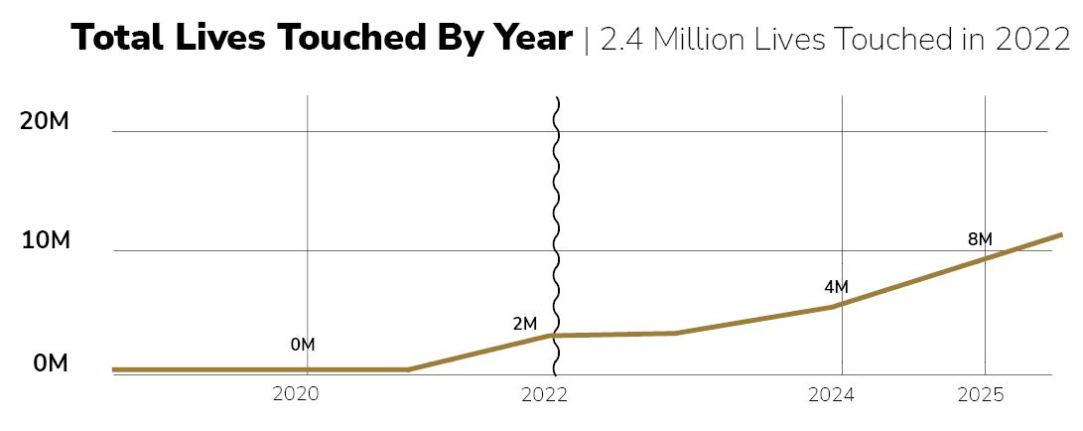
Jeff D. Williamson, MD, MHS; Eric S. Kirkendall, MD, MBI; Paul Yelton, MS; Jen McCraw, MBA, MSN, FNP-BC
Center for Healthcare Innovation
Mission
The mission of the Wake Forest Center for Healthcare Innovation is to collaboratively leverage the unique talents and capabilities of our innovators, digital health tools, scientific discoveries, and clinical care delivery system to improve population health, enhance the patient experience, reduce costs, and improve care provider work life.
The CHI is the only center in the organization that is jointly funded by the School of Medicine and the clinical health system.
Leadership
Jeff D. Williamson, MD, MHS​ CHI Director, Professor of Internal Medicine and Epidemiology; Chief, Section on Gerontology and Geriatric Medicine​.
Eric S. Kirkendall, MD, MBI​ CHI Deputy Director, VP, Chief Medical Information Officer/Chief Information Officer, IAS; Professor, Pediatric Hospital Medicine
Membership
Nearly 100 faculty/staff represented
Comprises more than 20 departments and specialty areas.
Recently launched a tiered-membership program: Core (including Membership Chair role), Champion, and Partner.
Mentor or awardee for more than 15 career development awards
CHI as a Core Driver of the aLHS
Collaborations
Comprehensive Cancer Center
Aging (SCHAAP) / Geriatrics
Center for Biomedical Informatics
Public Health Sciences
Population Health
Telehealth
Community/Diversity
eFRIEND – enrolled participants are over 30% Black and 65% female
DCARE - 27% of enrolled caregivers are underrepresented minorities
eCHI – Black Americans are 2x more likely to develop cognitive decline, and we will include a minimum of 25% of Black participants
Technology Capabilities
Real-time system integration
Scalable architected applications
Complex algorithm design and development
Currently have over 50 projects in the Center’s portfolio
Clinical Application Examples
mPATHTM
Shared clinical decision-making tool allowing patients to request screening for Colorectal Cancer or Lung Cancer
Used by > 60,000 patients
Identified over 4,000 patients due for colorectal cancer screening, 79% of these patients never had a screening.
Has been spun out as a startup called Digital Navigation Solutions, Inc.
Research and Other Funding
electronic Frailty Index (eFI)
eFI is an algorithmic tool utilizing the electronic medical record to mobilize routine data that already exists in a single, automated, objective score
Measured the eFI on over 1.5 million patients at Wake and Atrium
Expanded externally to CHESS (external Pop Health) and their value partners
Completing a customer agreement with UCSD/UC Irvine
Key Publications
Reuben DB, Gill TM, Stevens A, Williamson J, Volpi E, Lichtenstein M, Jennings LA, Tan Z, Evertson L, Bass D, Weitzman L, Carnie M, Wilson N, Araujo K, Charpentier P, Meng C, Greene EJ, Dziura J, Liu J, Unger E, Yang M, Currie K, Lenoir KM, Green AS, Abraham S, Vernon A, Samper-Ternent R, Raji M, Hirst RM, Galloway R, Finney GR, Ladd I, Rahm AK, Borek P, Peduzzi P. D-CARE: The Dementia Care Study: Design of a Pragmatic Trial of the Effectiveness and Cost Effectiveness of Health System-Based Versus Community-Based Dementia Care Versus Usual Dementia Care. J Am Geriatr Soc. 2020 Nov;68(11):2492-2499. doi: 10.1111/jgs.16862. Epub 2020 Oct 6. Erratum in: J Am Geriatr Soc. 2022 Jun;70(6):E19. PMID: 32949145; PMCID: PMC8086629.
Shah SJ, Fang MC, Wannier SR, Steinman MA, Covinsky KE. Association of Social Support With Functional Outcomes in Older Adults Who Live Alone. JAMA Intern Med. 2022;182(1):26–32. doi:10.1001/jamainternmed.2021.6588.
Miller DP Jr, Foley KL, Bundy R, Dharod A, Wright E, Dignan M, Snavely AC. Universal Screening in Primary Care Practices by Self-administered Tablet vs Nursing Staff. JAMA Netw Open. 2022 Mar 1;5(3):e221480. doi: 10.1001/jamanetworkopen.2022.1480. PMID: 35258581; PMCID: PMC8905387.
The SPRINT MIND Investigators for the SPRINT Research Group. Effect of Intensive vs Standard Blood Pressure Control on Probable Dementia: A Randomized Clinical Trial. JAMA. 2019;321(6):553–561. doi:10.1001/jama.2018.21442.
Pajewski NM, Lenoir K, Wells BJ, Williamson JD, Callahan KE. Frailty Screening Using the Electronic Health Record Within a Medicare Accountable Care Organization. J Gerontol A Biol Sci Med Sci. 2019 Oct 4;74(11):1771-1777. doi: 10.1093/gerona/glz017. PMID: 30668637; PMCID: PMC6777083.
Notes:
Improving patient outcomes through innovation.

