Slide 1
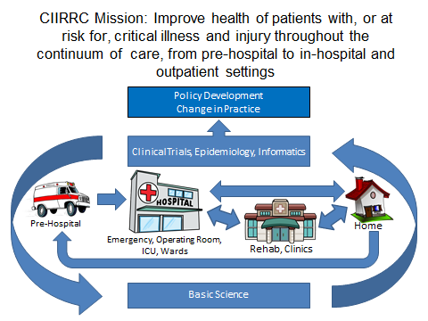
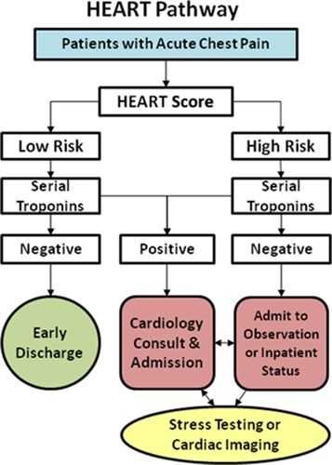
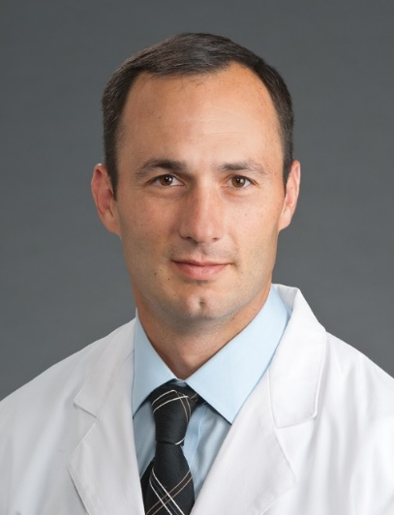
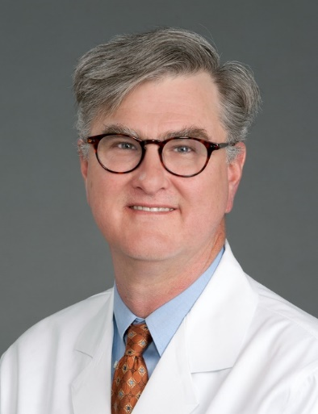
Critical Illness Injury and Recovery Research Center
D. Clark Files MD, Associate Professor and Chief, Pulmonary, Critical Care, Allergy and Immunologic Diseases
Purpose/Mission
The CIIRRC confronts the economic/healthcare challenge of high morbidity and mortality from critical illness and injury
CIIRRC integrates basic and clinical translational research across the continuum from pre-hospitalization (emergency medical services), emergency care, acute critical care hospitalization, post-hospital care, and community re-entry.
Leadership
Chadwick Miller MD MS
Professor and Chair, Emergency Medicine
D. Clark Files MD
Associate Professor, Pulmonary,
Critical Care, Allergy and Immunologic Disease
James Holmes MD
Professor, Burn Surgery
Membership
Number of Members: 37
Departments Represented: 14
2022 Publications: 198
22% of publications authored by more than one CIIRRC Member
Steering Committee Members: 10
Ellie Rahbar PhD (Biomedical Engineering), Charles McCall PhD (Int Med-Molecular Medicine), Kevin Gibbs MD (Pulmonology), Samuel Carmichael MD (Surgery Trauma), Shayn Martin MD (Surgery Trauma), Simon Mahler MD (Emergency Medicine), James Winslow MD (Emergency Medicine), Jessica Palakshappa (Pulmonology)
Types of Science
CIIRRC aims to combine physicians and providers from multiple care areas with scientists to improve models of care and patient outcomes.
CIIRRC embraces an Academic Health Learning System model by fostering collaboration on clinical trials, providing a platform/forum for research collaborations, and Pilot funding for early career investigators.
CIIRRC members have been awarded funding from multiple sources:
Training Components
CIIRRC Hosts a series of Grand Rounds presentations with distinguished visitors.
Speakers since 2019 included: David Calvin Goff Jr. M.D., Ph.D., FACP, FAHA (NHLBI), Bill Barsan MD (University of Michigan), Landon King MD (Johns Hopkins University), Bala Venkatesh MD (University of Queensland)
“Think Tank Series” of Seminars in 2022 with a focus on promoting research collaboration across the Southeast Region of Advocate Health.
CIIRRC awards up to 2 pilot projects per year to facilitate the development of extramural research grant proposals.
Academic Learning Health System
CIIRRC Changes medical care delivery for our patients. Some examples:
ORCHID Trial (PI) funded by NIH demonstrated that hydroxychloroquine did not help patients hospitalized with COVID-19.
Wake Forest is co-leading the ASTER trial nationally—this NIH-funded clinical trial will evaluate whether acetaminophen can limit injury to blood vessels in hospitalized critically ill patients.
Research Project Spotlight
CIIRRC collaborates with other Research Centers. The NIH-funded AngioNECTAR Trial is a collaboration with Hypertension and Vascular Center. In this study, scientists are measuring the Renin-Angiotensin Pathway in patients with COVID-19 in patients hospitalized across the country with COVID-19
CIIRRC supports new care pathways. The HEART Pathway (PI: Simon Mahler MD, MS): reduces objective cardiac testing during 30 days, shortens the length of stay, and increases early discharges.
Notes:
The Critical Illness, Injury and Research Recovery Research Center (CIIRRC) seeks to improve the burden of critical care-related disorders on human health. Our approach, including prevention, treatment and recovery, will use a discovery-based model to bridge the translational research spectrum of basic, clinical, epidemiologic and health policy sciences.

