Slide 1
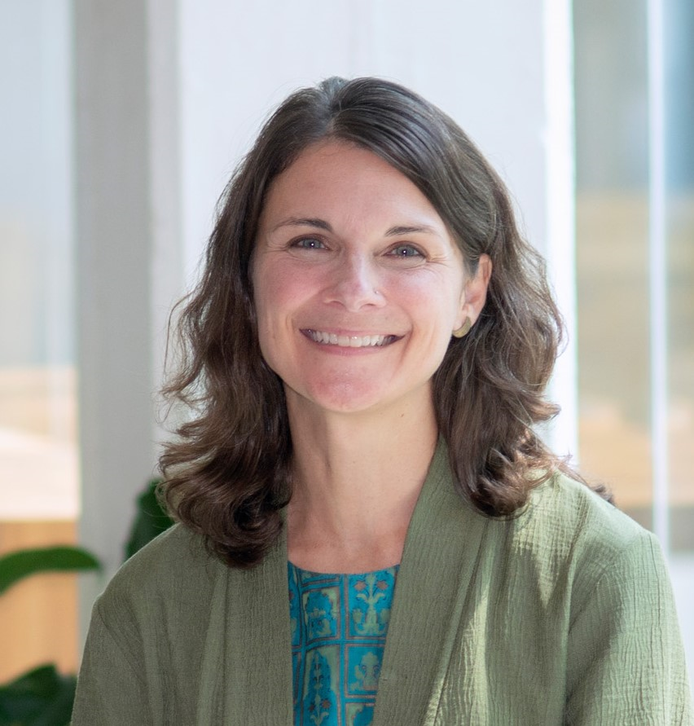
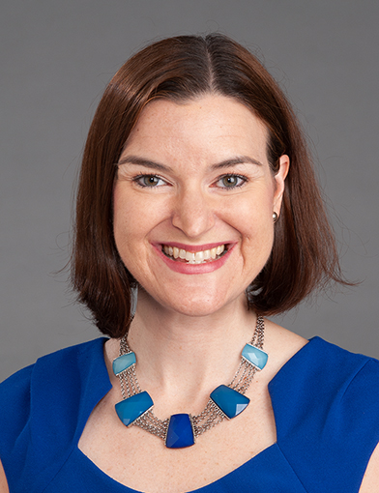
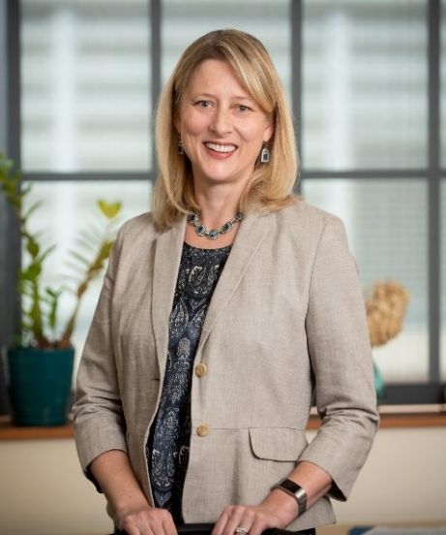
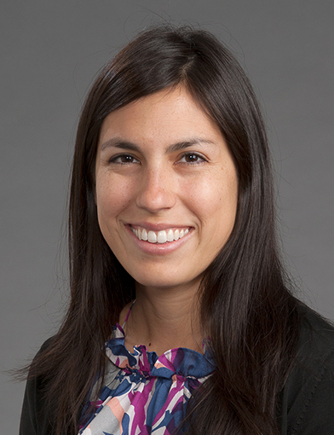
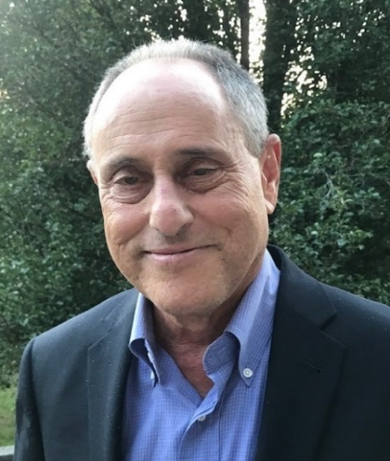
Suzanne C. Danhauer, Ph.D., Professor & Vice Chair, Department of Social Sciences & Health Policy; Director of Faculty Well-Being & Resilience,
Office of Faculty Affairs; Director, Center for Integrative Medicine, Wake Forest University School of Medicine
Center for Integrative Medicine (CIM)
Purpose/Mission
Longstanding. To promote integrative health and wellness through synergy of research, patient-centered care, education, and community engagement.
Current. To develop critical new areas:
  (1) well-being programs for our internal workforce
  (2) well-being/integrative health programs and services for the local community
  (3) establishment of an integrative health curriculum for learners across the enterprise
What is Integrative Medicine?
Integrative medicine and health reaffirm the importance of the relationship between practitioner and patient, focus on the whole person, is informed by evidence, and make use of all appropriate therapeutic and lifestyle approaches, healthcare professionals, and disciplines to achieve optimal health and healing (Academic Consortium for Integrative Medicine & Health).
Leadership
Science – Selected Studies
Partnerships
Integrative Medicine Clinic, Atrium Health Wake Forest Baptist (Wynne Brown, MD, Medical Director)
Academic Consortium for Integrative Medicine & Health
Veterans Affairs (VA) – VA-Private Sector Executive Management Fellow, Kathy Hedrick, PhD (2022-23)
Office of Faculty Affairs, Wake Forest University School of Medicine
(Developing) Community Partnerships
Training Components
Integrative medicine training for medical students directed by Dr. Baute Penry.
Integrative Medicine Certificate Program
  Over 100 medical students enrolled
  Program combines monthly topical lectures, experiential sessions, and community service (≥10 hours required)
Curriculum Design & Scholarship
  Nutrition module developed by Dr. Baute Penry and medical student.
  Survey revealed significant gap in medical student comfort level/knowledge of nutritional counseling.
  Nutrition module will be incorporated into the formal curriculum.
Community Outreach
  Student interest group helped to organize the Share the Health Fair (preventive health counseling for >500 local people).
  Student interest group routinely volunteers in the community
  (e.g., DEAC Clinic, Shalom Project).
Research Project Spotlight
Burnout in academic medicine faculty is a significant issue with numerous professional and personal consequences. It stems from a variety of “drivers.” This project targets “social support and community at work” as one driver of burnout and well-being.
Research Project Spotlight (cont.)
Connect • Reduce Stress • Calm Body & Mind
The ANCHOR Program
Background. Program based on Mind-Body Skills Program developed at Georgetown. Program evidence suggests decreased stress, depression, anxiety, sleep issues, and burnout; and increased mindfulness, empathy, meaningful connections, and well-being. The program also has demonstrated a transformative impact on individuals and medical school culture.
Target Group. Wake Forest University School of Medicine faculty or Atrium Health Wake Forest Baptist administrative leaders (N=100).
Program. Nine weekly 2-hour experiential sessions. Ten groups (n=10 each) over 3 years.
Measures. Pre- and post-program questionnaires (burnout, stress, mental/physical health, positive/negative emotions, flourishing, social connectedness) and program feedback.
Fit with Atrium Health strategic plan priority #1 (teammates and culture) and AMA Joy in Medicine recognition.
CIM Funding Source: Guth Family Fund in Integrative Medicine
ANCHOR Program Funding Source: The Duke Endowment
Yoga. Remotely-delivered Supportive Programs for Improving surgical pain and distress (RESPITE). R01 funding from the National Cancer Institute (8/22-
7/27). PI: Stephanie Sohl, PhD; Co- Investigators: Drs. Lees, Naumann, Kelly, Danhauer, Wells, Birken, Fanning, Levine, & Tooze.
Mindfulness. Online TEAM Migraine: Online Techniques and Education Aimed to Manage Migraine. R01 funding from the National Center for Complementary
& Integrative Health (7/22-6/27). PI: Rebecca Wells, MD; Co-Investigators: Drs. Powers, Gardiner, O’Connell, Moore, Schuman-Olivier, Yang, Haas
Suzanne C. Danhauer, PhD, Director, Center for Integrative Medicine
Vanessa Baute Penry, MD, Associate Director of Education, Center for Integrative Medicine
Jeffrey B. Feldman, PhD, Liaison to Academic Consortium for Integrative Medicine & Health
Notes:
Providing comprehensive, evidence-based care with a focus on improving overall health and well-being through innovative research and training.

