Slide 1
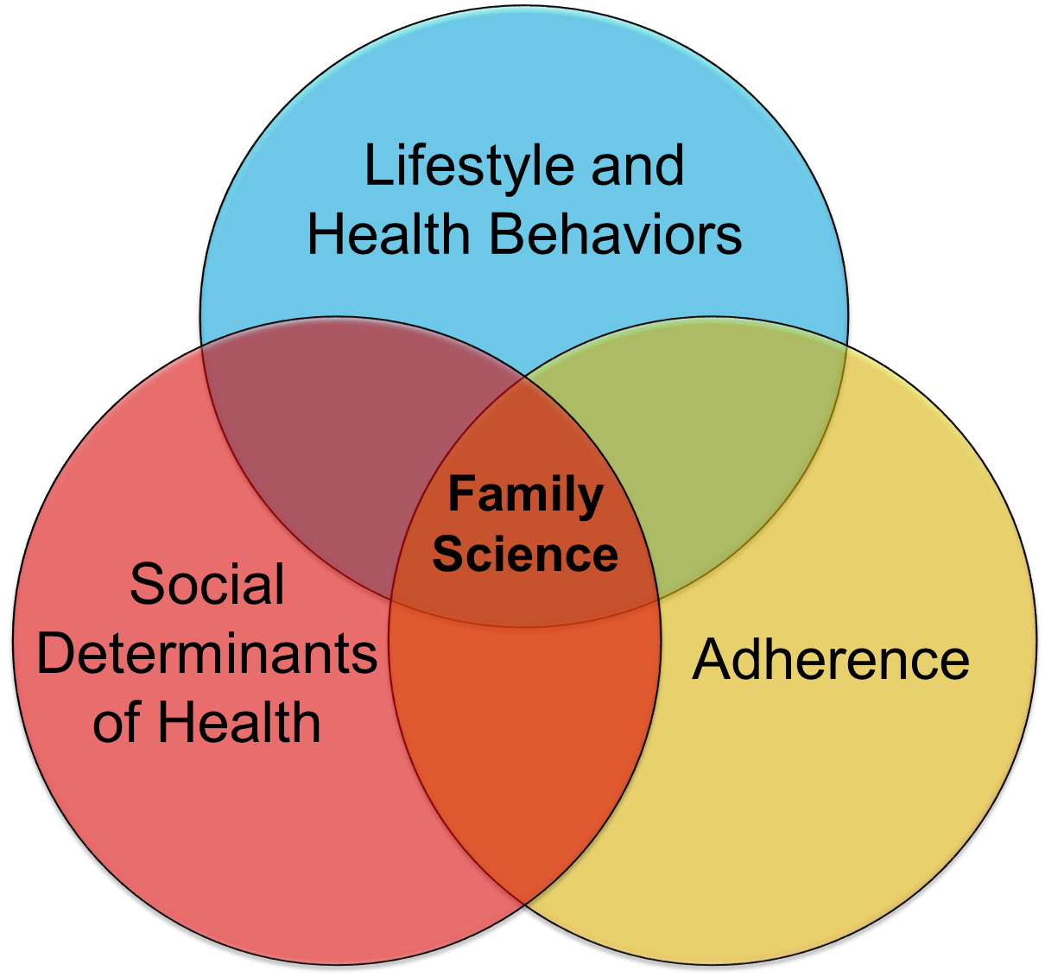
Joseph A. Skelton, MD, MS, Department of Pediatrics Mara Z. Vitolins, DrPH, RD, Department of Epidemiology and Prevention
Center for Prevention Science
in Child and Family Health
Purpose/Mission
To highlight the importance of understanding children within the context of their family, given that the family is the most important and proximal influence on the health and well-being of the child.
Expand this understanding beyond parenting to include family communication, relationships, and functioning.
Address the critical need to account for the family system in pediatric research to inform clinical care and health policy.
The long-term goal is to establish a nationally-recognized center investigating the influence of family on chronic disease prevention.
Leadership
Joey Skelton, MD, MS
Professor of Pediatrics
Director
Mara Vitolins, DrPH, RDN
Professor of Epidemiology
and Prevention
Associate Director
Diverse Membership
5 WFUSM academic departments
All faculty ranks represented
1 Post-Doctoral Fellow
4 Assistant Professors
4 Associate Professors
2 Professors
Diverse research disciplines
Obesity
Social determinants of health
Implementation Science
Education
Biostatistics and Analysis
Membership
During the initial year, 10 core members were actively engaged. In 2023, additional members will be added by invitation with plans to open membership to all faculty across the Health Enterprise in 2024.
Center members are responsible for attending monthly meetings, writing and reviewing manuscripts, reviewing applications for Center funding opportunities, developing and submitting grant applications in collaboration with other members, participating in research studios, and contributing to the Center’s Virtual Library in their area(s) of expertise.
To join, applicants are asked to present their current research via seminar, discuss ways this work includes or impacts prevention science and child/family health, and opportunities for collaboration.
Types of Science
Family Science: parenting style, family stress, family communication, and function
Lifestyle and Health Behaviors: child and family obesity, measurement of diet and physical activity behaviors
Adherence to treatment regiments: attrition and dropout, missed appointments, adherence studies
Social Determinants of Health: food insecurity, neighborhood and built environment, socioeconomics, social and community context
Center Activities and Resources
Summer Research Internships
Pilot Awards: $20,000 annual pilot program for studies that align with the purpose and mission of the Center
Visiting Professors: 2 visiting experts per year, rotating between different research domains of the Center
Mentorship: Center members provide research guidance to early career faculty
Collaborative Research Meetings and Team Science: monthly meetings to focus on works in progress, manuscript writing, and grant development; joint development of grant applications leveraging Center resources and expertise
Virtual Library: online resource developed and maintained by the Center featuring methodology and measures pertinent to the Center, with a particular focus on Family Science
Infrastructure: provide administrative and operational support for grant submissions, study start-up, and project management
Research Project Spotlight
Inaugural Pilot Award Recipient:
Leila DeWitt, DO, MA- PI
Assistant Professor of Pediatrics
“Hungry and Hospitalized- Perceptions of a Pediatric Hospital-based Food Pantry”
Understanding the impact of food insecurity (FI) interventions during an inpatient admission, when families are under great stress and lives are disrupted, is an important step in addressing the social determinants of health (SDH). To better understand the impact of the inpatient food pantry, we will conduct a mixed-methods study to include:
Semi-structured interviews with providers and caregivers to determine the acceptability of the inpatient food pantry.
Collect pilot electronic health record (EHR) data to assess the association of food insecurity and food pantry use with child health and healthcare utilization outcomes.
Preliminary Findings: Qualitative interviews identified several emerging themes-
Hospitalized families experience FI at home
Hospitalization exacerbates FI for parents and their children
Lack of food access negatively impacts their hospital stay
Families generally respond positively to being asked about FI during their hospital stay
Families consider inpatient food pantry to be a helpful resource
Next steps:
Complete EHR data collection and analysis
Conduct larger study on effects of ameliorating FI following hospital stays
Figure 1: Research Domains of Center
Notes:
Focused on investigating the influence of family on chronic disease prevention.

