Slide 1
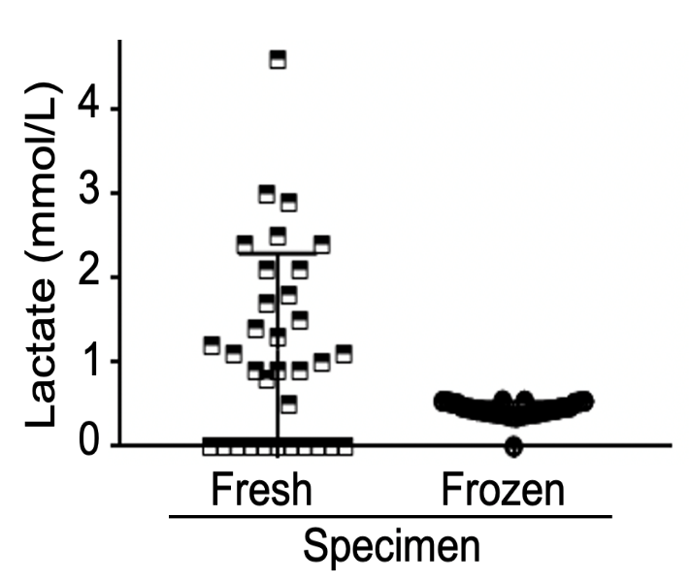
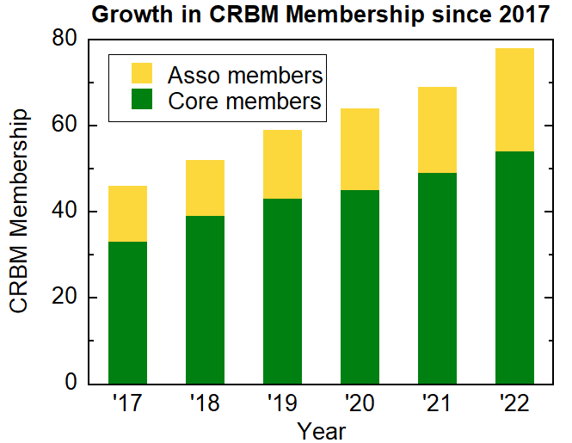
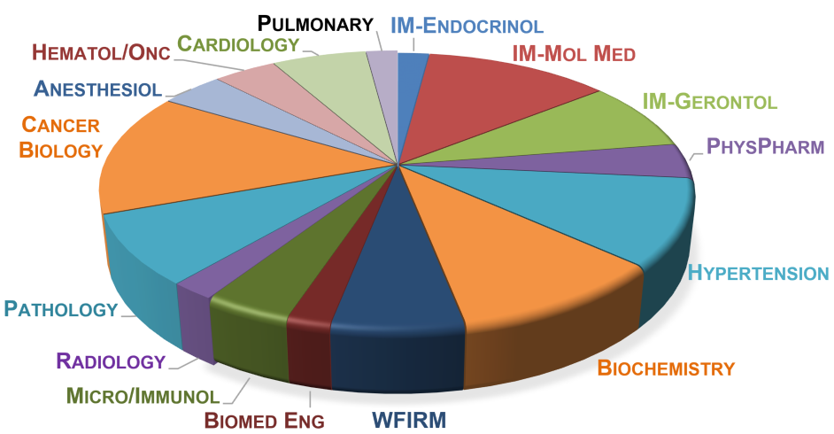
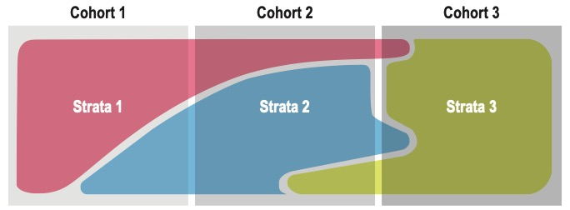
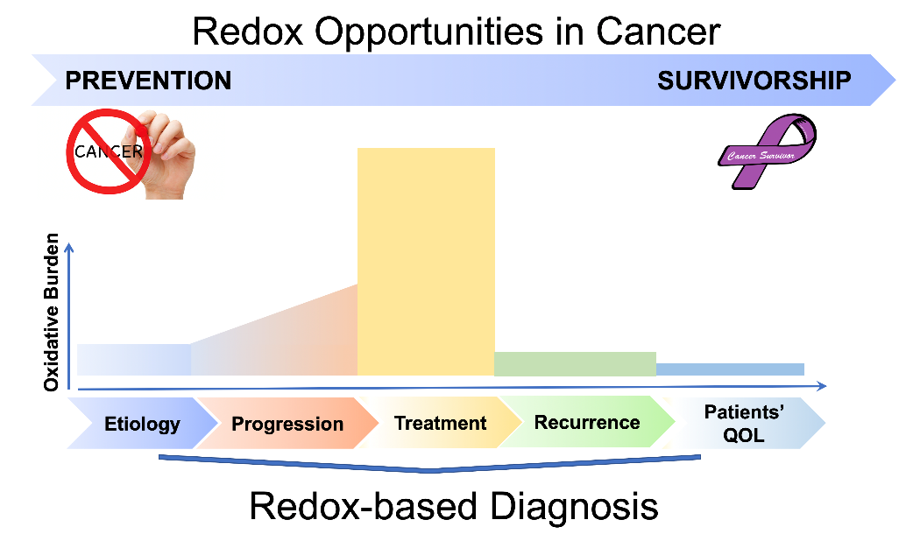
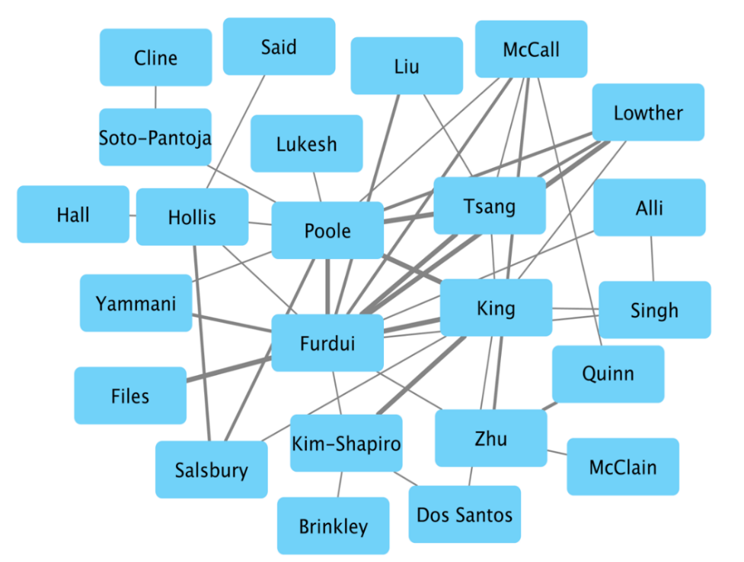
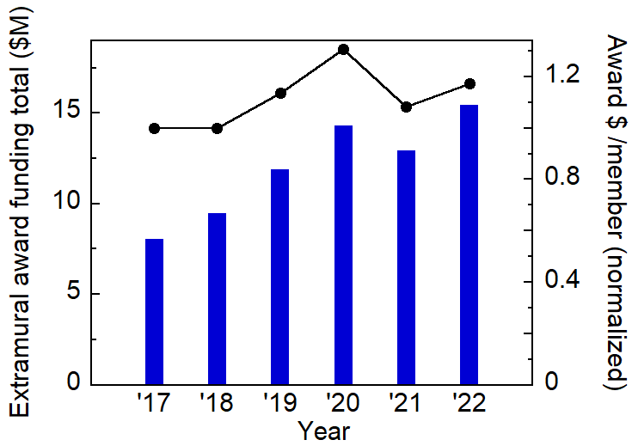
Co-Director, Cristina M. Furdui, PhD, Department of Internal Medicine, Section on Molecular Medicine Co-Director, Leslie B. Poole, PhD, Department of Biochemistry
Center for Redox Biology and Medicine
Mission
The CRBM core mission is to coordinate and facilitate cross-campus, inter-departmental, and multidisciplinary educational and research programs that have the common goal of advancing knowledge and improving the health of everyone, particularly patients suffering from diseases with disrupted redox balance such as cancer, aging, infectious diseases/sepsis, obesity-associated diabetes, and cardiovascular diseases.
CRBM’s bench-to-bedside and back research fosters development of cutting-edge redox-based diagnostics, new redox therapeutics, and innovative solutions for preservation of clinical specimens to facilitate discovery of clinically relevant biomarkers.
Priorities
Leverage local and national resources and work with other Centers around the Enterprise to advance the core mission.
Promote equity, diversity and inclusion in all research and training activities.
Provide support for pilot studies to encourage new, interdisciplinary collaborations leading to extramural funding.
Create cutting-edge education and seminar programs to expand the international recognition of the institution in redox biology and medicine.
Leadership
Co-Directors Cristina Furdui and Leslie Poole are world leaders in the expanding field of redox biology, and co-lead the center with an Executive Committee of five other faculty members @ WFUSM: Suzanne Craft, PhD; W. Todd Lowther, PhD; Donald A. McClain, MD, PhD; and @ WFU: Gloria Muday, PhD; S. Bruce King, PhD.
Membership
Membership continues to grow, from 33 faculty members in 2017 to 54 (Atrium Health/WF), representing 18 clinical and academic departments. Associated faculty (24) are from WFU basic sciences and regional institutions.
Members are highly collaborative (inter-action network of a subset below), and bring in substantial extramural research support, which has grown 1.9X in 6 years.
The Science of Redox Biology
Chemical reactions involving electron transfers (reduction and oxidation, i.e. redox reactions) are intricately associated with life and health.
Oxidizing species (collectively referred to as ROS, or Reactive Oxygen Species) are natural signals that regulate and balance the energy state of cells/organs/body.
In excess, ROS may divert normal signaling pathways and damage molecules, leading to impairment and disease.
Education and Training
CRBM provides an educational environment for redox-related research activities across multiple institutions
CRBM supports and encourages research and career mentoring for redox biology trainees at all levels
NIH/NIGMS T32 Training Program in Redox Biology and Medicine is currently in its 5th year
Started in 2019, this program has supported 13 PhD candidates (~2 years each), 7 of whom have graduated
Averages: 5.2 years to degree (PhD), and 4.6 publications per fellow, including in high-impact journals.
Center Activities (selected)
Annual Retreat (full day), with guest speaker, talks & posters
@WakeRedox Seminar Series
RBM T32 Training Program Activities, enriching the research environment:
Chalktalks (2 sessions/year)
Course in Redox Biology and Medicine
Alumni visits to enhance awareness of the diversity of scientific careers
Annual Call for Pilot Grants, 7 of the 25 CRBM-funded pilot studies has already resulted in extramural funding support.
Working Groups and Workshops
Metabolomics and Inflammation Working Group (regularly, Mon 1 PM)
Workshops: e.g., Redox Innovations (half-day), interest group with redox- and IP-related projects seeking collaborations
Innovative Research Project Spotlight
Redox Trapping for Preservation of Clinical Specimens (Furdui, Files et al)
New ROS PET Imaging Radiotracers (Solingapuram Sai et al)
Mitigation of doxorubicin (Dox)-induced cardiotoxicity (Lukesh, Poole et al)
Limiting artifactual oxidation of specimens is critical to:
reduce pre-analytical variability.
enable discovery of redox biomarkers.
improve clinical diagnosis, enable patient-tailored treatments, and improve prediction of outcomes.
Data showing loss of inter-patient variability for lactate and loss of information upon specimen freezing.
Utilize patented chemical reagents to develop a new blood stabilizing formulation.
Validate the new formulation for improved collection and analysis of blood compatible with advanced research technologies.
Scale-up collection and analysis of redox preserved specimen across EMPACT NETWORK
Study participants will be enrolled by Cohort (1: infection; 2: sepsis 3; 3: septic shock) and post-hoc adjudicated for Strata.
Phase I
Phase II
EMPACT:
EMbedded Precision in Acute Care Trials
IMPACT: Redox-based diagnosis could be critical to understand heterogeneity that is associated with the pathogenesis and resolution of sepsis in humans.
Ascorbate-based PET radioligand, [¹⁸F]KS1 can measure ROS.
Dual action: at tracer concentrations, it tracks ROS and at pharmacologic concentrations, it kills tumor cells.
A. B.
Extramural funding ↑ ~20%/member
Biomed Pharmacother. 2022;156:113937.
PET/CT images 90 min post-injection of [¹⁸F]KS1 in a A. healthy and B. irradiated hepatic-tumor bearing rhesus monkey. Arrows indicate L: liver, H: heart, K: kidneys, B: bladder, and LT: liver tumor.
IMPACT: Novel redox PET imaging radiotracers are broadly applicable to cancer and other diseases with inflammatory mechanisms of evolution enabling early detection and therapeutic intervention.
Released to form antioxidant H₂S
Cardiomyoblasts tested for cytotoxicity, caspase cleavage and Nrf2 activation
Released upon reaction with H₂O₂
Doxorubicin
Redox Biol. 2022;53:102338.
IMPACT: Novel prodrug, imparting tumor-selective activation by ROS delivering both DOX and H₂S; a highly promising and synergistic strategy for combating DOX-induced cardiotoxicity in cancer survivors.
Notes:
Aiming to improve the knowledge of redox processes contributing to diseases through innovative interdisciplinary research.

