Slide 1
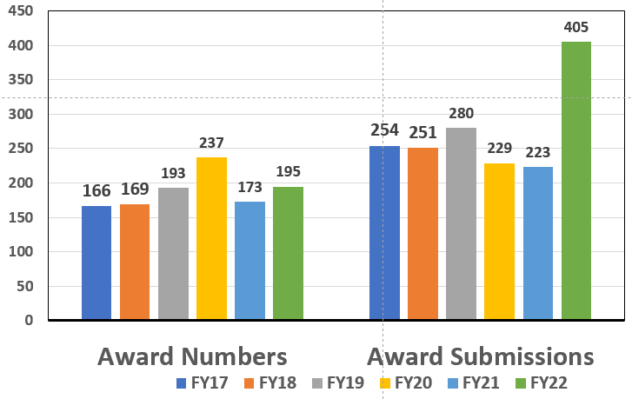
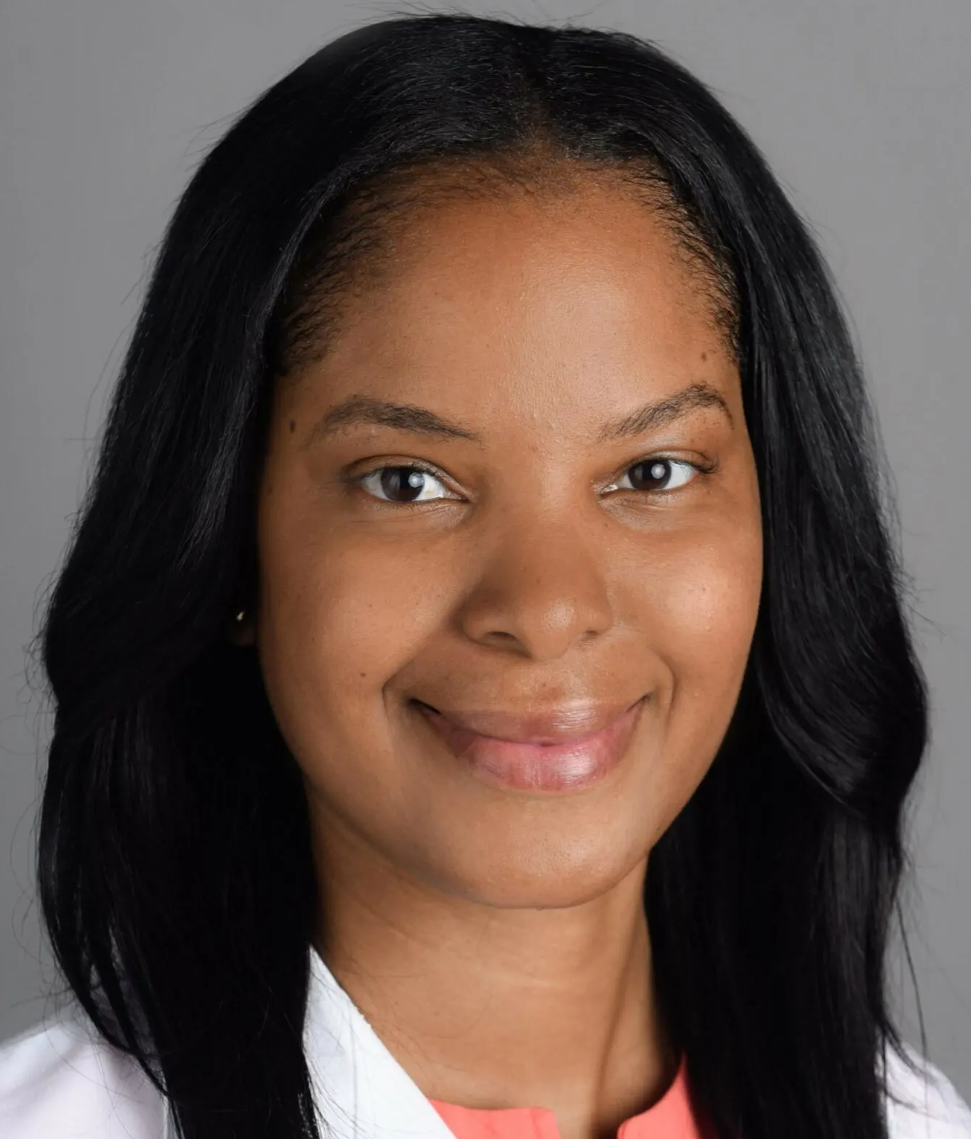
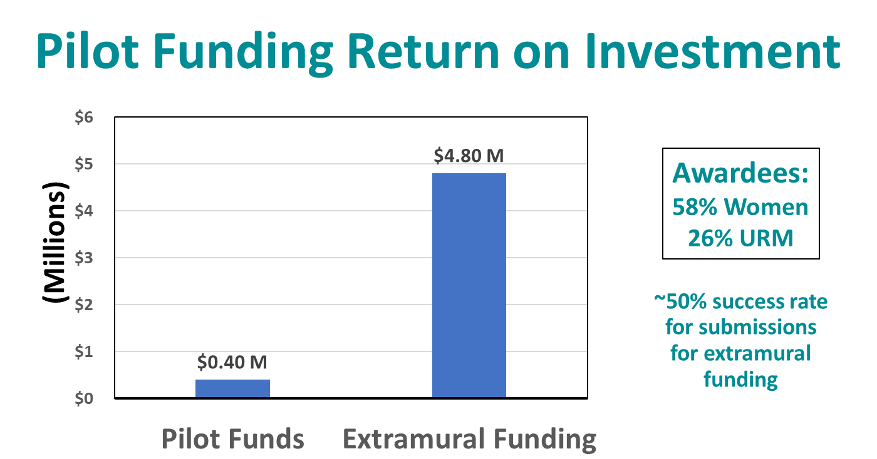
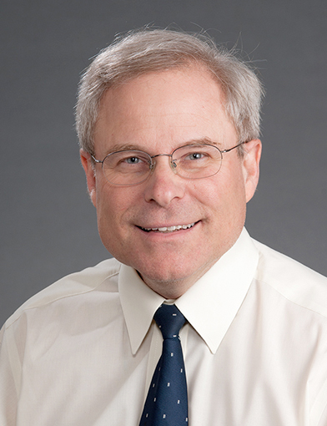
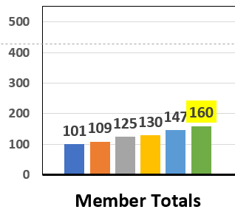
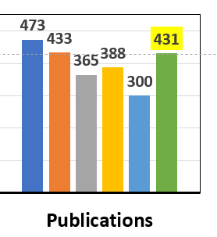
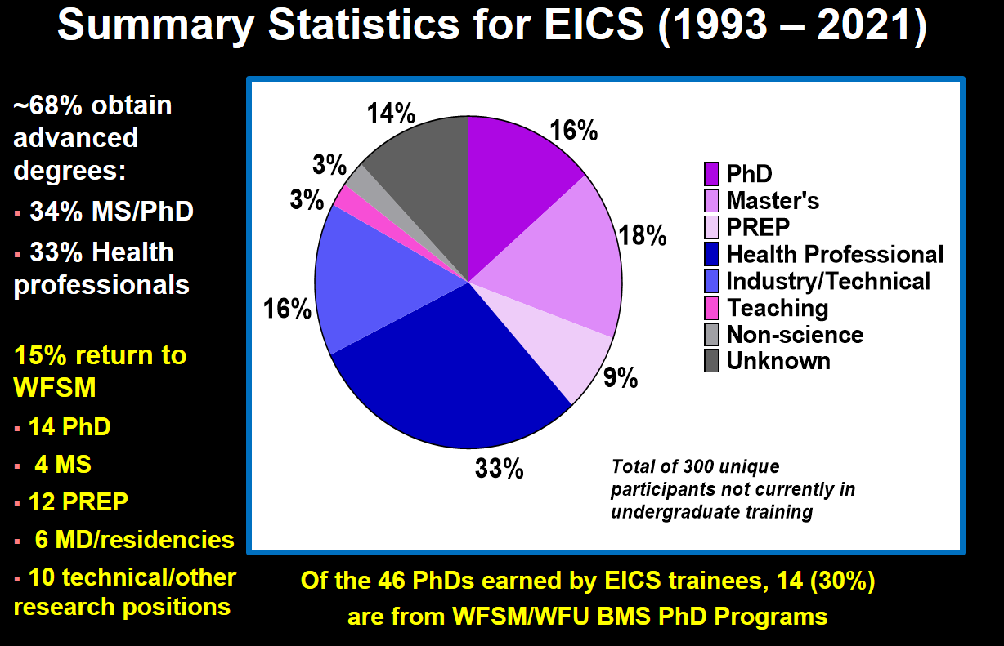
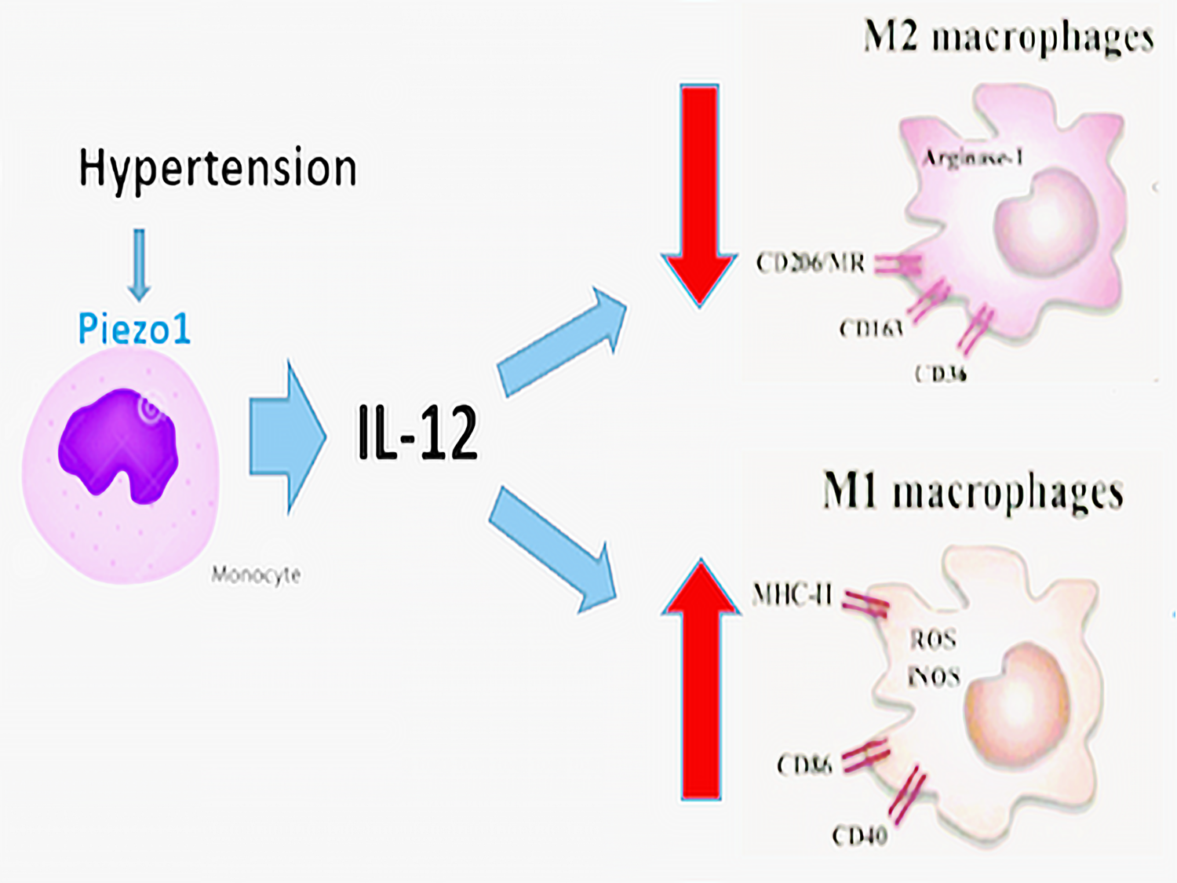
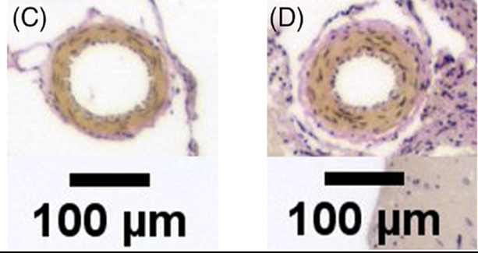
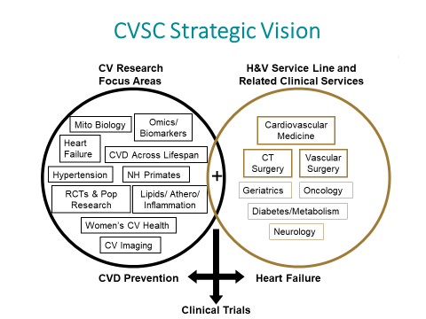
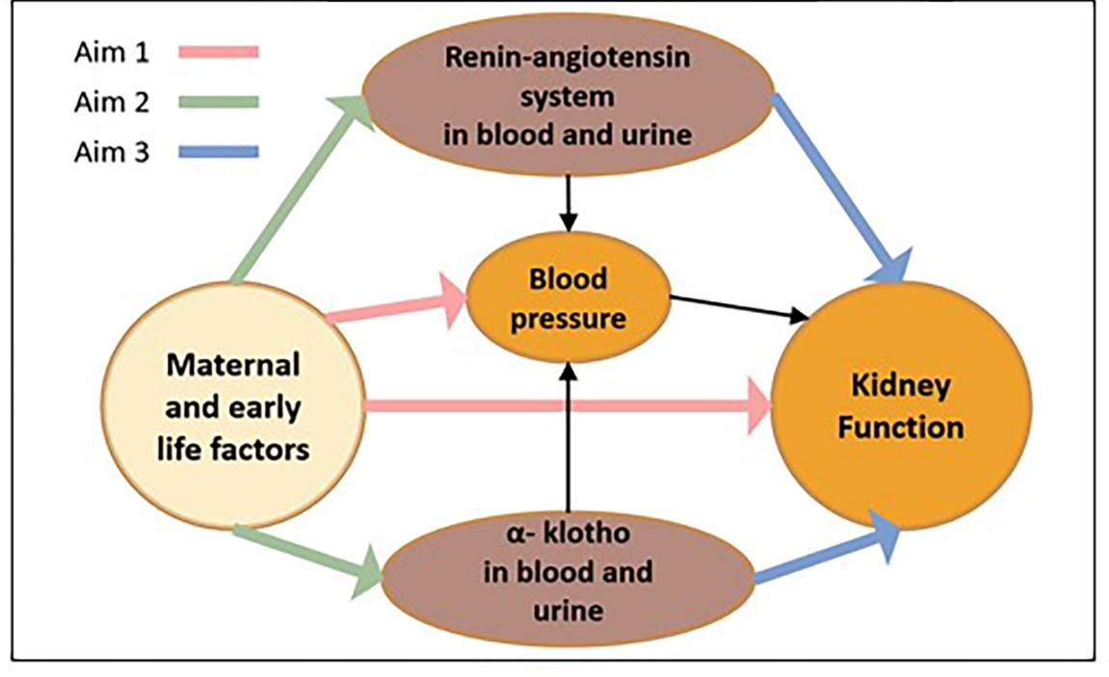
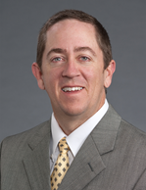

Debra Diz, PhD, Co-Director CVSC, David Herrington, MD, MHS, Co Director CVSC & Enterprise Vice Chair for Research, AH H&V Service Line
David Zhao MD, PhD, Enterprise Academic Chief for AH H&V Service Line, Geoff Rose, MD, Enterprise Chief for AH H&V Service Line
Cardiovascular Sciences Center (CVSC) &
AH Heart and Vascular (H&V) Service Line
Purpose/Mission
Provide key coordination and support for investigators engaged in CV research across the AHWF Enterprise to foster innovation and discovery concerning prediction, treatment, and prevention of cardiovascular diseases.
Three strategic priorities:
Enhance communication across the cardiovascular research community.
Facilitate ongoing and new research.
Support early career development of cardiovascular investigators.
CVSC Leadership
Organizational chart above illustrates the CVSC leadership groups promoting diverse, multi-disciplinary teams working on topics well-aligned with the Institutional Research Strategic Plan and Heart & Vascular Service Line priorities. We engage member input through 6 committees/12 committee leaders/~62 members involved.
Metrics and Members
Pilot Grants, Training Programs, Core Resources Provide Pathways for Research Careers
Enterprise-Wide Heart & Vascular Research Collaboration Spotlight
Extramural Awards~$70M /yr.
Total Member Funding
(~80% NIH)
FY17 - $42 M
FY18 - $46 M
FY19 - $57 M
FY20 - $86 M
FY21 - $73 M
FY22 - $73 M
Rehab-HFpEF
Clinical Trial
$30M NIH-funded trial in pts with HF
Study-wide PI (Kitzman - WF)
Charlotte PI (Superville – SHVI)
18 other sites across the country
ROI = 10X
Nicole Superville, MD
130 active awards specific for the AHWF Heart & Vascular Service Line in 2022
~400 Publications/yr.
Training Programs Return on Investment
Dalane Kitzman, MD
T32 post-doctoral training (faculty recruitment – 4 recent hires).
CVSC faculty lead CTSI, WIMS, Office of Faculty Affairs, WFU Graduate School program for research mentoring.
Undergraduate research training focused on diversity with WFU, WSSU, NC A&T (Figure shows Excellence in Cardiovascular Sciences (EICS) summer program outcomes).
Pilot Grant Awardees Research Spotlight
Stacey Wolfe, MD, Professor– Neurosurgery
Hypertension worsens secondary brain injury after ICH by Piezo1 mechanoreceptor-induced IL-12 release from monocyte/macrophages
Cardiovascular Sciences Center (CVSC) Directors
Drs. Diz and Herrington
Admin Unit
CVSC Membership (~160)
Executive Advisory Committee
CVSC Pilots (Chairs: Drs. Brinkley, Yamaleyeva)
CVSC Seminar Series
CVSC Resources
CVSC Career Development
Member led funding includes 9 Training grants (T32, T35, R25;
3 diversity focused) and 4 K's totaling $2.3M in ADC
Value of Training is priceless!
Research Resources Aligned with Heart & Vascular (and Other) Service Lines
CVSC Core Resource: Data Scientists
Andrew South, MD, Assoc. Prof – Peds.
Maternal cardiovascular health and offspring programmed hypertension in Vervet monkeys: role of the renin-angiotensin system
Specific CV-focused Expertise:
Analytics, Informatics, Statistics
Epic Clinical Data retrieval and analysis
Database creation, interface with RedCap
Productivity:
  Projects = 11
  Manuscripts = 10
  Grants = 2 submitted; support for initial data management set-up and analysis
  for additional 4+
Assistance is primarily to early career faculty and includes specialized expertise extended to others where needed
Notes:
Integrating the breadth and strengths of cardiovascular research, training the next generation of cardiovascular investigators and connecting outstanding research faculty and clinical care providers for rapid translation of knowledge.

