Slide 1
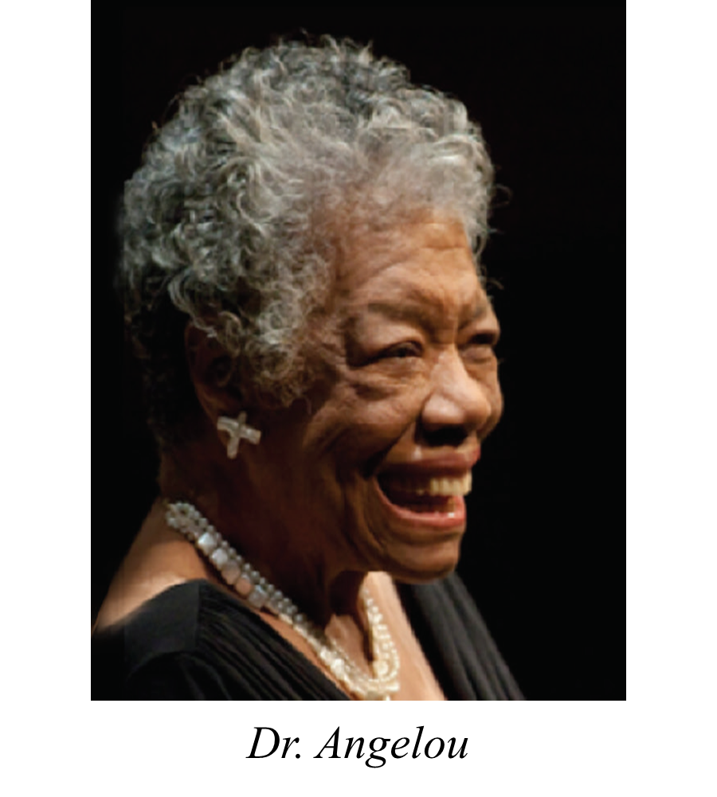
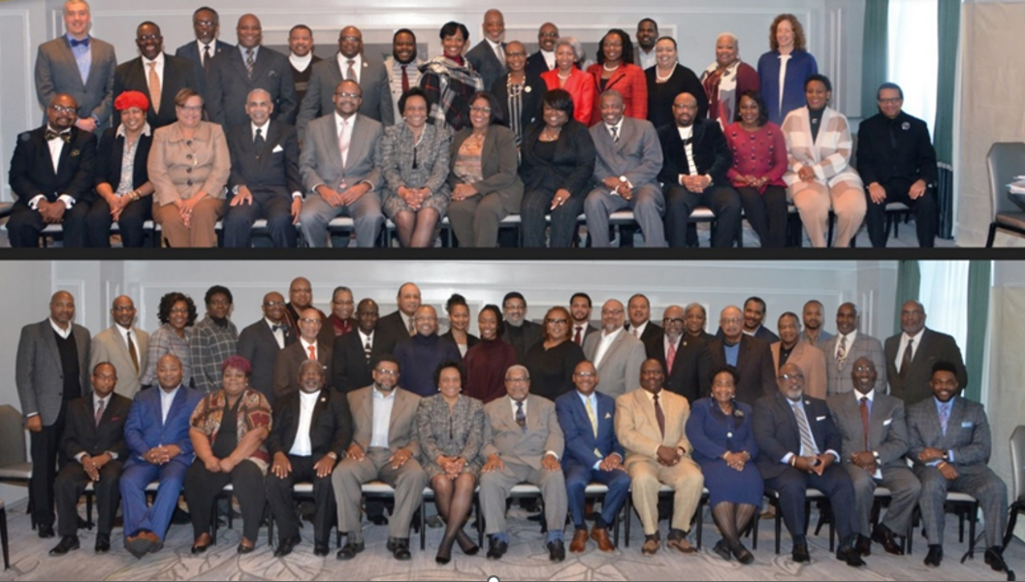
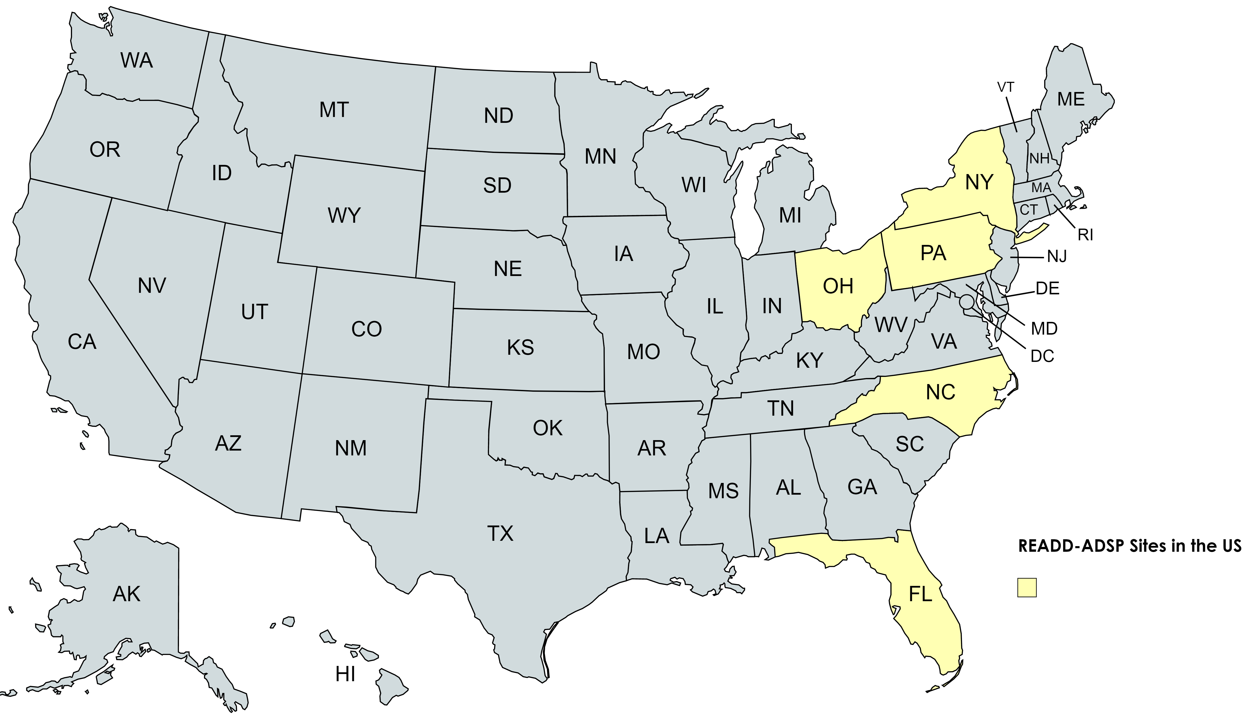
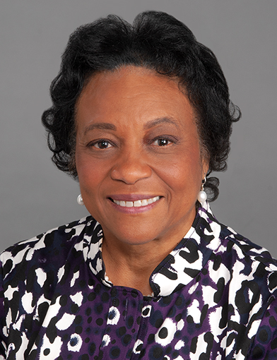
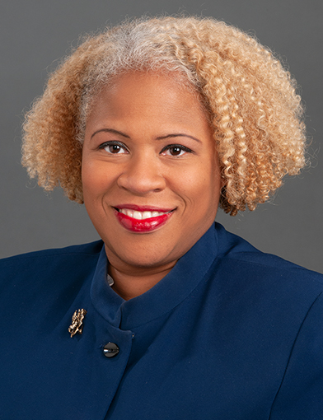
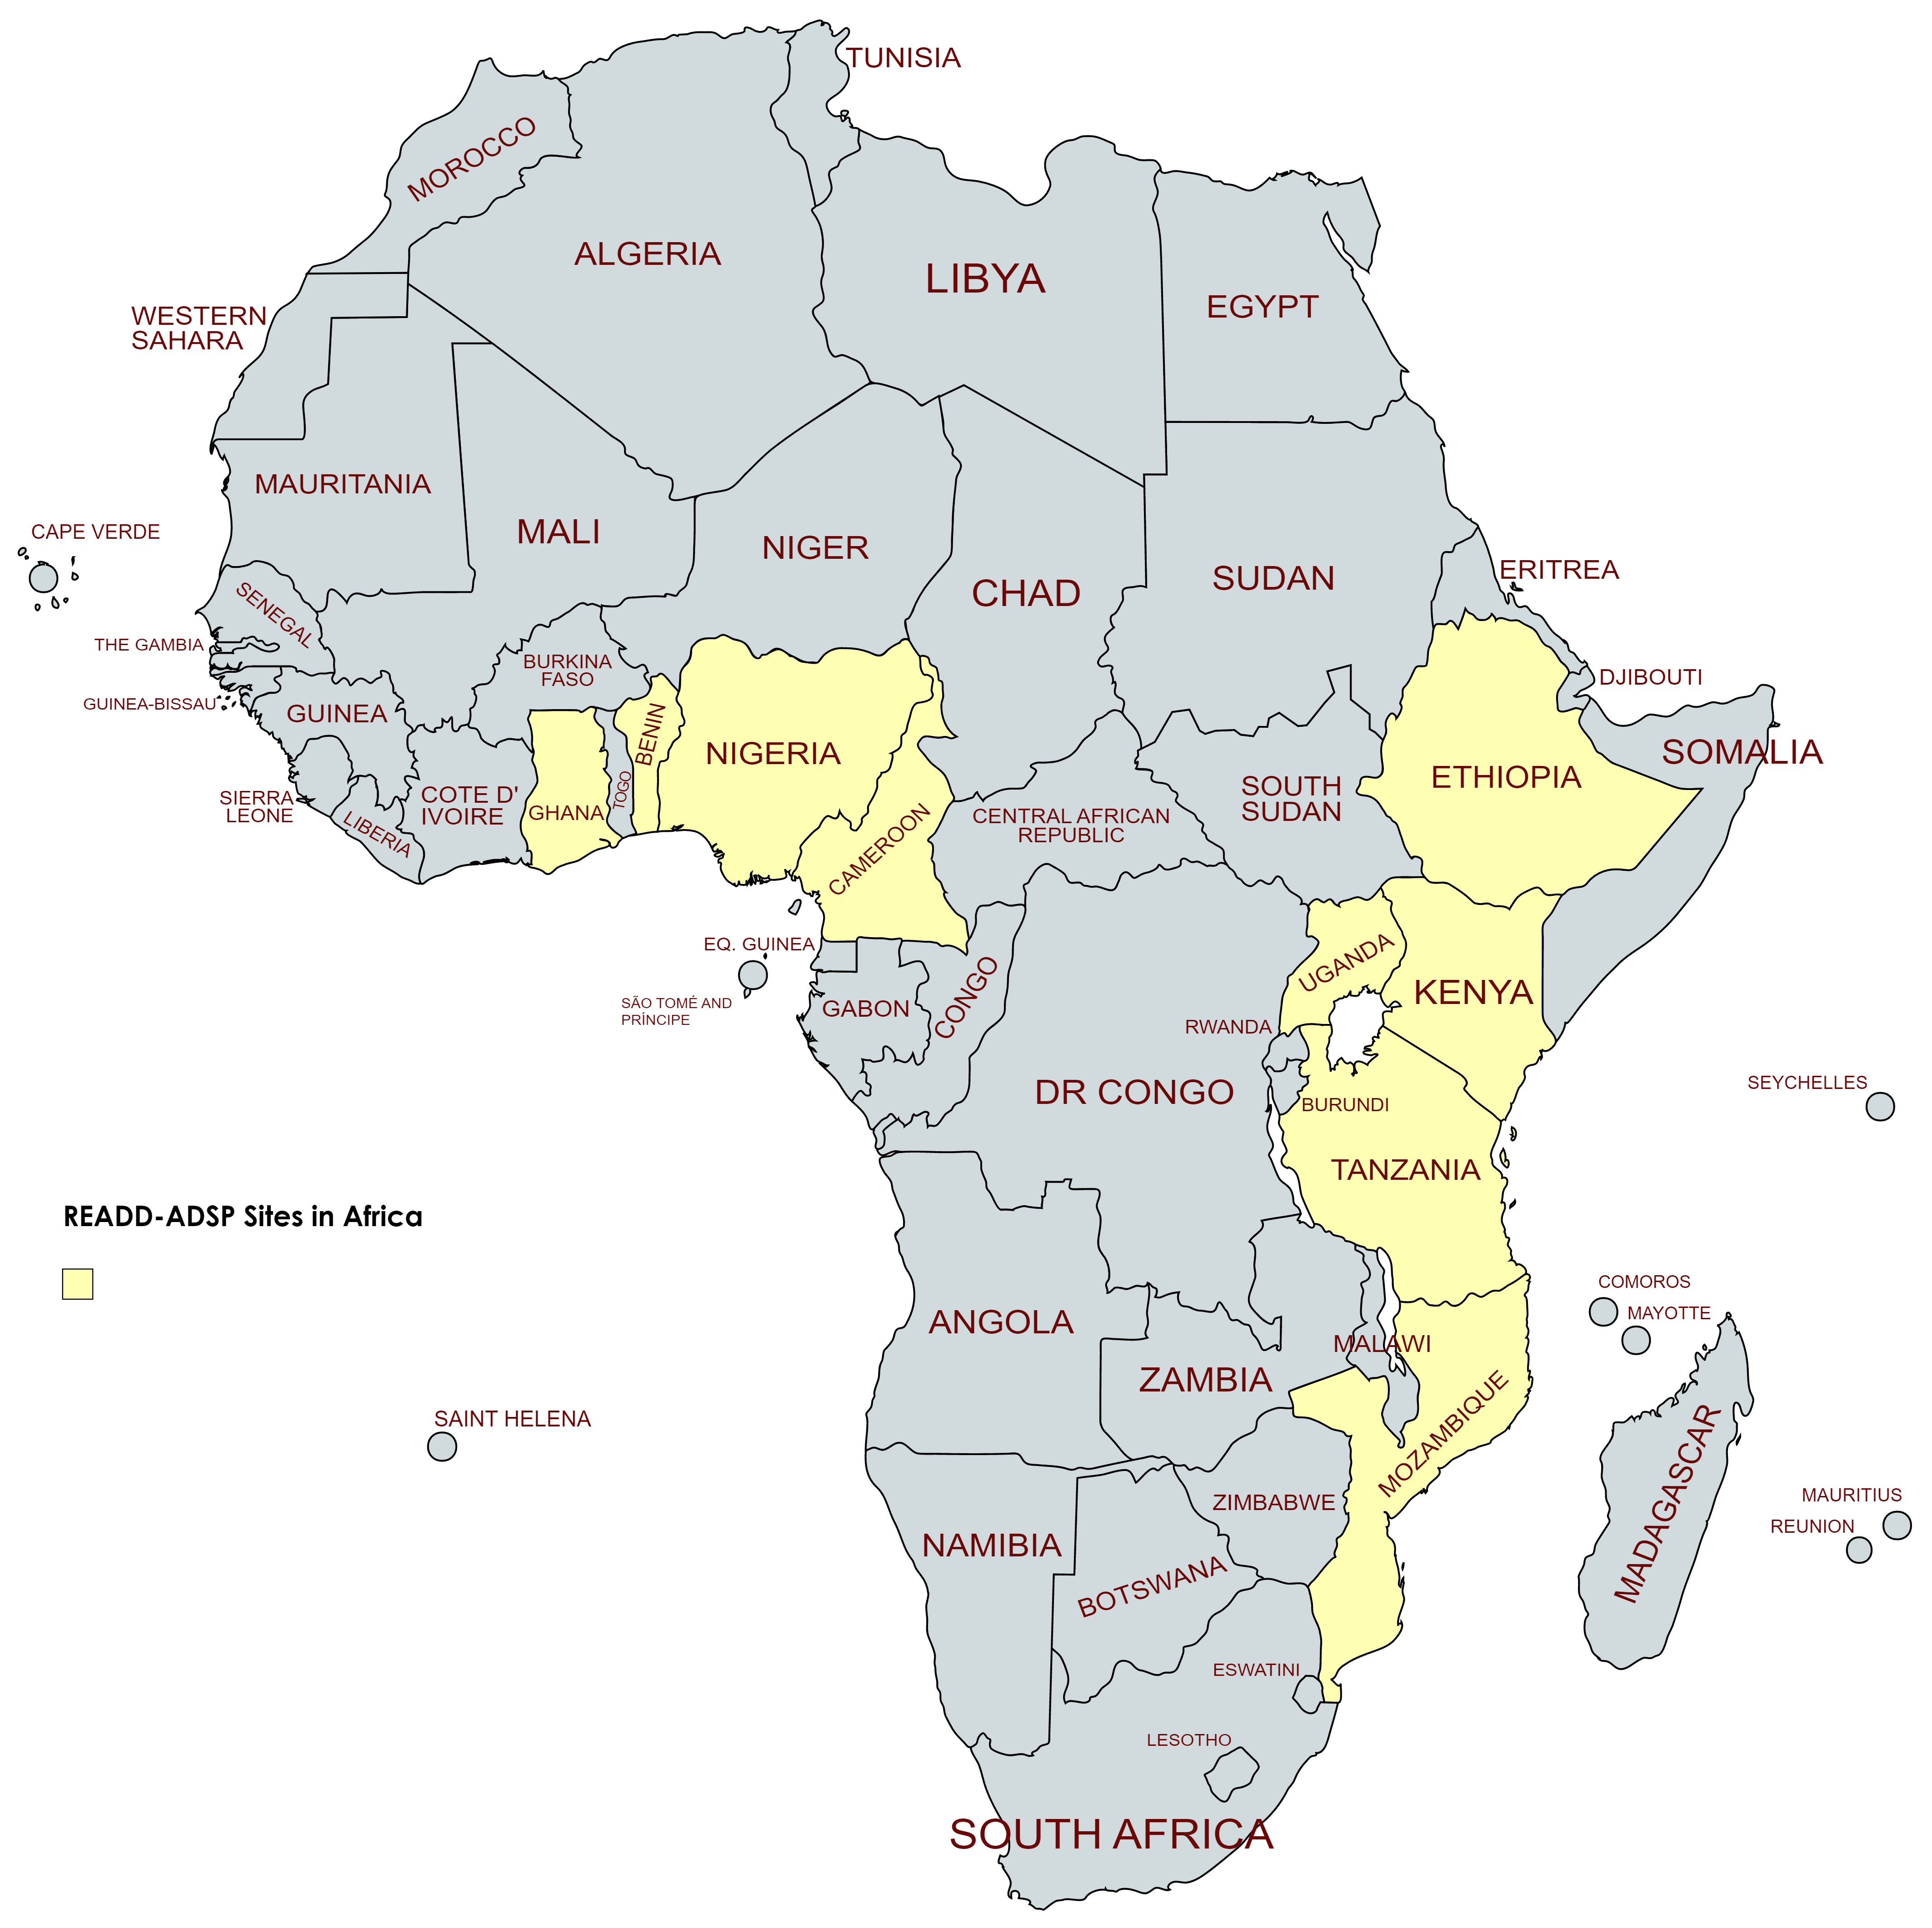
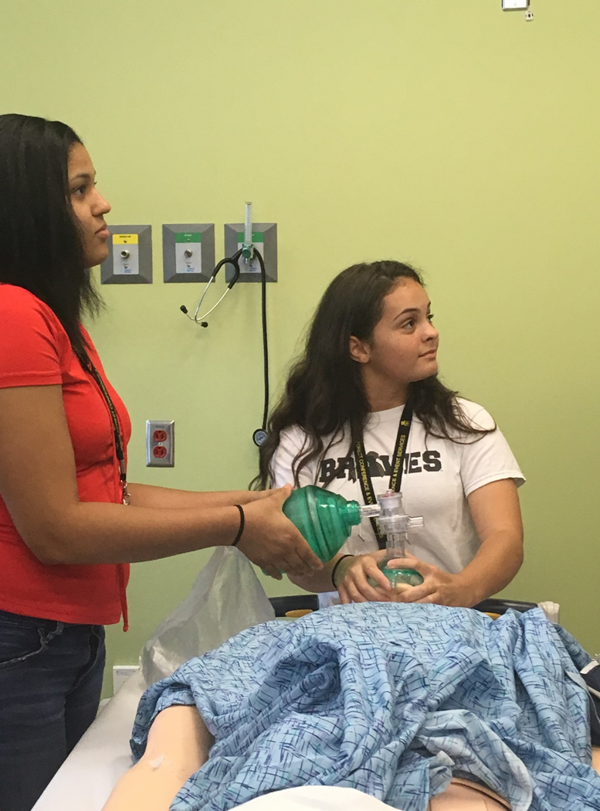
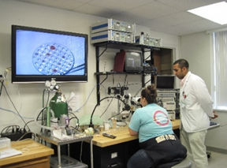
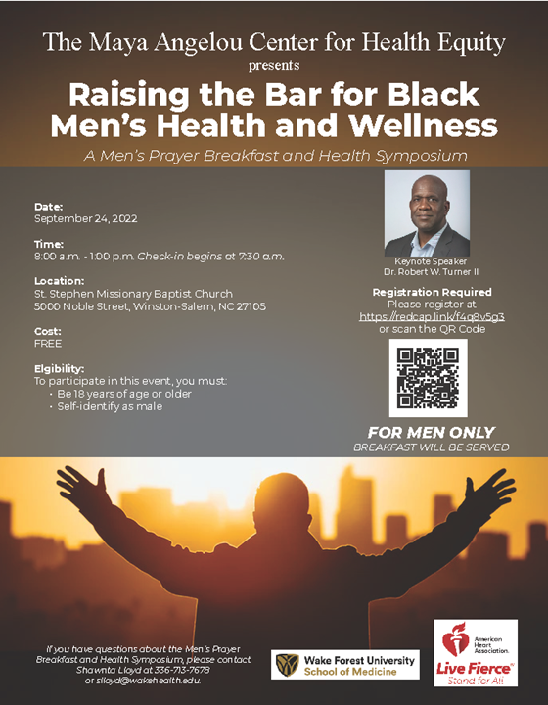
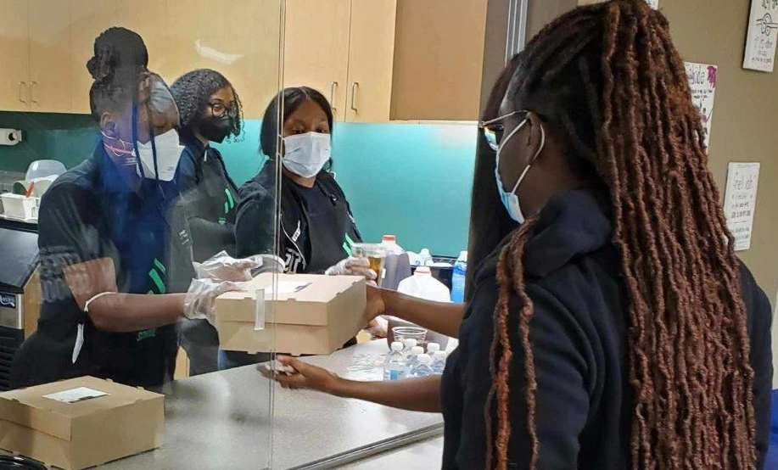
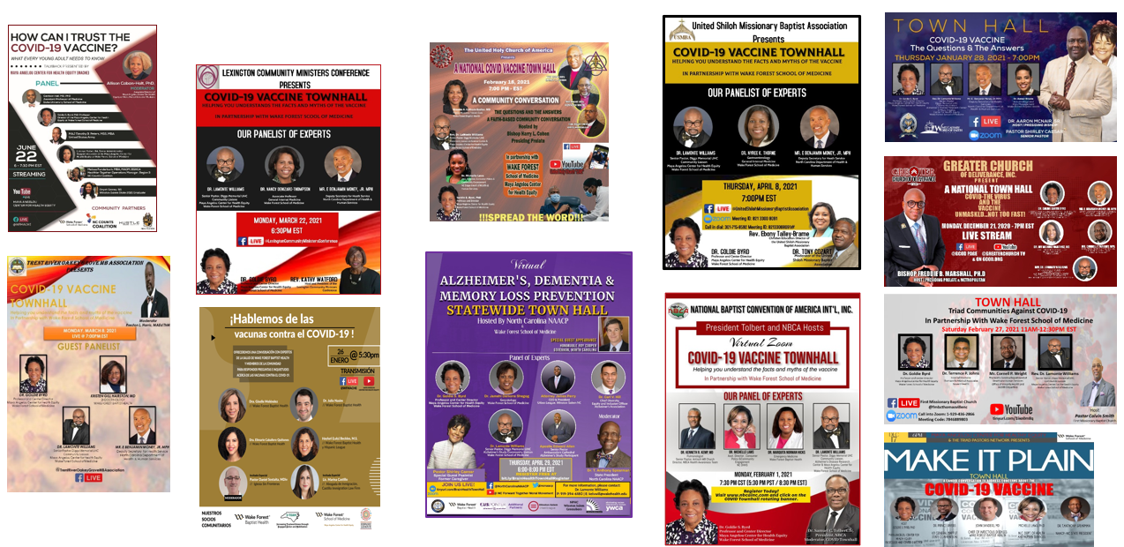
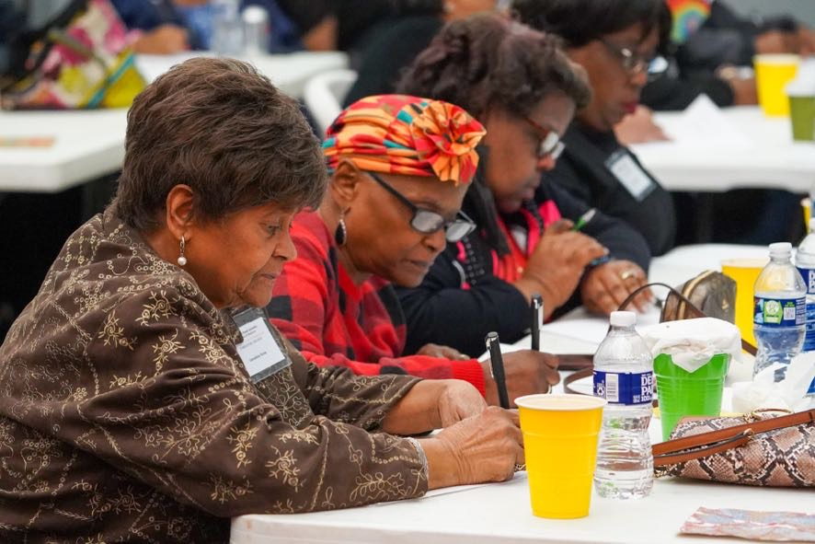
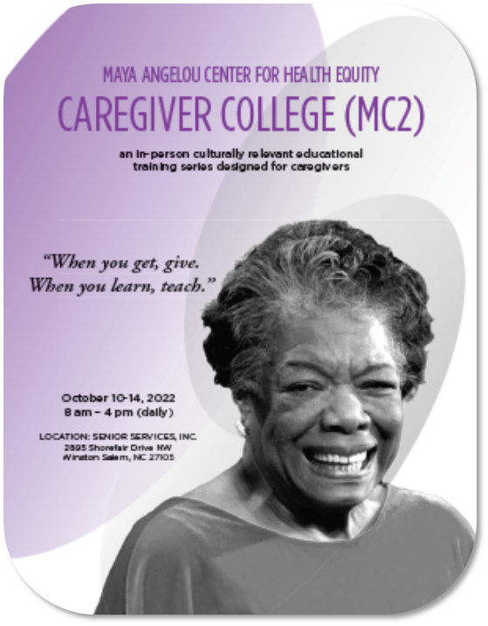
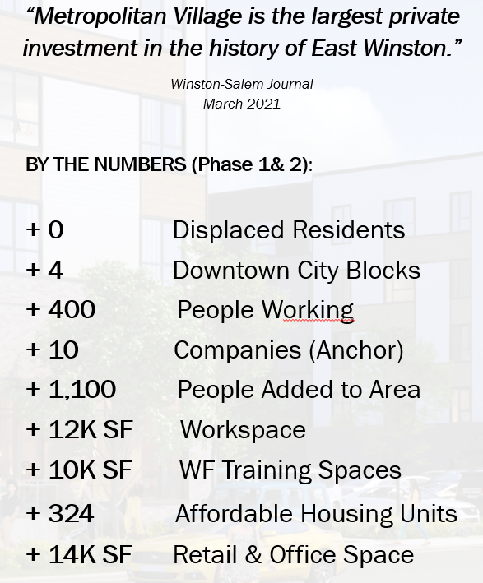
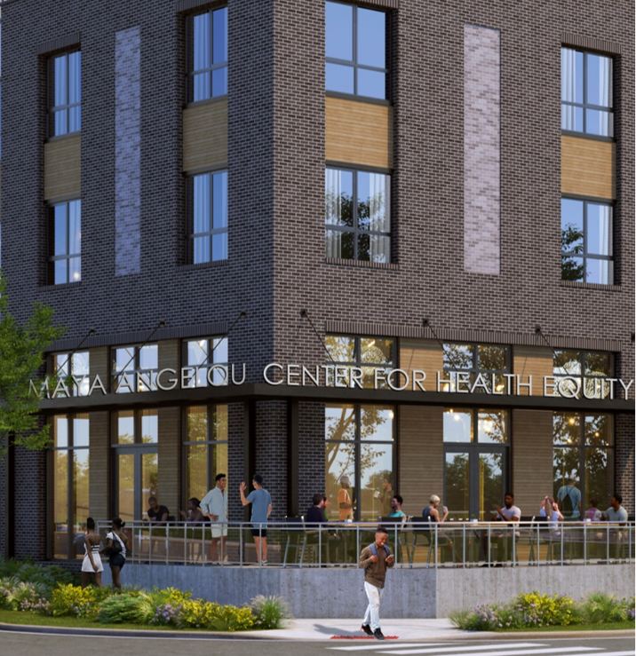
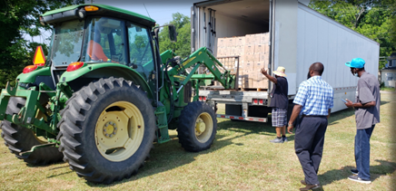
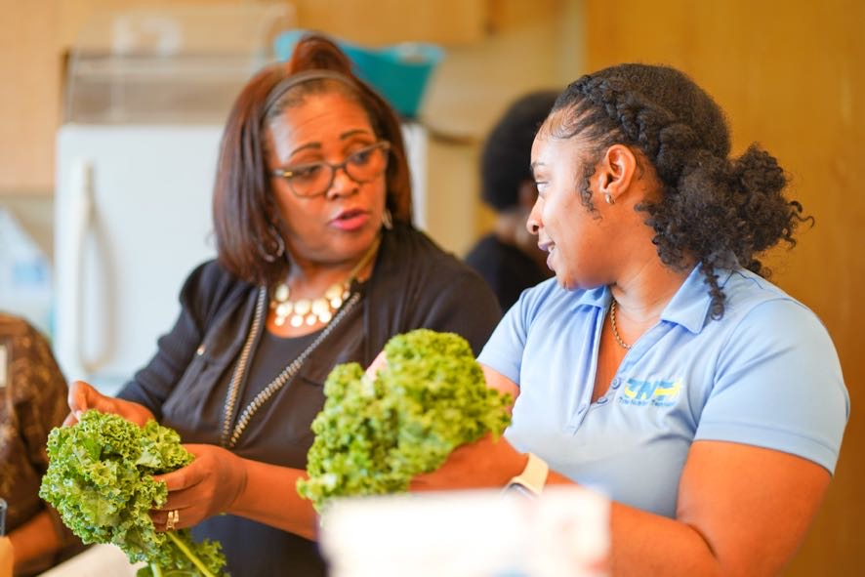
Connecting with Underserved Communities to Extend Our Health Impact
Maya Angelou Center for Health Equity
Purpose and Mission
Leadership
Membership
14 staff members
105 Affiliate Faculty and Staff
Areas of Expertise
Alzheimer’s Disease Genetics
Community-based participatory research
Integrating Special Populations
Recruitment Science
COVID-19
Community Outreach
Goal: Build trust and trustworthiness among underserved populations
Triad Pastors Network
Education
Goal: Train the next generation of health equity professionals
MACHE’s educational programs address several groups of learners, including:
Medical Students [Health Equity Certificate]
Graduate and Undergraduate Students [MACHE Student Internship Program]
STEM Educators [Medical Careers and Technology Pipeline program (MedCaT)]
American Indian High School Students [American Indian BioMedical Science Academy, (AIMS)]
Community Health Ambassadors [Triad Pastors Network Congregational Health Ambassadors Program]
Community Caregivers [MACHE Caregiver College (MC2)]
Research Project Spotlight
Recruitment and Retention for Alzheimer’s Disease Diversity Genetic Cohorts in the ADSP (READD-ADSP). READD-ADSP is a $46 million NIH-funded grant (U-19) to create the largest genetic resource for studying the genetic architecture of Alzheimer’s disease in individuals of African and Hispanic/Latinx ancestry.
The Maya Angelou Center for Health Equity (MACHE) promotes health equity through outreach to underserved populations, health education and training, and community-based participatory research.
US Institutions
University of Miami
Wake Forest School of Medicine
Columbia University
Case Western Reserve University
University of Pennsylvania
Recruitment Goal (n=13,000)
African | 5,000
African American | 4,000
Hispanic/Latinx | 4,000
African Institutions
University of Parakou: Parakou, Benin
Brain Research Institute: Oboboga, Cameroon
Addis Ababa University, Addis Ababa, Ethiopia
Kwame Nkrumah University of Science and Technology, Kumasi, Ghana
University of Ghana College of Health Sciences: Korie-Bu, Accra
African Mental Health Research and Training: Nairobi, Kenya
Eduardo Mondiane University: Maputo, Mozambique
University of Ibadan: Ibadan, Nigeria
Kilimanjaro Christian Medical University College: Kilimanjaro, United Republic of Tanzania
Makerere University: Kampaia, Uganda
Community Events
Goldie S. Byrd, PhD
Director
Allison Caban-Holt, PhD
Associate Director
Aims
Develop a large genomics resource for the study of AD in individuals with African and Hispanic/Latinx ancestry
Adjudication and harmonization of clinical neurocognitive data
Process, store, and assay biomaterials for the genomics resource including DNA isolation, plasma, and RNA for future gene expression studies
Management of all phenotype, genomic, and biomarker data
Perform genomic analysis
Youth education at Winston-Salem Street School
Response to COVID-19: Reached >300k
Other Research Projects | Funding Agency
R01 The Origins of Alzheimer’s Disease in African American | National Institutes of Health
Addressing Health Equity through Training and Literacy | Bank of America
Men’s Health Symposium | American Heart Association
Memory Connections | Federal Administration on Community Living
NC Registry for Brain Health Phase 3 | NC General Assembly
Planning a BOLD State-Wide Alzheimer Disease Caregiver College Model to Address Health Equity | NC Department of Health and Human Services/ Centers for Disease Control and Prevention
R01 African American United Memory and Aging Project | National Institutes of Health
700,000lbs of food distributed at 15 Statewide ‘Farm-Px’ Food Distribution Tour Sites
Notes:
Working to advance health equity and population health research.

