Slide 1
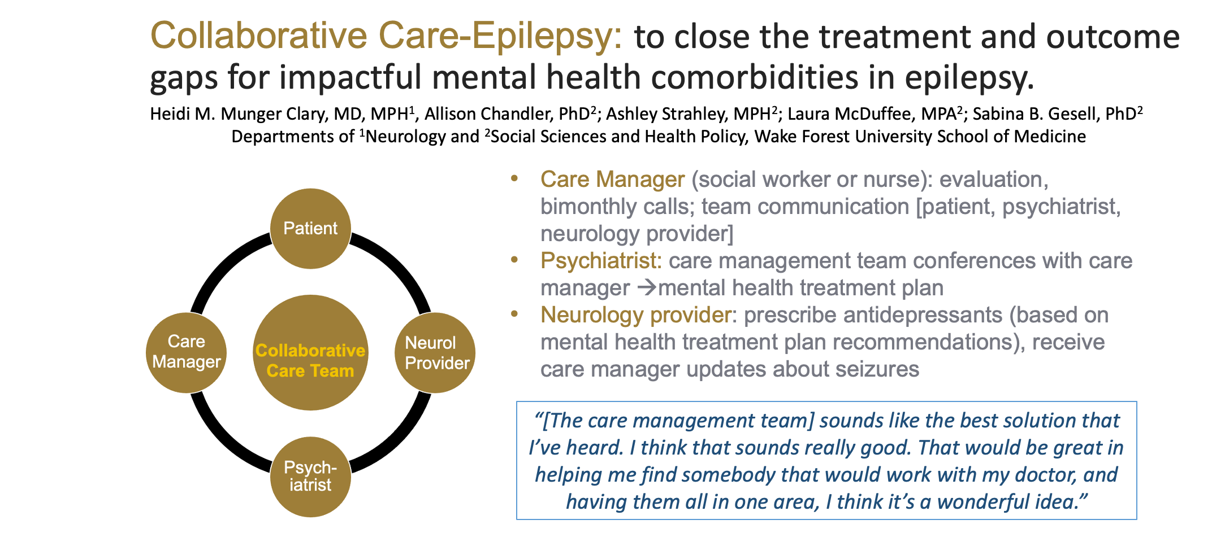
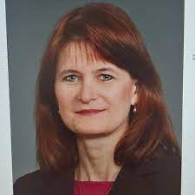
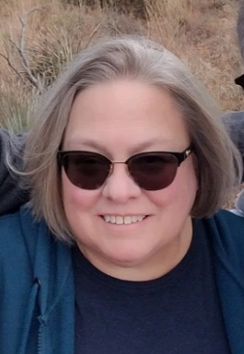
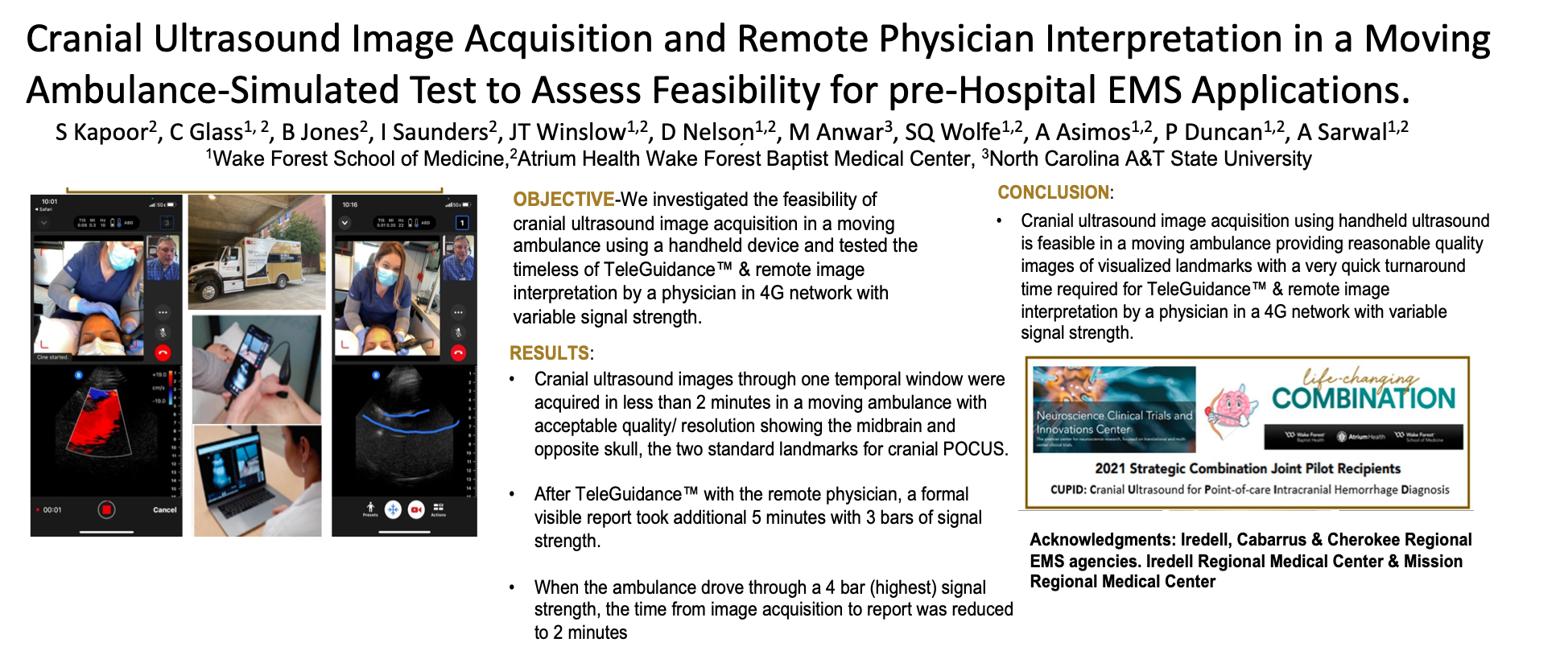
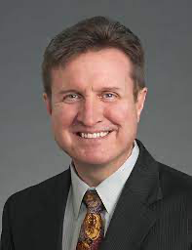
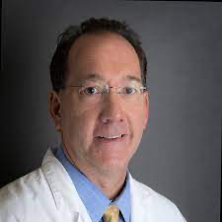
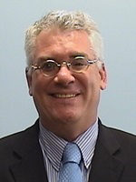
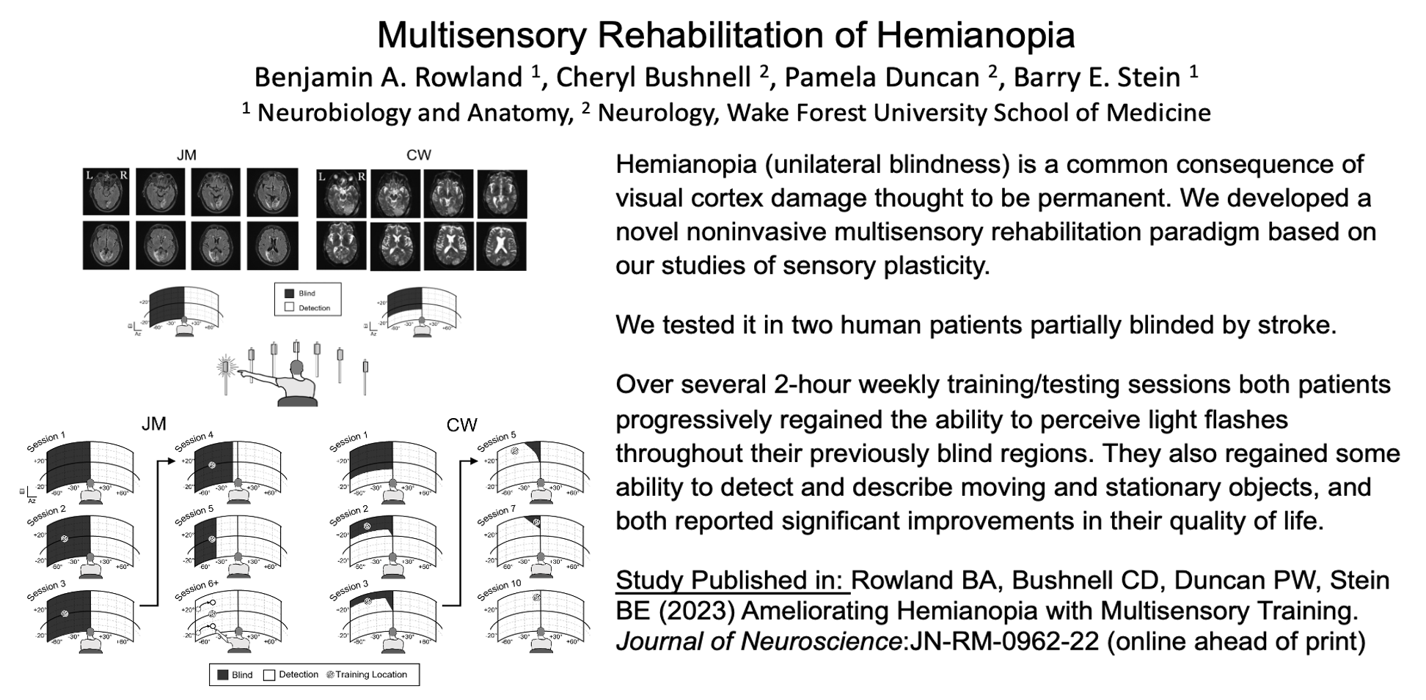
Neuroscience Clinical Trial and Innovation Center
Promoting development of new collaborative interactions between trainees, discovery scientists, and clinical investigators ACROSS THE ENTERPRISE
Purpose/Mission
The mission of the Neuroscience Clinical Trials and Innovation Center (NCTIC) is to promote advancement of Neuroscience Research.
Our focus is to develop new collaborations among basic science and clinical investigators with the goal of providing a platform for design and development of pilot studies, multi-center trials, and models of care into real-world implementation thereby bridging the gaps between basic science and clinical interventions. Part of our focus is to develop a pipeline of clinical trials to submit to NIH via the StrokeNet, NeuroNext, or the Trial Innovation Networks.
The overarching goal of NCTIC is to serve as a clearinghouse to facilitate interactions between basic science, clinical and public health investigators to develop and expand new interdisciplinary and translational studies that will improve patient care and outcomes in neurological disorders.
Our membership embodies the enthusiasm, excellence, and productivity we have to blur departmental boundaries and expand our mission to advance neuroscience research and patient care.
Leadership
Co-Directors
Cheryl Bushnell, MD, MHS
Professor, Neurology
Carol Milligan, PhD
Professor, Neurobiology and Anatomy
Executive Committee
Dwayne Godwin, PhD
Professor, Neurobiology and Anatomy
Andrew Asimos, MD
Medical Director,
Carolinas Stroke Network,
Neurosciences Institute, Atrium Health
Mark Hirsch, PhD, FACRM
Sr. Scientist,
Physical Medicine and Rehabilitation,
Carolinas Rehabilitation, Atrium Health
Membership
All members of the Atrium Health/WFUSM Neuroscience Community are considered members of NCTIC. We estimate our current membership includes over 150 members from >16 departments across Winston-Salem and Charlotte Campuses.
Training Components
Mentoring and Consultation on Project Design.
StrokeNet, and NeuroNEXT provide several mentoring and training opportunities have been established for residents, fellows, and junior faculty. Launched by Dr. Pam Duncan, the Wake Investigator Network Development (WIND) is one example of a peer-mentoring forum that meets monthly. Dr. Duncan has mentored multiple faculty prior to their grant submissions, including Heidi Munger-Clary, Halley Alexander, and Araya Puwanant. This program has expanded to include investigators from other departments (e.g., David Klorig, Ken Kishida). Dr. Pam Duncan has stepped down from leading this effort. Dr. Heidi Munger Clary is currently directing the program.
Neuroscience Graduate Program
While not directly related to NCTIC, many of our members are training faculty for the Neuroscience Program at Wake Forest, a vibrant, productive, and collaborative effort by faculty and trainees to investigate molecular and cellular structures, local neural circuits and brain areas, and behavior to enhance our understanding of the functional organization of the nervous system. We are committed to the idea that neuroscience, broadly conceived, provides a fundamental framework for understanding the biological basis of behavior and the causes of neurological and psychiatric disorders. There are 49 training faculty (PhD training) in the program. Currently there are 73 students enrolled (49 PhD; 4 MD/PhD, 21 MS). 47% of our PhD students have secured independent funding or were supported by a T32 award. As of July 2022, our students contributed to 42 publications with an additional 29 under review). Our Neuroscience Graduate students are the engine of our research community.
Center Outcomes
Obtaining substantial improvements in clinical trial enrollments
We have been selected as a site for 12 trials (one currently in startup) through StrokeNet with a total of 116 subjects consented and 76 randomized. We have successfully enrolled participants in the emergency department, inpatient and outpatient settings for hyperacute treatment, prevention and recovery trials. In fact, Wake Forest is the 5th highest enrolling site for a hyperacute trial that enrolls and randomizes patients within 1 hour of receiving thrombolysis (MOST).
For NeuroNEXT, Wake Forest has been selected for 3 trials which include 19 enrollments, and has been a lead enroller for all 3 trials. The NeuroNEXT U24 renewal was submitted on November 21, 2022.
Center Outcomes
Promoting new translational neuroscience research programs that will lead to increased extramural funding: Pilot Awards
17 pilot awards were granted over the past three years together with the following outcomes from these projects:
Three clinical trials registered on clinicaltrials.gov
Seven published manuscripts
Two manuscripts under review
15 meeting abstracts
Other Funding that is related to NCTIC
U24NS107197: Wake Forest NeuroNext Clinical Site (WAKENN)
PI: Duncan 07/15/18-06/30/23 TC: $1,549,990
The goals of this project as a NeuroNEXT clinical site is to offer promising therapies for neurologic disorders.
U24NS107235: Western North Carolina StrokeNet
PI: Bushnell 08/01/18-07/31/23 TC: $1,519,566
The goal of this project is for Wake Forest Baptist Health to act as a Regional Coordinating Center in North Carolina and to successfully implement StrokeNet trials.
PLACER-2020C3-21070: Telehealth-Enhanced Assessment and Management after Stroke-Blood Pressure (TEAMS-BP)
Multi- PI: Bushnell, Cheryl D (contact); Rosamond, Wayne 01/2022-12/2028
TC: $29,684,064
Goals: Randomized Controlled Trial: Achieving Blood Pressure Goals after Stroke through Comparative Effectiveness of Intensive Tailored Telehealth Management vs. Intensive Clinic Management.
Dana Foundation: Development of Wake Forest Center for Neuroscience and Society
PI: Milligan (contact), Mielke, Benca 10/1/2022-2/28/2023 TC: $150,000
T32 NS115704-01: Neuroscience Training at Wake Forest
Program Director: Milligan 07/01/2021-06/30/2026 TC: $1,329,719
Goals: To broad education in fundamental neuroscience together with a strong foundation in experimental design, statistical methodology, quantitative literacy as well as strong oral and written communication skills.
Research Project Spotlight
17 Pilot Awards | Total Investment $265,000
Extramural Applications Submitted | Applications Funded
Foundations: 3 NIH K23: 1 NIH R03. 1 NIH R21: 3 NIH RO1: 6 DoD: 1 VA. 1 | 3 1 1 3 0 1 1
 | Awarded Extramural Funding (total costs) $3,573,664
Notes:
The premier center for neuroscience research, focused on translational and multi-center clinical trials.

