Slide 1
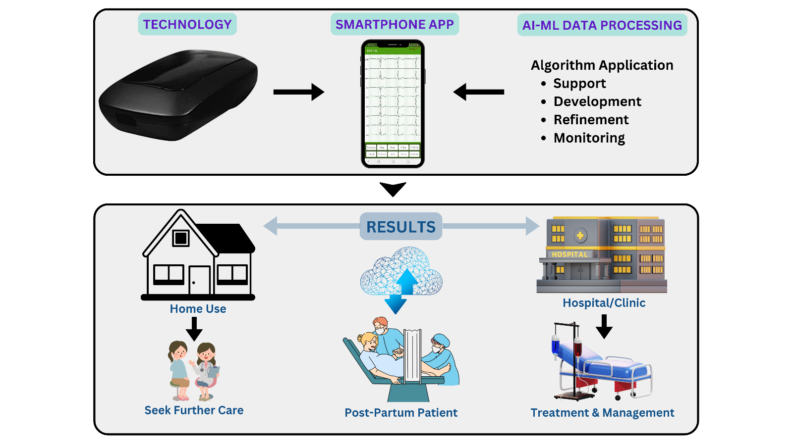
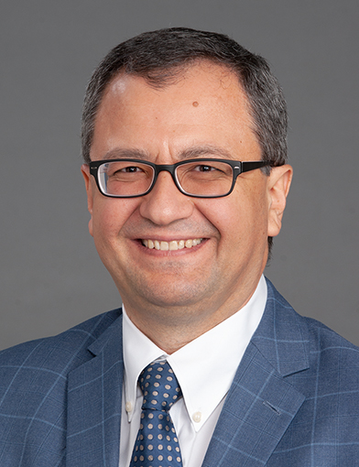
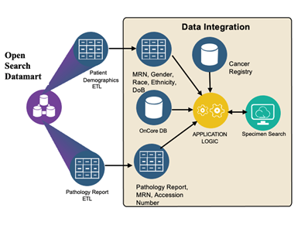
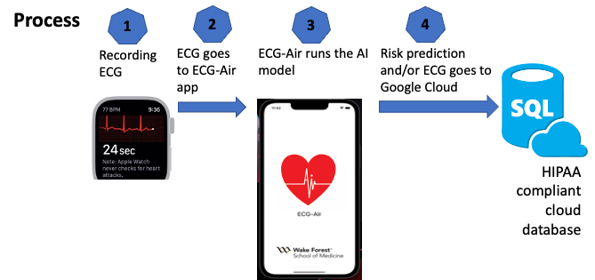
Wake Forest Center for Biomedical Informatics (WFBMI)
Dr. Stephen M. Downs and Brian Ostasiewski
Purpose/Mission
To contribute to Atrium Health Wake Forest Baptist’s evolution as a learning health system
To foster better health across the local and national community by advancing and promoting informatics research, practice, and education
Center Goals
We seek to achieve our mission by pursuing the following goals:
Collaborate: Integrate resources for research informatics across Atrium and Aurora Enterprise, and Wake Forest University, and synergistically support the informatics needs of other research centers, departments, and institutes.
Discover: Facilitate biomedical discovery across the spectrum of informatics, including bioinformatics, imaging, clinical, translational, and public health informatics, and develop a portfolio of externally funded research in the area of biomedical informatics.
Educate: Support and inspire the training of the next generation of investigators in the principles and practice of biomedical informatics.
Leadership
Metin Nafi Gurcan, PhD
Director, Center for Biomedical Informatics Professor, General Internal Medicine
Associate Directors
Stephen M. Downs, MD, MS
Professor of Pediatrics
Vice-chair Pediatric Learning Health Systems
Brian J. Wells, MD, PhD
Associate Professor, Family Medicine
Biostatistics and Data Science
Nicholas M. Pajewski, PhD
Associate Professor, Biostatistics and Data Science
Brian Ostasiewski
Director of Research Informatics, CTSI
Core Faculty
Meredith C. B. Adams, MD, MS
Oguz Akbilgic, DBA, PhD
Ajay Dharod, MD
Eric S. Kirkendall, MD, MBI
Jennie Q. Lou, MD, MSc, FACE
Da Ma, PhD
Muhammad Khalid Khan Niazi, PhD
Martin Kohn, MD, FACEP
Umit Topaloglu, PhD
Membership
247 members of the Center
Types of Science
Artificial Intelligence
Deep Learning
Image & Signal Processing
Natural Language Processing
Predictive Modeling
Clinical Decision Support
Data Standardization and Warehousing
Analytics and Visualization
Clinical Data Research Networks
Training Components
Intro to BMI (THSS 731)
Decision Analysis (THSS 727)
Prediction Modeling Using R course
Clinical Scholars in Informatics (CSI) Residency Pathway
EHR Research Workshop
WFBMI Annual Colloquium
Informatics in Action (IIA) seminars
CALIBIR Internship program for URM, funded by NLM R25
I³: In-year Informatics Internships
Informal Short Courses and Mentorship Program
Informatics Staff Specializations
Clinical Informatics Board Subsidy
New: Medical Education
Dr. Jennie Lou (Professor of Medicine and Biomedical Informatics) Associate Dean for Curriculum
Dr. Brian J. Wells (Associate Director, Biomedical Informatics)
Curriculum to include extracurricular areas of scholarly concentration in informatics across both Charlotte and Winston Salem campuses
HI faculty meet with incoming medical students during first week of orientation
Generate excitement about the importance of Biomedical Informatics in Healthcare
Student participation in a faculty-led 10-week summer internship end of first year. Includes funding to support projects
Research Project Spotlight: Akbilgic Lab
Cardiovascular Disease Detection and Prediction
Heart failure, sudden cardiac death, cardiomyopathies, arrhythmias
Early detection of neurodegenerative diseases
Parkinson’s Disease, Alzheimer’s Disease. Dementia
ai-mom: Peripartum adverse event prediction
Preeclampsia, postpartum cardiomyopathy
Remote AI-based screening via wearables
ECG-Air for CVD screening
Air-Monica: for peripartum event screening
@WFBMI
Notes:
Created to strengthen Wake Forest's research, education and clinical missions and directed by Dr. Metin Gurcan, professor of Internal Medicine, this cross-disciplinary initiative is designed to integrate resources throughout Wake Forest University School of Medicine, Wake Forest Baptist Medical Center and Wake Forest University while complementing the work of other research centers, including the Wake Forest Clinical and Translational Science Institute.

