Slide 1
Examining the Needs of Black Male Caregivers of Patients with Alzheimer’s Disease
Alexandrea Adams, MA
Wake Forest School of medicine

Slide 2
Outline
Community Organization: The Maya Angelou Center for Health Equity (MACHE)
Black Men’s Health
Capstone Project
Background
Methods
Analytical Plan
Public Health Implications
Acknowledgements
Questions
References

Slide 3
MACHE and Black Men’s Health

Slide 4
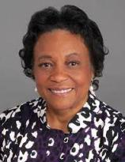
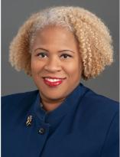
Maya Angelou Center for Health Equity
An institutionally sponsored Center that promotes health equity
Initiatives include:
Interdisciplinary community-engaged research
Health education and training
Health promotion and literacy
Social justice initiatives
Dr. Goldie S. Byrd
Director
Dr. Allison Caban-Holt
Associate Director

Slide 5
The State of Black Men’s Health in the US
Lowest life expectancy: 68.3 years
#1 cause of death: Heart disease
Black men are more likely than other groups to have chronic or poorly managed health conditions
Leading causes of death among men by race - https://www.cdc.gov/healthequity/lcod/men/2018/byrace-hispanic/index.htm
Life expectancy - https://www.cdc.gov/nchs/data/vsrr/VSRR10-508.pdf
Health outcomes - https://www.ncbi.nlm.nih.gov/pmc/articles/PMC6531286/

Slide 6
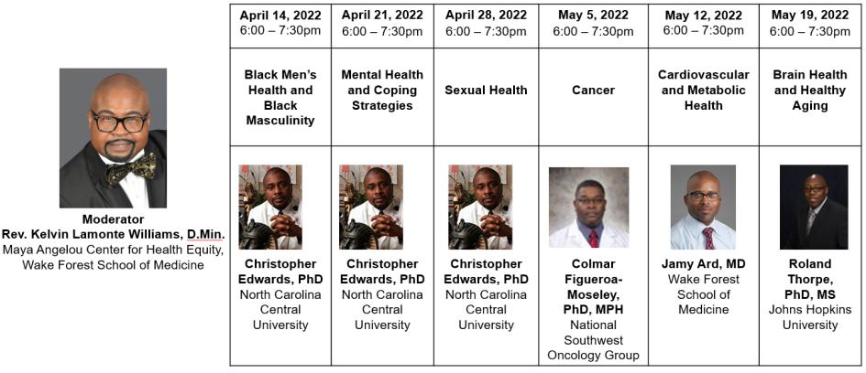
The Black Men’s Health Forum
Notes:
6 week health intervention for Black men, black male clinicians presented info on various health topics; black men attended weekly presentations with Q&A; 30 men completed the program; accountability partner attend online sessions

Slide 7
Men’s Breakfast and Health Symposium
Notes:
Dr. Robert Turner is keynote speaker; scientist and former NFL athlete; research focus on brain health among black men and athletes; men’s health across their lifespan with focus on brain and cardiovascular health; sponsored by AHA;
Also having health panel with 3 black male physicians –closed to men only

Slide 8
Capstone Project Background

Slide 9
Alzheimer’s disease
More than 6 million older adults in the United States (US) have Alzheimer’s disease (AD)
More than 2/3 of AD diagnoses are women
Blacks Americans are two times more likely to be diagnosed with AD than White Americans
Black Americans are more likely to receive an AD diagnoses at a later stage than White Americans
This juxtaposition places more burden on the caregiver
https://www.cdc.gov/media/releases/2018/p0920-alzheimers-burden-double-2060.html
AD statistics- https://www.alz.org/aaic/downloads2020/2020_Race_and_Ethnicity_Fact_Sheet.pdf.
AD by race- https://www.alz.org/media/Documents/african-americans-silent-epidemic-r.pdf
Notes:
Connect my project to current efforts fopr black men

Slide 10
Black Male Caregivers
Black caregivers account for 20% of all caregivers and more than 15% of those are men
The average Black male caregiver is 48 years old and belongs to the “sandwich generation”
69% of Black male caregivers are employed
Black male caregivers experience a great financial burden and are more likely to care for patients with the lowest rated health
https://www.alz.org/help-support/resources/black-americans-and-alzheimers
Black Caregiver statistics - https://www.caregiver.org/resource/caregiver-statistics-demographics/
Black male caregiver statistics - https://www.nextavenue.org/2-3-million-black-men-are-family-caregivers/
https://www.aarp.org/content/dam/aarp/ppi/2017-01/Breaking- Stereotypes-Spotlight-on-Male-Family-Caregivers.pdf
Notes:
Add images

Slide 11
Study Objectives
Assess caregiver burden experienced by Black male caregivers of AD patients.
Identify health, social, and environmental needs of Black male caregivers of AD patients to ensure well-being.
Examine perspectives of Black male caregivers of AD patients about:
1) the inclusivity of AD caregiver support groups and resources
2) the types of spaces in which Black male caregivers of AD patients feel most supported and comfortable sharing experiences

Slide 12
Capstone Project Methods
Protocol Design

Slide 13
Design and Setting
Design
Multi-method cross-sectional design consisting of a quantitative survey and qualitative semi-structured interview.
Setting
General community

Slide 14
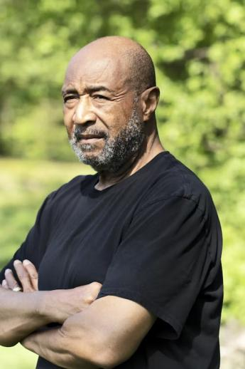
Sample
Inclusion Criteria
18 years of age or older
Self-identifies as Black or African American
Self-identifies as a male
Caregiver to a person with ADRD
Sample Size
15-20 Black male caregivers
Recruitment Plan
MACHE community listserv
MACHE men’s forum events
Pastor Triad Networks listerv
Local health centers
Community Outreach Events
Flyers

Slide 15
Measures
Quantitative Questions
Sociodemographic data
Caregiver Status

Slide 16
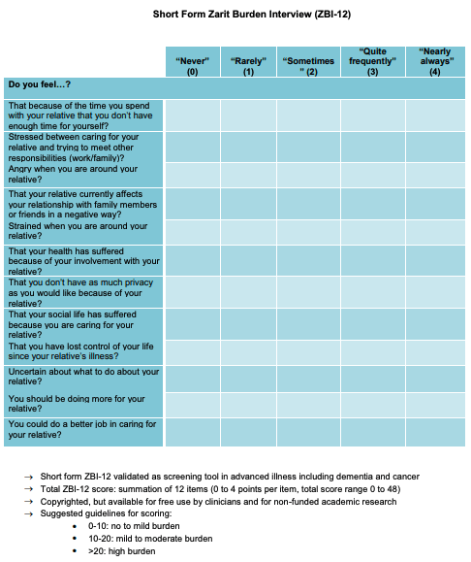
Measures
Quantitative Questions
Caregiver burden
https://www.theseniorlist.com/caregiving/caregiver-burnout/

Slide 17
Measures
Qualitative Interview Questions
Caregiver Burden
Do you feel that the quality of your life has changed since you became a caregiver for your loved one?
What new household roles have you had to take on due to your caregiver status?
Have you had to give up activities in your life due to caregiving? What types of activities have you had to give up since becoming a caregiver?
What do you do when you are feeling overwhelmed by your caregiving tasks?
Do you engage in “self-care”? If so, what do you do to take care of yourself? How often do you engage in these activities?
Who is your support system? Who do you usually confide in when you are feeling frustrated about your caregiving tasks?
Have you considered enrolling your loved one into an assisted living or nursing care facility? If not, what are your hesitations? If so, what was your motivating factor(s)?
Do you have a plan for when your loved ones’ disease progresses?

Slide 18
Measures
Qualitative Interview Questions
Health Resources
How long after your loved started showing signs of dementia did you reach out for help for a) your loved one and b) yourself?
What types of resources have you utilized for your loved one? Which ones were helpful and which ones weren’t? Why?
What types of resources have you utilized for your yourself? Which ones were helpful and which ones weren’t? Why?
Has your loved one’s health care provider suggested any resources for caregivers? If so, have you utilized any and how often? Did you find them useful?
Have you participated in a support group? If so, was it all male? Did you feel the group was helpful? If not, what has been your hesitation in joining one?
Have you used online resources to learn about ADRD and caregiving (ex: NIH, Alzheimers.org, Medicare.gov, MedlinePlus, Administration for Community Living, Administration on Eldercare, etc.)? If so, have you found any of these resources useful?
Do you feel the resources available to caregivers have been readily accessible and inclusive of your needs?
What resources would be beneficial to help improve your quality of life?

Slide 19
Capstone Project Analytical Plan

Slide 20
Data Analysis
Descriptive statistics (frequencies and percentages) will be calculated for sociodemographic information.
The Zarit Burden Interview will be scored based on a 5-point Likert scale to access caregiver burden (0-Never, 1-Rarely, 2-Sometimes, 3-Quite Frequently, 4-Nearly Always)
Scores range from 0 to 48.
Qualitative interviews will be analyzed using phenomenological theory.
The research team will analyze the qualitative data using thematic analysis approach to identify, analyze, describe, and report themes found within the given data set

Slide 21
Capstone Project Public Health Implications

Slide 22
Public Health Implications
There is a paucity of literature about the unique needs of Black male caregivers and how their burden differs from other demographics.
This capstone project aims to identify the needs of Black male caregivers to inform the development and enhancement of caregiving resources to provide Black male caregivers with necessary support.

Slide 23
Next steps
MACHE Team will continue to develop the proposed project.
The proposal will be submitted to for grant funding.

Slide 24
Acknowledgements
I would like to thank the Maya Angelou Center for Health Equity for providing resources and guidance with this project.
I would like to thank Dr. Lloyd for all of her incredible guidance and help throughout working on this project. She provided mentorship and taught me a lot about the research process.
Dr. Shawnta Lloyd

Slide 25
Questions

Slide 26
References
Alzheimer’s Association. (2021). 2021 Alzheimer’s disease facts and figures. Alzheimer’s & Dementia, 17(3), 327–406. doi:10.1002/alz.12328
Alzheimer's Association. Race, Ethnicity and Alzheimer's, Alzheimer's Association, 2020, https://www.alz.org/aaic/downloads2020/2020_Race_and_Ethnicity_Fact_Sheet.pdf. Accessed 2022.
Family Caregiver Alliance. “Caregiver Statistics: Demographics.” Caregiver Statistics: Demographics - Family Caregiver Alliance, https://www.caregiver.org/resource/caregiver-statistics- demographics/.
Brooks, Rodney. “Hidden Truth: 2.3 Million Black Men Are Family Caregivers.” Next Avenue, Next Avenue, 26 Nov. 2020, https://www.nextavenue.org/2-3-million-black-men-are-family-caregivers/.
Accius, Jean. “Breaking Stereotypes: Spotlight on Male Family Caregivers - AARP ...” Slidelegend.com, AARP Policy Institute, Mar. 2017, https://www.aarp.org/content/dam/aarp/ppi/2017-01/Breaking- Stereotypes-Spotlight-on-Male-Family-Caregivers.pdf.
Brooks, Rodney. “Hidden Truth: 2.3 Million Black Men Are Family Caregivers.” Next Avenue, Next Avenue, 5 Oct. 2020, https://www.nextavenue.org/2-3-million-black-men-are-family-caregivers/.
Liu, Ruotong et al. “Caregiving Burden among Caregivers of People with Dementia through the Lens of Intersectionality.” The Gerontologist, gnab146. 4 Oct. 2021, doi:10.1093/geront/gnab146
Simpson, G. M., Stansbury, K., Wilks, S. E., Pressley, T., Parker, M., & McDougall, G. J., Jr (2018). Support groups for Alzheimer's caregivers: Creating our own space in uncertain times. Social work in mental health, 16(3), 303–320. https://doi.org/10.1080/15332985.2017.1395780
Zarit, S. H., Reever, K. E., Back-Peterson, J. (1980). Relatives of the impaired elderly: correlates of feelings of burden. The Gerontologist, 20, 649-655.
Braun, V., & Clarke, V. (2014). What can "thematic analysis" offer health and wellbeing researchers?. International journal of qualitative studies on health and well-being, 9, 26152. https://doi.org/10.3402/qhw.v9.26152
Zamawe F. C. (2015). The Implication of Using NVivo Software in Qualitative Data Analysis: Evidence-Based Reflections. Malawi medical journal : the journal of Medical Association of Malawi, 27(1), 13–15. https://doi.org/10.4314/mmj.v27i1.4
Tang, W., Hu, J., Zhang, H., Wu, P., & He, H. (2015). Kappa coefficient: a popular measure of rater agreement. Shanghai archives of psychiatry, 27(1), 62–67. https://doi.org/10.11919/j.issn.1002-0829.215010
Zarit, S. H., Reever, K. E., Back-Peterson, J. (1980). Relatives of the impaired elderly: correlates of feelings of burden. The Gerontologist, 20, 649-655.

