Slide 1
Community Engagement: What does a doctor look like?
Ashley Eaves, MD, MA

Slide 2
Background
Underrepresented Minorities (URMs) in Healthcare Professions
Impact on Health Equity: A diverse healthcare workforce can improve healthcare outcomes, access to care, and equity for patients. One way to improve the diversity of the healthcare profession is to expose children at a young age to science and the medical field to improve the pipeline of minority students.
United States Statistics (2018 - 2020)
African American physicians = 5.3%
(it was 1.3% in 1900)
African American male physicians = 2.6%
African Americans in the United States (including mixed race) = 14.2%

Slide 3
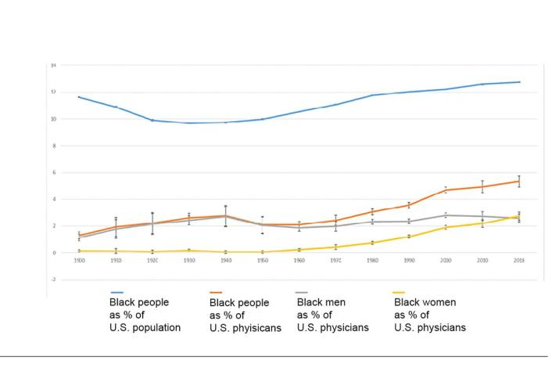
Background

Slide 4
Background
Literature Review on Improving Healthcare Delivery for Minorities
Patient-provider racial and ethnic concordance (seeing a minority physician that is the same of the patient) results in improvements in:
Time spent together (between patient and provider)
Medication adherence
Shared decision-making
Wait times for treatment
Cholesterol screening
Patient comprehension of cancer risk
Patient perception of treatment decisions
Reduced implicit bias (by provider)
Patient engagement is higher
Increased consent for preventative services

Slide 5
Community Organization
Crosby Scholars Community Partnership
Helps middle school and high school students in Forsyth County prepare for college admission and other post-secondary opportunities academically, personally, financially
African American Males Pursuing Educational Dreams
AAMPED is a subset of Crosby Scholars, began in 2016 – 2017
Provides workshops designed for African American males targeted for college and life success skills – examples include career exploration programs, College Success Camp, college tours, drug-prevention workshops, and others
African-American Males have demonstrated a 19% increase in completion of the Crosby Scholars program since AAMPED began

Slide 6
Objectives
“What does a doctor look like?” Presentation
Goal was to provide exposure to science and the healthcare profession (specifically Pain Medicine, Anesthesia and PM&R) to youth of color. Ultimate, long-term goal is to inspire these Underrepresented Minorities to consider a career in medicine or other healthcare professions.
https://www.ncsl.org/research/health/health-disparities-laws.aspx
Notes:
https://www.ncsl.org/research/health/health-disparities-laws.aspx

Slide 7
Methods
Location: Took place at a site designated by the Crosby Scholars/AAMPED – part of a Goodwill conference center
Participants: 25-30 middle school African American males. They were already part of the Crosby Scholars/AAMPED program, we did not have to recruit them.
Methods: Presentation to children. Then into 3 small groups at stations using Simulation Lab equipment to both speak with and give kids hands–on experience including physical exam, intubation, blood draws, ultrasound, and spine injections.
Analysis of results: paper survey was completed at the end of the session prior to leaving.

Slide 8
Results of Survey
Question 1 – What knowledge have you gained from the AAMPED medical program?
Question 2 – What careers are you interested in pursuing?
Question 3 – How has the AAMPED medical program helped you to reach your goals in school?
Question 4 – What are 3 things that you will share about the AAMPED medical program with your friends?
Question 5 – Why are you in the Crosby Scholars AAMPED program?

Slide 9
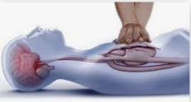
Results of Survey
Question 1 – What knowledge have you gained from the AAMPED medical program?
Suture a wound, understand a sonogram, CPR, and about different medical careers
Different medical careers, such as CNA, RNA, and forensic science
I put in a suture, and 3% of AA males are doctors (more are needed)
I have learned how to save my money
How young black males can come together and have a positive experience
Notes:
https://cpr.heart.org/en/resources/what-is-cpr

Slide 10
Results of Survey
Question 2 – What careers are you interested in pursuing?
Crime scene investigation
A police officer, firefighter
Nutrition and dietician, and second RNA or forensic scientist
Anesthesiology or lawyer
Psychiatry
Notes:
https://csi.fandom.com/wiki/CSI:Crime_Scene_Investigation_Season_10

Slide 11
Results of Survey
Question 3 – How has the AAMPED medical program helped you to reach your goals in school?
Time management, what I believe I can achieve
Has helped me become more respectful
Has definitely put me ahead in some parts of science
A positive outlook and more confidence
Learned about a lot of different jobs in the medical field
Notes:
https://www.independent.co.uk/topic/science

Slide 12
Results of Survey
Question 4 – What are 3 things that you will share about the AAMPED medical program with your friends?
Good way to learn about different medical jobs, excellent hands-on task, helps with determining what medical field for the future
Gives me knowledge about medical field and helps prepare for the future
Medical knowledge, science class help, that you should join
Learn how to properly do CPR, how to take care of your lungs, how to do ultrasound
It’s hands on, it’s amazing, learn about careers in medicine that I didn’t know existed

Slide 13
Results of Survey
Question 5 – Why are you in the Crosby Scholars AAMPED program?
To gain different skills and knowledge for the future, such as financial, how to dress for interviews, proper way to eat and table setting
I love science, technology, engineering and mathematics
Because I want to pursue my educational dreams
Because I have enjoyed my experience
To help achieve my educational dreams as a black male
Notes:
https://www.etsy.com/listing/1134998028/men-suits-2-piece-wedding-wear-2-piece?gpla=1&gao=1&&utm_source=google&utm_medium=cpc&utm_campaign=shopping_us_a-weddings-clothing-suits-mens_suits&utm_custom1=_k_Cj0KCQjwpeaYBhDXARIsAEzItbHY4ugavhFvsRQugbSyOaaI6UeCE7a1zT6cY7mnNw-Ox4rNv-_bxnEaAnUTEALw_wcB_k_&utm_content=go_12560180297_118715461159_506995676852_pla-314648635826_c__1134998028_468305734&utm_custom2=12560180297&gclid=Cj0KCQjwpeaYBhDXARIsAEzItbHY4ugavhFvsRQugbSyOaaI6UeCE7a1zT6cY7mnNw-Ox4rNv-_bxnEaAnUTEALw_wcB

Slide 14
Implications
Implications of project
Health equity implications – ideally will help with exposure and ability to pursue careers in healthcare and subsequently improve healthcare outcomes.
Community partner involvement– they will be able to continue this project through the attendings I worked with in the following years (and improve impact measurement tools)
Next steps for capstone project – Ideally I can continue these types of community engagement and pipeline programs in my next role and learn from this experience

Slide 15
Thank You!
Organization: AAMPED – through Crosby Scholars
https://www.crosbyscholars.org/aamped/
Attendings: Dr Heather Columbano, Dr Martina Downard (Anesthesia Department)

Slide 16
References
Ferdinand KC, Yadav K, Nasser SA, Clayton-Jeter HD, Lewin J, Cryer DR, Senatore FF. Disparities in hypertension and cardiovascular disease in blacks: The critical role of medication adherence. J Clin Hypertens (Greenwich). 2017 Oct;19(10):1015-1024. doi: 10.1111/jch.13089. Epub 2017 Aug 30. PMID: 28856834; PMCID: PMC5638710.
Traylor AH, Schmittdiel JA, Uratsu CS, Mangione CM, Subramanian U. Adherence to cardiovascular disease medications: does patient-provider race/ethnicity and language concordance matter? J Gen Intern Med. 2010 Nov;25(11):1172-7. doi: 10.1007/s11606-010-1424-8. Epub 2010 Jun 23. PMID: 20571929; PMCID: PMC2947630.
Persky S, Kaphingst KA, Allen VC Jr, Senay I. Effects of patient-provider race concordance and smoking status on lung cancer risk perception accuracy among African-Americans. Ann Behav Med. 2013 Jun;45(3):308-17. doi: 10.1007/s12160-013-9475-9. PMID: 23389688; PMCID: PMC3644014.
Saha, S., Beach, M.C. Impact of Physician Race on Patient Decision-Making and Ratings of Physicians: a Randomized Experiment Using Video Vignettes. J GEN INTERN MED 35, 1084–1091 (2020). https://doi.org/10.1007/s11606-020-05646-z
Penner LA, Dovidio JF, Gonzalez R, Albrecht TL, Chapman R, Foster T, Harper FW, Hagiwara N, Hamel LM, Shields AF, Gadgeel S, Simon MS, Griggs JJ, Eggly S. The Effects of Oncologist Implicit Racial Bias in Racially Discordant Oncology Interactions. J Clin Oncol. 2016 Aug 20;34(24):2874-80. doi: 10.1200/JCO.2015.66.3658. Epub 2016 Jun 20. PMID: 27325865; PMCID: PMC5012663.
Hagiwara N, Slatcher RB, Eggly S, Penner LA. Physician Racial Bias and Word Use during Racially Discordant Medical Interactions. Health Commun. 2017 Apr;32(4):401-408. doi: 10.1080/10410236.2016.1138389. Epub 2016 Jun 16. PMID: 27309596; PMCID: PMC5161737.
King WD, Wong MD, Shapiro MF, Landon BE, Cunningham WE. Does racial concordance between HIV-positive patients and their physicians affect the time to receipt of protease inhibitors? J Gen Intern Med. 2004 Nov;19(11):1146-53. doi: 10.1111/j.1525-1497.2004.30443.x. PMID: 15566445; PMCID: PMC1494794.
Strumpf EC. Racial/ethnic disparities in primary care: the role of physician-patient concordance. Med Care. 2011 May;49(5):496-503. doi: 10.1097/MLR.0b013e31820fbee4. PMID: 21430577.
Cooper-Patrick L, Gallo JJ, Gonzales JJ, Vu HT, Powe NR, Nelson C, Ford DE. Race, gender, and partnership in the patient-physician relationship. JAMA. 1999 Aug 11;282(6):583-9. doi: 10.1001/jama.282.6.583. PMID: 10450723.
https://www.census.gov/library/stories/2021/08/improved-race-ethnicity-measures-reveal-united-states-population-much-more-multiracial.html#:~:text=In%202020%2C%20the%20Black%20or,million%20and%2012.6%25%20in%202010.
https://newsroom.ucla.edu/releases/proportion-black-physicians-little-change
https://www.medscape.com/viewarticle/949673
Ly, D.P. Historical Trends in the Representativeness and Incomes of Black Physicians, 1900–2018. J GEN INTERN MED 37, 1310–1312 (2022). https://doi.org/10.1007/s11606-021-06745-1

