Slide 1
Community Resource Hub
Improving access to all

Slide 2
Background
SDOH
Social
Env. Exposure
Health
Education
Why This Project Matters
Social determinants of health are responsible for up to 80% of individual variance in health outcomes¹
Uptick in persistence among healthcare workers to identify these needs in the clinical setting and direct patients to appropriate social services²
Focused on leveraging the strengths of patients, families, and communities alike³⁻⁵
Reduce physician and staff burnout where social and policy barriers may form preventative obstacles^{6,7}

Slide 3
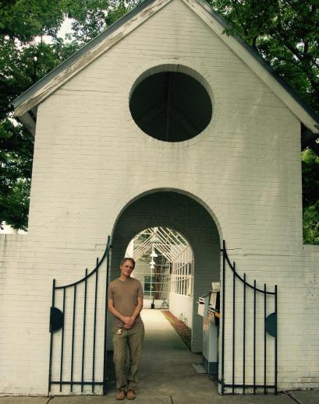
Community Organization
The Shalom Project
501(c)(3) established in 2006
Food pantry, pharmacy, and medical clinic
Medical clinic located on 4th Street
Assists with the basic needs of medical care, clothing, and food in North Carolina’s Forsyth County
Oversees long term initiatives to engage with and involve the community in efforts to reduce poverty

Slide 4
Objectives
Project Goals
Equip patients with tools needed to take control of their health comprehensively
Update for the forseeable future; transform into a regularly used resource within Forsythe County
Personal Goals
Gain a deeper understanding of the:
  1) Breadth of resources we have available within our community
  2) Ways to adequately meet both the needs of providers and needs of patients by providing comprehensive resource information

Slide 5
Methods
Identifying Areas of Need
Partnered with biostatistician Dr. Klein; analyzed most frequent diagnoses from 2021
Randomly generated 100 MRNs for contact to complete phone survey
  76 patient surveys completed
  Surveys were offered in English and Spanish
  Shalom currently does not have patient exclusion criteria

Slide 6
Results/Findings
Qualitative and Quantitative Results
Two main areas identified:
  Diabetes education
  Mammography and pap smear services
Overall, 93.8% of patients surveyed indicated that they felt comfortable enough to ask about community resources from a provider at The Shalom Project
100% of patients surveyed agreed that they perceived the care they provided to patients at The Shalom Project to be safe

Slide 7
Resource Hub Design
A Work in progress

Slide 8
Resource Hub Design
Physical Resources
Diabetes Educator on site
Donated by Forsyth County Public Health Department (diet plans, exercise regimens)
Process of organizing while Shalom prepares to move locations
Partnership with Novant Health Mobile Mammography, Downtown Health Plaza
Website Design
Transition to https://www.givepulse.com/
Currently working with website designer to discuss visual presentation of resources within Shalom’s standards

Slide 9
Ongoing Development
Action steps, Future implications, and more

Slide 10

Implications
What Next?
Identified areas of need within our local community
  Re-conduct analysis and survey at the end of this year
Establish Health & Wellness counseling at The Shalom Project clinic
Utilize ”Community Resource Hub” as a resource for patients and providers
Begin distribution in 2023 following The Shalom Project’s relocation

Slide 11
References
Iott, B. E., Eddy, C., Casanova, C., & Veinot, T. C. (2020). More than a Database: Understanding Community Resource Referrals within a Socio-Technical Systems Framework. In AMIA Annual Symposium Proceedings (Vol. 2020, p. 583). American Medical Informatics Association.
O'Gurek, D. T., & Henke, C. (2018). A practical approach to screening for social determinants of health. Family practice management, 25(3), 7-12.
Tung, E. L., Abramsohn, E. M., Boyd, K., Makelarski, J. A., Beiser, D. G., Chou, C., ... & Lindau, S. T. (2020). Impact of a low-intensity resource referral intervention on patients’ knowledge, beliefs, and use of community resources: results from the CommunityRx Trial. Journal of general internal medicine, 35(3), 815-823.
McGuire, S. L., Gerber, D. E., & Clemen-Stone, S. (1996). Meeting the diverse needs of clients in the community: effective use of the referral process. Nursing outlook, 44(5), 218-222.
Holtrop, J. S., Dosh, S. A., Torres, T., & Thum, Y. M. (2008). The community health educator referral liaison (CHERL): a primary care practice role for promoting healthy behaviors. American journal of preventive medicine, 35(5), S365-S372.
de la Vega, P. B., Losi, S., Martinez, L. S., Bovell-Ammon, A., Garg, A., James, T., ... & Kressin, N. R. (2019). Implementing an EHR-based screening and referral system to address social determinants of health in primary care. Medical care, 57, S133-S139.
Berry, C., Paul, M., Massar, R., Marcello, R. K., & Krauskopf, M. (2020). Social needs screening and referral program at a large US public hospital system, 2017. American journal of public health, 110(S2), S211-S214.

