Slide 1
Samaritan Ministries Menu Evaluation Based on Guests’ Chronic Health Conditions
HEALTH EQUITY CERTIFICATE CAPSTONE PROJECT
WALTER SCOTT DIONISIO DUY, MS2
SEPTEMBER 8, 2022

Slide 2
About Samaritan Ministries:
Samaritan ministries is an interdenominational, volunteer-based Christian ministry serving Winston-Salem and Forsyth County
Samaritan Soup kitchen serves ~145k lunches/year
Samaritan Inn: 70 bed homeless shelter for men (at 50% capacity due to COVID-19)
Project Cornerstone: long-term recovery program

Slide 3
Introduction:
Unaddressed or untreated chronic health conditions can lead to increased risk of medical complications, infection, heart attack, stroke and death.
Homeless population is at severe risk of undiagnosed/untreated chronic health conditions.
Diet can be an important factor in managing / treating chronic health conditions.

Slide 4
Objectives:
Project aims to survey guests for chronic health conditions and see if this would necessitate a change in the current soup kitchen menu.
Much of the soup kitchen resources come from donations, so a change in the menu could require additional resources to purchase alternative ingredients.
Work with Novant Health nutritionists to evaluate data obtained from survey.

Slide 5
Sample Menu:
Samaritan ministries provided me with some sample menus
Menus are created with the goal of utilizing donated food and providing variety to Samaritan Ministries guests
Recipes are chosen to be familiar and comfortable, while being nutritious.
Samaritan Ministries does purchase additional food (mostly meat). This is funded through its operating budget.

Slide 6
Survey:
Information requested includes alcohol/tobacco/drug use and approximate number of meals taken at Samaritan Ministries per week
Checklist of chronic conditions
Medication list, as necessary
Survey takes less than five minutes to complete.
All Samaritan Inn and Cornerstone guests answered the survey

Slide 7
Survey Results:

Slide 8
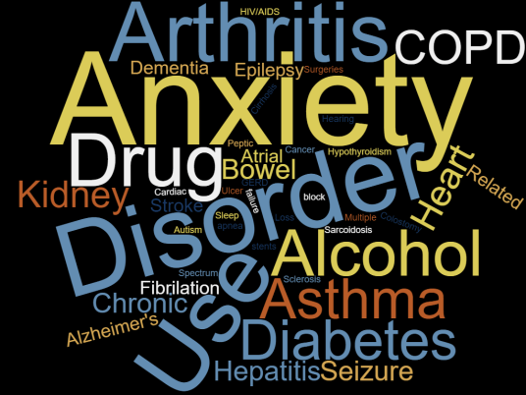
Survey Results:

Slide 9
Survey Results:
Highest incidence (>25 guests) of Anxiety (~41%), Depression (50%), Hypertension (~36%)
Moderate incidence (~15) of Alcohol (~16%) + Drug (~17%) use disorders, Other mental health disorders (~17%), Inflammatory Bowel Disease (~6%)
Other issues include: hearing loss, other surgical history, colostomy, pancreatitis, sleep apnea, hypothyroidism, sarcoidosis

Slide 10
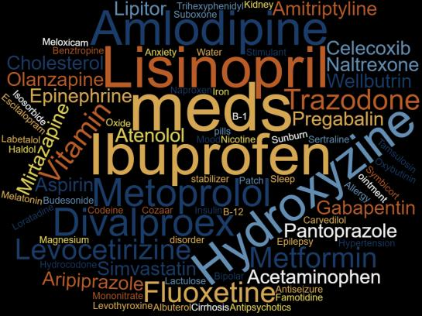
Medications:

Slide 11
Medications:
Most of the medications the guests had were to treat:
Mood disorders/anxiety
Hypertension
Pain
Diabetes
Allergies
GERD

Slide 12
Survey Limitations:
Many guests were unwilling to take survey
Reporting bias for guests – Alcohol + Drug use disorder and diabetes seems to be underreported
Lack of health maintenance in this population can limit diagnosis of chronic health conditions (diabetes, hypertension)
Guests don’t remember medication names

Slide 13
Recommendations:
Paleo diet (less grains/legumes) have been used to ameliorate anxiety/depression symptoms. Has been shown to be useful for Inflammatory Bowel Disease (Crohn’s/Ulcerative Colitis)
Low FODMAP (Fermentable Oligosaccharides, Disaccharides, Monosaccharides, and Polyols)
DASH (Dietary Approaches to Stop Hypertension) diet
Push for more water intake instead of sweetened tea or coffee with sugar/cream.

Slide 14
Future Work:
Novant Health nutritionists to evaluate survey data and make recommendations.
Periodically update survey results with new shelter guests.
Produce and provide dietary educational resources for soup kitchen guests.
Healthy cooking videos on Samaritan Ministries social media.

Slide 15
Works Cited:
“About - Samaritan Ministries - Winston-Salem, NC.” Samaritan Ministries, 29 June 2020, https://www.samaritanforsyth.org/about/.
Wicks, Rosemary et al. “Experiences of food insecurity among urban soup kitchen consumers: insights for improving nutrition and well-being.” Journal of the American Dietetic Association vol. 106,6 (2006): 921-4. doi:10.1016/j.jada.2006.03.006
Nwakeze, Peter C et al. “Homelessness, substance misuse, and access to public entitlements in a soup kitchen population.” Substance use & misuse vol. 38,3-6 (2003): 645-68. doi:10.1081/ja-120017388
Eppich, Simone, and Claudia Plaisted Fernandez. “Study finds Chapel Hill, NC, soup kitchen serves nutritious meals.” Journal of the American Dietetic Association vol. 104,8 (2004): 1284-6. doi:10.1016/j.jada.2004.05.208
Biggerstaff, Marilyn A et al. “Living on the edge: examination of people attending food pantries and soup kitchens.” Social work vol. 47,3 (2002): 267-77. doi:10.1093/sw/47.3.267
Eid, Georgia. “Six Reasons to Go Paleo for Mental Health.” Psychology Today, Sussex Publishers, 19 Sept. 2019, https://www.psychologytoday.com/us/blog/diagnosis-diet/201909/six-reasons-go-paleo-mental-health.
Murphy, Michelle, and Julian G Mercer. “Diet-regulated anxiety.” International journal of endocrinology vol. 2013 (2013): 701967. doi:10.1155/2013/701967
Huang, Qingyi et al. “Linking What We Eat to Our Mood: A Review of Diet, Dietary Antioxidants, and Depression.” Antioxidants (Basel, Switzerland) vol. 8,9 376. 5 Sep. 2019, doi:10.3390/antiox8090376

Slide 16
Questions?

