Slide 1
Pediatric Liver Transplant Overview
2018

Slide 2
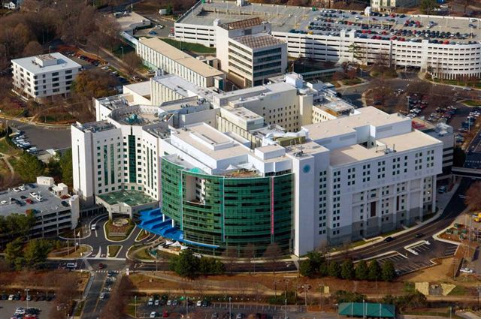
Levine Children’s Hospital
Carolinas Medical Center

Slide 3
Pediatric Liver Transplant Program: Our Team
Transplant Surgeons
  Lon Eskind, MD, Surgical Director
  David Levi, MD
  Vincent Casingal, MD
Mid-Level Providers
  Mary Alice Boulware, ACPNP
  Michael Filsinger, PA
  Alexzandria Messer, PA
  Ashley Wagner, PA
Transplant Hepatologists
  Vani Gopalareddy, MD Medical Director
  Ameesh Shah, MD
  Daniel Rory Kelley, MD
Pharmacists
  Kevin Cooper, Pharm D
  Bennett Noell, Pharm D
  Joslyn Brown, Pharm D

Slide 4
Pediatric Liver Transplant Program: Our Team
Program Assistant
Business Manager
Michael Daniels
Financial Coordinators
Leah Wilson
Katie Reynolds
Crystal Reinhardt
Medical Social Workers
Katie Boulware, MSW
Clinical Dietitian
Arlecia Phillips, RD
Rebekah Regenfuss, RD
RN Coordinators
Cathy Opladen, RN

Slide 5
Criteria for Referral
Cirrhosis/ End Stage Liver Disorder
Acute Liver failure
Liver tumors
Chronic Liver disorders

Slide 6
SRTR: Pediatric Kidney Report
January 5, 2018

Slide 7
Transplant Statistics
These and additional statistics may found at
  www.unos.org
  www.ustransplant.org
  www.optn.org

Slide 8
The Transplant Process
Referral received and reviewed for appropriateness
Insurance approval obtained
Patient scheduled for Transplant Evaluation
Then…
Evaluation
Wait List
Follow up
Transplant

Slide 9
The Evaluation Process
Appointments:
Transplant Coordinator/NP
Social Worker
Financial Coordinator
Transplant Nephrologist
Dietitian
Transplant Surgeon
Urologist as needed
Infectious Disease Physician as needed
Child Life
Other tests/consults as needed
Patient responsibilities:
Immunizations updated
Bring completed paperwork mailed to at time of evaluation scheduling
Discuss living donation with family and friends
Both parents/guardian must be present for evaluation. If both parents are not actively involved in healthcare, parent must bring an adult support person.

Slide 10
Multidisciplinary Support
Social Worker
  Assessment of readiness and needs
Financial Coordinator
  Verifies insurance benefits, explains expected costs
  The cost of medication after transplant is one of the BIGGEST financial concerns for transplant patients
Dietician
  Performs a nutritional evaluation
  Provides general recommendations to ensure good nutrition prior to transplant

Slide 11
Approval Process
Evaluation completed
Multi-Disciplinary team meets to discuss each patient’s candidacy
Collective team decision
Proceed with either listing, not listing or further testing

Slide 12
Listing
Patients are not Wait Listed for a kidney until:
Completion of pre-transplant evaluation
All health maintenance has been received (immunizations, dental clearance)
Transplant Team medical approval
Insurance company approval
Patient is notified by a phone call and
a letter within 10 days of being placed on the kidney Wait List!

Slide 13
Waitlist- Patient Responsibilities
Update Demographics
Insurance Changes
Changes in Dialysis
Travel/Vacation
Cross Match Tube to Immunology Lab (q 30 days if actively listed)
Update health maintenance as recommended
Maintain weight goals
Remain compliant with treatment
Medical condition changes
  Surgery, hospitalization, blood transfusions

Slide 14
Waiting Time
Priority is given for the following reasons:
Dialysis start date or labs showing kidney function (GFR) < 20 ml/min.
Patients with increased PRA (antibody level), which makes finding a compatible kidney more difficult.
Pediatric candidates (age < 18).

Slide 15
Re-evaluation
Once actively listed, will require annual re-evaluation in order to maintain listing status.
While awaiting transplant, if the patient is not followed by our nephrology group, they must be seen by our transplant nephrologist bi-annually at a minimum. These visits could be requested more frequently if increased concerns/complications.

Slide 16
CMC Kidney Transplant Program: Supply and Demand
Number of CMC Kidney Transplants vs. Candidates on Waitlist

Slide 17
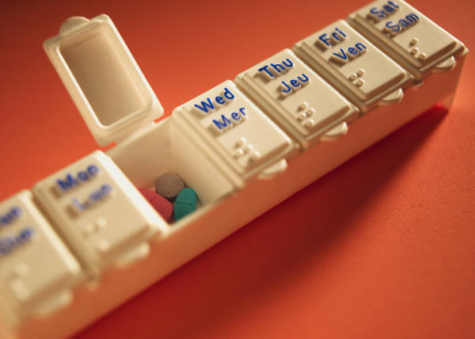
Discharge Process
Goal is to discharge by post-op day#7
Written test evaluating transplant knowledge
Follow-up appointments are in Charlotte
Home Equipment
  Scale (not provided)
  Thermometer
  Machine Blood pressure monitor
  Pill box

Slide 18
Follow up Pediatric Nephrology: LCSC
All follow-up care is in Charlotte at discharge
Typically labs and physician follow-up is 3 times weekly after discharge for the first month
Labs and visits taper the further out from transplant if no complications
Goal is to transition patient back to primary nephrologist for shared care 6 months after transplant

Slide 19

Housing Options for Patients
Ronald McDonald House of Charlotte
Within a block of Levine Children’s Hospital
35,000 square foot home
28 guest rooms with private bathrooms
Laundry facility with supplies
Meals prepared nightly
Large communal spaces (living room, playroom, outdoor playground)
Provided at no cost to patient/family

Slide 20

Housing Options for Patients
Hospitality House of Charlotte:
Located adjacent to hospital
22 room/44 bed facility
Staffed 24/7
Large double kitchen
Laundry facility with supplies
Close proximity to grocery stores, restaurants, etc.
Provided at no cost during evaluation stage

Slide 21
Long-Term Risks of Transplant
Rejection
Infection
Recurrence of primary disease (i.e. FSGS)
Malignancies – solid organ, skin, lymphoma
High blood pressure
Diabetes
High cholesterol
Coronary artery disease

Slide 22

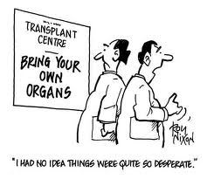

Slide 23

Who Can Be a Kidney Donor?
Over 18 years old and in good medical health
NO high blood pressure, diabetes, history of cancer or other chronic medical problems
Donors are evaluated by their own Living Donor Team
Donors are informed of the risks of kidney donation and can change their mind at any time
Life expectancy & quality of life is the same as the general population
Donor testing, evaluation and surgery is covered by recipient’s insurance
Donor safety is as important to us, as it is to you!

Slide 24
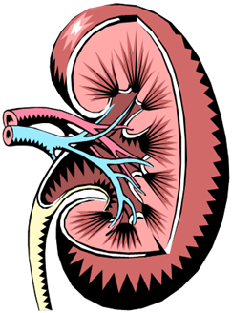

Compatible Blood Type- Living Donor
Donor
Recipient
O
A, O
B, O
AB, A, B, O
O
A
B
AB
Average waiting times on the waiting list vary according to blood type.

Slide 25


Kidney Paired Donation
What if….
My Donor is not the same blood type?
Size and/or age of donor and recipient different?
Crossmatch is Positive?
Donors can still donate for you but not directly to you. Kidney Paired Donation.

Slide 26
Living Donor Statistics
Did You Know…..
Shorter waiting time to receive a transplant
The less time on dialysis, the better your long term outcomes may be
Better transplant results
Living donor kidney transplants last longer. (Median transplant lifespan 8-12 yrs [deceased] vs. 15-22 yrs [living])
Longer lifetime benefit from transplant

Slide 27

Now that you Have Found a Living Donor,
What’s the Next Step??
Share our contact information
CMC Transplant Living Donor Office
704-355-3602

Slide 28
Contact Information
Carolinas HealthCare System
Transplant Department
PO Box 32861
Charlotte, NC 28232
1-800-562-5752 or 704-355-6649 (option #4)
Fax: 704-446-4875
Transplant coordinators:
Kristin Davis, ACPNP, BC
office: 704-381-5410
Megan Germino, RN, MSN
office: 704-381-6867
December 2014

